Slide 1
Credit Risk Analysis
Predicting Loan Defaults: A Comprehensive Machine Learning Approach
Ramon Tomzer
9/10/23

Slide 2
Outline
Executive Summary
Introduction
Methodology
Results
Conclusion
Appendix

Slide 3
Executive Summary

Slide 4
Executive Summary
Summary of Methodologies
Data Aggregation from Kaggle
Data Wrangling using Pandas
Exploratory Data Analysis using Matplotlib and Seaborn

Slide 5
Executive Summary
Summary of Results
Key Performance Indicators
Test Accuracy: 93.22
Precision: 93.96
Recall: 73.65
F1 Score: 82.58
AUC-ROC: 96.14
This Credit Risk Analysis model has exhibited compelling performance in predicting loan defaults. The model achieved an impressive accuracy rate of 93.22%, suggesting that it correctly identifies whether a loan will default or not most of the time. It also scored high in other key metrics:
Interpretation of Metrics:
Precision: At nearly 94%, the model is highly precise in predicting the positive class, meaning it has a low rate of false positives. This is crucial for a financial institution, as mislabeling a defaulting loan as non-defaulting could be quite costly.
Recall: At 73.65%, the model captures a reasonable percentage of all actual defaults. While not as high as we'd ideally prefer, this still implies that the model is useful in a real-world setting for identifying high-risk loans.
F1 Score: The balance between Precision and Recall is represented by the F1 Score of 82.58%, indicating a well-rounded model.
AUC-ROC: The AUC-ROC score, a comprehensive metric that considers both the true positive rate and the false positive rate, is exceptionally high at 96.14%, further confirming the model's quality.

Slide 6

Introduction

Slide 7
The Landscape of Lending - A Brief Overview
In the ever-competitive field of finance, lending remains a cornerstone service for financial institutions. However, it comes with its own set of challenges:
High Risk: Lending inherently carries the risk of borrowers defaulting on their payments.
Decision-making Dilemma: Traditionally, loan approval and risk assessment have relied on a range of factors that are both subjective and complex.
Operational Costs: The process of evaluating loan applications is time-consuming and costly, making operational efficiency a key concern.
Regulatory Scrutiny: Financial institutions are under constant pressure to adhere to increasing regulatory requirements, particularly concerning risk management.
With these challenges in mind, it's clear that an accurate, efficient, and automated system for credit risk assessment is not just an advantage—it's a necessity.

Slide 8
Understanding Credit Risk - Why It Matters
The financial landscape is fraught with risks, chief among them being credit risk associated with loan defaults.
Inaccurate assessments can lead to a multitude of problems, such as financial losses for institutions and increased costs for consumers.
Therefore, there is an urgent need for a reliable, data-driven approach to evaluate and predict the likelihood of loan defaults.

Slide 9
Setting the Course - Our Objectives
Building upon our understanding of the lending landscape and its challenges, we've identified the following key objectives for this project:
Predictive Accuracy: To develop a machine learning model with a high degree of accuracy in identifying potential loan defaults.
Informed Decision-making: To identify key variables and their impact on loan default risks, thereby providing actionable insights for financial institutions.
Operational Efficiency: To streamline the loan approval process by automating risk assessments, making it quicker and more cost-effective.
By achieving these objectives, we aim to arm financial institutions with the tools they need to make more informed, data-driven decisions, ultimately reducing risk and increasing operational efficiency.

Slide 10
Exploratory Data Analysis

Slide 11

Unveiling the Blueprint - Our Methodology
To tackle the objectives laid out, I adopted a comprehensive, step-by-step methodology that leverages cutting-edge technology and machine learning algorithms. Here's how I went about it:
“I am Groot-enator.”

Slide 12
Methodology continued
Data Exploration and Cleaning:
Performed meticulous data cleaning, handled missing values, and managed outliers.
Tool Used: Python's Pandas library.
Feature Engineering:
Engineered new features and selected the most impactful ones to enhance model performance.
Tool Used: Pandas for manipulation and Scikit-learn for feature selection.
Exploratory Data Analysis (EDA):
Visualized data distributions, correlations, and other patterns to gain deeper insights.
Tools Used: Matplotlib and Seaborn for insightful visualizations.
Model Selection:
Evaluated multiple machine learning models like Random Forest, Gradient Boosting, and K-Nearest Neighbors (KNN).
Tool Used: Scikit-learn for machine learning algorithms.
Hyperparameter Tuning:
Fine-tuned model parameters to boost performance.
Tool Used: Scikit-learn's GridSearchCV for optimization.
Model Evaluation:
Employed multiple metrics such as accuracy, precision, recall, F1 score, and AUC-ROC for a holistic model assessment.
Tool Used: Scikit-learn for metrics and evaluation.
Automated Model Verification:
For a sanity check, we also employed automated machine learning to verify our model.
Tool Used: PyCaret.
By employing this methodology, we ensured a rigorous, data-driven approach to achieving our objectives, setting the stage for impactful, actionable results.

Slide 13
Decoding the Data - What's Under the Hood?
In the quest to make financial lending more transparent and less risky, I sourced a dataset that paints a vivid picture of loan applicants. This rich dataset is broken down into a few main categories.
By dissecting these variables, we aim to construct a predictive model that not only accurately forecasts loan defaults but also pulls back the curtain on what variables most influence this critical outcome.
Personal Information:
ID: Unique identifier keeping track of each applicant.
Age: Providing insights into life stages, potentially affecting loan repayment capability.
Financial Health Check:
Income: A direct indicator of an applicant's ability to repay the loan.
Home Ownership: Whether they own, rent, or have a mortgage. A sign of financial stability.
Employment Length: Longer employment often equates to more stable income.
Loan Amount: The capital they’re asking for.
Interest Rate: The cost they're willing to bear for the loan.
Status:
Fully Paid: The dream scenario for lenders.
Charged Off: The nightmare, essentially written off as a loss.
Current: Still in the game, but it's too soon to tell.

Slide 14

Data Cleaning & Preprocessing - Laying the Foundation for Success
In the world of machine learning, garbage in means garbage out. That's why I put immense effort into cleaning and prepping the data, ensuring that the models learn from the best information possible. Here's how I rolled up my sleeves and got my hands dirty:

Slide 15
Data Cleaning and Preprocessing
Handling Missing Values:
Filled in missing numerical values with advanced mean imputation, using machine learning algorithms.
Used domain expertise and common sense to impute categorical values.
Outlier Treatment:
Used the Interquartile Range (IQR) method to identify outliers.
Replaced or capped outliers based on domain insights and a methodical approach.
Feature Engineering:
Using PyCaret, normalized variables like income and loan amount, enhancing model performance.
Data Transformation:
Utilized One-Hot Encoding to convert categorical variables into a numerical format compatible with machine learning algorithms.
Accounted for the skewness of distribution manually, as well as in the PyCaret setup.
Data Scaling:
In the PyCaret models, the data was normalized.
Data Splitting:
The data was partitioned into training, validation, and test sets to ensure an unbiased evaluation of the model.
By systematically cleaning the data, we not only made it palatable for our machine learning models but also laid a rock-solid foundation for them to learn effectively.

Slide 16
Modeling & Results

Slide 17
Machine Learning
Scikit-Learn Modeling:
PyCaret Modeling:
Data Preprocessing: One-hot encoding was applied on categorical variables like 'Home' and 'Intent'.
Modeling: Various machine learning algorithms, including Logistic Regression, Random Forest, Gradient Boosting, and KNN, were used.
Hyperparameter Tuning: Performed grid search to find the best parameters for Random Forest and Gradient Boosting.
Evaluation Metrics: Metrics such as accuracy, precision, recall, F1 score, and AUC-ROC were calculated.
Data Preprocessing: PyCaret was used to handle preprocessing steps like one-hot encoding, normalization, and missing value imputation when setting up the experiment.
Modeling: Multiple algorithms were automatically compared using PyCaret's compare_models() function.
Hyperparameter Tuning: PyCaret tune_model() function was used to find the best hyperparameters for the top-performing models.
Evaluation Metrics: The same metrics as in the Scikit-Learn experiment were used for evaluation.

Slide 18
Top-Performing Model: XGBoost
In both our experiments using Scikit-learn and PyCaret, XGBoost consistently emerged as the top-performing model. This robust algorithm, which stands for eXtreme Gradient Boosting, is part of the larger Gradient Boosting framework. XGBoost is particularly well-known for its execution speed and model performance.
XGBoost's ability to perform so well across various metrics showcases its robustness and confirms why it's a go-to algorithm for many machine learning practitioners. Its high performance across the board makes it an excellent choice for our credit risk analysis model.
Key Performance Metrics:
Test Accuracy: An impressive 93.22% means the model is highly reliable in its predictions.
Precision: At 93.96%, the model is precise in predicting the positive class, minimizing the false positive rate.
Recall: A score of 73.65% signifies that the model captures a good proportion of actual defaults.
F1 Score: The harmonic mean of Precision and Recall stands at 82.58%, indicating that the model is balanced.
AUC-ROC: A score of 96.14% further validates the model's quality and its ability to distinguish between the classes effectively.

Slide 19
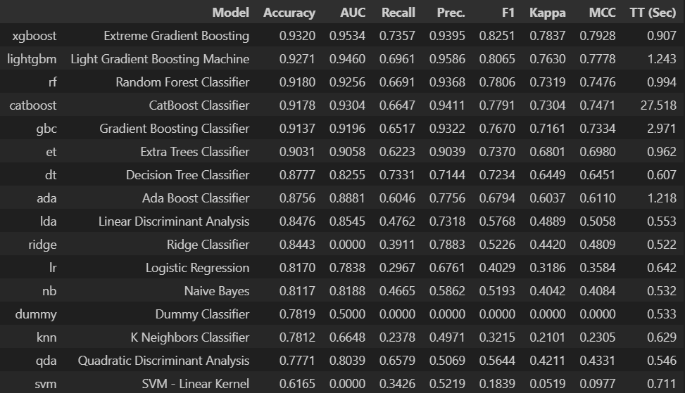
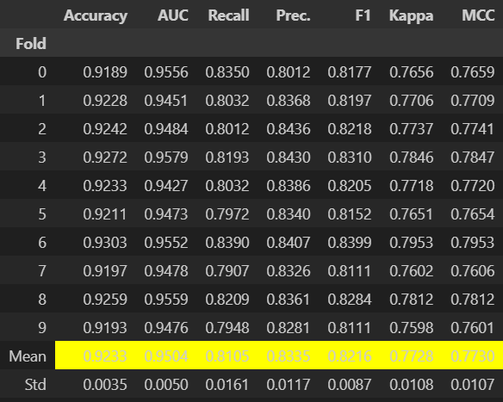
Top-Performing Model: XGBoost

Slide 20
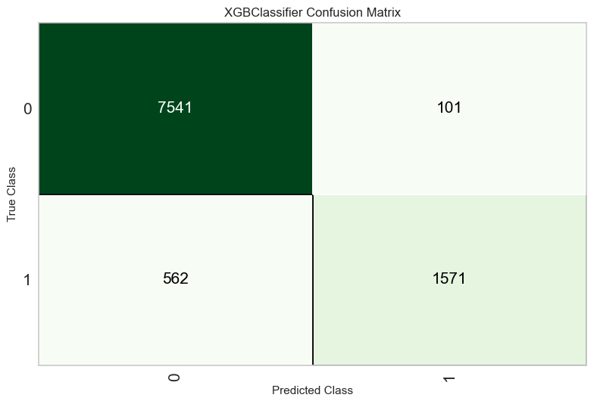
Model Evaluation
True Negatives (Top-left: 7541): This is the number of correct predictions that a loan will not default. It's a high number, suggesting that our model is effective at identifying loans that are likely to be repaid.
False Positives (Top-right: 101): These are the loans that were wrongly classified as defaults. Although the number is relatively low, these are type I errors that could lead to missing out on profitable lending opportunities.
False Negatives (Bottom-left: 562): These are the loans that did default but were wrongly classified as non-defaults. These are type II errors and are more problematic because they represent loans that could result in losses.
True Positives (Bottom-right: 1571): This is the number of correct predictions that a loan will default. It's a significant number, showing that the model is also good at identifying risky loans.

Slide 21
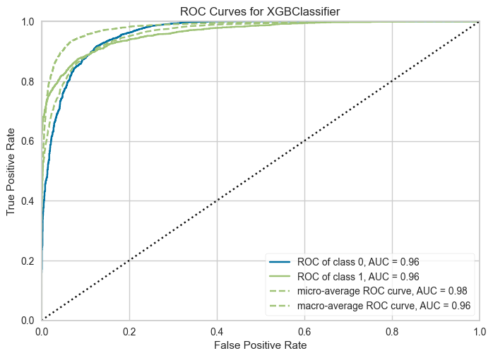
Model Evaluation
AUC-ROC Score: 96.14%
The Area Under the Receiver Operating Characteristic Curve (AUC-ROC) is a comprehensive metric that considers both the true positive rate and the false positive rate. An AUC-ROC score of 96.14% is exceptionally high, indicating that the model's ability to distinguish between the classes (loan default or no default) is near-excellent.
A high AUC score like this one is highly desirable and indicates that our model does an outstanding job of separating the classes. It means that the model provides a robust measure for evaluating its performance across different classification thresholds, making it a reliable tool for predicting loan defaults.

Slide 22
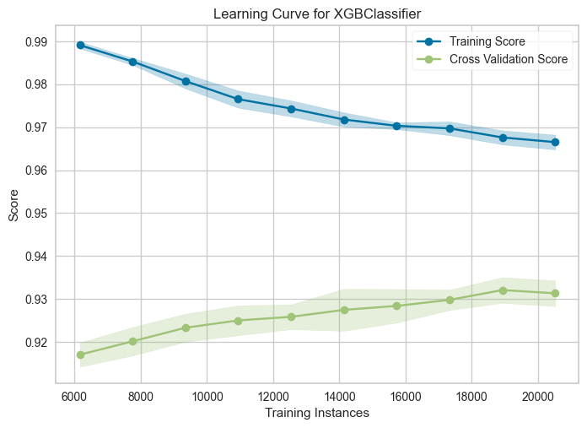
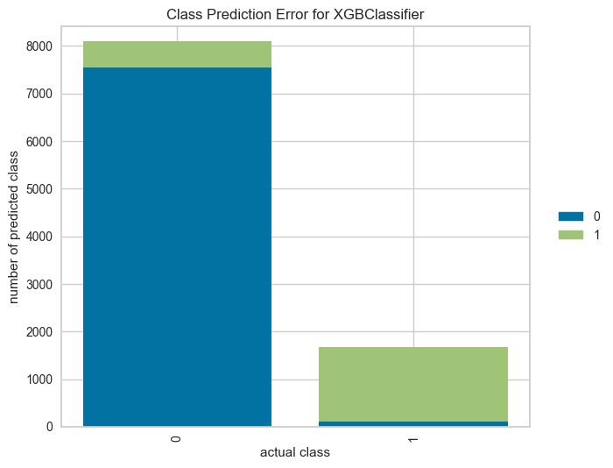
Model Evaluation

Slide 23
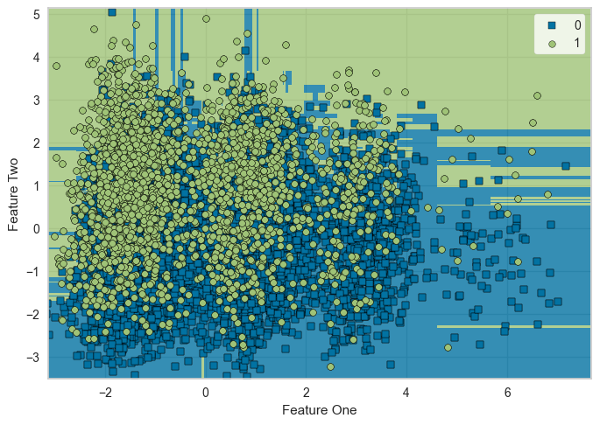
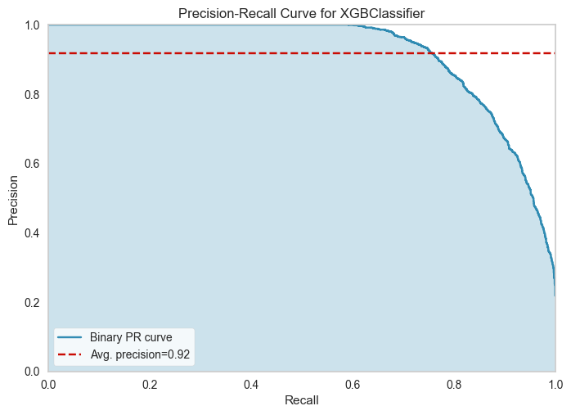
Model Evaluation

Slide 24
Conclusion & Next Steps

Slide 25
Conclusion
The Credit Risk Analysis model, particularly XGBoost, has demonstrated exceptional performance across various evaluation metrics. With a test accuracy of 93.22%, precision of 93.96%, recall of 73.65%, and an AUC-ROC score of 96.14%, this model stands as a robust tool for financial institutions to predict loan defaults effectively.
By employing a machine learning approach, we've managed to create a predictive model that not only provides accurate predictions but also offers insights into key variables that are influential in the decision-making process. This allows financial institutions to make data-driven decisions, thereby significantly reducing the risk associated with loan approvals.

Slide 26
Next Steps & Future Work
Feature Engineering: Although the model performs well, further feature engineering could refine it.
Ensemble Methods: Exploring ensemble methods or more complex algorithms to improve performance.
Larger Dataset: A more extensive dataset, possibly with more features, could enhance the model's predictive power.
Model Updates: As financial landscapes evolve, so too should the model. Periodic updates and tuning are essential for maintaining its efficacy.
Real-world Testing: Before full deployment, the model should be tested in a controlled, real-world setting to ensure it meets all operational requirements.
By adhering to these next steps, we aim to continually refine our model, making it an increasingly valuable asset for risk assessment in the loan approval process.

Slide 27
Appendix

