Slide 1
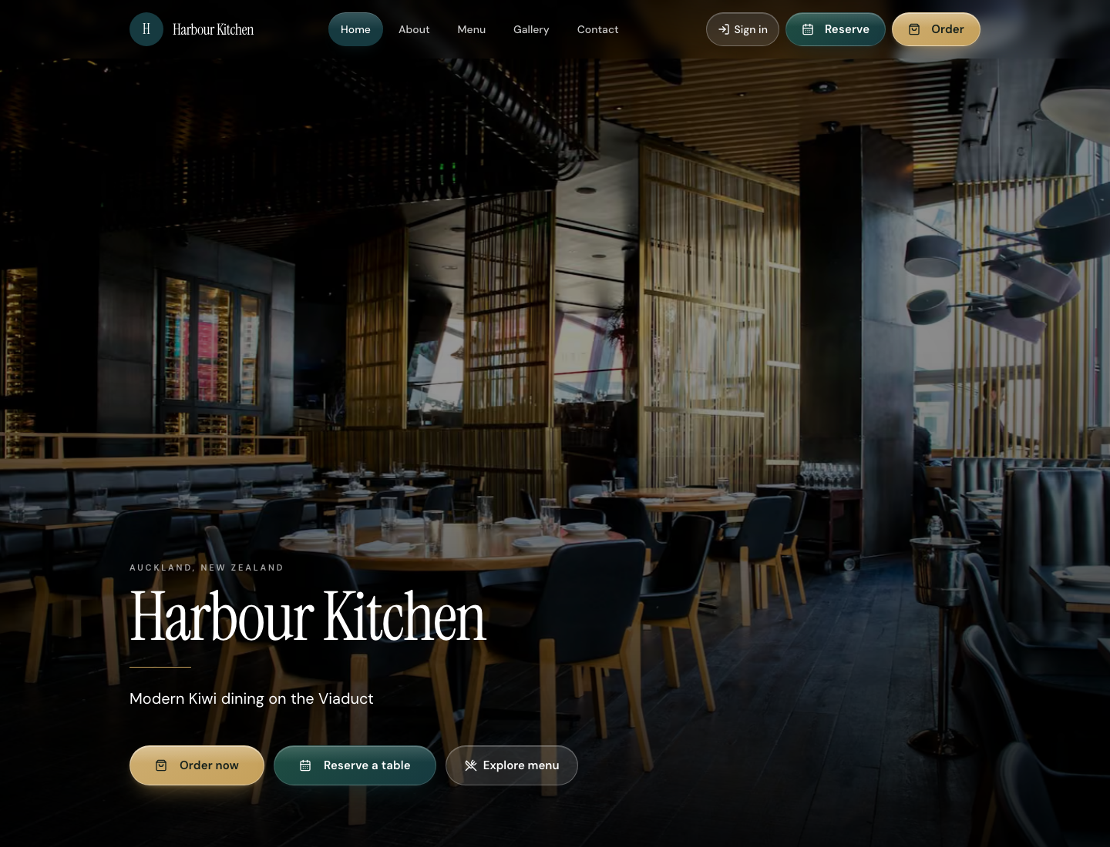
RR NOVA
FOR RESTAURANT OWNERS
Your restaurant.
Your customers.
Your data.
One platform.
The all-in-one platform that turns your website, menu, orders, and bookings into one growth engine.
Crafted for Aotearoa New Zealand hospitality
Live demo · Harbour Kitchen · Auckland
01 / 10

Slide 2
RR NOVA
THE PROBLEM
Too many disconnected systems.
Website builders, PDF menus, booking widgets, delivery apps, and spreadsheets — nothing talks to each other.
Too many tools
Menu chaos
Missed revenue
5–10 logins every service — nothing talks to each other.
Printed menus and apps go stale the moment a dish is 86’d.
Guests bounce to aggregators — you pay commission on customers you already earned.
Blind service
Manual grind
No clear ROI
No single view of covers, tickets, waitlist, or guest history.
Staff re-type bookings and answer the same calls every night.
Hard to see what drives spend, repeats, or empty midweek tables.
02 / 10

Slide 3
RR NOVA
THE SOLUTION
One platform for your whole venue.
Website, menu, ordering, reservations, customers, and analytics — in one place.
Premium guest website
Live digital & QR menu
Direct online ordering
A branded site that matches your room — not a generic template.
Publish once. Website, QR, and ordering stay in sync.
Pickup, delivery, and dine-in on your brand — keep the margin.
Reservations that fit
Owner dashboard
NZ-first by design
Online bookings with capacity rules, confirmations, and calendar control.
Menus, orders, bookings, guests, and analytics together.
Timezone, GST-aware pricing mindset, and Aotearoa hospitality pace.
03 / 10

Slide 4
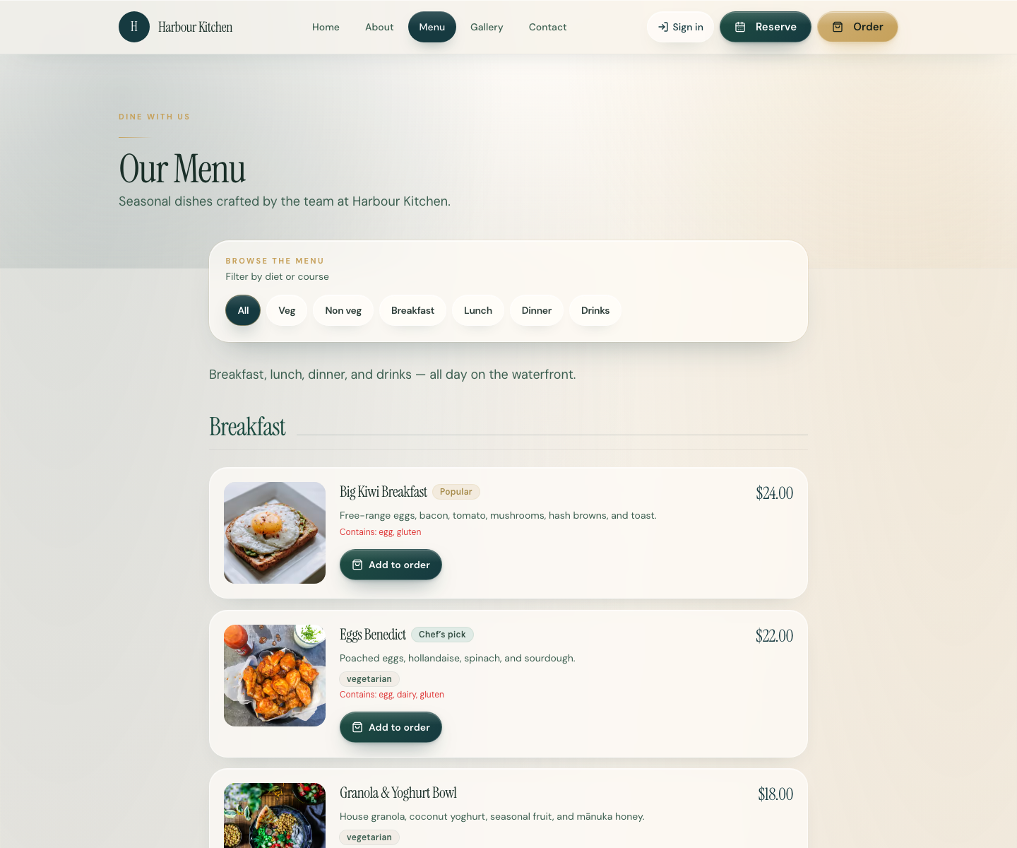
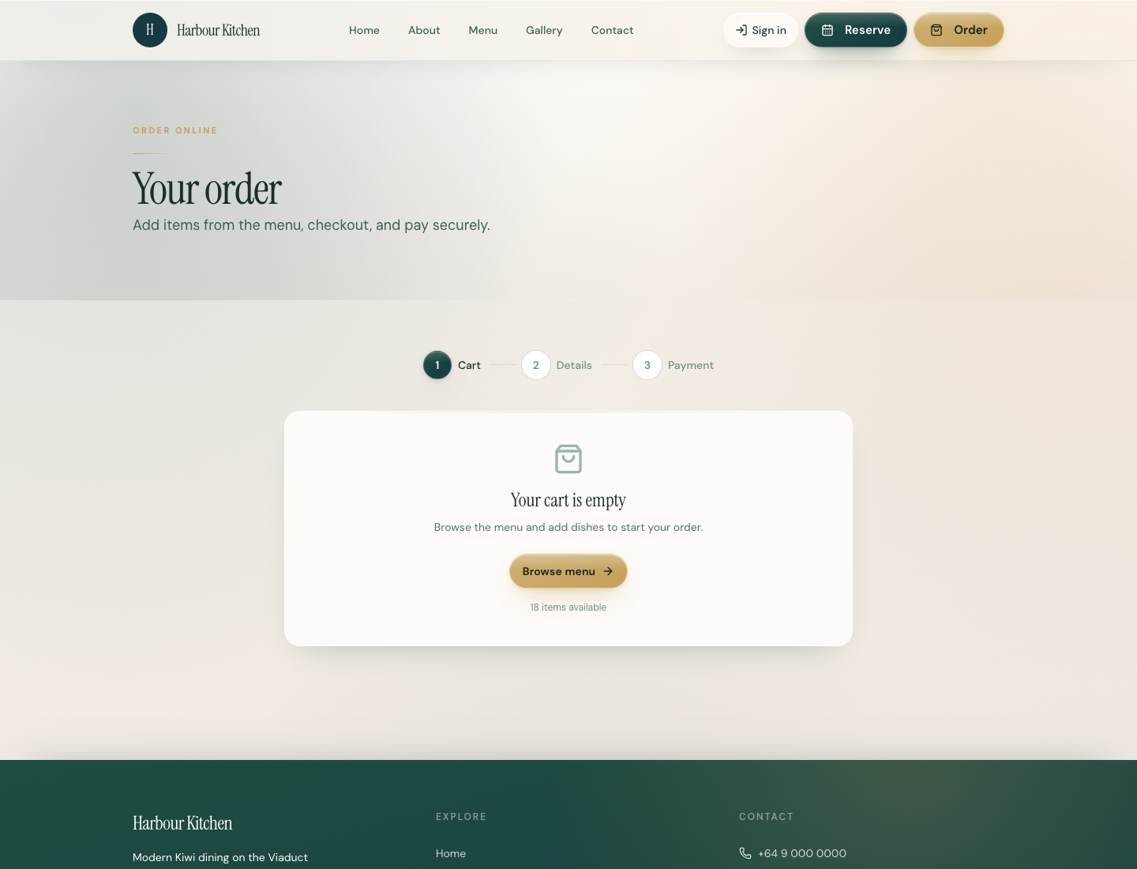
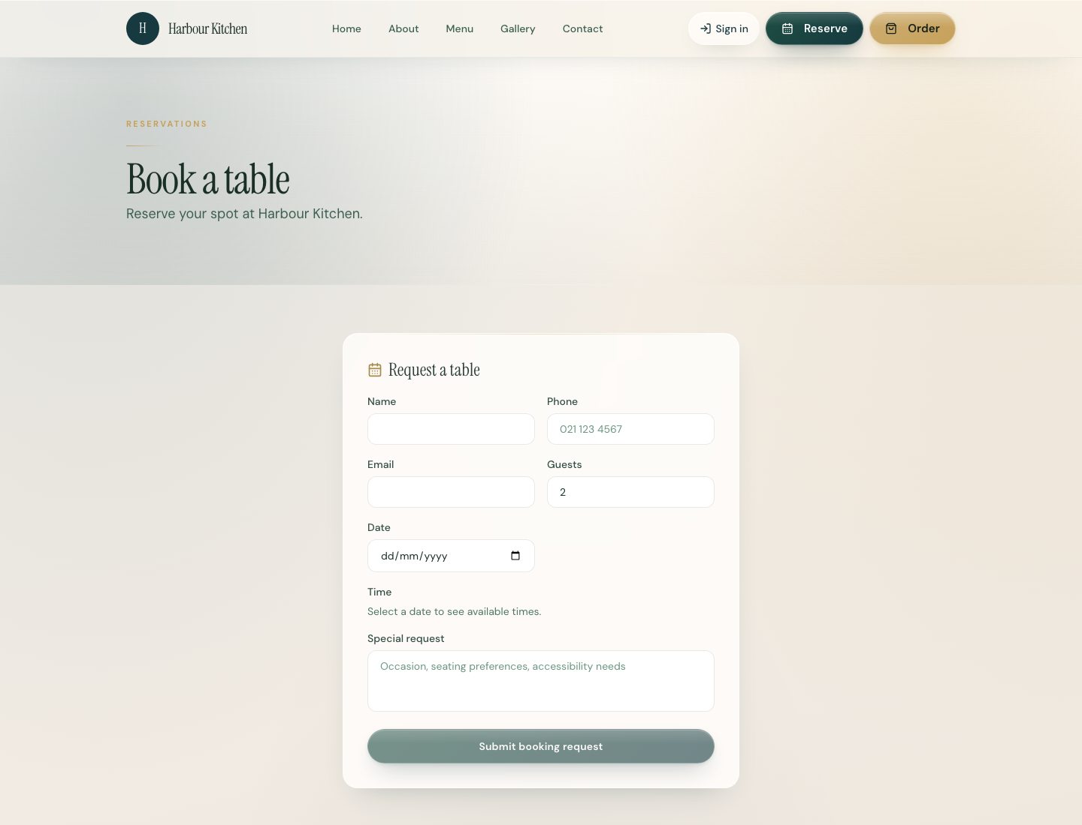
RR NOVA
GUEST JOURNEY
From first visit to regular.
01
02
03
04
Discover
Browse
Order / Reserve
Return
→
→
→
A premium branded site guests trust.
Live menu with dietary filters and allergen notes.
Checkout or book a table — without leaving your brand.
Guest history and timely follow-ups bring them back.
04 / 10

Slide 5
RR NOVA
DIRECT REVENUE
Keep customers ordering and booking on your brand.
Direct orders and bookings reduce aggregator fees on guests you already attract.
Convert more visitors
Order Now and Reserve sit on a premium site guests trust.
Keep margin in-house
Guests stay with you instead of leaking to third-party marketplaces.
Fill quiet sessions
Live menu, offers, and analytics help shape lunch and midweek demand.
Turn covers faster
QR menus and clear ordering cut friction from table to kitchen.
05 / 10

Slide 6
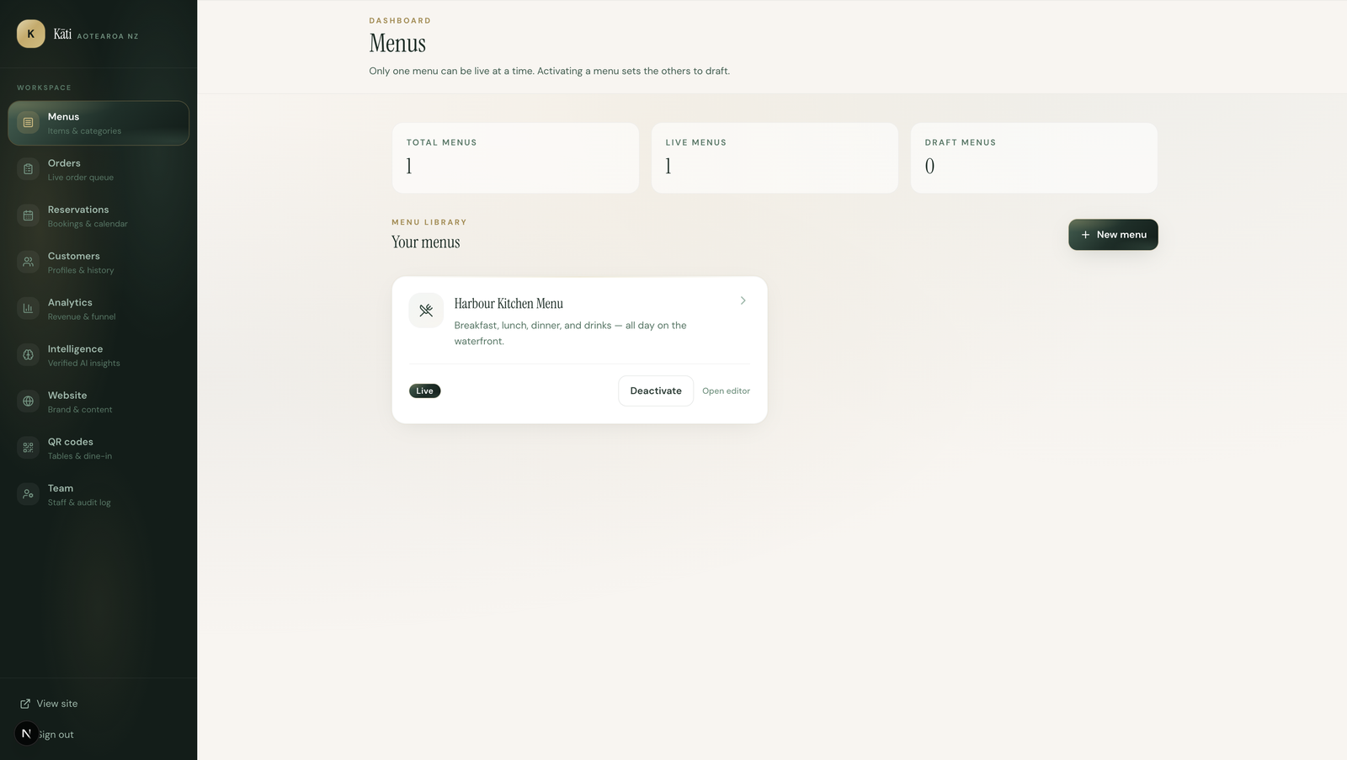
RR NOVA
OPERATIONS
One dashboard to run the venue.
Menus, orders, reservations, customers, analytics, website, QR, and team — without hopping between apps.
— Live menu control — publish once, stay in sync
— Orders and reservations in one workspace
— Capacity rules you control from the dashboard
— Fewer tools. Fewer errors. Calmer service.
06 / 10

Slide 7
RR NOVA
CUSTOMER RELATIONSHIPS
Turn one-time guests into regulars.
Guest profiles, history, and timely follow-ups turn one-offs into people who come back.
Know who walked in
Serve them better
Earn the next visit
Unified guest profiles from orders and reservations — not inbox scraps.
History at hand during a busy service, so regulars feel recognised.
Own the relationship on your brand, not on someone else’s marketplace.
07 / 10

Slide 8
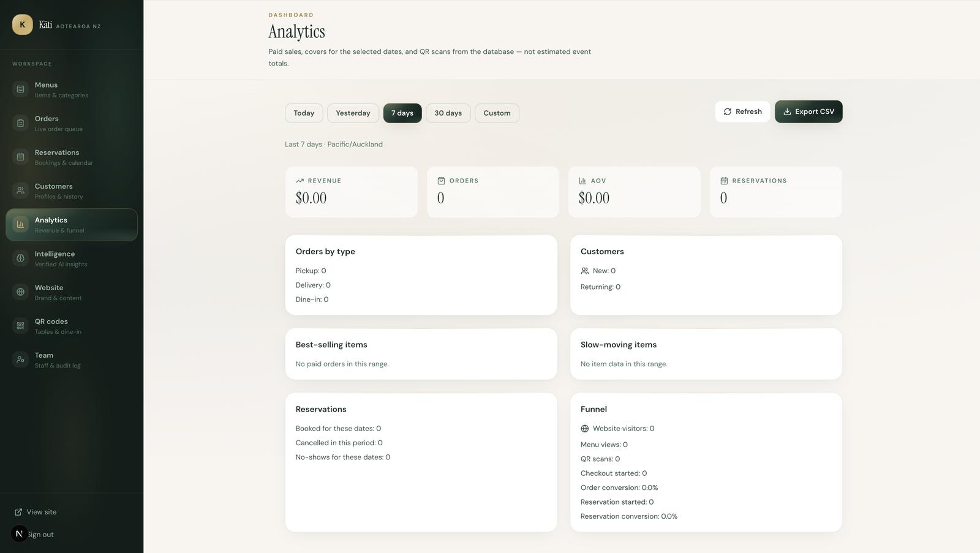
RR NOVA
ANALYTICS
Stop guessing. Start seeing.
Revenue, AOV, bestsellers, reservations, and conversion funnel — facts from your venue data. Never invented numbers.
Revenue
What the room actually made
AOV
How tickets are building
Bestsellers
What to push — and protect
Funnel
Where guests drop off
08 / 10

Slide 9
RR NOVA
THE SHIFT
Before vs after RR NOVA.
Before
After RR NOVA
✕ 5–10 logins every service
✓ One dashboard for the whole venue
✕ Stale menus & broken booking links
✓ Live menu, QR, and site in sync
✕ Aggregator fees eating margin
✓ Direct orders with secure checkout
✕ Guest data trapped in inboxes
✓ Unified guest profiles & history
✕ Managers flying blind on covers
✓ Live boards for kitchen & floor
✕ Marketing is an afterthought
✓ Analytics guiding real decisions
09 / 10

Slide 10
RR NOVA
NEXT STEP
What could this look like for your restaurant?
Explore the Harbour Kitchen live demo — or start your own workspace.
restaurant-digital-platform-beige.vercel.app
Platform home · Guest site /r/harbour-kitchen · Owner dashboard /dashboard/menus
RR NOVA · Your restaurant. Your customers. Your data. One platform.
10 / 10

