Slide 1

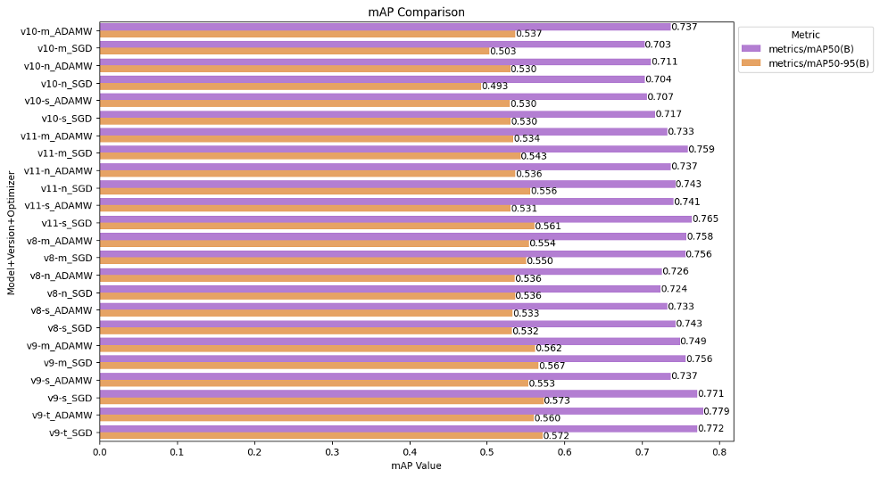
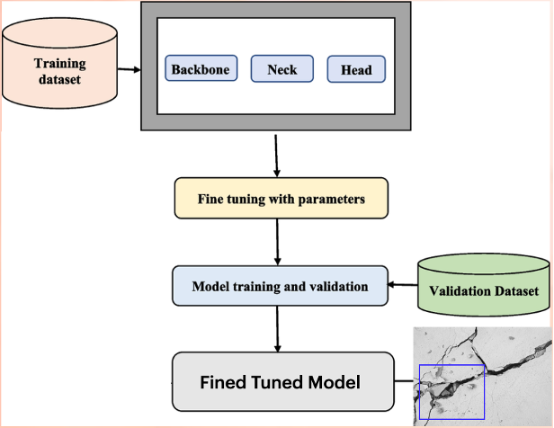
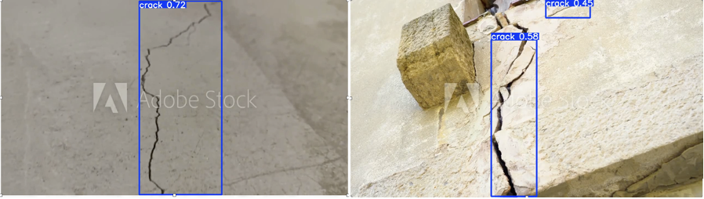
CRACK DETECTION IN INFRASTRUCTURE USING OPTIMIZED YOLO MODELS
Gaurang Panpalia, Nitish Rai, Rudraksh Agarwal| Dr. Anindita Kundu |
School of Computer Science and Engineering
Introduction
Parameter Fine-Tuning
Hyperparameters are carefully adjusted to improve accuracy. Key parameters include learning rate, batch size, and number of epochs. Additional tuning involves modifying anchor box sizes and refining augmentation strategies. These optimizations ensure the model adapts well to the specific characteristics of crack detection.
Training and Validation
The model is trained on the annotated dataset by minimizing losses: bounding box loss (position accuracy), classification loss (correct labeling), and confidence loss (object presence). The validation set helps monitor training progress and prevents overfitting, ensuring the model performs well on new, unseen data.
Fine-Tuned Output
The final YOLO model can accurately detect cracks in a wide variety of conditions. It generalizes well, even in real-world scenarios involving different lighting, orientations, and noise. This makes it suitable for practical structural inspection tasks like bridge and road monitoring.
The primary aim is to identify the most effective object detection model for accurately and efficiently detecting cracks.
UAV Integration: This vision model can be deployed on UAVs (drones) to detect cracks in real time. Upon detection, it can notify authorities immediately, preventing the usage of unsafe structures and enabling rapid deployment of maintenance teams.
Ceiling Camera Utilisation: Surveillance cameras positioned around infrastructure sites can integrate this model to detect cracks, especially during natural disasters or structural failures. Automated alerts enable quick responses, minimizing risks and preventing potential catastrophes.
Motivation
The motivation for this research stems from the growing global concern over deteriorating infrastructure and the preventable tragedies that arise from undetected structural failures. Numerous high-profile incidents underscore the urgent need for intelligent, real-time structural health monitoring systems:
Results
v9-t_ADAMW Highest mAP@50 overall best at detecting cracks accurately.
v11-n_ADAMW Best Precision reliable for high-confidence predictions.
v11-m_SGD Best Recall catches most cracks, even if some are false.
Scope of the Project
The primary scope of this project is to evaluate and benchmark the performance of four advanced versions of the YOLO (You Only Look Once) object detection architecture—YOLOv8, YOLOv9, YOLOv10, and YOLOv11—specifically for the task of surface crack detection in civil structures. Rather than focusing on deployment or integration with UAVs or embedded systems, the study remains confined to a comparative analysis of model performance on a curated and well-annotated dataset, with the objective of identifying the most suitable model. architecture for future use.
Methodology
Dataset Preparation
The crack detection dataset contains 4,029 high-resolution images labeled with bounding boxes around visible cracks. The data is split into 92% for training, 5% for validation, and 3% for testing. Each image is resized to 416×416 pixels to meet YOLOv11’s input requirements. To improve generalization, augmentation techniques such as flipping, rotation, cropping, brightness and hue shifts, and light blurring are applied. Labels follow the YOLO format, listing class and normalized bounding box coordinates.
Model Structure
The YOLO model is composed of three main parts: the Backbone, Neck, and Head. The Backbone extracts deep features from input images using networks like CSPDarknet or MobileNet. The Neck enhances these features across scales using architectures such as PANet or FPN. The Head then predicts bounding boxes, object classes, and confidence scores. Non-Max Suppression (NMS) refines final predictions by eliminating overlapping boxes.
Conclusion
From a deployment perspective, YOLOv9-tiny with AdamW is an ideal candidate for real-time, resource-constrained applications such as drone-based inspections, on-site crack monitoring, and embedded surveillance. The results reaffirm that optimizer selection plays a crucial role not only in convergence but also in feature sensitivity, even in compact model variants.
References
Taffese, W. Z., Sharma, R., Afsharmovahed, M. H., Manogaran, G., & Chen, G. (2025, January). Benchmarking YOLOv8 for Optimal Crack Detection in Civil Infrastructure. Conference Paper. Retrieved from https://www.researchgate.net/publication/387952132.
Sohaib, M.; Arif, M.; Kim, J.-M. Evaluating YOLO Models for Efficient Crack Detection in Concrete Structures Using Transfer Learning. Buildings 2024, 14, 3928. https://doi.org/10.3390 buildings14123928
Akyürek, H. A., Kozan, H. İ., & Taşdemir, Ş. (2024). Surface Crack Detection in Historical Buildings with Deep Learning-based YOLO Algorithms: A Comparative Study. CRPASE: Transactions of Electrical, Electronic and Computer Engineering, 10(3), 1–14. https://doi.org/10.61186/crpase.10.3.2904
Chen, Y.; Zhu, Z.; Lin, Z.; Zhou, Y. Building Surface Crack Detection Using Deep Learning Technology. Buildings 2023, 13, 1814. https://doi.org/10.3390/ buildings13071814

