Slide 1

Project Object Model

Slide 2
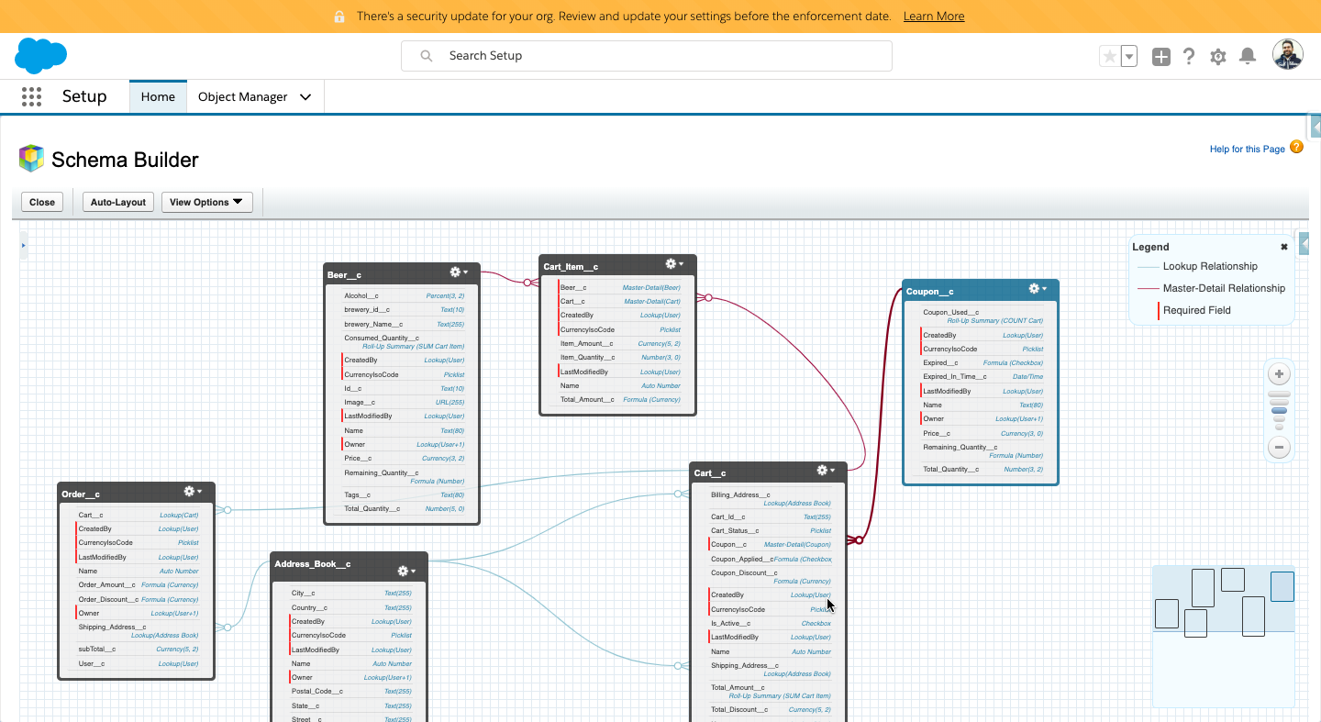
Object Model

