Slide 1

Starbucks Beverages
Nutritional Facts

Slide 2
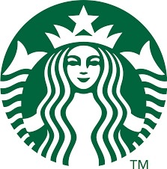
KEY TAKEAWAYS
No one goes to Starbucks for coffee
242 Beverage Options Available
High-Calorie Beverages Dominate Hand-Crafted Beverages
Fat Content Highest Among Hand-Crafted Beverages
Carbohydrate content derived primarily from sugar

Slide 3
Beverages Served

Slide 4
Beverage Calorie Content

Slide 5
Fat Content of BEVERAGES SERVED

Slide 6
BEVERAGE BY SUGAR AND CARBOHYDRATE

