Slide 1
Predicting the Market with Recurrent Neural Networks
By: Ryan C. Dallavia

Slide 2
Key Takeaways
This is an exploration of the performance of recurrent neural networks and long-short term memory nodes on data from the U.S. capital markets.
The purpose was primarily to understand the coding of the network and not create an engine for trading decisions (don't use this for trading).
Simple models (i.e., fewer hidden layers, shorter lookback periods) won.
Activation functions matter a lot
Further research should use this as a launching point for building a more extensive model.

Slide 3
Motivation
The market prediction problem has never been solved.
It’s a problem in n-dimensions.
Research from the 1990s says neural networks are excellent models of the market

Slide 4
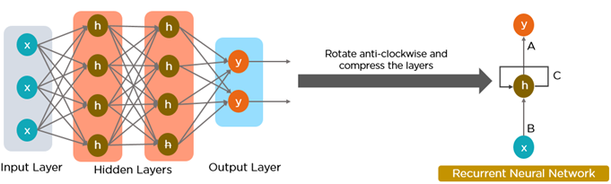
What’s a Recurrent Neural Network
Source: Quora

Slide 5

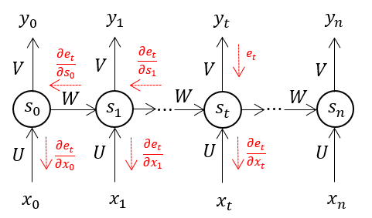
What’s a Recurrent Neural Network
Source: Medium

Slide 6
Methodology
Monthly data on SPY
Calculation of Price Changes
Calculation of 30, 50, 90, and 200 day Moving averages
Calculation of Relative Strength Index
Interpretation and coding of signals
Build the model in Keras

Slide 7
Results
Complex model (2 layers, long look-back period)
Tanh performance
reLU Performance

Slide 8
Results
Simple model (One layer, One period look back)
Tanh Performance
reLU Performance

Slide 9
The Winning Model
eliminating the hidden layer and returning to reLU with a 1-month look back yielded the best test set results (MSE = .36)

Slide 10
What’s Next
Data augmentation: technical, fundamental, and economic
Data periodicity (monthly, Weekly, Daily)
Test in a live environment

