Slide 1
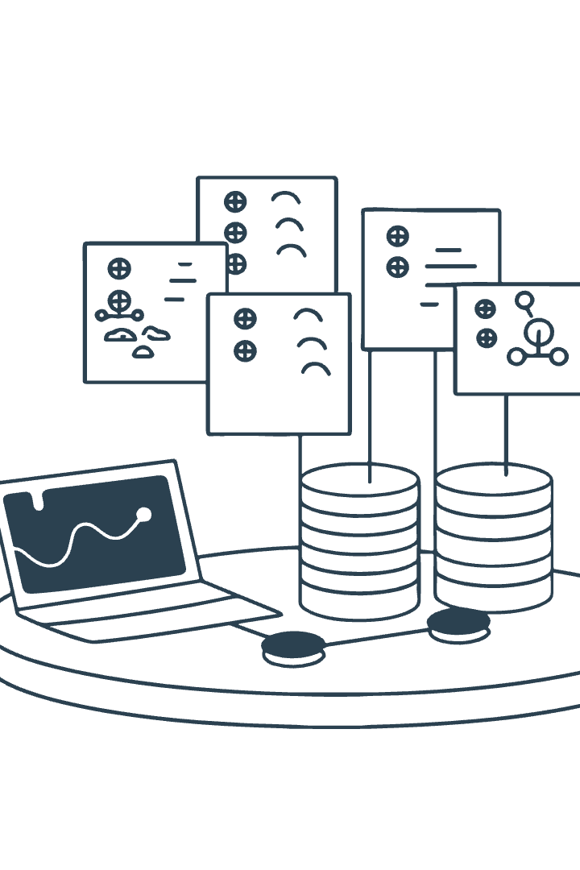
Smart Inventory and Supply Chain Management System
CS242 Final Project
Rick Djouwe & Klea Mustafaj
A Java-based solution for simple and efficient inventory optimization.

Slide 2
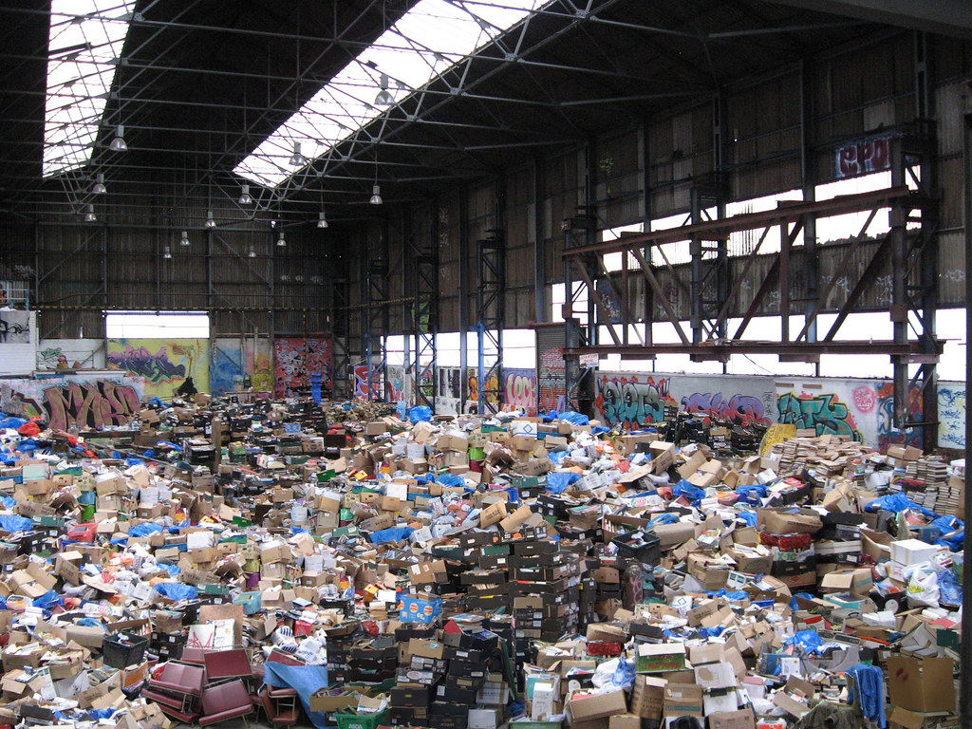
The Challenge of Inventory Management
1
Stock Control
2
Tracking/sales
Manual tracking is time-consuming and prone to errors.
Overstock and stockouts lead to financial losses.
3
Expiration Tracking
Expiration tracking is often overlooked
4
Consumer Need
Lack of demand forecasting resulting to inefficiencies.

Slide 3
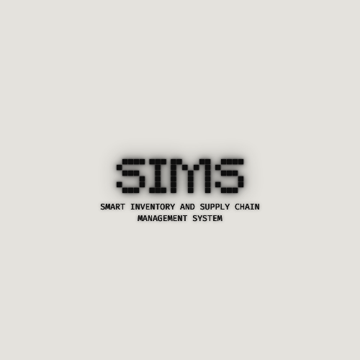
The solution
1
Inventory Management
2
Stock Control
Provides restocking alerts
Automates inventory and tracking and management
3
Expiration Tracking
Automatic alerts for items nearing expiration dates
4
Sales Reporting
Daily revenue calculation and file-based report generation

Slide 4





Key Features
Inventory Management
Comprehensive item tracking and control
Expiration Alerts
Proactive notification system for perishable goods
Daily Reporting
Automated sales tracking and revenue analysis
Help and Support
Integrated FAQs and troubleshooting resources

Slide 5


I/S Management Interface
User-friendly GUI for efficient inventory control and monitoring
Item Entry
Add new products with detailed information
Stock Updates
Modify quantities and track inventory levels
Item Removal
Delete obsolete or discontinued products

Slide 6

I/S Management Interface
Advanced tools for stock control and analysis
Feature Function
Search Find items quickly by name or ID
Sort
Organize inventory by various criteria
Filter
Display specific categories or stock levels

Slide 7

Help & Support Interface
Comprehensive assistance for smooth system operation
FAQs
Quick answers to common questions
Troubleshooting
Step-by-step guides for issue resolution
Contact Support
Direct line to technical assistance team
User Manual
Detailed documentation for all system features

Slide 8
Technical Implementation
Java Programming
Core language for system development
Data Structures
HashMap, LinkedList, PriorityQueue for efficient data management
GUI Framework
Java Swing for interactive user interface design
Challenges
Time Management
Balancing project development with academic and personal commitments.
Scope Definition
Deciding which features to prioritize to meet the project requirements within the given timeframe
Team Coordination
Ensuring consistent communication and collaboration.
Integration of Features
Ensuring smooth interaction between classes/modules like inventory tracking, alerts and reporting
User Interface Design (GUI)
Making the system intuitive and user-friendly despite limited time
Pdf Generation
Developing and optimizing a pdf generation algorithms

Slide 9

Future Enhancements
1
Demand Forecasting
Implement machine learning for predictive inventory management
2
Cloud Integration
Develop cloud-based database for improved scalability
3
Pdf Generation
Create companion app for on-the-go inventory management
4
API Development
Build APIs for third-party integrations and expansions

