Slide 1
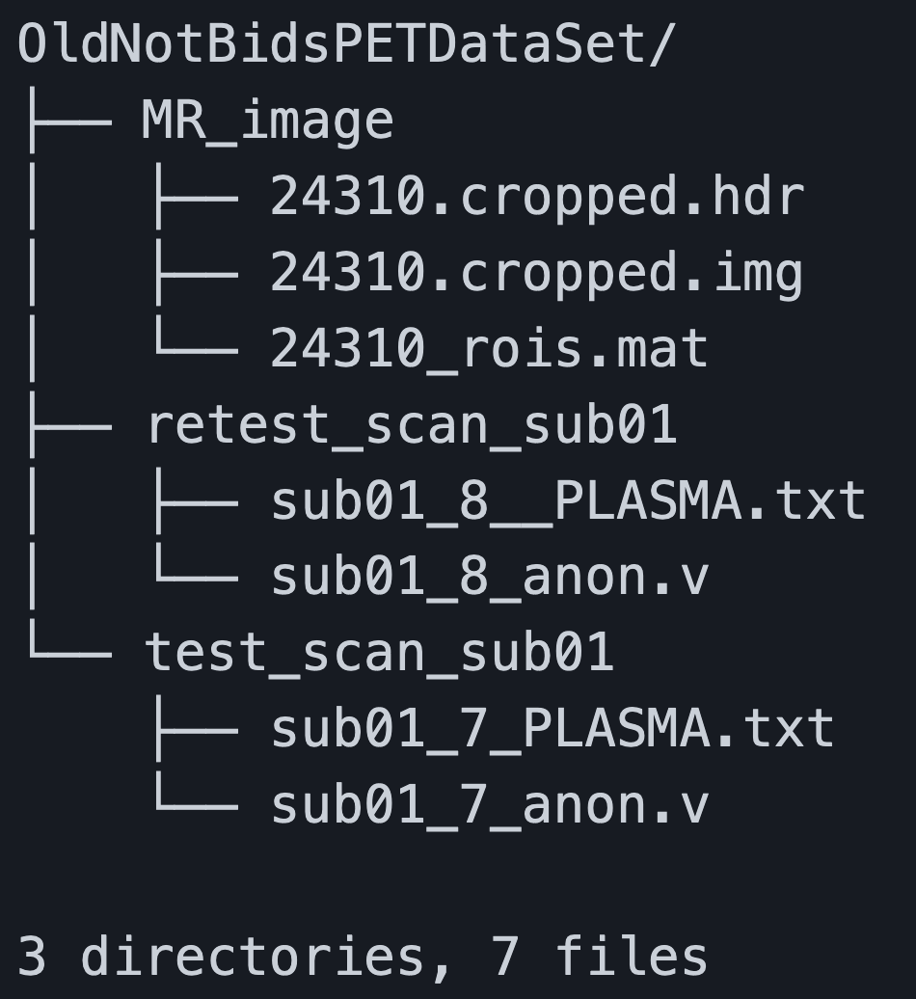
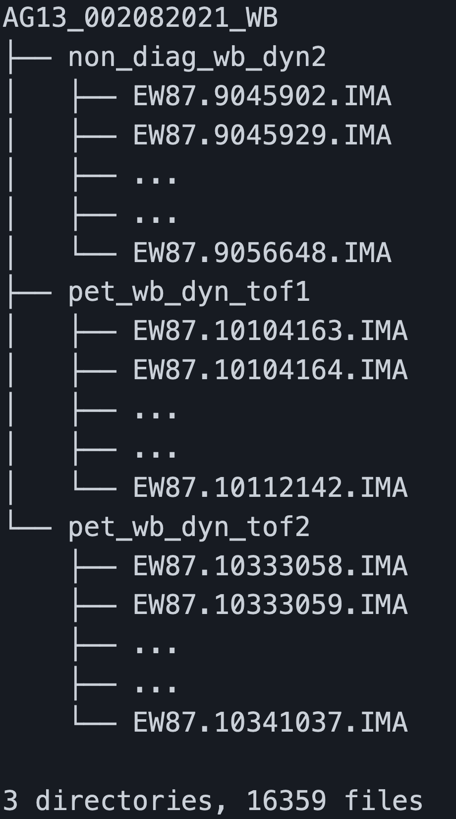
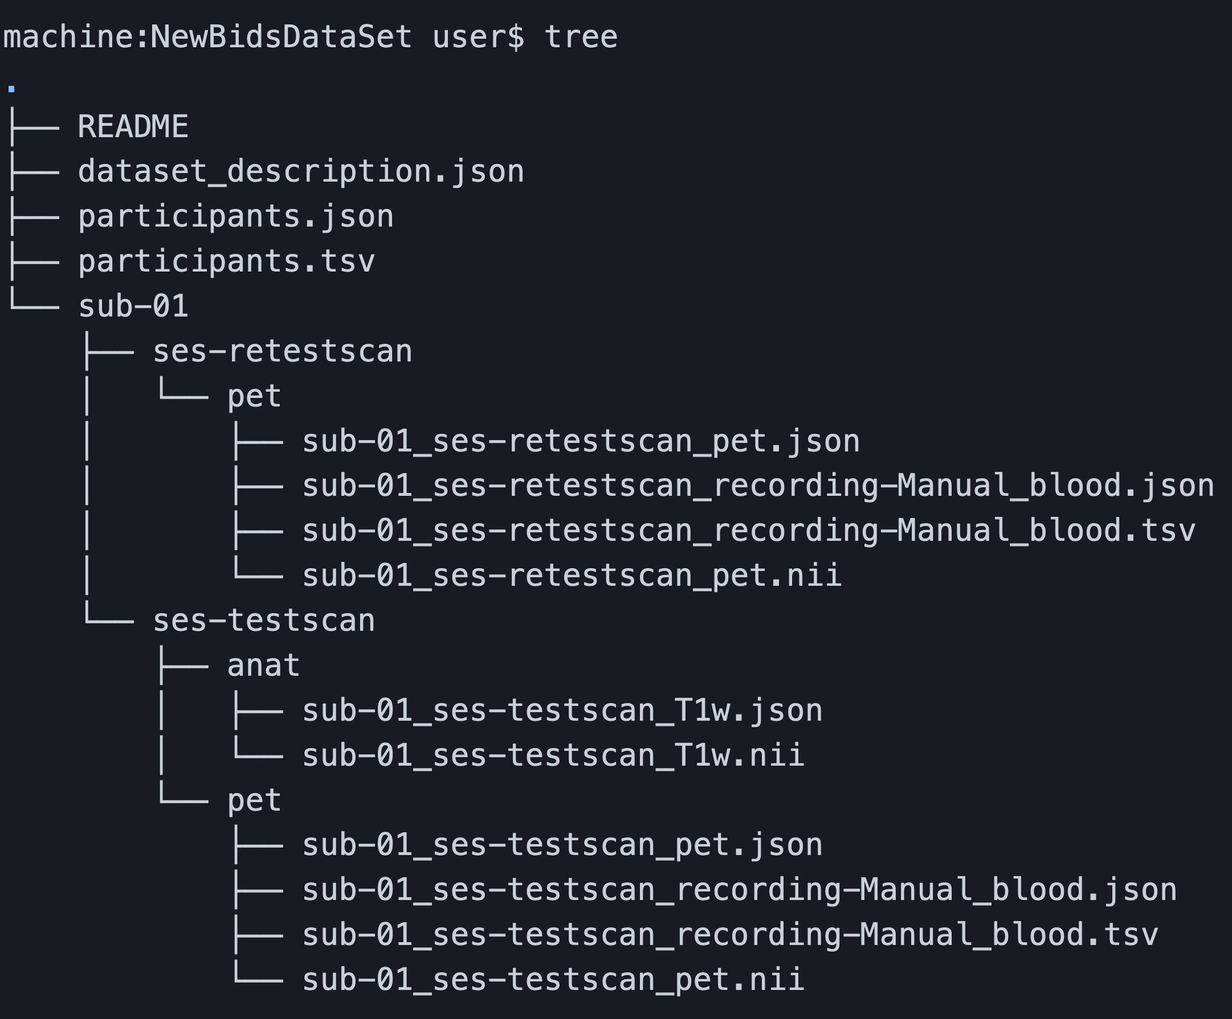
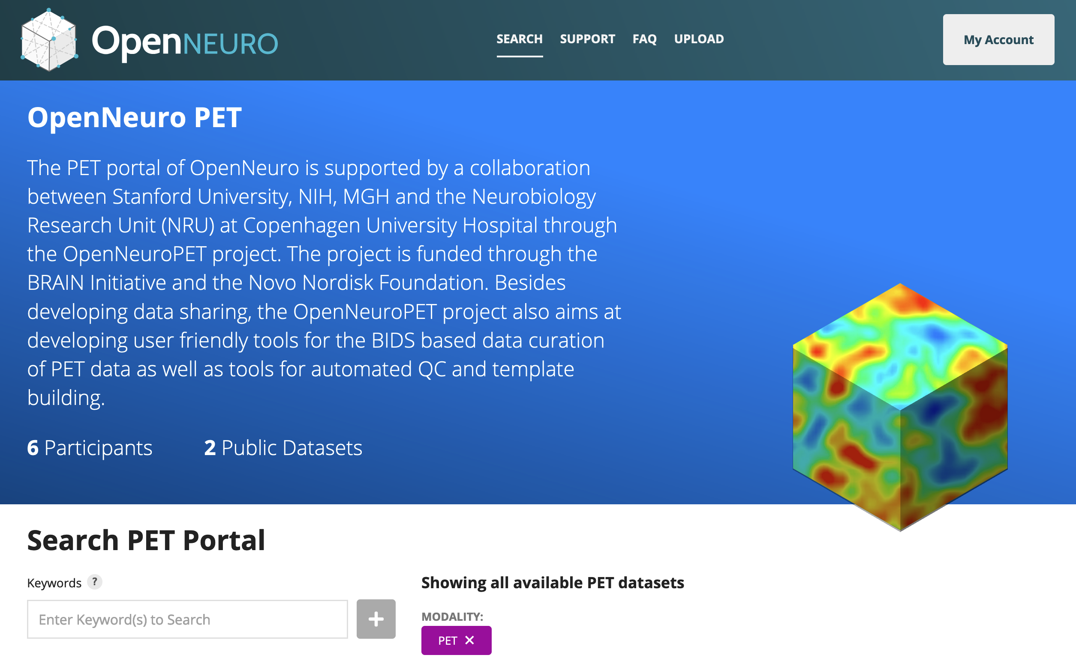
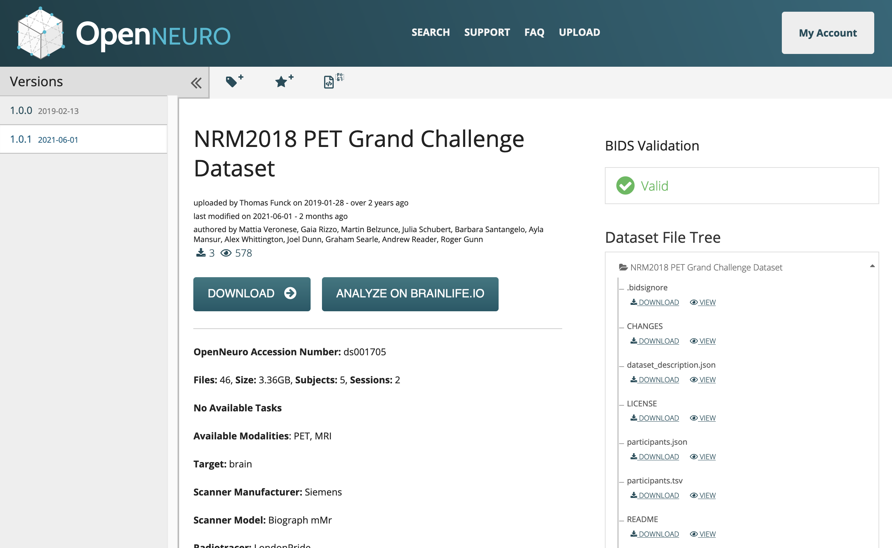
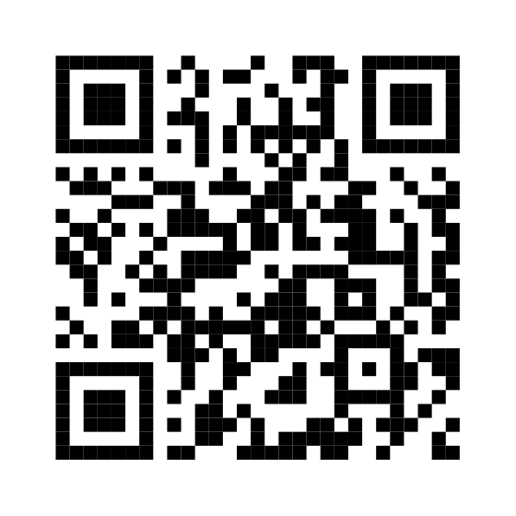

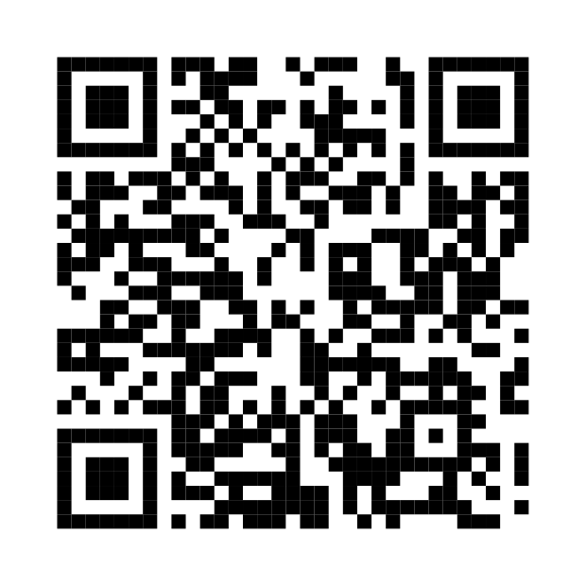




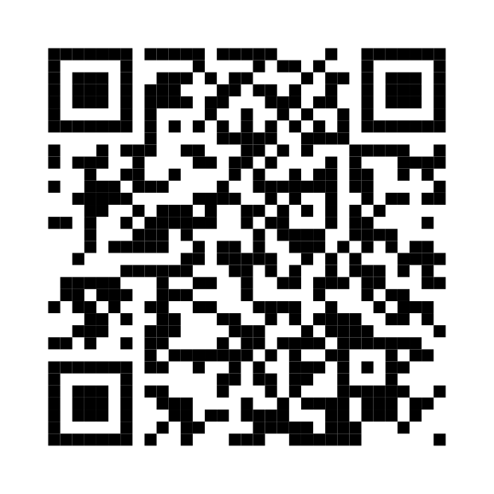
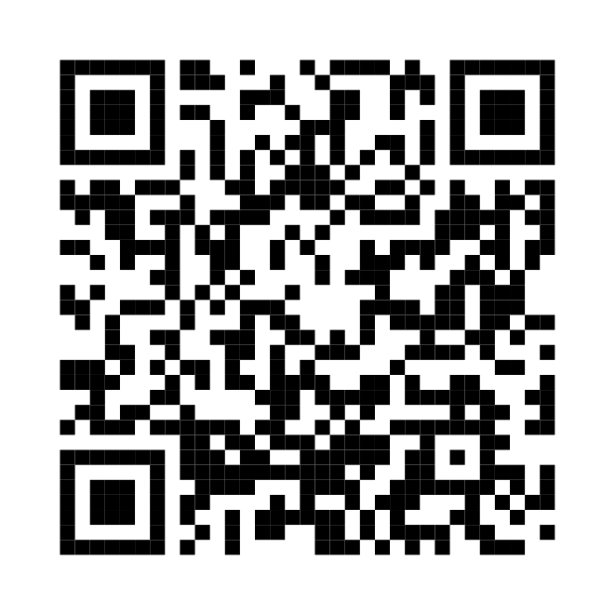
Introduction and Methods
OpenNeuroPET is developing infrastructure and tooling that increases accessibility and reproducibility of PET data.
OpenNeuroPET is focused on creating the infrastructure to guide PET research data into BIDS, but what does that look like?
One of the first steps to increasing the shareability of PET data was the inclusion of PET into the popular brain imaging data structure BIDS [2] with the BIDS extension proposal 009 (BEP009 [3]). A standardized data format makes sharing different datasets simpler as part of the data dictionary is included in the file structure itself. Modalities follow a standard scheme and additional metadata is included in json or tab separated text files.
Organizing these datasets into the standardized BIDS set on the right leads to easier classification for humans and machines alike.
Conclusions and Ongoing Efforts
OpenNeuroPET is working on developing software to support the PET BIDS standard, reaching out the PET community to educate and collaborate, as well as continuing to extend BIDS to support PET pre-processing derivatives.
OpenNeuro is currently involved in:
Once a PET dataset is converted into BIDS it can be uploaded, browsed, and downloaded via a browser (or the command line) at openneuro.org [4]. The BIDS Validator [8] will tell you if the dataset is valid and you can collect, view, or run analysis on this standardized structure.
Conversion of reconstructed PET data and metadata into BIDS
Supporting the addition of GDPR-DUA upload portals for OpenNeuro.org
Reaching out to senior PET experts while extending BIDS further with BIDS extension proposal 023 to include pre-processing derivatives
Working with popular neuroimaging communities and members to better support PET imaging e.g. the BIDS Standard, PETSurfer, and NiBabel
Learn more about BIDS
Read about BEP009
We at OpenNeuroPET encourage you to reach out to us via the link to the right with questions or comments.
https://openneuropet.github.io
Results
OpenNeuroPET is a collaboration between Stanford university, NIH, MGH and the Neurobiology Research Unit (NRU) at Copenhagen University Hospital. It is funded through the BRAIN initiative and the Novo Nordisk foundation.
Before PET was integrated into BIDS with BEP009 this chicken and egg problem was nearly intractable. OpenNeuroPET’s current focus is attacking each side of this problem. By converting PET datasets to host on OpenNeuro.org from the Neurobiology Research Unit at Copenhagen University and the NIMH OpenNeuro can test and develop conversion software while populating a sparse BIDS PET landscape. OpenNeuroPET has created converter software for ECAT image types and continues to extend coverage into other imaging formats such as Dicom, Analyze and MicroPET. To see the current converters or use the BIDS Validator on your own PET data follow the QR codes below.
References
There is little PET BIDS data to study, or create tools, analysis, or pipelines for.
There’s no reason to convert PET data into BIDS,
Or it’s too difficult to even bother.
1. Innis RB, Cunningham VJ, Delforge J, Fujita M, Gjedde A, Gunn RN, Holden J, Houle S, Huang SC, Ichise M, Iida H. Consensus nomenclature for in vivo imaging of reversibly binding radioligands. Journal of Cerebral Blood Flow & Metabolism. 2007 Sep;27(9):1533-9. 2. Gorgolewski KJ, Auer T, Calhoun VD, Craddock RC, Das S, Duff EP, Flandin G, Ghosh SS, Glatard T, Halchenko YO, Handwerker DA. The brain imaging data structure, a format for organizing and describing outputs of neuroimaging experiments. Scientific data. 2016 Jun 21;3(1):1-9. 3. Norgaard M, Matheson GJ, Hansen HD, Thomas AG, Searle G, Rizzo G, Veronese M, Giacomel A, Yaqub M, Tonietto M, Funck T. PET-BIDS, an extension to the brain imaging data structure for positron emission tomography. bioRxiv. 2021 Jan 1. 4. Gorgolewski K, Esteban O, Schaefer G, Wandell B, Poldrack R. OpenNeuro—a free online platform for sharing and analysis of neuroimaging data. Organization for human brain mapping. Vancouver, Canada. 2017 Jun;1677(2).
5. Greve, D. N., Salat, D. H., Bowen, S. L., Izquierdo-Garcia, D., Schultz, A. P., Catana, C., ... & Johnson, K. A. (2016). Different partial volume correction methods lead to different conclusions: An 18 F-FDG-PET study of aging. NeuroImage, 132, 334-343.
6. Greve, D. N., Svarer, C., Fisher, P. M., Feng, L., Hansen, A. E., Baare, W., ... & Knudsen, G. M. (2014). Cortical surface-based analysis reduces bias and variance in kinetic modeling of brain PET data. Neuroimage, 92, 225-236.
7. Most work on NiBabel so far has been by Matthew Brett (MB), Chris Markiewicz (CM), Michael Hanke (MH), Marc-Alexandre Côté (MC), Ben Cipollini (BC), Paul McCarthy (PM), Chris Cheng (CC), Yaroslav Halchenko (YOH), Satra Ghosh (SG), Eric Larson (EL), Demian Wassermann, Stephan Gerhard and Ross Markello (RM).
8. https://github.com/bids-standard/bids-validator#acknowledgments
Use a PET BIDS Converter
Verify your conversion with the BIDS Standard’s BIDS-Validator
OpenNeuroPET
Gitte Moos Knudsen, Robert Innis, Melanie Ganz-Benjaminsen, Adam Thomas, Cyril Pernet, Martin Nørgaard,
Douglas Greeve, Russel Poldrak, Paul Wighton, Anthony Galassi

