Slide 1
Arduino IDE
Download and install instructions – https://arduino.cc
Single one-stop, editor, compiler and library for Arduino Systems
Board
UNO board, UNO-clones using CH340 USB-serial interfaces
Processors ATMega 328 (DIP, Quad-pack SMD)
Experiment, test using UNO, prototype using Nano
Require USB on laptop, USB cable for interfacing/power
Language for programming (Reference)
Based on Processing
Quite similar to C++

Slide 2
Language Nuances (percularities)
Case-sensitive, each statement terminated with a “;”
Good programming practices
One statement on one line
Use tabulation/indentation to show nesting
Full CAPS for constants, use const instead of #define
Start all Class/objects with Capital letter
All other variables start with lower case (camelCase recommended)
Use /*..*/ and // for comments
Define all functions before setup() and loop()

Slide 3
setup() - required
A function, which is run only once
Put all initialization and configuration statements here
Configure for Input/Output
Serial speed
Initialization of global variables
Setup of devices

Slide 4
loop() - required
Also a function
Runs without stopping
When function ends, it restarts at the beginning
All variable declared within the function are local

Slide 5
Processing statements
Copious library of functions
Also plenty of 3rd party libraries (sometimes too many)
Condition statement
If-then-else
switch – case
Loops
for used for definitive number of loops (e.g. n times)
while used for in-determinate number of loops (0, 1, or n times)
do..while used for in-determinate number of loops, at least once (1,..n times)

Slide 6
Digital Input/Output
Digital – values are only LOW (0V), or HIGH (5V)
Initialise/configure our Pins (0..13)
pinMode ( <pinNumber>, <MODE> )
INPUT - digital input pin (reads LOW, HIGH)
OUTPUT – digital output pin (outputs LOW, HIGH)
INPUT_PULLUP – same as INPUT but connects an internal 20K resistor
Input / Output
digitalRead( <pinNumber> )
Returns an integer based on the port reading value (LOW, HIGH)
digitalWrite(<pinNumber>, <LOW|HIGH>)
Outputs a LOW or HIGH to the pin

Slide 7
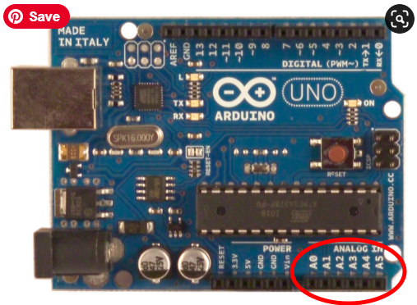
Analog Input
Analog = variable voltage levels
Inputs using only A0..A5
Returns a value from 0..1023 based on
Vref
Voltage applied at the analog pin
Example, if 3.1V is applied at A1
Value = analogRead(A1)
Value returned = 3.1 * 1024/5 = nnn

Slide 8
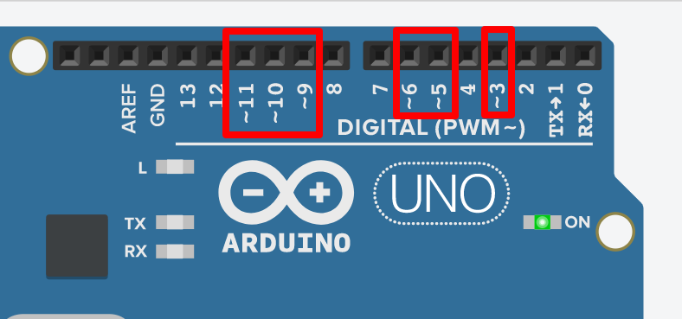
Analog Output
NO direct analog output
ATMega328 uses Pulse-Width Modulation (PWM)
Voltage is proportional to the duty-cycle
analogWrite(<pwm pin>)

Slide 9
Serial IO Library
A neat way of troubleshooting your Arduino code.
Uses the Uno’s Tx and Rx pin to send data back to the IDE using the USB interface
Serial Library
Serial.begin(<speed>) sets up comms speed (9600)
Serial.print(), Serial.println() sends data back to the host
Use the Serial Monitor to check your answers

