Slide 1
EP1000
Computer Controlled Cutting

Slide 2
Computer Controlled Cutting
Perform Cutting operations based on digital data.
Also known as CNC (Computer Numerical Control)
Data is provided from:
CADD operations
Digital 2D drawings
Provides accurate and precise cutting operations
Used in:
Laser cutting & engraving
Flatbed cutters & 2D routers
Milling machines

Slide 3
2D profile
All cutting systems work on a 2D profile which provides an outline of the cut.
Advantages:
The cut is precise with little wastage of material.
Allows positioning to prevent wastage.
Repeatability
Vector File formats:
DXF (Data eXchange Format)
PDF (Portable Document Format)
SVG (Scalable Vector Graphics)

Slide 4
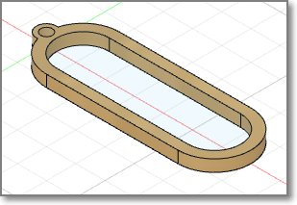
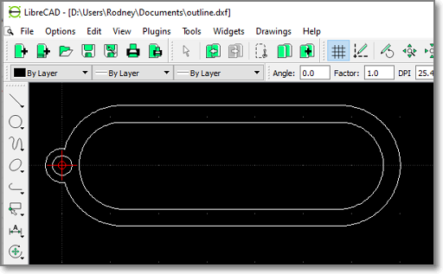
Vector Software
2D Vector drawing programs: Inkscape, AutoCAD
CADD Software – Fusion 360
Don’t forget InkScape !

Slide 5
Software Tools
Fusion 360
Full CAD/CAM software to obtain profiles
Lots of modelling tools to help
Vector Drawing software
Inkscape
LibreCAD (for DXF files)
CorelDraw (licensed software)
Output Vector formats
DXF (outdated, but still used, text editable)
PDF, EPS
SVG (may have different variants)
AI (Adobe Illustrator format)

Slide 6
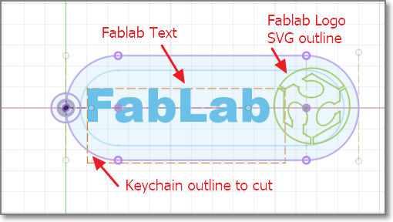
Exercise 1: Keychain for cutting
Let's make a keychain for the fablab with logo
Size: 30mm x 70mm x Thickness (dependent on material)

Slide 7
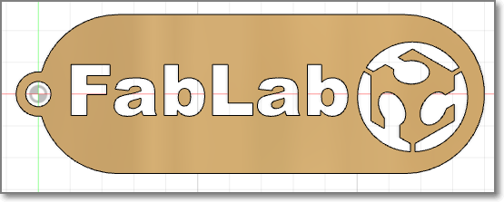
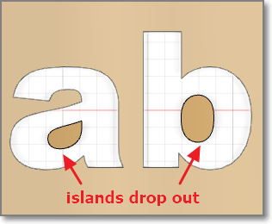
What happens when cut
Islands may form, these drop out after cutting
Need to edit the Vector file before cutting
Placement of causeways to prevent drop-outs
Post production (i.e. edit DXF exported file)

Slide 8
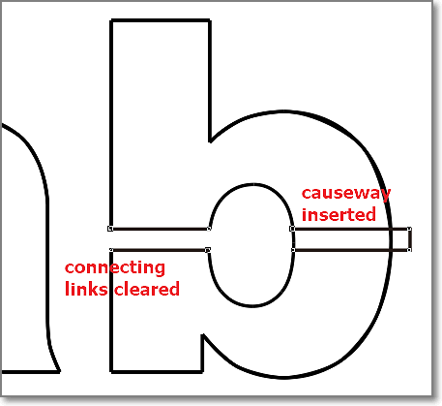
Post Production Editing
Use a Vector Drawing program to create the causeways
May need knowledge of vector drawing program
Suggest CorelDraw

Slide 9
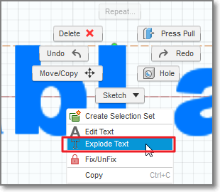
Fusion 360 Explode Text
Use the Explode Text function to separate each letter in the word.
Add causeways in Fusion 360 before extrusion for cut surface

Slide 10
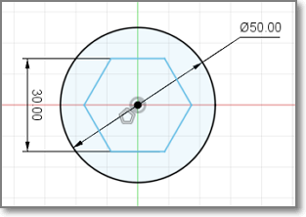
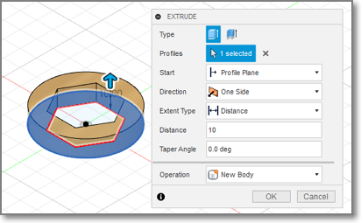
Fusion 360: Export Cut Profile -1
Create your design
Extrude surfaces to create object

Slide 11
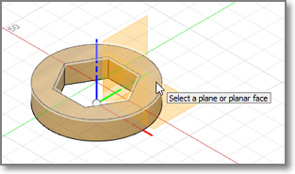
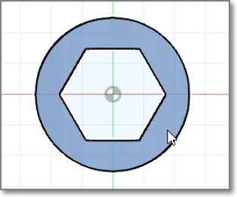
Fusion 360: Export Cut Profile -2
New sketch on object profile to cut
Click again on profile to verify/select

Slide 12
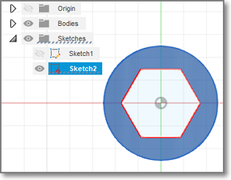
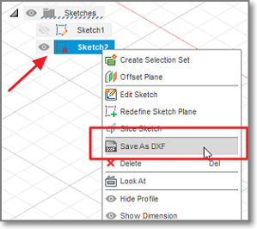
Fusion 360: Export Cut Profile -3
New sketch created
Should rename to avoid confusion (design_dxf)
R-Click on sketch name
Save As DXF

Slide 13
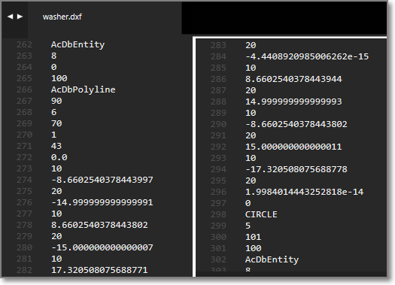
DXF format
A simple text format that defines the coordinates of the profile.
Can come in different versions
Backward compatible only

Slide 14
Fusion 360: Modelling
Modelling allows us to simulate the actual object using CADD
We can use CADD tools to help us in the design
Most common tools are:
Combine
Joints
Cross-sectional views
Clearances

Slide 15
EP1000
Computer Controlled Cutting
End

