Slide 1
EP1000
3D Printing

Slide 2
Technology
A new technology - Additive Manufacturing
Advantages
Anyone can manufacture
Can create almost anything
Ideal for rapid prototyping (visualisation)
Disadvantages
Slow (to very slow)
May not have the material strength

Slide 3
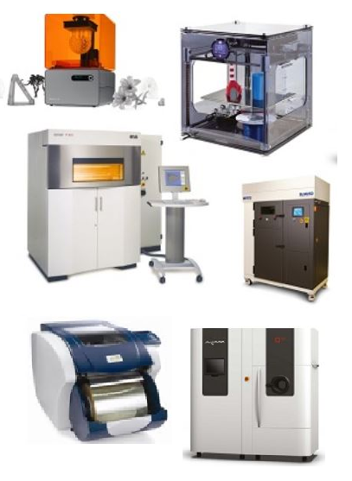
Processes
stereolithography (SLA)
digital light processing (DLP)
fused deposition modelling/fused filament fabrication
ink-jet binder
polyjet
cut sheets
selective laser sintering (SLS), selective laser melting (SLM)
electron beam melting (EBM)

Slide 4
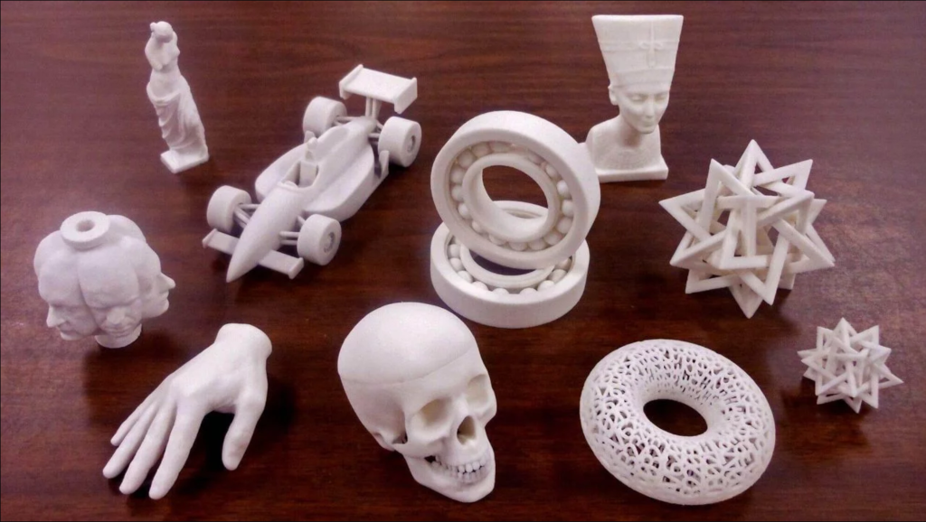
Additive Technology – 3D printing
Almost anything can be 3D Printed (If you can model it, it can be printed)

Slide 5
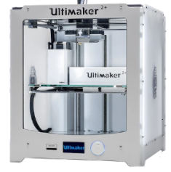
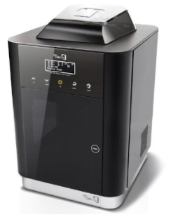
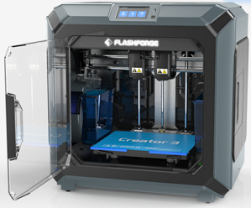
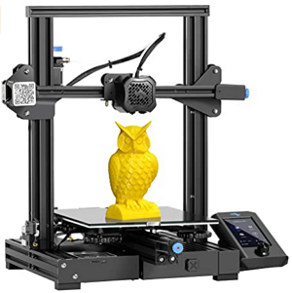
Comparison of 3D Printers at Fablab
Printer | Ultimaker 2+ | Cubicon Style 3DP-2105 | Flashforge Creator 3 | Creality Ender 3 Pro v2
Size (mm) | 210x210x205 | 150x150x150 | 300x250x200 | 220x220x250
Filament Dia | 2.85mm | 1.75mm | 1.75mm | 1.75mm
Type | FDM | FDM | FDM | FDM
Speciality | Old, reliable, fast | Small, reliable, precise, ABS | Dual extruder, reliable, fast | Slow, general purpose, cheap

Slide 6
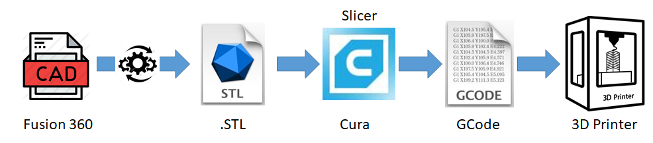
3D Workflow
Create a 3D Model of the object using CAD
Extract the 3D Model representation (.STL, .OBJ, .3MF)
Use a slicer (e.g. CURA) to slice the model into layers.
Extract each layer into a machine readable file (.GCODE)
Send to the 3D Printer for fabrication

Slide 7
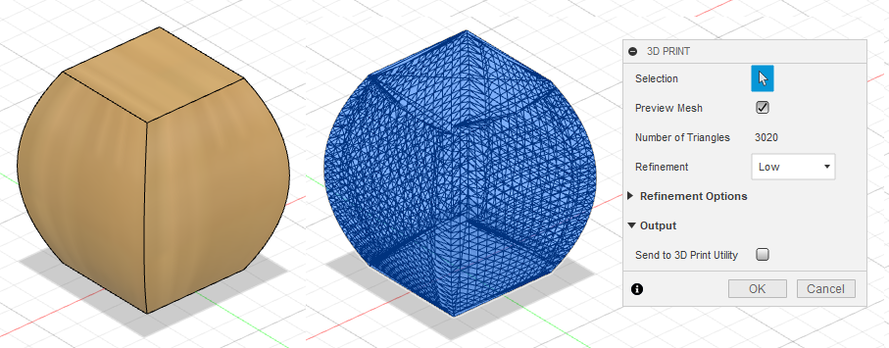
3D Model extraction
Fusion 360 > Tools > Make > 3D Print
Refinement: Medium
Output to File (.STL) – Standard Tessellation Language (other .OBJ, 3MF)

Slide 8

Slicing Software - CURA
Ultimaker CURA
A program that converts digital 3D models into printing instructions for a given 3D printer to build an object.
Slicer virtually “cuts” 3D object into many horizontal layers
3D printer constructs the object by re-creating layers (additive manufacturing)
Best 3D Slicing Software in 2021

Slide 9
Slicer Graphic Area Elements
Offers a 3 Graphical area where you can visualize how the model transforms into a layered representation
Printing bed plane
Visualization and camera control – allows viewing from different angles
Model positioning control – allows repositioning for better prints
Layer Preview
Shell – external lines that define the outline
Outer wall – material line that defines the surface
Inner wall – material line that defines the shell thickness
Infill – the contents between the outer and inner walls
Supports – structures for overhangs
Adhesion layers
Raft – a plate/layer between bed and the print
Brim – lines of material around the first layer, allowing wider contact
Skirt – single line for testing of material flow
Notes:
Graphic Area Elements (https://www.solidprint3d.co.uk/3d-slicer-software-how-it-works-and-what-to-expect/)
Slicers offer a 3D graphics area where you can visualize how the model transforms into a layered representation. Every slicer has its unique interface style, but there are common elements to consider:
Printing bed plane: It represents the shape and dimensions of the real bed. Here you can visualize a comparison between the object and the space provided by the printer. With this, you have a graphical representation for:
Coordinate systems.
Model orientation, scale and position relative to the bed.
How the model adheres to the bed.
If you are printing multiple objects, you can check how they’ll arrange.
Visualization and camera control: Through icon bars and mouse/keyboard controls.
Model positioning controls: Same as the previous point.
Layer preview: Once the parameters are ready, the interface lets you scroll through each layer. It allows you to check how the material would be distributed within. The following are the main types of distributions:
Shell: The external lines that define the shape of the object.
Outer wall: The material line that defines the surface of the shape.
Inner walls: The material lines that define the shell thickness.
Infill: Fixes density percentage inside the object. There are many possible patterns to distribute the material within the hollow space.
Supports: Structures made for overhangs. We need them to avoid layers collapsing during the printing process if their overhang. You can generate them automatically or manage manually for better control over the result.
Adhesion layers: Sometimes an object has poor contact area with the bed, considering it needs to stick well during the printing process. There are many more factors that could affect adhesion, like part height, bed surface rugosity, type of material and printing speed. Regardless of the case, slicers offer the following structures as a solution for this.
Raft: A thick plate between the part and the printing bed.
Brim: Extra lines of material around the first layer, allowing a wider contact area.
Skirt: A single line around the part. It allows testing material flow and bed leveling before starting with the part itself.

Slide 10
Slicer Settings
Layer height – determines how thick each layer is
Line Width – horizontal thickness of each extruded line
Shell thickness – thickness of the object wall
Top, Bottom thickness – quantity of solid lines on the top/bottom of print
Infill Settings – density of material between inner, outer walls
Extruder Temperature – temperature to melt the filament, flow
Print Speed – how fast to move the extruder head
Cooling Settings – affects the cooling of the filament as it is printed
Support Settings – type of support, if any, for overhangs
Adhesion structure settings – how the model will be placed on the bed

Slide 11
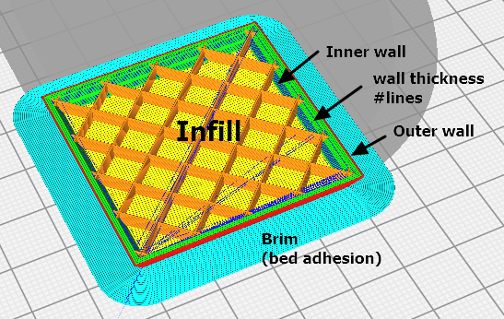
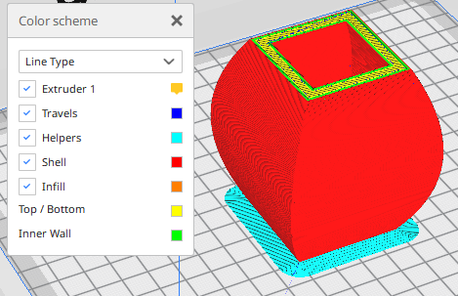
Slicer parameters
Slice, then use Preview with Color Schemes to see the different effects of your slicer settings

Slide 12
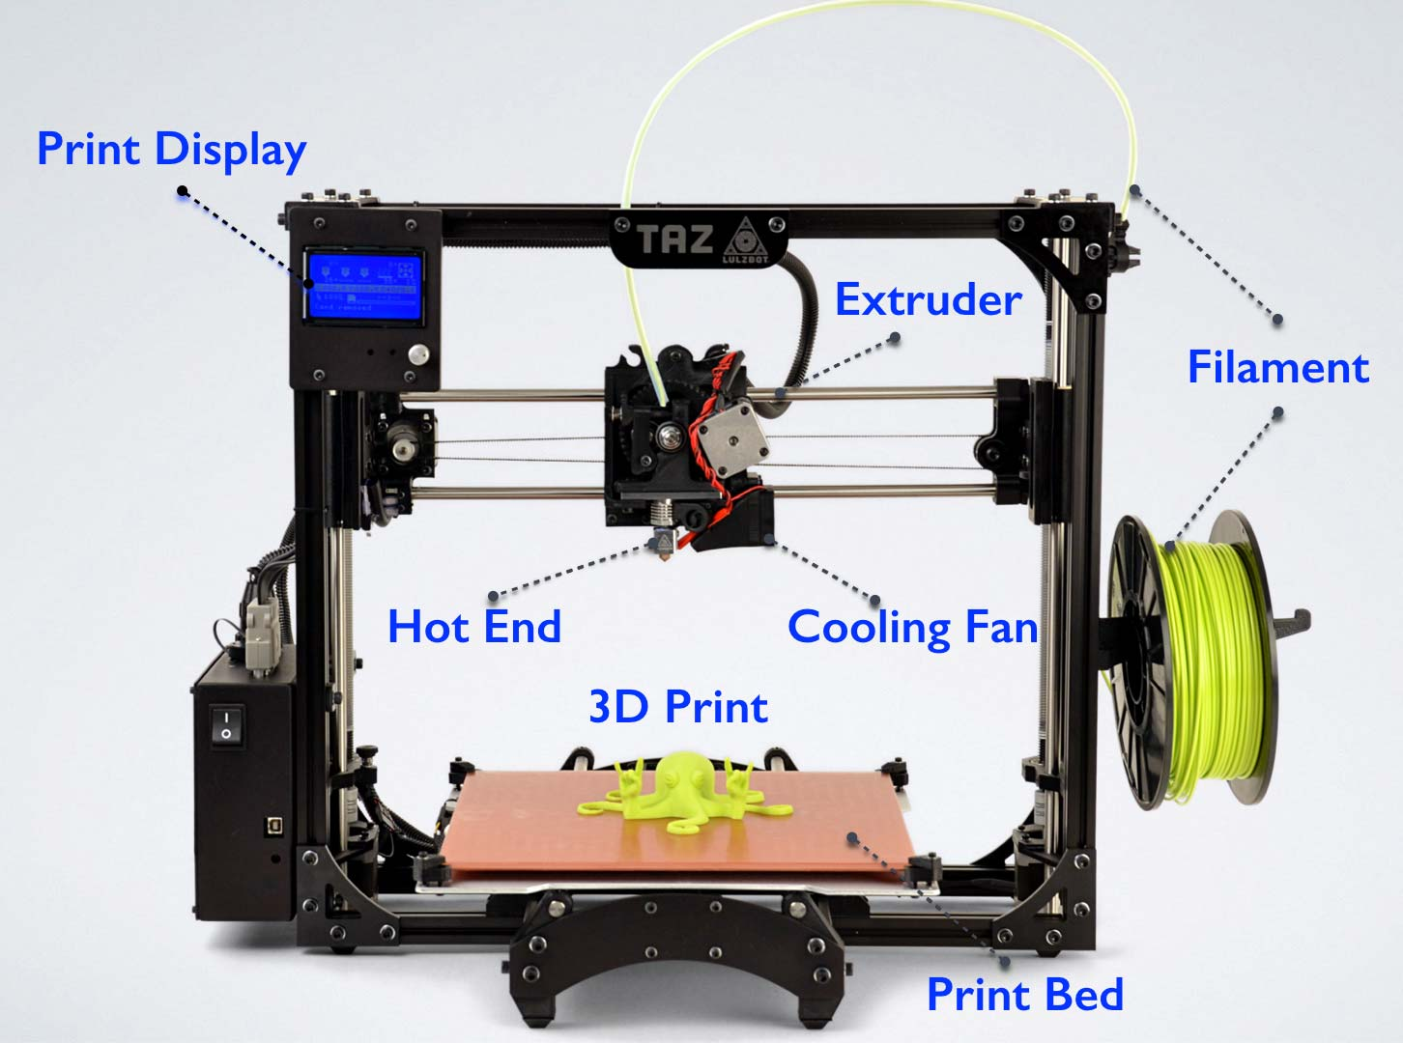
FDM Printer elements
Most FDM printers are similar.
Filament is fed into the extruder unit
Extruder unit heats up, melts the filament and forces it out to form a thinner filament string
Filament string is placed on bed/model
Cooling is applied using fans

Slide 13
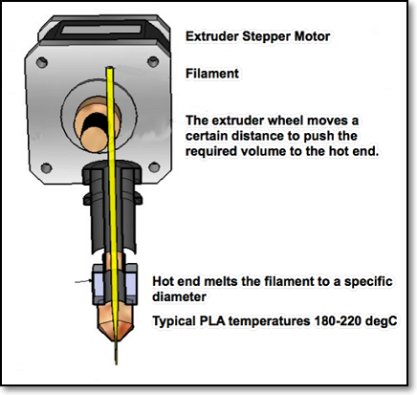
Extruder Module
Heated tube with a nozzle
Extruder heats up filament and melts it, forcing molten filament through tube and nozzle
Nozzle controls diameter of extruded material
Flow rate controlled by stepper motor and the feed of the filament.
User adjustable 20%~150%
Some printers can have 2 extruder heads

Slide 14
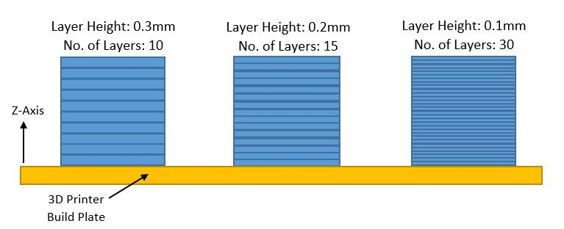
Layer Height
Height of each printed layer
Thinner layers give finer prints, however, slower
Range: 0.1 ~ 0.4 mm (Rule-of-thumb: ½ nozzle diameter)
Affects resolution, smoothness and time taken to print.

Slide 15
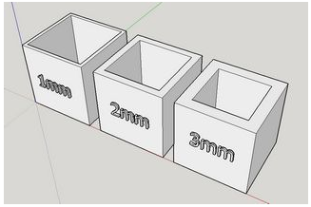
Wall Thickness
Number of strands to make up the thickness of the wall.
E.g wall thickness = 3mm using 0.2 layer Inner wall : 0.8 mm Outer wall : 0.8 mm Wall thickness: 1.4 mm (7 passes of the nozzle)
Affects time and strength of print

Slide 16
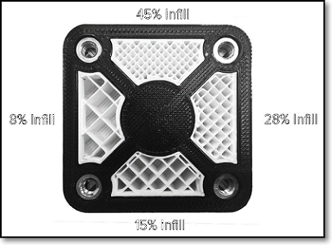
Infill Percentages
Controls the amount of fill in the internal cavities.
Higher percentages take longer time, but higher strength
Can specify the type of infill pattern structure (lines, triangles)
Typical infill: 10 ~ 20%

Slide 17
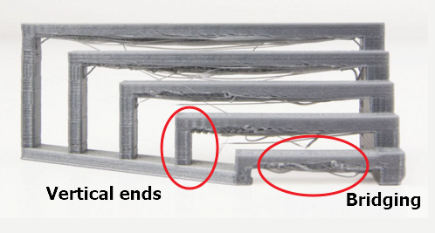
Bridging
Prints between 2 points that have no connection to each other.
3D Printer prints the base layer, then the vertical structures.
Horizontal structures have no supports other than at the end.
There is a max distance you can bridge without stringing

Slide 18
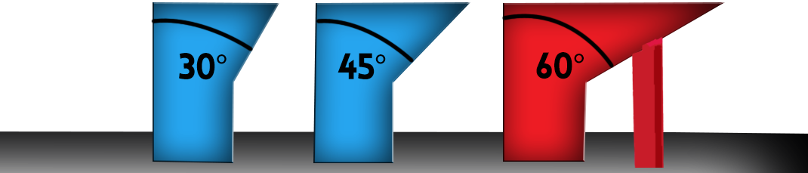
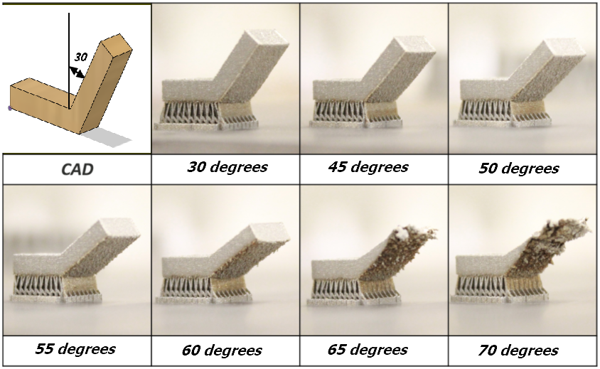
Overhang limits
3D printers cannot print on air
There is a limit where there is insufficient support
Most printers can handle an overhang of 45º
Use a test print to determine your overhang angle

Slide 19
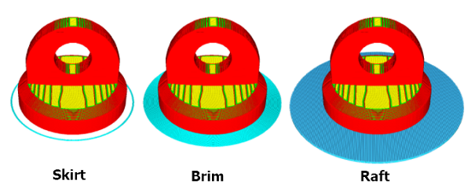
Platform adhesion
Printer bed is heated to improve adhesion
Sometimes print object requires help in adhering to plate
A Raft is a base of extruded material, the object is built on it.
Brims allow some extra adhesion to the base of object
Skirts are used to clean/extrude material to test

Slide 20
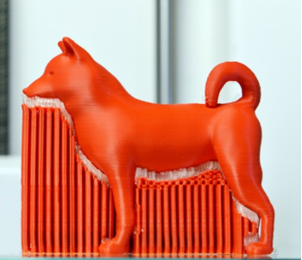
Supports
Supports are used to aid in printing overhangs
Supports make impossible prints possible
Supports are removed after printing
Sometimes, the positioning of print can help in reducing the need for supports

Slide 21
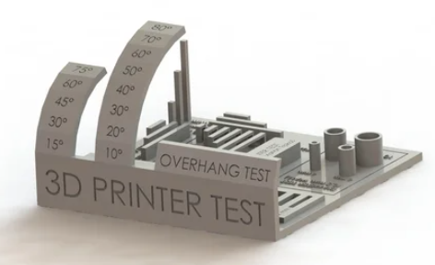
Benchmarking your printer
Testing your printer to determine practical limits
Not every printer performs the same each time
Very important that the bed is level. (All3DP 3D Printer Bed Levelling)
Search for printer test models with explanations on the tests: (All3DP 2021)
Ref: All-in-one 3D Printer test

Slide 22
Recommended Cura Settings
Printer | Ultimaker 2+
Material | PLA
Nozzle | 0.4mm
Layer Height | 0.2mm
Wall Thickness | 0.8mm (4x)
Infill | 10~20%
Print Speed | 50~80 nm/s
Temperature | 190~205ºC
Supports | Depends
Bed Adhesion | Depends
Tips
Recommended layer height approx. ½ nozzle size
Skin layers > 0.8mm
More infill takes more time
Try not to use supports, cleaning up is a pain
Check for bed adhesion, at best use brim
Print time < 1 hr if possible
Always be around until the base is built

Slide 23
Assignment: Chess Piece - Knight
Convert your chess piece to an STL file
Check that the size is no larger than 30x30x50mm
Hollow out the chess piece
Use CURA to slice and prepare your print
Layer height 0.2~0.25mm
Keep skin/walls to 0.8~1 mm
Infill 15% is more than enough
Do you require supports? Why?
Ensure that there is enough bed adhesion
Keep your print down to < 1hr

Slide 24
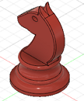
Assignment: Chess Piece - Knight
Take note of
CURA settings (use screen shots/captures)
The time and amount of material used
Photos of the 3D object being printed
Photos of your unfinished printed piece
Photos of your finished piece
Document your work and findings
Take the 3D Printer Certification Quiz
Found on BB (Fablab Page)
Use the chess piece as your project

Slide 25
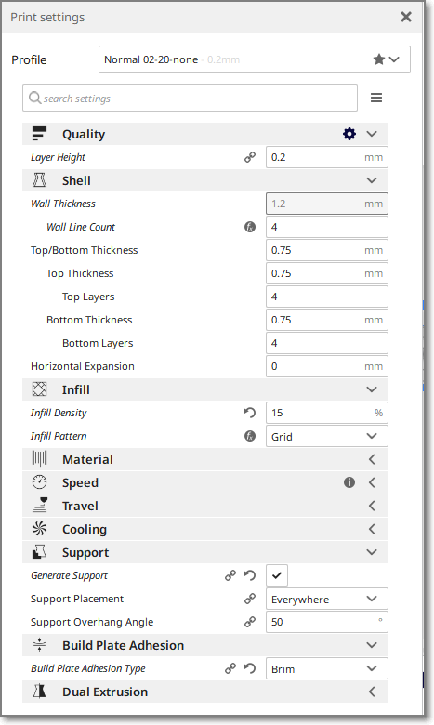
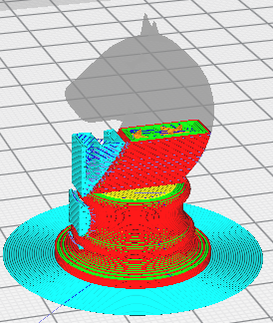
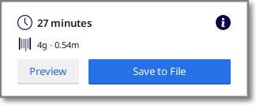
Knight: Print
Knight files (zip)

Slide 26
EP1000
3D Printing
End

