Slide 1
EP1000
3D Models - 2

Slide 2
Methods of Creating 3D Models
Extrusion
Use a 2D plane profile
Extend into the 3rd plane
Rotation
Use a 2D plane profile
Rotate the plane around an axis
Sculpting
Start with a 3D object
Add, remove 3D objects
Subdivide the surface into sections
Push, pull, extend, contract sections

Slide 3
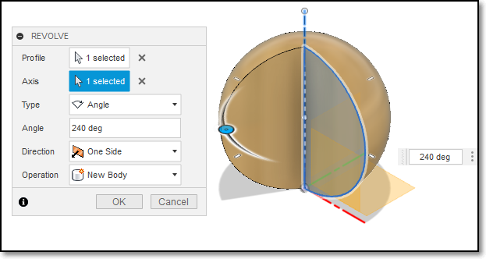
Create > Revolve
Start with a 2D closed profile in plane
Create > Revolution
Select the axis of revolution
Select the angle to revolve

Slide 4
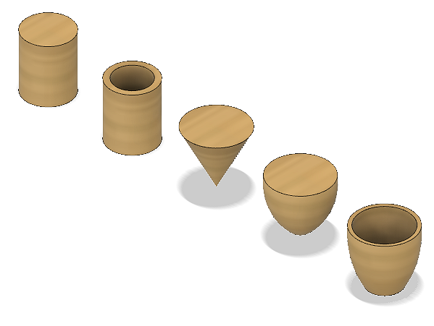
Create > Revolve
Revolve used for
Uniform objects revolved about an axis
Creates objects not possible with Extrude
What profiles were used to create these objects?

Slide 5
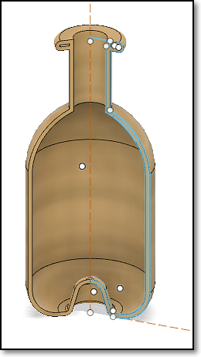
Revolve using Arc profiles
You can create bottle objects using arc profiles.
You can also use the revolve command to cut parts which you do not need.
E.g. Hex nut

Slide 6
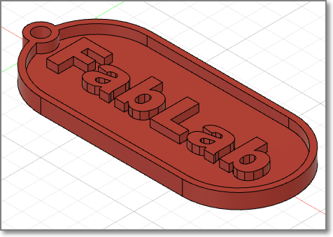
Exercise 1: Name Tag
Let's make a name tag
dimensions: 30mm x 70mm x 4 mm
rim of 1.5mm thickness around the edges, height 2.5mm
key-ring hole of 4mm, re-enforced with 1.5mm rim
name or design/pattern 0.5mm below surface
base of name tag 1.5mm thick

Slide 7
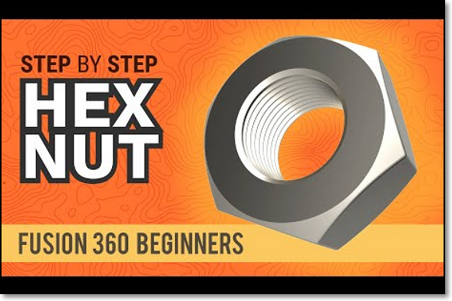
Exercise 2: How to model a Hex Nut
This is Kevin Kennedy’s video tutorial on the modelling of a hex nut: https://youtu.be/Xho87HJ-XDo
A useful tutorial should you need to create odd-sized fasteners.

Slide 8
EP1000
3D Models - 2
End

