Slide 1
EP1000
Computer Controlled Cutting 2

Slide 2
Lasercut Parametric Box
Boxes are useful in all projects as they provide housing or containment.
Making the box parametric allows changes, accommodating for boxes of different sizes, types.
A practical example that can be used for other projects.

Slide 3
Start with a sketch
Sketch on paper how your box looks like and the approximate dimensions.

Slide 4
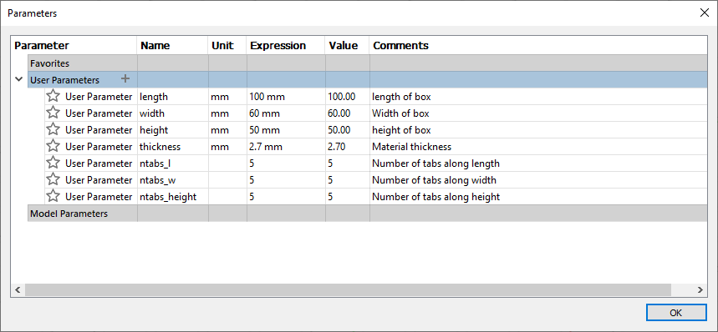
Define the parameters

Slide 5
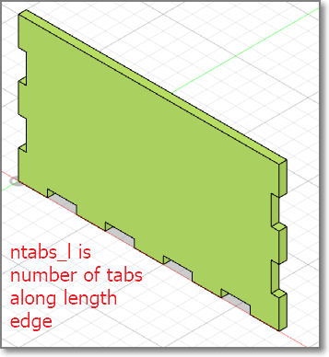
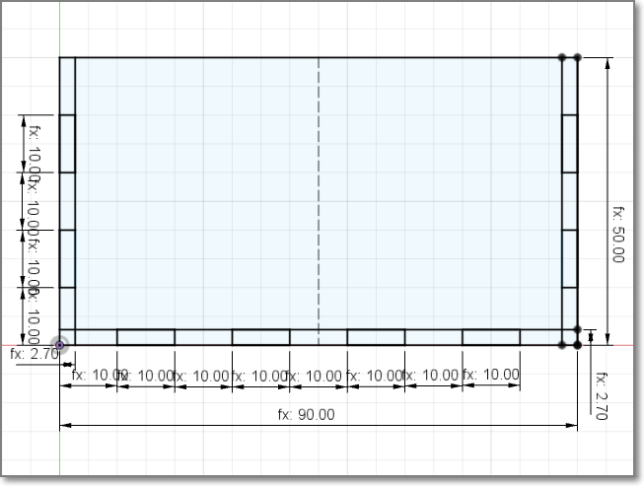
Create the front face
Make a new component
Sketch the face
Add the tabs
tabLength = length/(ntabs_1*2-1)
Extrude

Slide 6
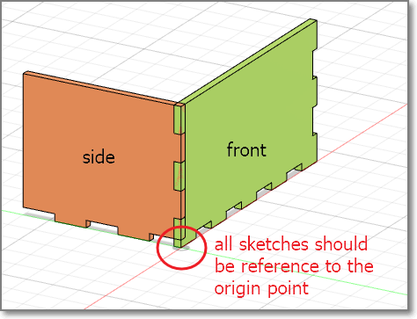
Add the side component
New component
Create sketch
Start for ORIGIN
Choose EDGE face of front tab
Constrain sketch to the front component
Draw the tabs
Extrude

Slide 7
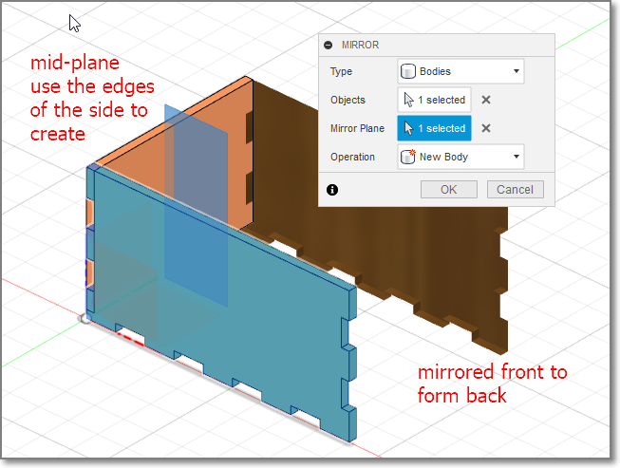
Mirror front to form back
Create a mid-plane
Switch off visibility of front body to help
Choose front and rear edges of side
Mirror the front using the mid-plane
Repeat for left and right sides

Slide 8
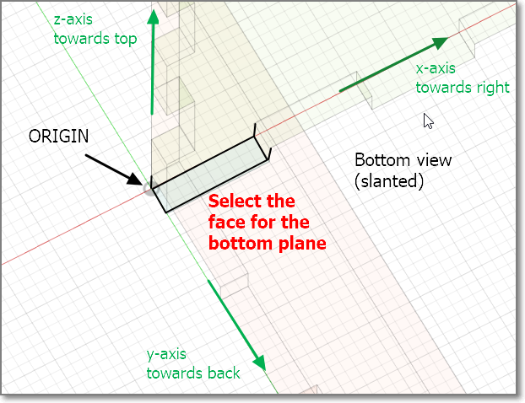
Create the base
Rotate the object to bottom view
Create new component
Create sketch
Start from ORIGIN
Sketch the base
Constraint to edges
Extrude

Slide 9
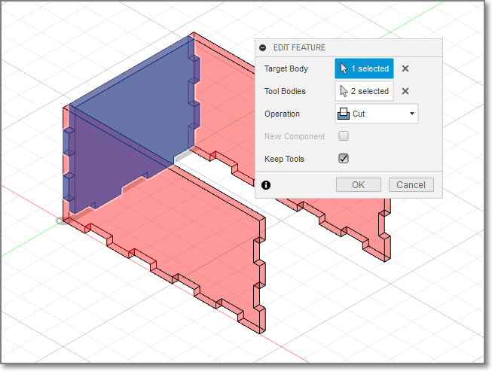
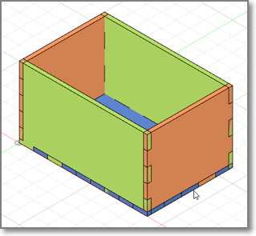
Combine
Use the combine tool to create the tabs.
Turn OFF components that are not used to improve visibility

Slide 10
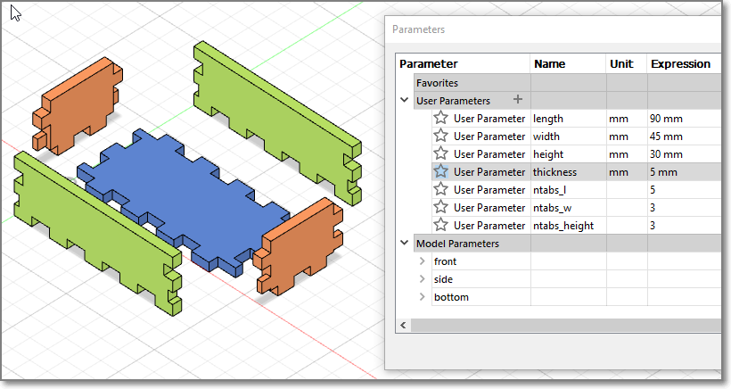
Completed Model
Change your parameters, the box should change without problems
Some parameters do not work that well (which ones, why?)

Slide 11
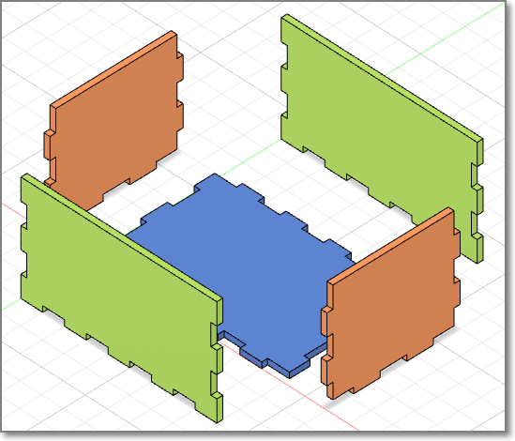
Check Model
Export and check the DXF of each of the components. Align them for laser cutting
Q: Does the thickness of the material affect the DXF output for laser cutting?

Slide 12
Assignment: Musical Box
You are to create a closed box with a movable lid, specifications are as follows:
Must have a movable lid
Must be lasercut (wood 2.5~3.6mm)
Must be able to accommodate “mechanical hand-cranked music box movement”
Drawn and modelled in Fusion 360
Can be glued together (no nails, hinges etc)
Must be “decorated” in some manner

Slide 13
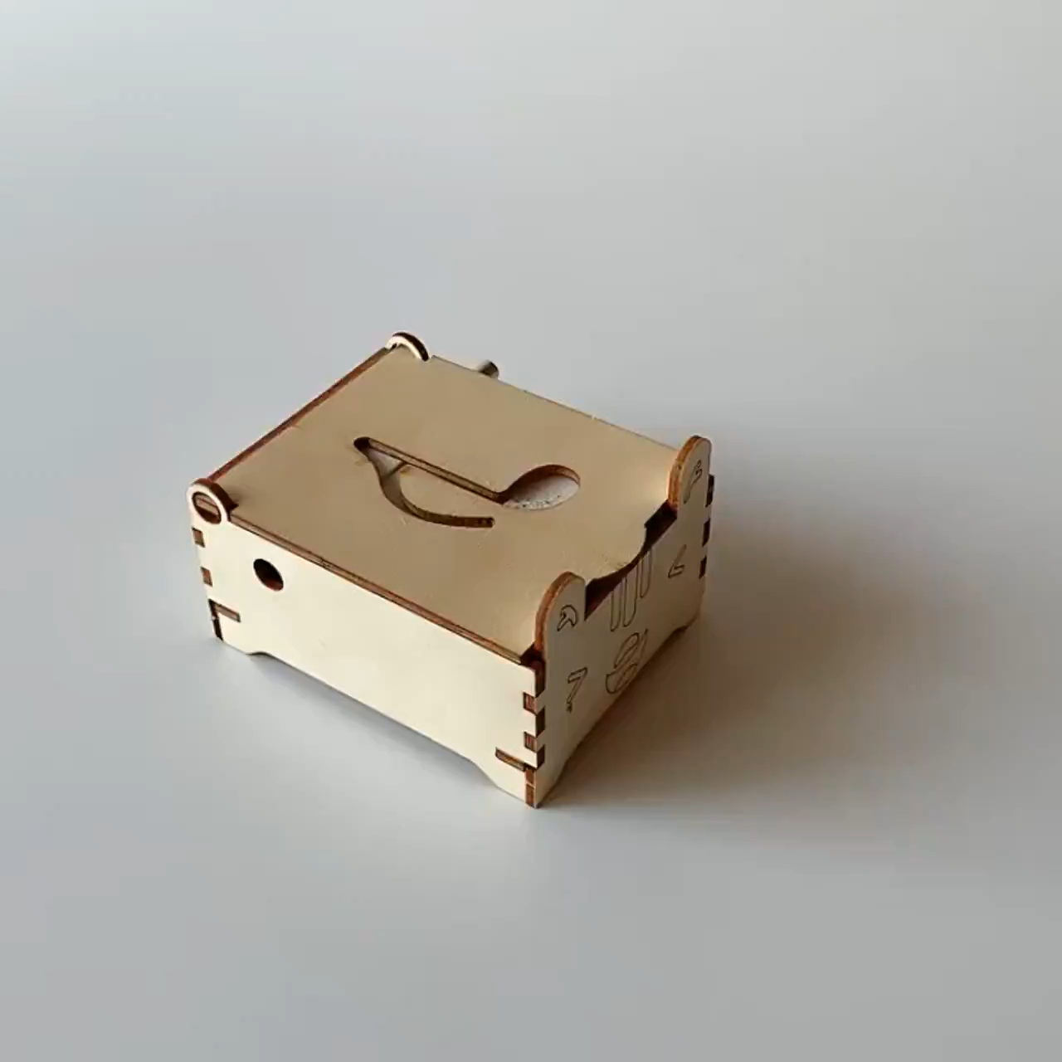
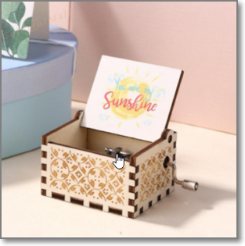
Example: Music Box
Search: Musical Box Mechanical Hand Crank

Slide 14
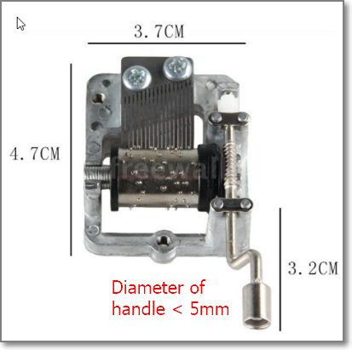
DIY Music Box
Hand Crank Musical Mechanism Craft DIY Music Box
Must accommodate musical hand crank
Measurements are approximate
You can omit the hole for the crank until the box is assembled.

Slide 15
Marking Scheme
Item | Description | Score
1 | Fusion 360 Box design (.f3d included) – 25% Lid – 25% | 50%
2 | Laser cut box fitting | 20%
3 | Write-up (how-to) | 20%
4 | Fitting, Enhancements | 10%
Deadline for submission: Friday, Week 2 Term 2 (tentative)

Slide 16
EP1000
Computer Controlled Cutting
End

