Slide 1
EP1000
Project-1-Planning

Slide 2
Planning
Most important phase in your project
Decides your route and what you have to do
Provides a plan for the next few weeks
Decide on what equipment to use
Allows for parallel work
You will always NOT have enough time
Scope your project
Don’t forget your documentation (25%)
Do what you can, move on.

Slide 3
Create an overview
Uno (testing)
Nano (implementation)
Clock settings
Micro-controller
Display
Pushbutton
Touch Sensor Remote control Keyboard
LCD (16x2)
TM1637 4-digit
Voice
Dot-matrix 7219
Words
Exact time-keeping
Other Sensors
Software
RTC Clock module
Network time
Temperature
Humidity
Light
Decide now!

Slide 4
Decide ….why?
Affects your project
Complexity of the project
Components availability
Software development
Physical design of the project (25%)
Decide, based on
Familiarity with components
Available software and examples
Available designs

Slide 5
Time planning
Week | Time allocation | Purpose
1 | 4 hr | Get specifications, sizing Sketch project Draw design using Fusion 360 Documentation | Sketches, .F3D, specifications, measurements
2 | 4hr | Laser cut, 3D print design Start micro-controller testing Documentation | Lab work (closures?), start testing
3 | 4hr | Complete project test Start fitting Integration | Software development, testing, Integration
4 | 4hr | Integration of components Documentation Presentation slide, video | Integration, documentation, presentation

Slide 6
Specifications
Get specification sheets on ALL items
Example:
Uno R3
Nano
Get dimensions of ALL components
Do a mock-up of your project
Use cardboard, paper, foam, scrap
Size up the items, do not physically oversize, undersize
Sketch, measure proposed design

Slide 7
Physical design
Sketch a design
Dimension your design
Decide what to
Laser cut (flat surfaces, stacking, enclosures)
3D Print (irregular shapes, moving parts, holders)
Make allowances
for redos, mistakes
lab closures, bookings, time/space allocation
Over-exactness

Slide 8
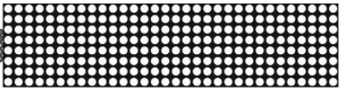
Physical Design
40mm
1637
Deciding on your components affects the size and shape of your physical system
Do a MOCK UP!
80mm
60mm
LCD 80x36
100mm
80mm
180mm

Slide 9
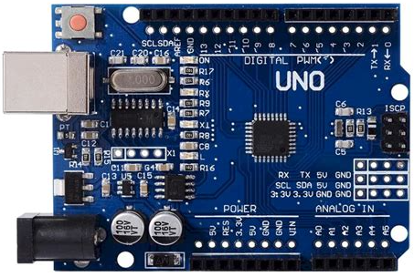
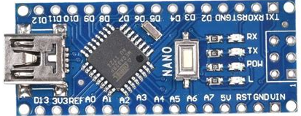
Test vs Implementation
All testing to be done with the UNO board
Easy connections
USB & Power
Lots of examples
Easy testing!
53.3 mm
68.6 mm
All implementation to be done with the Nano board
Connections are there (same as UNO)
Mini-USB, No Power (except 5V)
Uses ATMega328 (same processor), so runs the same code
Need to solder wires/pins
17.8 mm
43.2 mm

Slide 10
Other considerations
Pins vs Wires
Pins need a mini-breadboard
Wires need soldering (another skill?)
May need multiple GND and Power
How to transfer code from UNO to Nano
Start, Stop, Pause buttons ?
Power considerations
5V, GND
Voltage regulation
Power sockets (no USB connections)
Indicators

Slide 11
Implement a design
Design drawn using Fusion 360
Learn how to assemble parts for fittings
Vector/Raster graphics for decals, labels, artwork
Documentation
Include all RAW files (.f3d, .jpg, .png)
Record machine settings
Write up your work

Slide 12
EP1000
Project-1-Planning
End

