Slide 1
EP1000
3D Models - 2

Slide 2
Methods of Creating 3D Models
Extrusion
Use a 2D plane profile
Extend into the 3rd plane
Rotation
Use a 2D plane profile
Rotate the plane around an axis
Sculpting
Start with a 3D object
Add, remove 3D objects
Subdivide the surface into sections
Push, pull, extend, contract sections

Slide 3
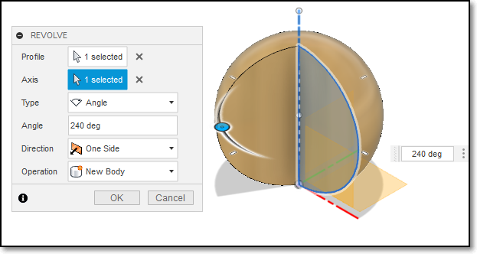
Create > Revolve
Start with a 2D closed profile in plane
Create > Revolution
Select the axis of revolution
Select the angle to revolve

Slide 4
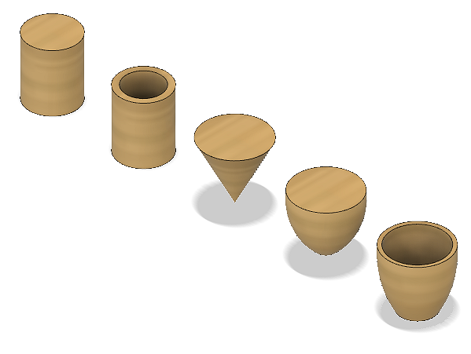
Create > Revolve
Revolve used for
Uniform objects revolved about an axis
Creates objects not possible with Extrude
What profiles were used to create these objects?

Slide 5
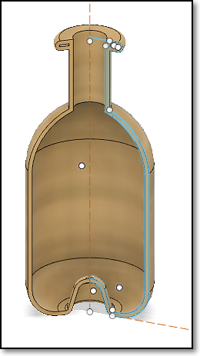
Revolve using Arc profiles
You can create bottle objects using arc profiles.
You can also use the revolve command to cut parts which you do not need.

Slide 6
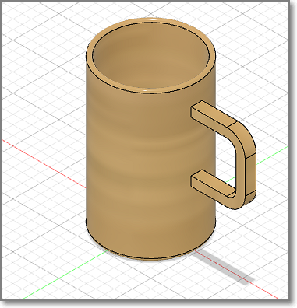
Exercise 1: Mug with Handle
Let's make a mug with a handle
dimensions: 50mm (diameter), 80mm (height)
Include an arc at the base of the mug
let the mug’s thickness be about 2.5mm
add a handle (ear) of thickness 6mm of your choice
Go wild with your design! It’s just an exercise on using the revolve and extrude functions.

Slide 7
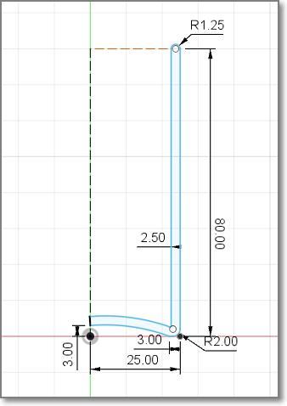
Tip 1:
You can use the profile as a guide.
Make sure you have a closed profile before you revolve.
Also, ensure that you do NOT overlap across the axis

Slide 8
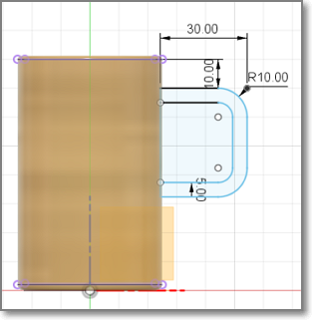
Tip 2:
Create the handle on the mid-plane.
Project the mug onto the plane to get the intersect points.

Slide 9
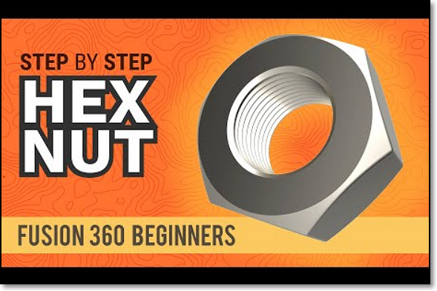
Exercise 2: How to model a Hex Nut
This is Kevin Kennedy’s video tutorial on the modelling of a hex nut: https://youtu.be/Xho87HJ-XDo
A useful tutorial should you need to create odd-sized fasteners.

Slide 10
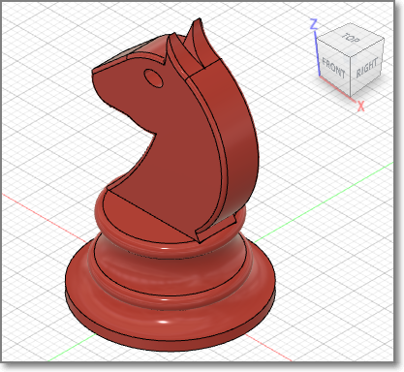
Exercise 3: Chess piece - Knight
Design a Knight chess piece:
Base: 30mm
Height: 50mm
Head thickness: 5mm
Use a template for the head
The base should be hollow

Slide 11
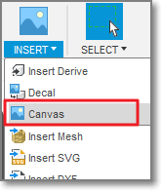
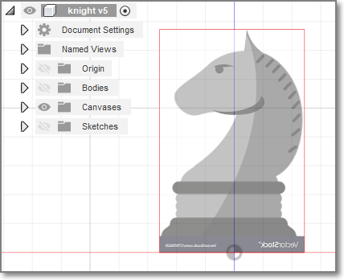
Tip: Use a canvas
Let’s cheat and use a template (do a Google search)
Insert > Canvas
Adjust transparency
Adjust position
Create Sketch
Draw the profile
Switch off canvas

Slide 12
When you have finished…
Embed your Fusion 360 file in your web page
Ref:
Fusion 360 How to embed a viewer of a Fusion 360 design into a website
EP1000 Assignment: 3D Modelling
Include this exercise in your documentation, including the steps taken

Slide 13
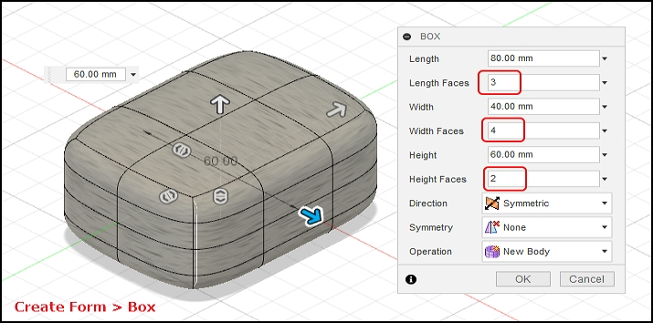
Sculpting
Use a basic 3D shape, break up the shape, manipulate each part.
Like playing with plasticine

Slide 14
Sculpting
Product Design Online Tutorials:
How to sculpt an Earbud
Sculpting for plastics parts: Part 1, Part 2
Good for creating objects with no definite shapes
Time consuming
Great Effects

Slide 15
EP1000
3D Models - 2
End

