Slide 1
EP1000
Final Presentation Assignment

Slide 2
Schedule
Typical Schedule
Week 13~15 | Integration of Project Final construction Write-up | Final laser cutting
Week 15~16 | Complete: - Presentation slide - 1 minute video - Ownership card Write-up on project Complete updates on site | Ownership card template is available. Used to “show-off” your project in the gallery.
Week 16 | Last date for website documentation updates
Week 16 + 1 | Physical Presentation | Refer to booking table

Slide 3
Project Integration
Complete construction of your project
Do minor touch-ups using glue, hand-drill
Remember to include a Power socket
Convert microcontroller board from Uno to Nano (ref: Arduino UNO moving to Nano shows how to transfer your project from the UNO to the Nano board.)

Slide 4
Power & Wiring
Use a DC Power Socket (Ref : DC Female Power Jack)
Color code your wires for better visibility
RED (Vcc)
BLACK (Gnd)
Use a multi-meter to check connectivity, voltages (Ref: The Best Multimeter Tutorial)
Use multi-core flexible wires, check the thickness of the wire
Solder your connections (Ref: Soldering Crash Course)
Be tidy (Ref: Breadboarding tips)

Slide 5
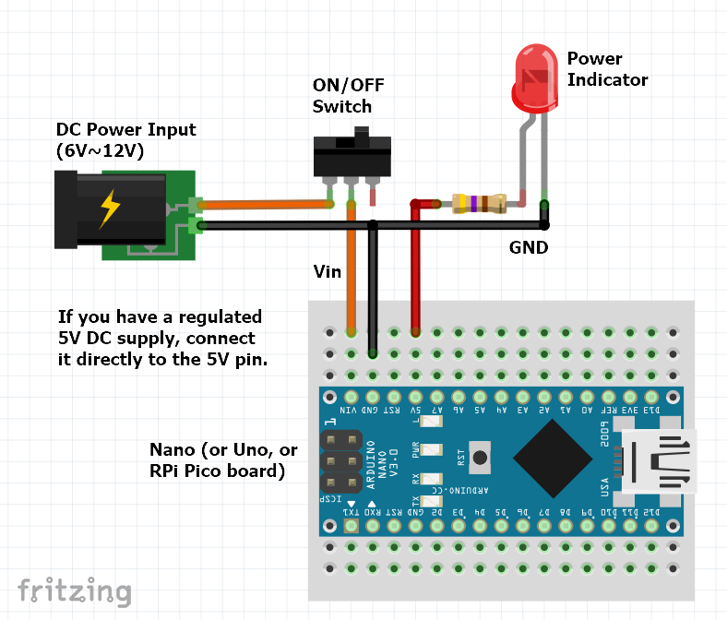
DC Power Supply
You need to include
DC Power Supply (either external or battery)
An OFF/ON Switch
Power indicator

Slide 6
Final connections
Power sockets, push-buttons, external connections
Hand-drill holes
Use hot-glue to mount loose connections
Try to keep your wiring tidy
Leave one side open for “fixes”
Use tape to secure (temporarily) and note changes in your documentation

Slide 7
Documentation
Documentation accounts for 40% of the marks (added up in all the sections)
Include your RAW files
.f3d designs, .dxf, .svg (no need for .STL)
.ino, .cpp and code
Show the machine settings you use
Balance the photos and text
Keep your images to 1024 x 768
You need descriptive text
Explain how you built your project.

Slide 8
CA3 Summative Project
SNo | Description | Weightage
1 | 3D Printing | 15%
2 | Computer Controlled Cutting | 15%
3 | Embedded Systems (with Input/Output) | 15%
4 | Integration | 20%
5 | Presentation | 15%
6 | Documentation | 15%
7 | Innovation, Expertise, Work done | 10%
 | Total | 105
Note: You can score a maximum of 100 marks out of 105. The 5 marks are bonus marks which may be gained in any section

Slide 9
CA3 Breakdown
3D Printing, Computer Controlled Cutting requires
RAW Design files (5%)
Implementation – settings, how you cut etc (5%)
Documentation on the process (5%)
Embedded systems
Requires use of a microcontroller, preferably Nano (5%)
Uses at least 1 input device (5%)
Uses at least 1 output device (5%)

Slide 10
CA3 Breakdown 2
Integration (15%)
How well you fit your project together
Power, Wiring, Placement & Organisation
Presentation (20%)
Presentation Slide (5%), Video (5%)
Oral Presentation (10%)
Documentation (15%)
Instructions & How-to, Readability, Use of images
Innovation, Expertise (10%)
Show us that you have learnt and done something well!

Slide 11
Final Presentation 1
Presentation Slide
Single slide showing your project
Must include:
Title of your project
Your Name, Course, Course Code: EP1000
It’s purpose and how you achieve it
Any interesting features
Format: .PNG file 1920x1080 pixels.
Presentation Video
Approx. 1 minute video (in landscape mode) on what your project does, how it works/operates, how you created it
Follow the links for an example

Slide 12
Final Presentation 2
Registration site (link to be provided later)
Register for your presentation date/time-slot
Upload your presentation slide (.png), rename it to {name}.png
Upload your video (or provide a link to YouTube)
Upload your Project Owner Card
Be present at least 15 minutes earlier
Bring and prepare your project for demonstration

Slide 13
EP1000
Final Presentation
End

Slide 14
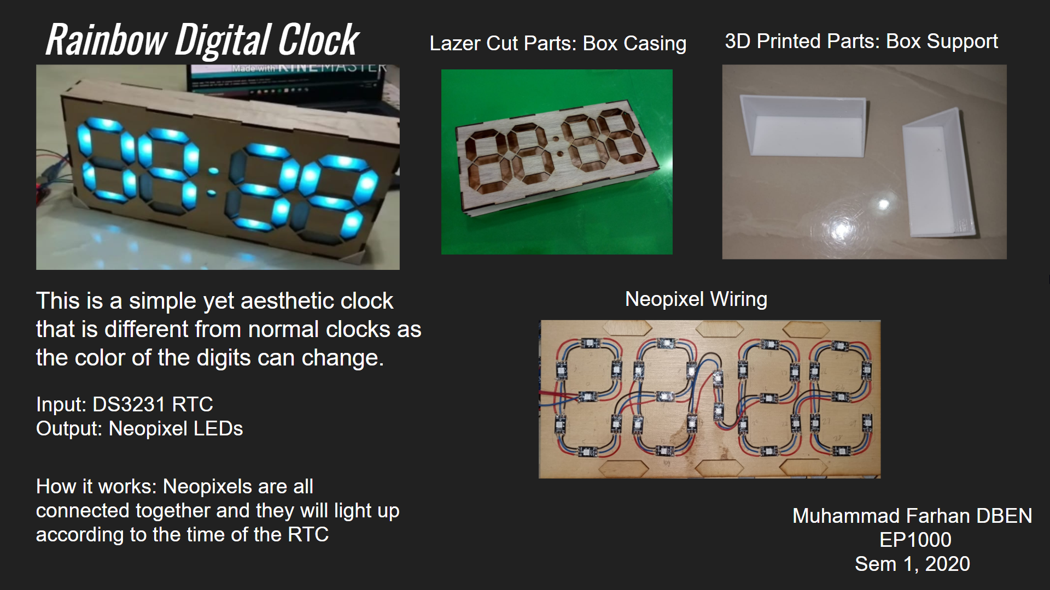
1920 pixels
1080 pixels
MUST include
Title of your project
Your Name, Course,
EP1000, Year/Sem
It’s purpose and how you achieve it
Any interesting features
Saved as a .PNG file (e.g. MFarhan_presentation.png)
Size 1920x1080 pixels

Slide 15

Sample Video
YouTube: Rainbow Digital Clock

