Slide 1
EP1000
Actuators

Slide 2
Actuators
A component of a machine that moves/controls a mechanism in a system.
An “output” device.
Examples:
Displays – LED, LCD, Neopixels
Motors – DC Motors, Stepper Motors, Servo Motors
Valves – Water, gas
Solenoids – controls heavier voltages, currents
Sounds – buzzers, alarms

Slide 3
Display devices
The most common output display devices used in projcects are:
LEDs (indicators)
LCD (display panels, information) 16x2, 20x2
7-segment tube displays
Dot-matrix displays (running messages)
Oled displays
NeoPixels (strip lights, multi RGB leds)

Slide 4
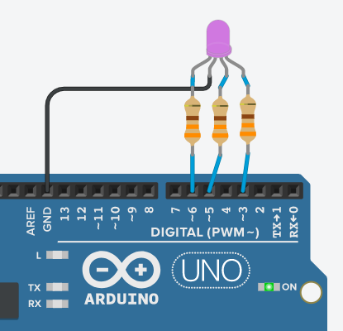
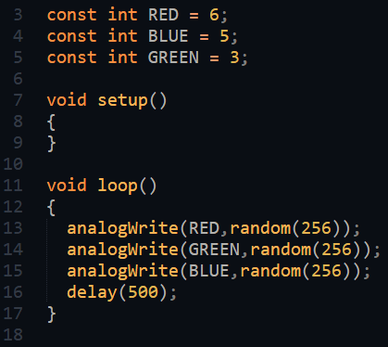
LEDs
Types: single, RGB, 7-segment
Identify the Anode (or Cathode)
Ensure there is proper current limiting resistors
You need a delay to maintain the display (persistence of vision)
You can use PWM to obtain different intensity levels.
Uno Random RGB Led using PWM

Slide 5
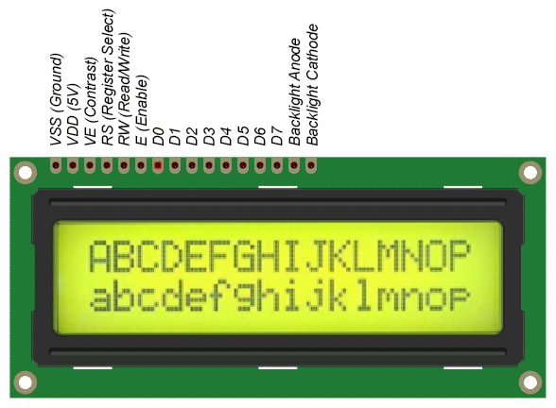
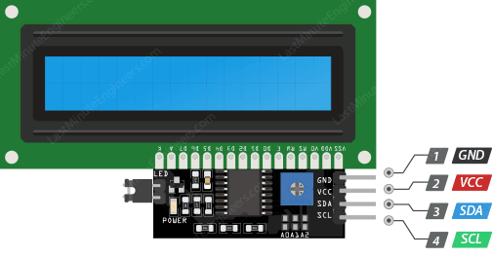
LCD Displays
Common method of displaying information
Usually Hitachi HD44780 control requires 11 lines (8 data, RS, RW, En)
Made simpler using an I2C 1602 controller for the LCD panel
Library: LiquidCrystal I2C by Frank de Brabander.
Reference: LastMinuteEngineers

Slide 6
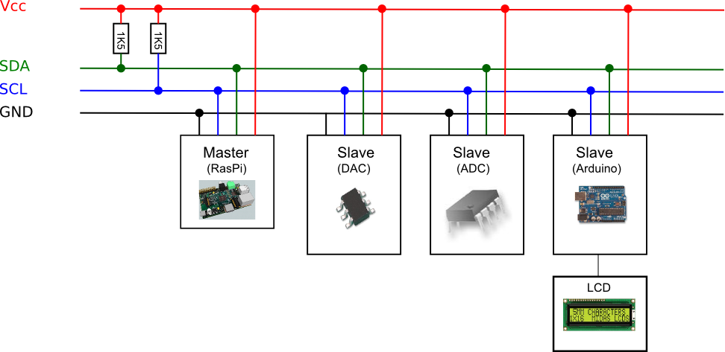
I2C Interface
A method of Serial communication.
Uses 2 wires (SDA, SCL) to communicate between devices.
Each device has a unique address which identifies it.
Can have up to 1024 devices
Ref: How To Mechantronics How I2C Communication Works and How to use it with Arduino

Slide 7
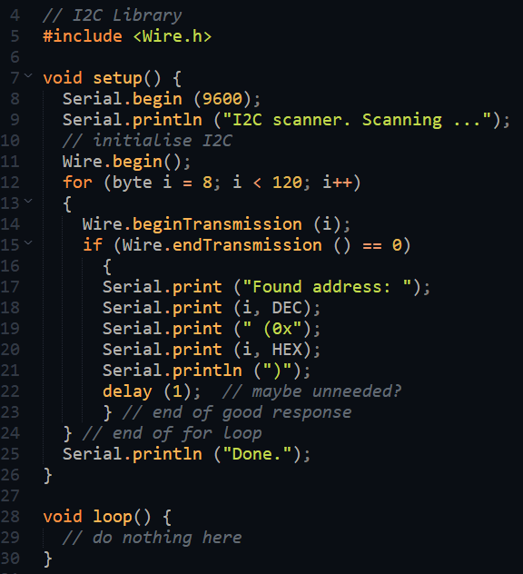
Identifying I2c devices
Use the controller (master) to scan the bus for devices (slaves).
The addresses will be printed out on the Serial Monitor.
You can then use the address to write/read from the device.
Library: Arduino Wire Library
Example code is usually provided by the device library.

Slide 8
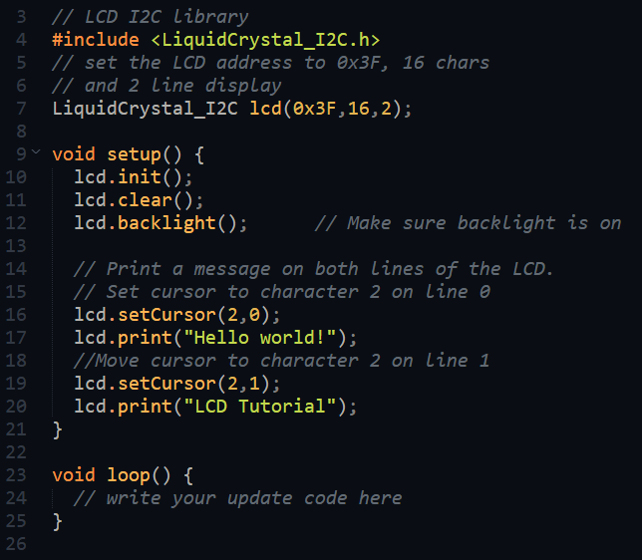
Writing to I2C LCD display
Using the LiquidCrystal_I2C library.
Create the object lcd
Initial housekeeping
Initialise
Clear the screen
Turn on backlight
To print messages
Position the cursor
Print the message

Slide 9
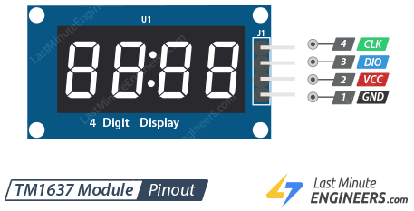
Tube 7-Segment Display TM1637
7-segment displays common in projects
Having multiple 7-segments require conversion and multiplexing
TM1637 provides 4-digit 7-segment display with only 2 digital I/O lines.
Library: TM1637-master by Avishay Orpaz.
Tutorial:
Last Minute Engineers
Makerguides
Other versions have 6~8 digits
Simplifies circuitry

Slide 10
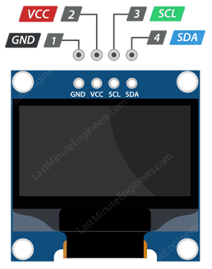
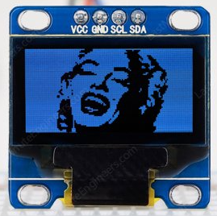
Oled Displays SSD1306
Very small, graphic displays (30x20mm)
Getting popular, for IOT projects for information display.
Resolution: 128x128, 128x64, 128x32 pixels
Uses I2C interface
Library: SSD1306 by Adafruit
Tutorials:
Last Minute Engineers
Adafruit

Slide 11
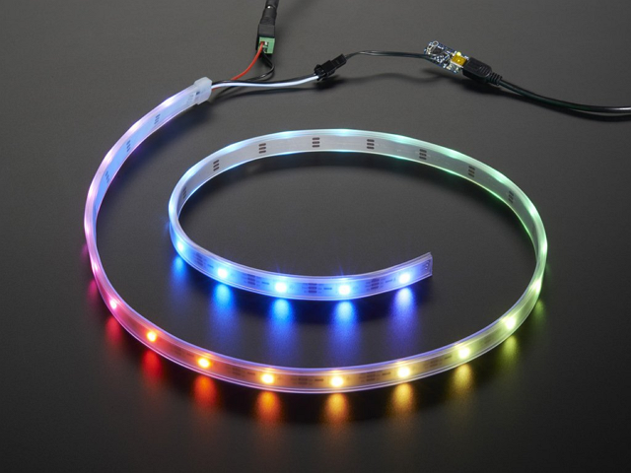
NeoPixels
Individually addressable LEDs housed on a strip and controlled by a single digital I/O pin from the microcontroller.
Can control
Which LED to turn ON/OFF
Intensity of light
Color (If RGB)
Good for lighting, ambient light control, effects
Library: Adafruit Neopixel
Tutorial:
Adafruit
Neopixels require quite a lot of current. Always supply the neopixels from a separate power source, not from the microcontroller.

Slide 12
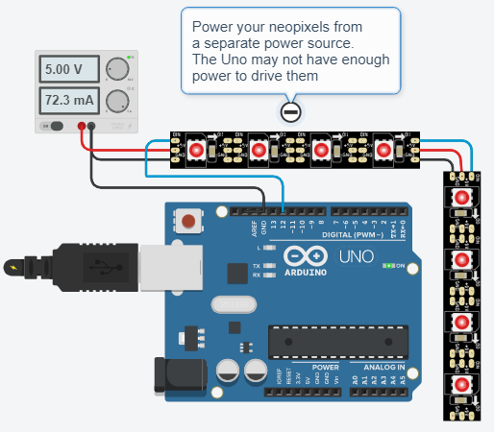
Neopixels - demo
Always power up neopixels using a separate power source for the extra current required.
You can join strips of neopixels together.
Adafruit Library comes with a number of very useful methods:
Color(r, g, b) returns a 32bit color
fill() fills neopixels with same color
setColor() sets individual neopixels
setBrightness() controls intensity
clear() blanks out
show() must be called before the neoplxels can display
Uno Neopixel Strip

Slide 13
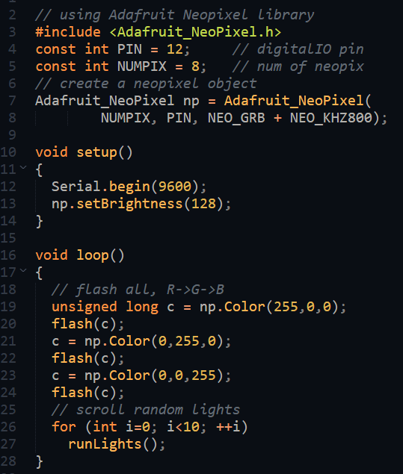
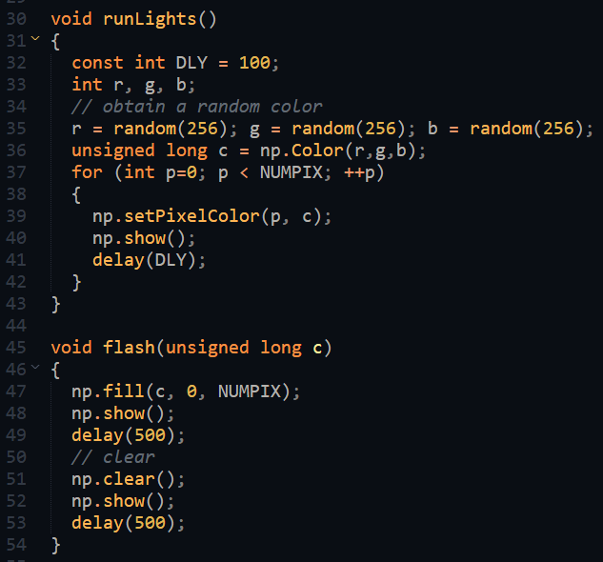
Neopixels – demo code
uint32_t = unsigned long = 32bit
uint16_t = unsigned int = 16 bit

Slide 14
Motors
Motors
AC
DC
DC Motors require a DC current to work.
DC motors are usually continuously rotating. Can control speed and direction
Stepper motors can move in ‘steps’. Usually done using a controller module, or by changing phase activation.
Servo motors can be controlled to move, stop/hold, change direction using pulses.
Motors consume a lot of current, hence requires an interface circuit. Should not be driven from a digital IO pin.
continuous
stepper
servo
rotational
positional

Slide 15
DC Motor control
Use a digital IO pin to control a transistor (Q). Transistor acts like a “tap”
Qon allows current to flow, which makes motor move.
Qoff turns off the current.
Using PWM to control the On/OFF sequence allows control in motor speed.
PWM at low speeds do not provide much torque.

Slide 16
EP1000
Actuators
End

