Slide 1
EP1000
3D Models

Slide 2
Essential Tools in Fusion 360
From Autodesk Training
Introduction to Fusion 360
User Interface Overview
Open, close, export, upload, and save designs
Set Preferences
Adjust Display settings
Use the Marking Menu
Use the Toolbox
Create A Project
Open a Design created in another CAD system
Components and Bodies
Parametric vs. direct modeling
Working with Design versions
Sketch Constraints

Slide 3
Fast Track for Engineers
Kevin Kennedy Product Design Online
Recommended: Learn Fusion 360 in 30 days
Highlighted Topics
Navigating the Fusion 360 User Interface (sections explained) - REVISED 2019
Default settings for Fusion 360
How to Manually Add Sketch Constraints - Learn Autodesk Fusion 360 in 30 Days: Day #16
How to Create text in Fusion 360
How and Why to Fully Constrain Your Sketches

Slide 4
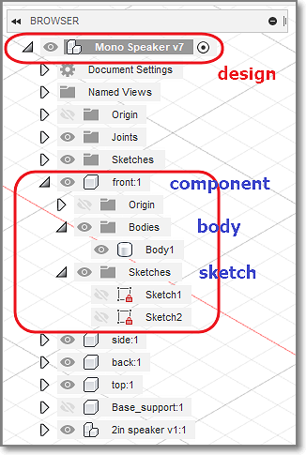
Fusion 360 Building Blocks
Sketch
Created in a 2D plane
Sketches should be constrained and closed
Forms the building block of all models
Body
Usually created from a sketch(s)
Is a SOLID
Can combine to form other bodies
Component
Made up of bodies and sketches
Usually "joined" or "combined“
Can be used to form other components

Slide 5
Constraints
Why constrain a sketch?
A constrained sketch cannot be changed (accidentally).
Each segment is locked by a dimension or a constraint.
Constrained segments are drawn in BLACK
Kevin Kennedy: How and Why to Fully Constrain Your Sketches

Slide 6
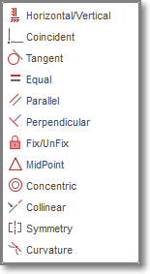
Types Of Constraints
Dimension
Horizontal, Vertical
Coincident (constrains a point to another point, line, arc, or curve.)
Tangent
Equal
Parallel
Perpendicular
Fix / UnFix
MidPoint
Concentric
Colinear ( constrains a line to another line, so that both lines fall onto the same line)
Symmetry
Curvature

Slide 7
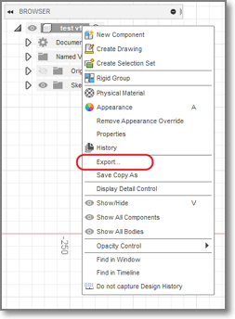
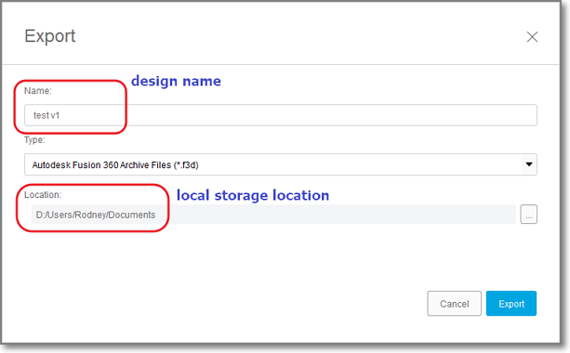
Saving Designs
Fusion 360 saves all files into the cloud
You can share your files within the cloud
You can export your design file to the local storage using export.
Output format is .f3d

Slide 8
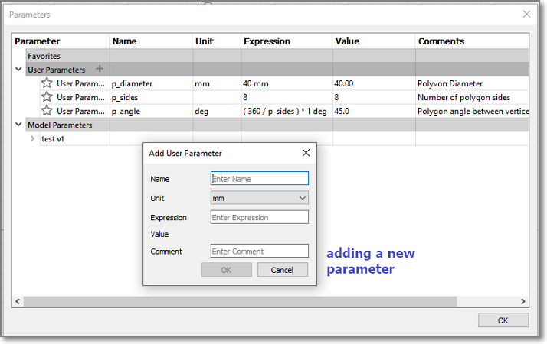
Parametric Design
Enter variables as parameters
Use parameters in your design
Design becomes very flexible

Slide 9
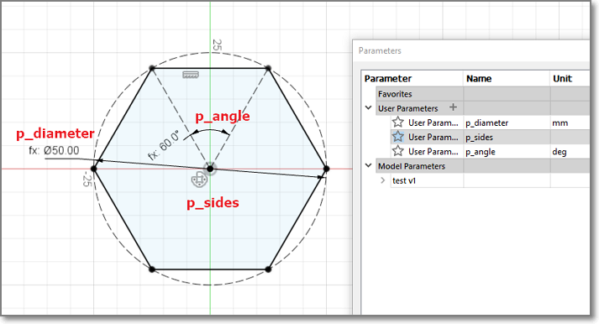
E.g. Parametric Polygon
A fully configurable polygon with parametric sides and size.
Try changing the parameters

Slide 10
Methods of Creating 3D Models
Extrusion
Use a 2D plane profile
Extend into the 3rd plane
Rotation
Use a 2D plane profile
Rotate the plane around an axis
Sculpting
Start with a 3D object
Add, remove 3D objects
Subdivide the surface into sections
Push, pull, extend, contract sections

Slide 11
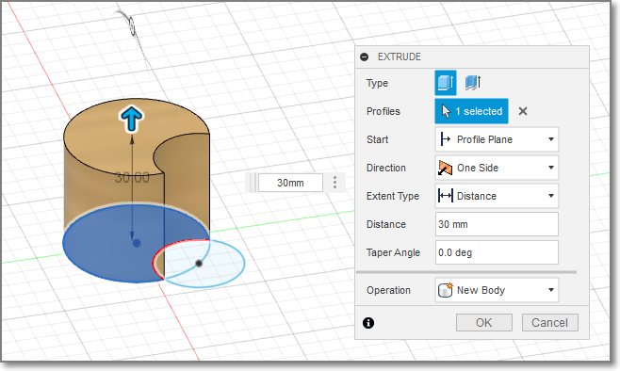
Extrusion
Start with a 2D closed profile in plane
Stop Sketch
Create > Extrude in 3rd axis

Slide 12
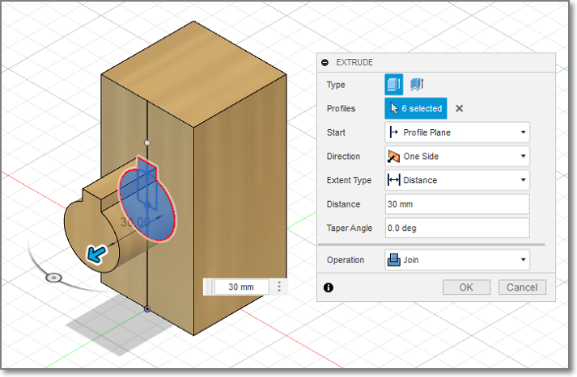
Extrude – Join / New Body
You can build new bodies by adding/creating the original.

Slide 13
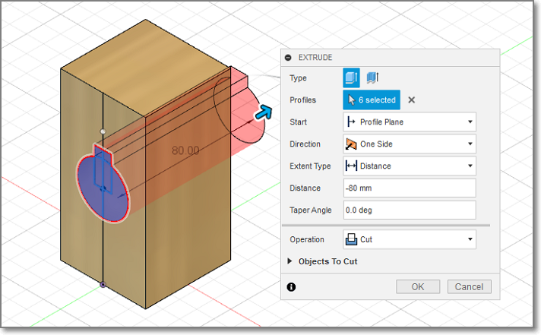
Extrude – Cut
You can cut holes using subtraction to the original..

Slide 14
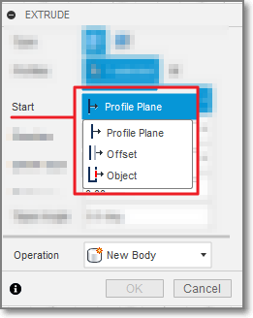
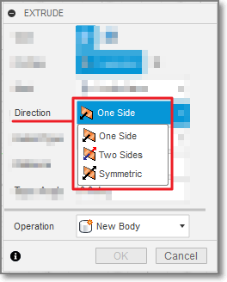
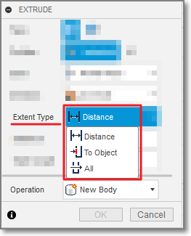
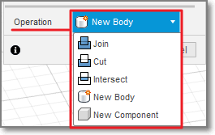
Extrude - options
Start
Direction
Extent Type
Operation

Slide 15
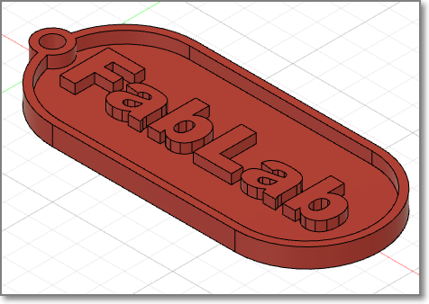
Exercise 1: Name Tag
Let's make a name tag
dimensions: 30mm x 70mm x 4 mm
rim of 1.5mm thickness around the edges, height 2.5mm
key-ring hole of 4mm, re-enforced with 1.5mm rim
name or design/pattern 0.5mm below surface
base of name tag 1.5mm thick

Slide 16
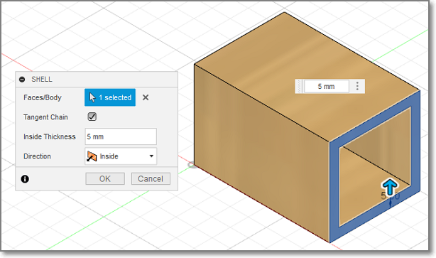
Modify > Shell
Makes a shell of the solid object
Starts with the face that was selected
The shell thickness must be specified

Slide 17
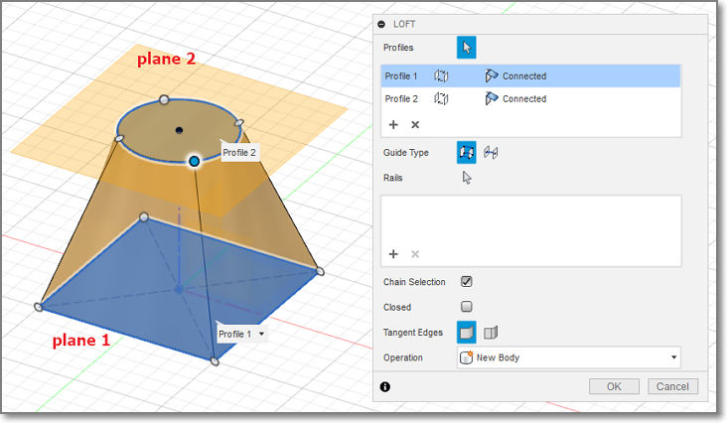
Create > Loft
Create a solid object from profiles on different planes

Slide 18
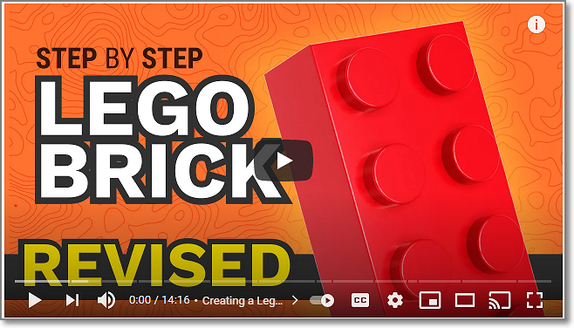
Exercise 2: A Lego brick
This is Kevin Kennedy’s video tutorial on the drawing of a Lego brick. https://youtu.be/6yPKMSb6ja8

Slide 19
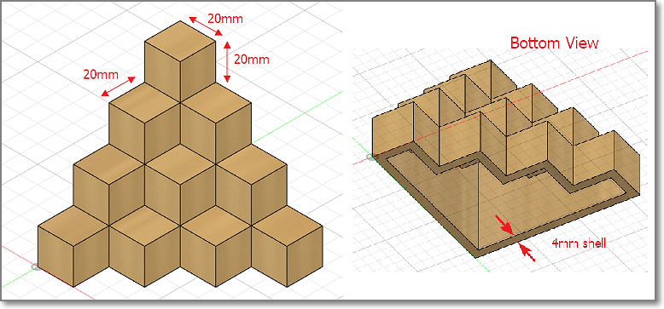
Exercise 3: Extrudes & Planes
This object is made up of 20 cubes (20mm) glued together and then shelled to a thickness of 4mm

Slide 20
EP1000
3D Models
End

