Slide 1
EP1000
Digital Fabrication Prototyping Fundamentals Introduction

Slide 2
Presented by:
Rodney Dorville (FablabSP)
Course Site: https://rdorville.github.io/ep1000digfab
Contact | Details
Email | Rodney_Dorville@sp.edu.sg
Telegram Messenger | @RodneyD_SG
Office Tel: | 6772-1451

Slide 3
Digital Fabrication
Learn how to use Digital Fabrication techniques in
Computer Aided Design
3D printing processes
Laser Cutting
Embedded controllers - sensing & actuation
Covert your design into a working prototype
Integrate technologies
Document and present your prototype.

Slide 4
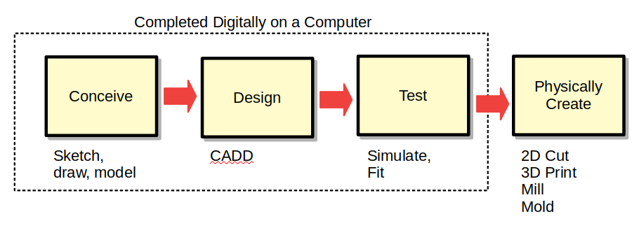
Definition
Digital modeling and fabrication is a design and production process that uses digital information as its source. (Ref: WikiPedia)
Digital Fabrication allows you to build your object/idea on a computer and spending minimal time as well as expertise in creating the physical object on the actual machine.
Workflow

Slide 5

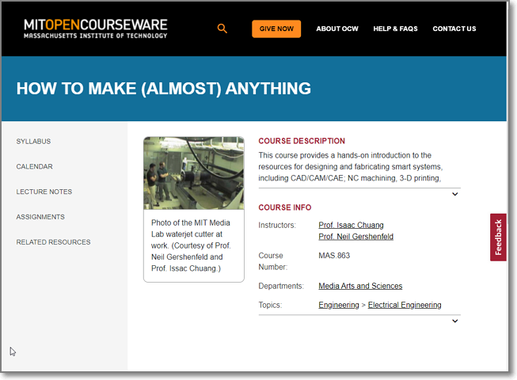
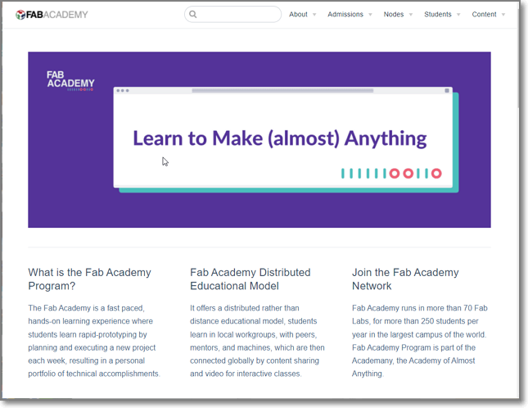
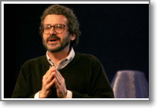
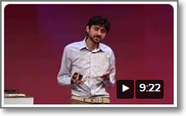
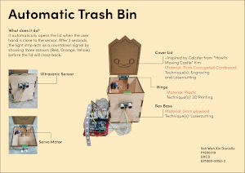
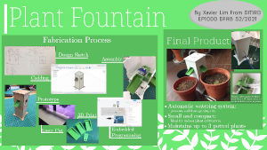
Commercial Break!
Fab Foundation
MIT: How to Make
FabAcademy
Prof. Neil Gershenfeld
Manu Prakash

Slide 6
Assessment
Course Assessment
Assessment Method
Documentation
Skill Certifications (Safety, 3D Printing, Laser Cutting)
Skill Assignments (mini-practical projects)
Module Project
Sn | Code | Description | Score
1 | CA1 | Safety, Documentation, Web site | 20%
2 | CA2 | Digital Fabrication Skills | 40%
3 | CA3 | Summative Project | 40%

Slide 7
Course Schedule 22/23 Sem 1
Week | Date | Topic | Comments
1 | 18 Apr | Introduction, Fablab Safety, Tools, Documentation, HTML | Safety Assessment
2 | 25 Apr | HTML & CSS, Website, Github Pages, Version Control, Markdown | Jake Wright's Example, Github account
3 | 02 May | Computer Graphics - Raster, Vector Fusion 360, 2D-CADD | Public Holiday Selfie, Logo, Basic F360
4 | 09 May | 3D Modelling techniques 3D Printing Process | Extrusion, Rotations, 3D-Model, 3D Print Knight
5 | 16 May | Box creation, 3D Model tools Laser Cutting | Public Holiday Laser Cutting - Name tag
6 | 23 May | Fablab Certifications - 3D Printing, Laser Cutting | Certifications, 3D & Laser cutting practical
7 | 30 May | 3D Printed Knight piece Music Box Mini-project | Mid-Semester Test Project work
8,9,10 | 06 June | Term Break (3 weeks)

Slide 8
Course Schedule 22/23 Sem 1
Week | Date | Topic | Comments
11 | 27 June | Basic Electronics Arduino System | Breadboarding, soldering, simulation, TinkerCAD, Uno
12 | 04 July | Basic Arduino Programming Simple Input/Output | Simulation – Uno, Switch & LED interfacing
13 | 11 July | Input Devices Switches, Ultrasonic, Sensors | Public Holiday Ultrasonic, DHT-11
14 | 18 July | Output Devices Displays, LCD, Neopixel, Motor control | Output programming, LCD, Neopixel, Servo, Stepper
15 | 25 July | Project Week 1 Conception, Design | Design, cardboard prototype, materials, components
16 | 01 Aug | Project Week 2 Physical cutting, fabrication | Physical cutting and fabrication
17 | 08 Aug | Project Week 3 Electronics, Microcontroller integration | Soldering, testing, fitting, integration
18 | 15 Aug | Project Week 4 Documentation, Testing | Site, Presentation, 1-minute Video
19 | 22 Aug | Exam Week - Presentations

Slide 9
Extra benefits…
Besides your grades …
Fablab Safety
3D Printing Certification
Laser Cutting Certification
Usage of Fablab, equipment, materials outside of course hours
Life-long skills in “making”

Slide 10
EP1000
Introduction
End

