Slide 1
EP1000
Fab Lab Safety

Slide 2
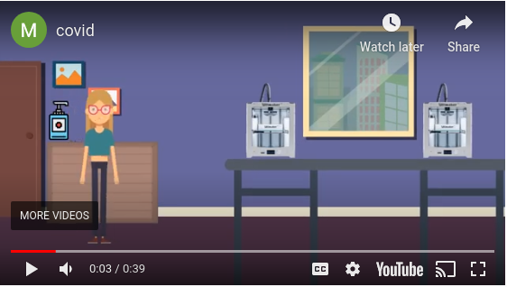
Safety During COVID-19
Safety Issues to be observed during this period.
COVID-19 Latest Information from MOH about coronavirus

Slide 3
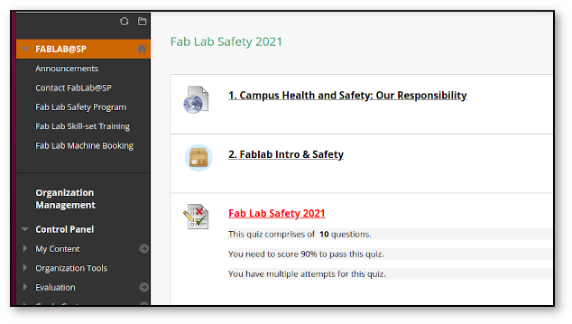
Safety Assessment 2021
You need to complete ALL components
SP ESP > My Community > Fablab@SP > Fab Lab Safety 2021

Slide 4
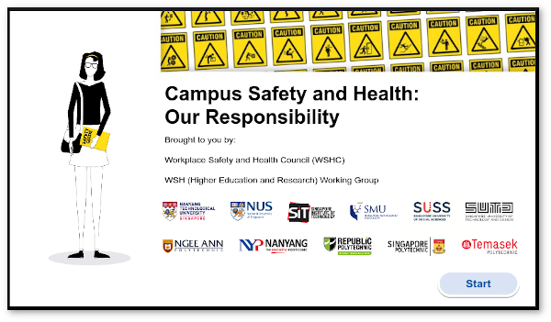
Campus Safety and Health: Our Responsibility
Good to review at least ONCE a semster.

Slide 5
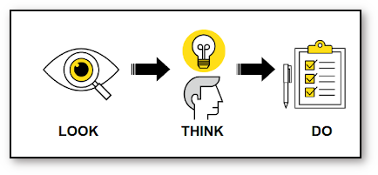
Fab Lab Safety
Your well-being is the MOST important issue in the lab.
We want to create an efficient, productive and safe environment for you to work in.
Look - Think - Do !
More information:
ESP > My Community > Fablab SP > Safety

Slide 6
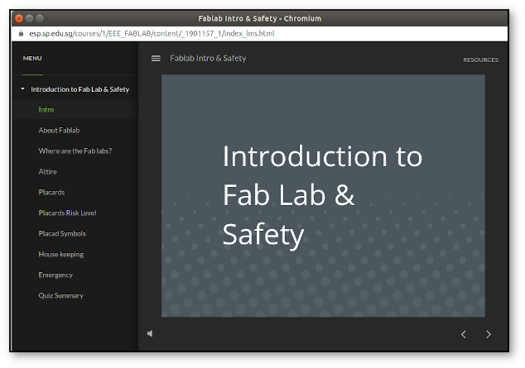
Fab Lab Safety
Looks specifically at safety in SP's Fab Labs

Slide 7
Assessment
You will now complete the Safety Assessment by
Completing the Polytechnic Workplace Safety & Health assessment
Read and understand Fab Lab Singapore Polytechnic Safety Notes
Complete the Safety Assessment under supervision.
Inform your supervisor once you have successfully completed the assessment.
This assessment will contribute 5% to your overall score for this module.

Slide 8
EP1000
Fab Lab Safety
End

