Slide 1
EP1000
CSS

Slide 2
(more) HTML
Before we can get to CSS, we need to cover a little more about HTML
Review
HTML is for CONTENT
CSS is for LAYOUT
Often we “break-up” a page into sections (<div>, <section>)
Easier management
Can generate a template for consistent use
Duplicate pages, changing only relevant sections.

Slide 3
The <head> Element
the HTML <head> element is a container for
<title>
<link>
<style>
<script>
<meta>
contains metadata (data about the HTML document)
Metadata is not displayed.

Slide 4
The <head> Element (cont’d)
<title>
text which is displayed on the browser's bar or page's tab
required in HTML documents
purpose
defines a title in the browser's toolbar
provides a title for the page when added to favourites
displays a title for page in search engine results.
<link>
defines the relationship between current document and an external resource.
most often used to link external style sheets

Slide 5
The <head> Element (cont’d)
<style>
used to define style information for a SINGLE HTML page.
<script>
used to define client-side Javascripts
<meta>
used to provide information about the page.
used by browser to decide how to reload/render the page
used by search engines to define keywords and content

Slide 6
Block and Inline
Block-level Elements
Starts on a new line
Takes up full width available
Has top and bottom margin
Example
<div> used as a container
Inline Elements
Does not start on a new line
Takes up as much space as necessary
cannot contain a block-level element
Example:
<span> used to mark up a block of text

Slide 7
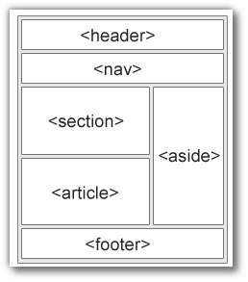
Layout Elements and Techniques
uses a kind-of <div>
(Semantic elements) that define the different parts of a web page
header
nav
section
article
aside
footer
Clearly describes its meaning to both the browser and developer
Layout techniques:
CSS framework
CSS float property
CSS flexbox
CSS grid

Slide 8
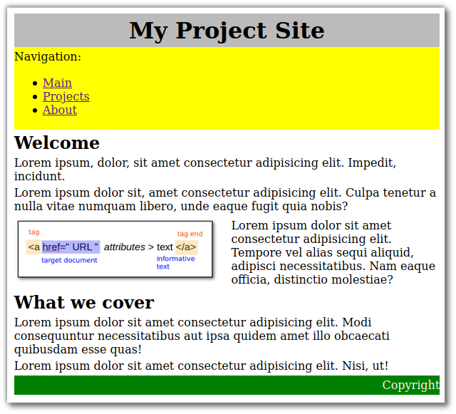
Typical Project Page
Can you break down the blocks?
Can you name them?
How about the layout?

Slide 9
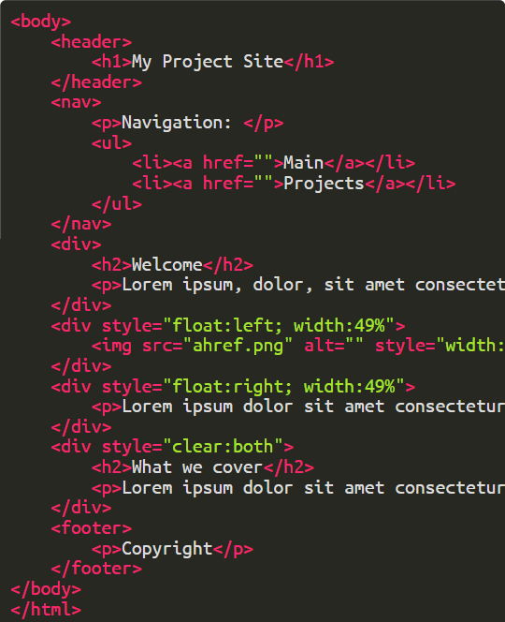
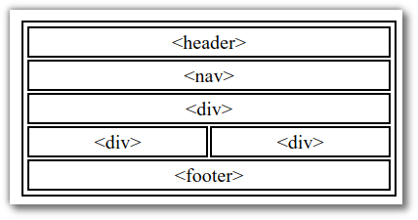
Typical Page Breakdown

Slide 10
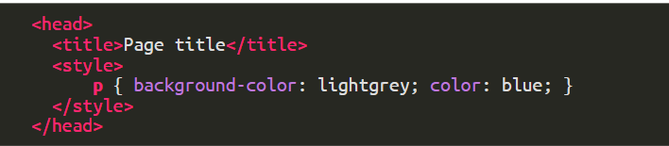
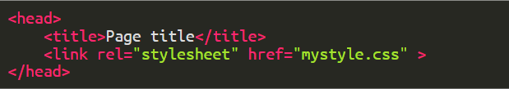
Cascading Style Sheets (CSS)
Describes how HTML elements are to be displayed.
Controls LAYOUT
INLINE
within HTML file <head>
In an external CSS file (recommended)

Slide 11
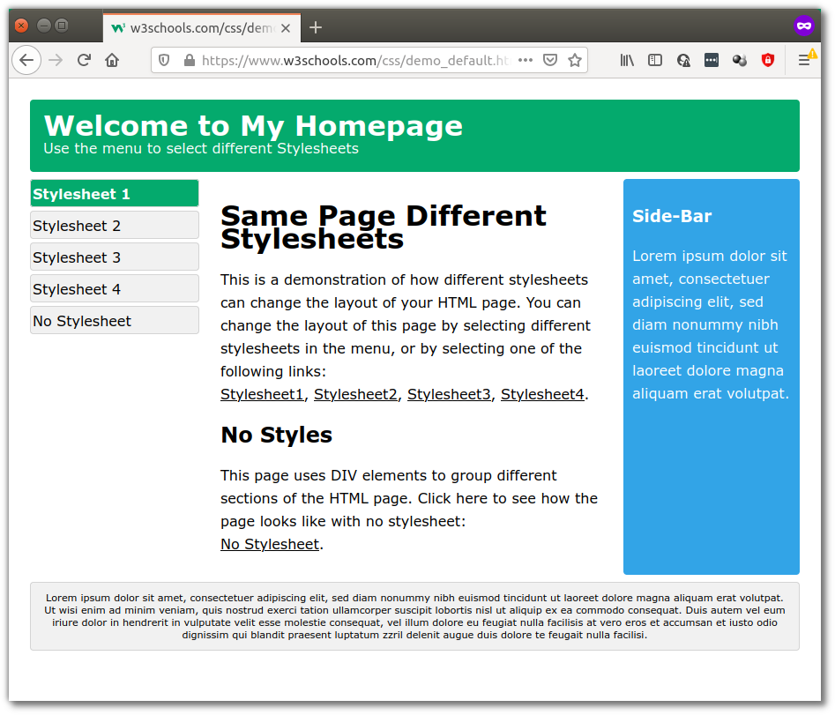
One HTML Multiple Styles
Example: W3Schools One HTML Page - Multiple Styles

Slide 12
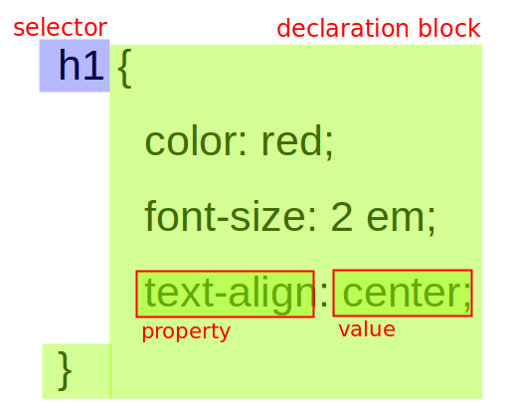
CSS Rule Syntax
A CSS Rule consists of
a selector which identifies the HTML element
a declaration block which holds the formatting
Selector points to the HTML element to style
Declaration defines how to format it using
a property
a separator (colon (:))
value for that property
each declaration is separated by a semi-colon (;)
you can have many declarations in a block
you can have many CSS rules in a file.
All selected elements on the page will be formatted

Slide 13

CSS Selectors
Selectors are used to "find" the HTML element you want to style
element Selector
Selects the HTML element based on the element name.
Affects all elements on the page

Slide 14
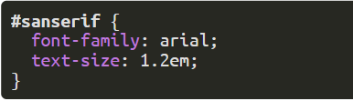
CSS Selectors - id
id Selector
Uses the id attribute of an HTML element
Unique within a page, should be used only once
To select the specific id, write a hash (#) followed by the id
with

Slide 15
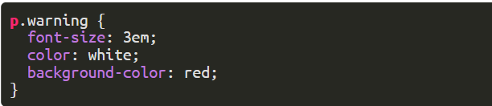
CSS Selectors - class
Selects HTML elements with a specific class attribute
There may be more than one occurrence of this class
To select elements with a specific class, write a period (.), followed by the class name. with
CSS Class vs ID: Which One To Use

Slide 16
Worked Example
We start learning CSS with a page which has some content.
The structure of the page is shown on the right.
We will look into formatting the page.
You can download a copy of the site ep1000_htmlcss.zip content (as a compressed file), if you want to work along with us.
Only the HTML file is included, you need to create the stylesheet.

Slide 17
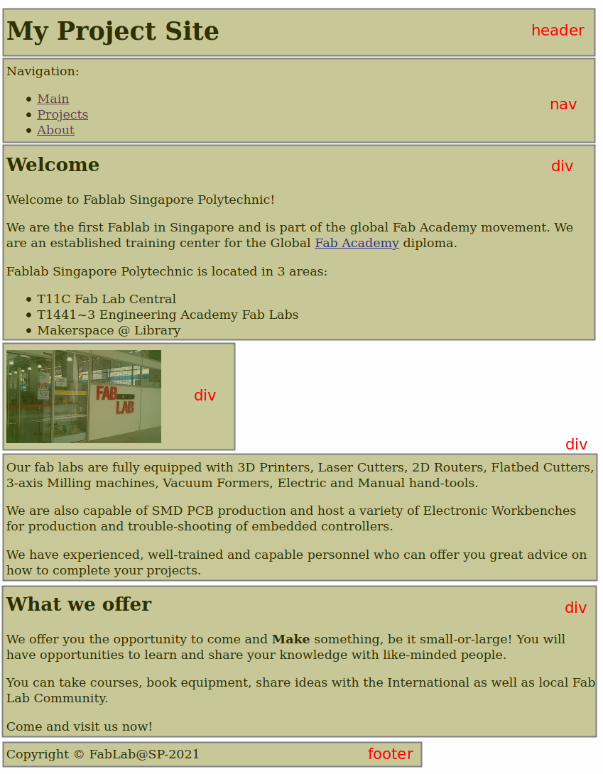
HTML Content Blocks

Slide 18
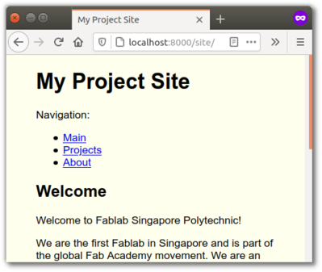
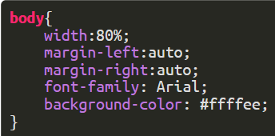
Centering the page
Before we start let's centre the entire page
have the content cover only 80% of the window
centre the contents
change all fonts to Arial
change the background color

Slide 19
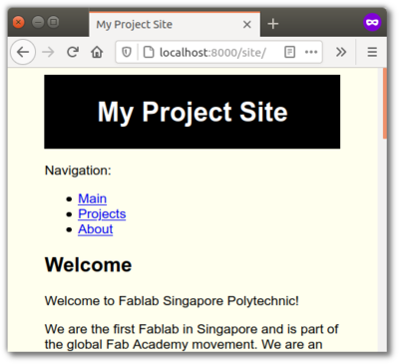
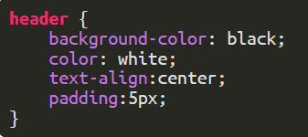
Changing the Header title
Let's make the header a bit more prominent
inverse the colours
centre the heading text
add some spacing

Slide 20

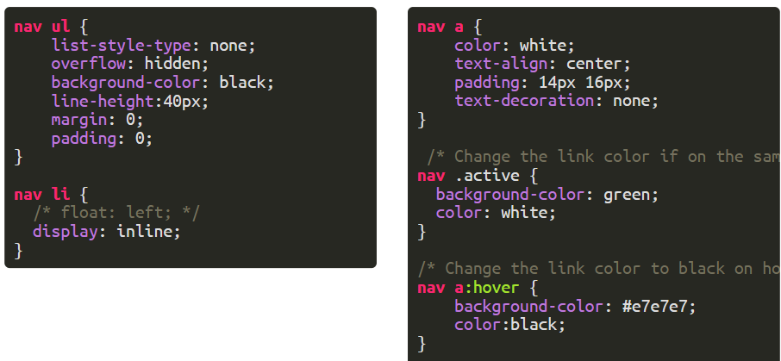
Navigation Bar
Examples from W3 Schools, horizontal nav bar

Slide 21
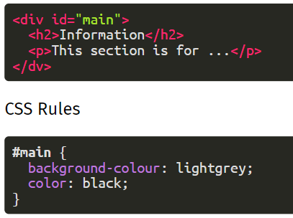
<div> sections
use "id" or class" to designate them
create CSS rules for each id, class

Slide 22
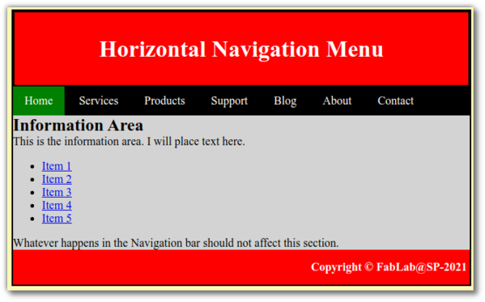
Tip
It's easier to work with blocks, work on each block-at-a-time.
Use bright colours, borders to designate areas
Get/Use ideas from other templates
Use Firefox/Chrome Developer Tools to troubleshoot
Firefox F12 key 14 Firefox Developer Tools
Chrome F12 key Tutorial for Beginners

Slide 23
Worked Tutorial
Jake Wright - Learn CSS in 12 minutes
shows the creation of a site content (not much)
shows how an effective layout can be planned
shows creation of a simple Project Site
Task:
watch JW's video in its entirety (just watch)
use paper and pencil, follow development of structure/layout
create the content of the site
create the layout of the site
Think:
how can you add your About page to the site
how can you add project pages to the site

Slide 24
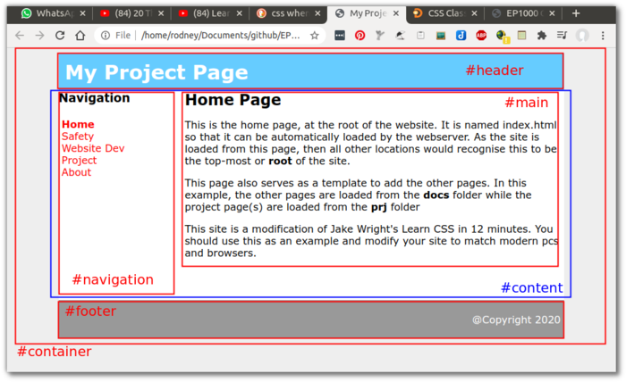
JW Layout
Jake Wright uses id (e.g. #container, #navigation) to define his rules for his page.

Slide 25
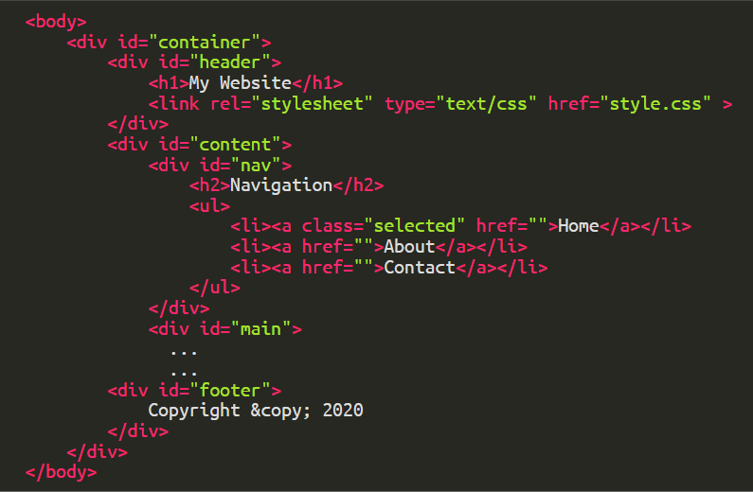
JW Content

Slide 26
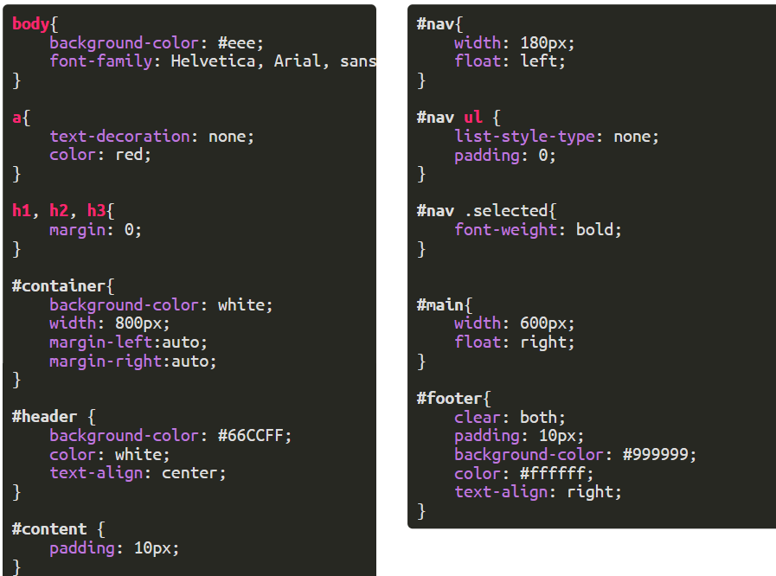
JW Layout

Slide 27
Marked Assignment (part 1)
Task
Create a Project Documentation Site using HTML and CSS
Your site must have
a Main page, explaining what this site a all about
an About page, introducing yourself. You must include some biodata, a selfie and means of contact. You should also write one or two paragraphs about yourself.
a project(s) page (minimum 2)
navigation to move from one page to the other
Project page(s)
links to projects/assignments that you have created
link to your final project
an initial page listing the tools that you have used/are using to create your website and the reasons to use them.
include the table we discussed in class.

Slide 28
Marked Assignment (part 1) cont’d
Must-haves
You will need to use the JW Site (HTML & CSS) as a base
Modify to suit modern browsers of min. width 1024 pixels.
Modify the colours and font to your liking
Have a project page showing what you have changed.
Your site needs to be self-contained within a folder, but have a structure for
Organisation of images
Projects (this must be a separate section)
On one of the project pages, show whether this is a viable method for documenting your project
Why, why-not
A simple how-to to add pages/projects
Deadline
Last week of semester (more to come)

Slide 29
Questions ?
Ask now or forever be silent…

Slide 30
EP1000
CSS
End

