Slide 1
EP1000
Documentation

Slide 2
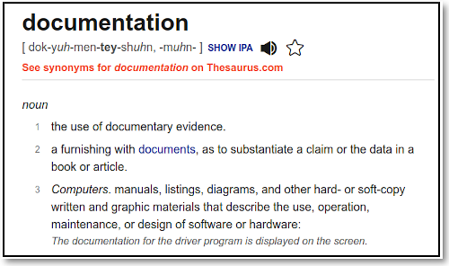
Documentation
Definition:
Ref: dictionary.com
What is documentation and its techniques?

Slide 3
Why document?
"If You Didn't Document It, It Didn't Happen"
Requirements:
Fieldwork
Training in transcribing experiences
Recording of experiences

Slide 4
Documentation Techniques
What to collect?
Written text
Images (Photos, Videos, Drawings)
Sound (Recordings)
Purpose
aim to collect information
create high quality materials
enable recovery of knowledge
generate resources on the information
Dependent on what you want to record
convenience
portability
relevance
pros and cons

Slide 5
Exercise
How would you document
what you told someone
the posting of a letter
a payment for an item
an accident
a project
Where would you put all this information?

Slide 6
Project Documentation
Requires
text descriptions
images - photos, drawings, sketches
video
audio
Best Methods
Easy to learn and use
Easily accessible, updateable
Able to store all of the above
Achiveable
Post on WWW in a shareable/archiveable location

Slide 7
Best Solution
Use PURE text
No need for special software/editors
Readable across platforms
Publish on the WWW
Use HTML – defines content
Use CSS – defines layout
Use Markdown – so simple!
Achievble / Shareable locations
github sites
gitlab sites
Why NOT use WIX ?

Slide 8
Pure Text Editors
Why not Microsoft Word / WordPad / LibreOffice ?
Word Processors
Have different formatted files with binary/inserted code
May be difficult to read cross-platform
Recommended Text Editors
Notepad++
Github Atom
Sublime Text 3
Visual Studio Code
Advantages over other text editors
Unlimited Text Length
Syntax Highlighting, Enhancements, Scripts, Snippets
Open Source/Free, Cross Platform
Windows Users should look at Portable Apps

Slide 9



How to write documentation?
Practise, practise, practise!
Document as you work
Write step-by-step as you develop
Instructables !
Make something, and document the process as you go.
Explain what you made with text, images, video, and files.
Publish your amazing project to the web.
How to Write an Instructable class - Jessieratfink

Slide 10
EP1000
Documentation
End

