Slide 1
EP1000
HTML

Slide 2
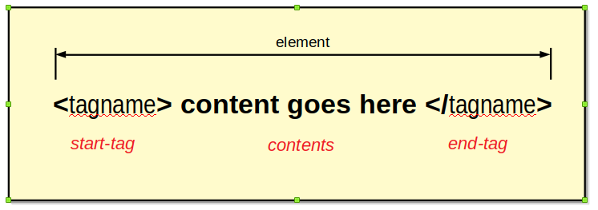
Hypertext Markup Language
HTML is the standard markup language for creating Web pages.
HTML describes the structure of a Web page
HTML consists of a series of elements
Each element has a start and end tag
Each element has content
Elements tell the browser how to display the content
HTML define CONTENT.
Ref:
W3 Schools HTML tutorial
W3 Schools HTML reference

Slide 3
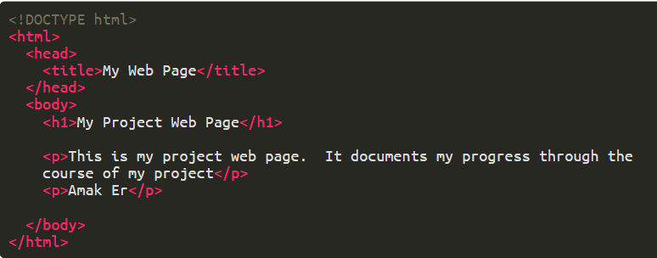
Web Page
Structure
Use a folder to hold the contents of your website.
The starting page of your website is name index.html.
All webpages have the default extension HTML
The website is uploaded to a Web Server, which hosts the pages.

Slide 4
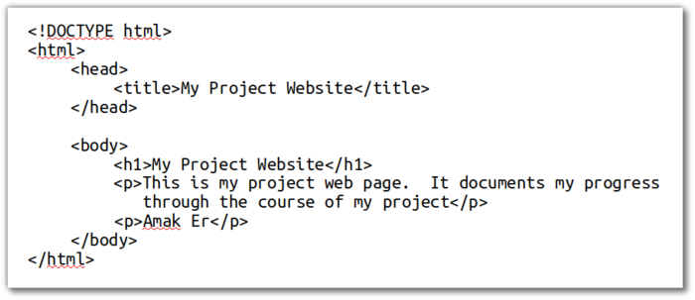
Structure
!DOCTYPE html identifies this as a HTMLv5 document.
the <html> </html> tags show the content of the page.
the content is made up of a head and a body
the head section has
a title which identifies the page
the body section, has the bulk of the content
has a heading (bold large text)
has paragraphs of text

Slide 5
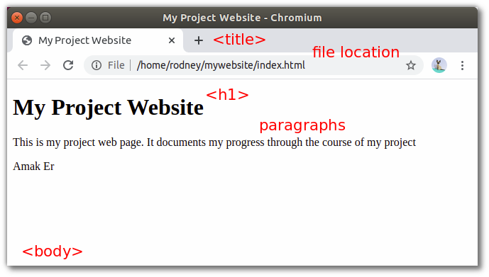
Rendered by a Browser
Drag-and-drop your file (index.html) on a browser window.
Your browser will convert (render) the contents.
This includes text, images, audio and video.

Slide 6
Build your first Website
Create a folder mywebsite
Create a file index.html within the folder.
Edit and enter the contents of a basic web-page.
Save your file and display it on the browser.
Tips (especially for Windows users)
use a Pure Text Editor (NOT notepad)
turn ON file extensions viewing in Explorer.
create a folder for your website, this is called the root folder.
the starting file must be named index.html
name all your files in lowercase
do NOT use spaces in the filenames.
keep all your files in the same folder (you can have sub-folders)
file location is relative to this root folder

Slide 7
Learning HTML
You will need to understand and know how to use BASIC HTML.
We don't expect you to be experts.
A list of what you need to learn
Elements
Attributes
Headings
Paragraphs
Style
Formatting
Colors
Comments
Images
Lists
Bookmarks
Links
Tables
Layouts

Slide 8
Headings and Paragraphs
Headings
Headings are used as titles or sub-titles on the webpage
Keep H1 as the title of the page.
Use H2 and H3 for your sub-headings/titles
Limit your headings up to 3-levels.
Paragraphs
Paragraphs are used to define text.
Paragraphs makes text appear on a new line.
White space is ignored in paragraphs.
Remember to start and end your paragraphs with the <p> tags.
special tags/characters:
&nbsp; non-breaking white space
<br> line-break
special characters: &amp; (&), &lt; (&), gt; (>), &copy; (©)
<pre> pre-formatted text

Slide 9
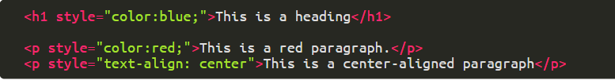
Styles
the <style> attribute is used to add styles your elements.
you can change color, font, size, and more.
we will use CSS to apply styles
Inline Styles
styles can also be applied inline (for a particular element)
however,
leads to confusing web-sites
only used as a quick-patch solution
more on styles, when we work on CSS

Slide 10
Formatting
You can format your text to emphasize what your intentions.
Here is a short list of formatting elements
<b> - Bold text
<i> - Italic text
<em> - Emphasized text
<strong> - Important text
<small> - Smaller text
<del> - Deleted text
<ins> - Inserted text
<mark> - Marked text
<sub> - Subscript text
<sup> - Superscript text
Colors
You can also manipulate the colors of your elements
More elaborate explanation can be found here

Slide 11
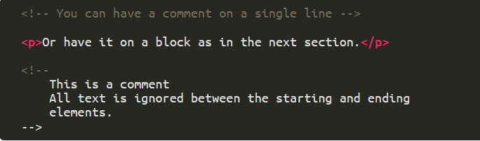
Comments
Comments help in putting messages in your code to help you document your work.
Comments are also used to block out code for experimentation/debugging.
Comments are not displayed/rendered by the browser.
You can read more here.

Slide 12
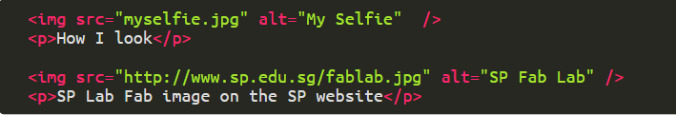

Images
You can display images on a web page using the <img> tag.
Images are linked to the web page using the <img> tag.
The <img> tag has the end-tag as />
The <img> has two required attributes
the src which references the image
the alt which provides a text explanation
If your images are too large (or small), you can format them
I suggest you use the inline-style attribute
You can specify both width and height.
However, if you only specify one, then the aspect ratio is kept
The following images are accepted: .jpg, .png, .gif, .ico, .jpeg, .svg

Slide 13
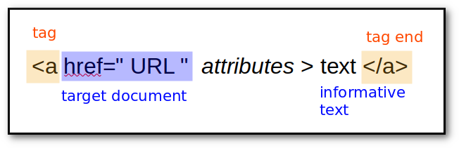
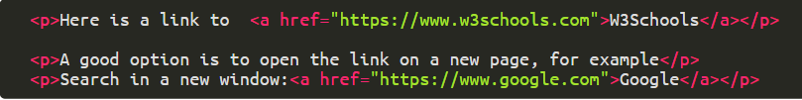
Hyperlinks
The true power of the WWW is hyperlinks.
Links allow pages to be connected together.
When you click on a link, you can "jump" to another document.
A link DOES NOT need to be text!

Slide 14
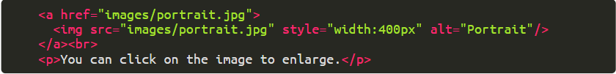
Absolute and Relative URLs
Absolute URLs have the full (absolute) URL address in the link
Usually link to documents outside of the site
Relative URLs are used for documents within the site
For example, if images are kept within a sub-folder
Links are not limited to text, but to other objects as well!

Slide 15
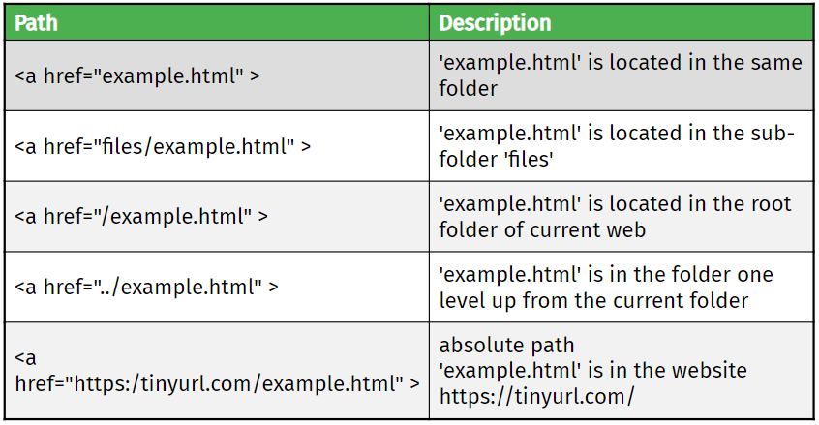
HTML File Paths
Examples applies to <img> as well

Slide 16
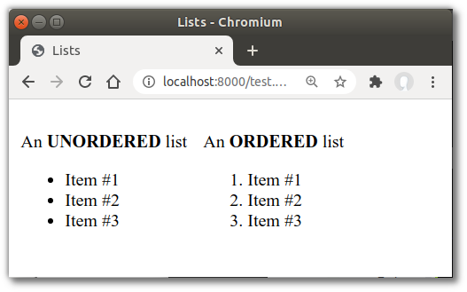
Lists
Lists are used to organise information in groups.
There are two types of lists
You can nest the lists

Slide 17
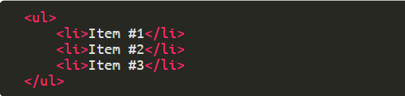
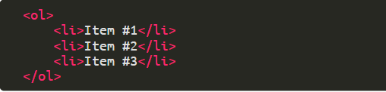
Lists
Unordered lists use the <ul> tag
Ordered lists use the <ol> tag
In both cases, the list items are tagged using <li>

Slide 18
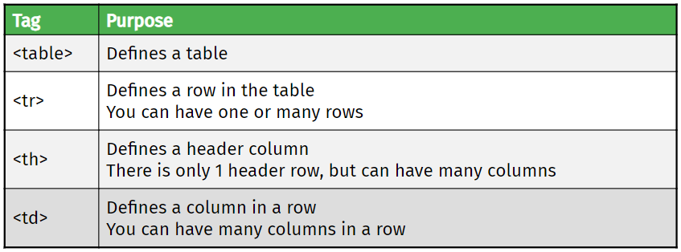
Tables
Tables allow you to organise your information in rows and columns.
Limit the sizes of your tables, as the browser needs to load the table before it can be rendered.
More on tables at W3Schools
Alternatively, you can use a table generator

Slide 19
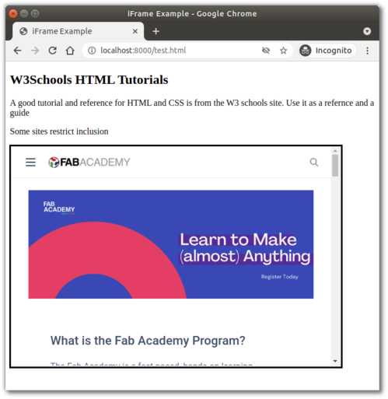
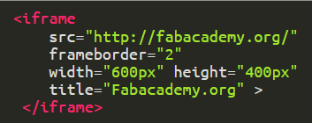
Iframe Element
Used to display a webpage within a web page.
You will use it to display your Fusion 360 drawings

Slide 20
About Page
Every site has an About page
The about page informs the reader about the author/purpose of the site.
Task
Create an About page, which is linked from the main page (index.html)
Write one or two paragraphs informing the reader about the purpose of this site.
Use a table with two columns, to show
A selfie of the author (on the left)
Some information about the author (on the right)
Provides some means of contacting the author
Have links that can return to the main page
Extra Credit
Store your images in a folder named "images"
Images is located as a sub-folder to the root of the site.

Slide 21
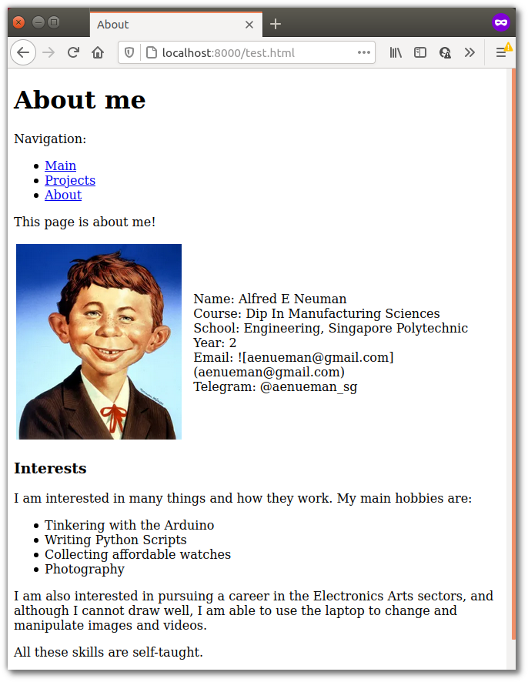
Sample
Hints:
Use a table to separate the image from the text and to provide a side-by-side layout
Use <div> to divide sections

Slide 22
Tools
Use your text editor and your browser for most of the work
Essential visual tools
Html code editor – check your code immediately
Html linter – format and validate your code
ResizeImage your image (alt. imageResizer)
References:
W3Schools HTML Tutorial & Reference
HTML Color Picker

Slide 23
EP1000
HTML
End

