Slide 1
EP1000
Markdown

Slide 2
Site Templates
Typical site organisation
Main page
Describes the context of the site, an introduction of what is to come, why the site was built
About page
Provides information about the author, how to contact him/her
Provides background to the authors
Project pages
A separate section made up of project pages
Each page describes a task or a context of help
Final Project page
A major project construction
Communization of the work done in sections

Slide 3
Page Templates
In order to maintain uniformity, each page should be built from the page template
Contains
Navigational information
Page title, page information,
References, links
Footer section for informational bits and links
Consider
What can be duplicated?
Which section should change?
How can we automate the adding of pages?
Site Name
Navigation bar
Page title
Project
Information
Footer

Slide 4
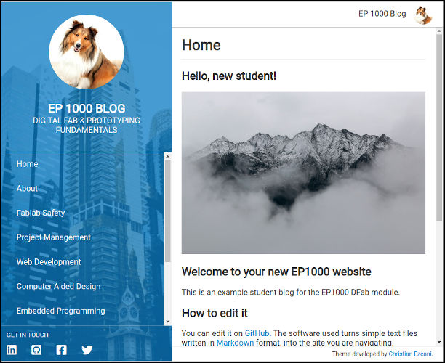
Can we “borrow” examples?
JW Sample Site
EP1000 example
W3schools
Static Site Templates
Static Site Builders
HUGO
Jekyll (EP1000 example)
Other examples
ReadTheDocs
GitBook
TiddlyWiki, MoinMoin, Doku-Wiki
Active sites: CMS, WordPress, Site Providers, ASP

Slide 5
Static Sites
Sites that are cannot be changed/loaded from a database
Why? No embedded code
Can’t I just write in plain text ? (yeah, right, you’re just one of the top 100 public intellectuals of US)
Advantages:
Full control
HTML=content, CSS=layout
Use templates
Beautiful
Can add some extra functionality
Javascript
Java
Can be Responsive (Bootstrap)
Disadvantages:
Need to write in HTML and CSS
Need to learn HTML, CSS
Javascript, Java
Bootstrap
Templates may be confusing
Too much control
Need to understand the template

Slide 6

Markdown
Light-weight markup language for creating formatted text using a plain-text editor.
Markdown is widely used in blogging, instant messaging, online forums, collaborative software, documentation pages, and readme files.
You can learn it in less than 15 minutes! Mastering Markdown Markdown Guide

Slide 7
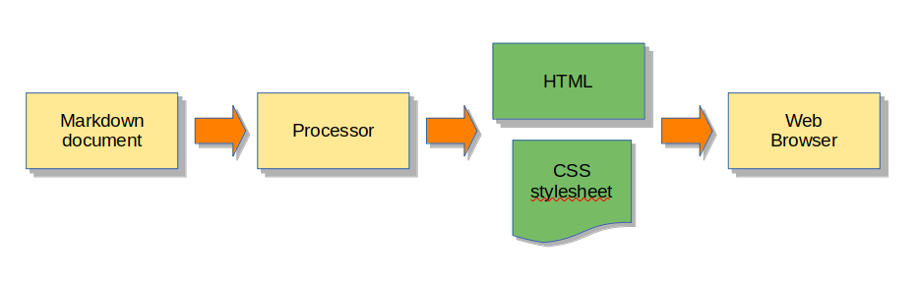
Markdown Processing
index.md and other md files
Python program JavaScript GitHub automatically processes .md files when they are committed to the repository.
Converted files (HTML) are stored in a temporary buffer, unliked from the md files. Github pages serves them up.

Slide 8
Markdown Editors
Online Markdown Editors
HackMD
StackEdit
Dillinger
Plug-ins for common editors
Sublime Text
MarkdownEditing,
Using Markdown in Sublime Text 4
Atom
Set up & Use Atom as a Markdown Editor
Visual Studio Code
Markdown and VSC
Any plain-text editor will work!
Markdown Live Preview

Slide 9
Github & Markdown
Github automatically converts markdown files into HTML
Site starts with index.md
Problems:
Limited formatting (there are some available themes)
Boring….mainly text
Poor control of data flow, layout
Need a program to preview your work (Github may be slow)
Solutions:
Easy to write documentation
Use HTML when you need control

Slide 10
Alternatives
Strapdown
Original ides: strapdown.js
Javascript wrap-around for Markdown Pages
Can be online or on-site (move the JS files)
ReMarkJS
Convert Markdown to presentation slides

Slide 11
EP1000
Markdown
End

