Slide 1
EP1000
Git

Slide 2
Git, Github, Github Pages
Git
A software for tracking changes in any set of files.
Implements Version Control over distributed networks.
Most widely used modern VCS.
Free and open-source software distributed under GNU.
Github
A provider for Internet hosting for software development.
Uses Git plus its own features
Offers basic services free of charge.
The largest repository of public domain software development.
Github Pages
Websites for you and your projects, hosted directly from your Github Repository.
Just edit, changes are live.

Slide 3
Usage: Git, Github, Github Pages
Git
Track your work using a repository
Software used is git (available cross-platform)
Github
Host your project work on the internet
It’s free (provided you share your work)
Github Pages
Make it easier for your users to read your project work by documenting it as webpages.

Slide 4

Github
A website and cloud-based service that allows developers to store and manage their code/work, as well as track changes to their code/work.
Additionally, allows you to host publicly accessible static web-pages.

Slide 5
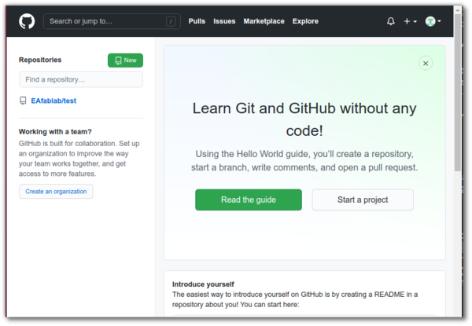
Create An Account
Signup for Github
Select an easily recognizable username
Use your email (personal/permanent)
Select a password (min. 6 characters/digits)
Confirm your account using email

Slide 6
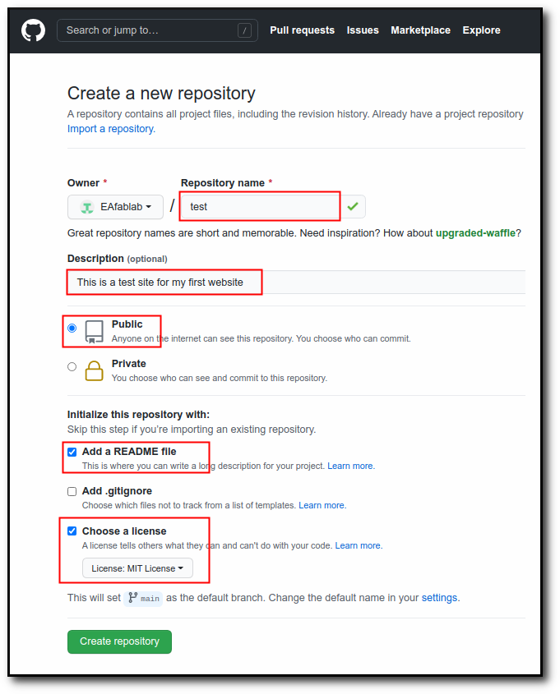
Project / Repository
Repository
A repository is a project space.
You can make as many repositories as you like.
Create a repository
Give it a name
Needs to be Public
Add a README
Give it a license
You can now add files to the repository.

Slide 7
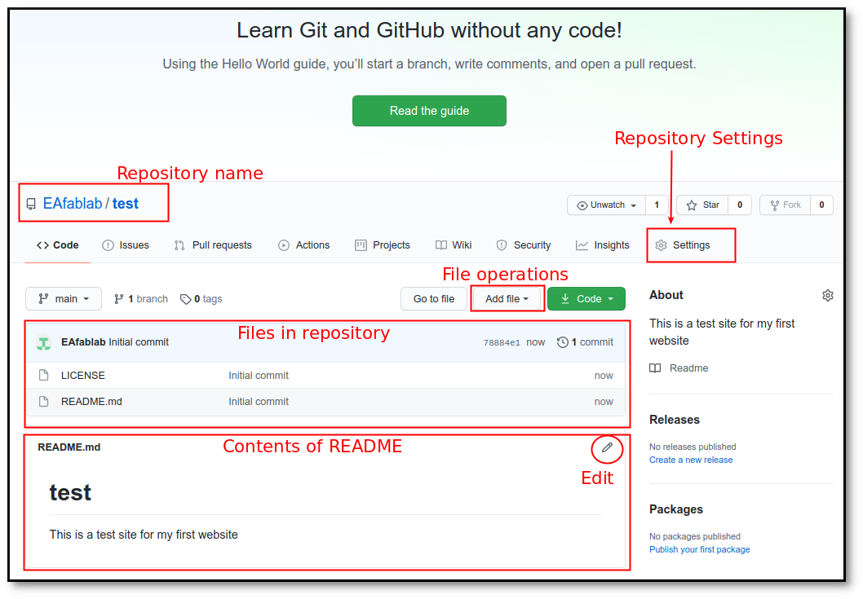
Your Repository
Upload your website to this repository

Slide 8
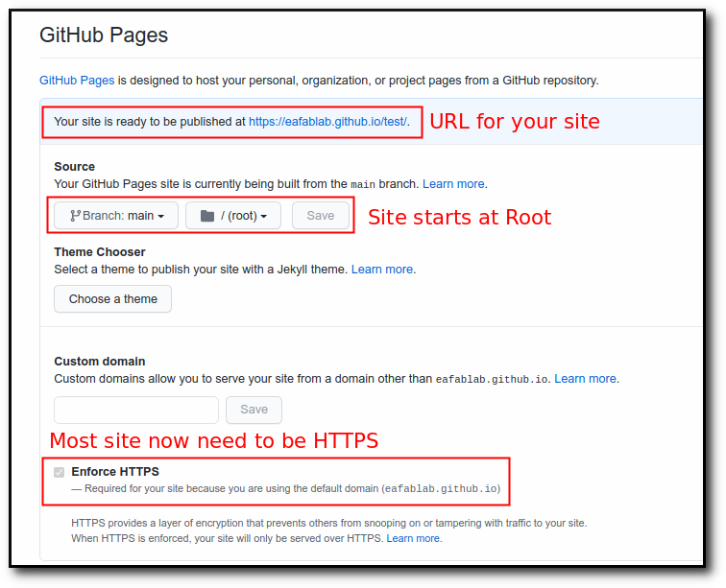
Github Pages
Instruct Github to host your work as a Github Page.
Settings
Scroll down until you see GitHub pages
Select branch as Main
Note down your URL.
Eg. https://username.github.io/test

Slide 9
ReCap
Github account
Your github account is https://github.com/username
Github repository
Each project is stored in a repository.
The repositories are located in your Github account.
Github pages
You can convert a repository into a web-site.
requires setting in your Github account.
requires an index.html as the start/main page.
link your pages from the main page.
only static web pages are supported.
Your github page is https://username.github.io/repository

Slide 10

A software for tracking changes in any set of files.
Implements Version Control over distributed networks.
Most widely used modern VCS.
Free and open-source software distributed under GNU.
Advantages of learning Git
Now a requirement for software developers
Can use git to keep track of your own software projects
Cross-platform
Usually implemented as a COMMAND LINE INTERFACE
Windows/Mac have Github Desktop implementations.
Installation
Git site for downloads and installations
GUI version (Windows10, Mac)
Reference Book: Pro Git book
Tutorial: YouTube Git Crash Course by Brad Traversy, TraversyMedia.com

Slide 11
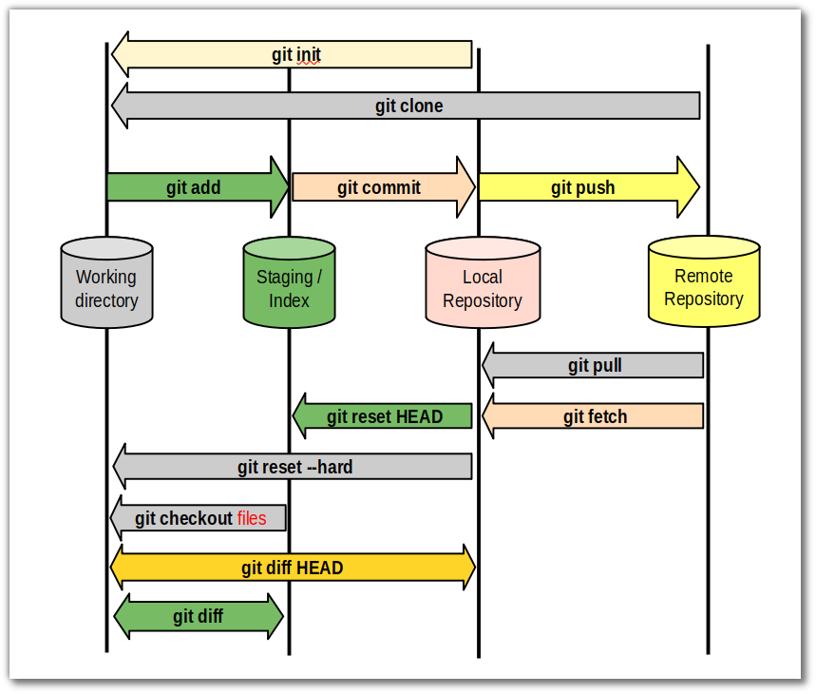
Git workflow & Commands

Slide 12

Configure Git
Configuration
Enter your git-password to authorise the operations.
Using the CLI, you can use https or ssh.
You can also use public/private keys.

Slide 13
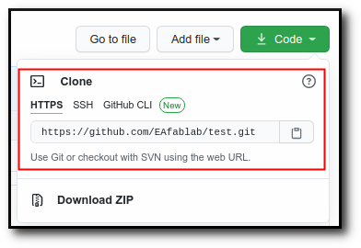
git init / git clone
git init
Initialises a new repository (locally)
Created in a folder (.git) in the current directory
Repository is clean, empty.
git clone {URL}
Clones (makes an exact copy) of a remote repository.
Easiest way to start a repository.
initialises the local repository before copying the files.
Any public repository (from Github) can be cloned.

Slide 14
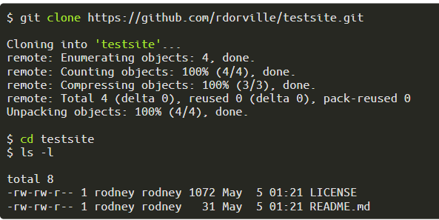
Working On Github
First create the repository on GitHub e.g. testsite
Obtain the URL from the clone link.
Clone the repository
download the Zip file, extract the contents in the folder
use git clone {URL}
use the gui desktop
The name of the folder is the name of the repository.

Slide 15
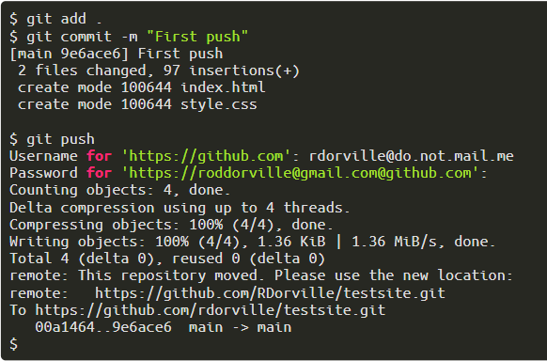
First Update to Remote
Copy your files into the repository folder
git add . to add the files to the index (works recursively)
git commit records changes to the local repository
git push updates the remote repository with the changes.
This is usually your typical workflow to record changes.

Slide 16

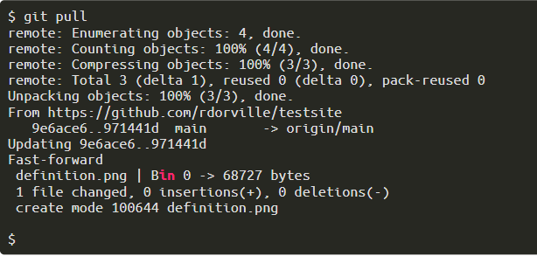
Working with Others
What happens when more than one person works on the project? What happens when you have more than one workstation (e.g. home, work, laptop)
The remote repository may have changed.
Hence, sync your local repository before you work
Or, when you have changes

Slide 17
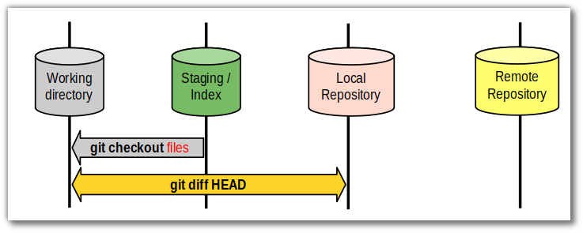
Oops! I deleted a file!
How do you recover your missing file?
git stores the changes in the local repository
to retrieve previous versions, do a git checkout
Which file?
git log shows your history
you can recover your work at any point.
file is identified by its hash (checksum)

Slide 18
I want to try a ‘new’ idea
Try something new
Split or git branch the original idea to start something new
Make changes to the original project (while keeping the original code)
Try different ideas simultaneously for your project
HELP!
try Google first
watch a few tutorials
there's always Pro Git
try this:
move your local files to another folder
re-clone the project/repository
recover your local vs remote changes manually

Slide 19
Typical Git workday/routine
Morning - Just started work on project
git pull bring down any changed files.
work on project (add, delete, change)
git add any significant changes
work more...
Coffee break!
git add any changes, save in buffer area
Lunch
git add, git commit to save position on local repo
keep working on project
5:00pm!
git add, git commit to save all changes and work done for the day
git push to synchronise with remote repository

Slide 20
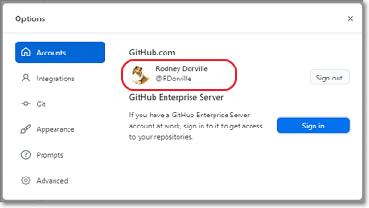
Github Desktop
git config
Sign in
Check that credentials are correct
Check the email and username is correct (configuration)
You will be asked by Github to login and verify

Slide 21
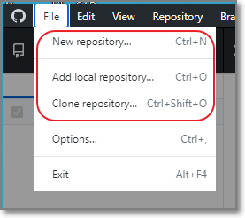
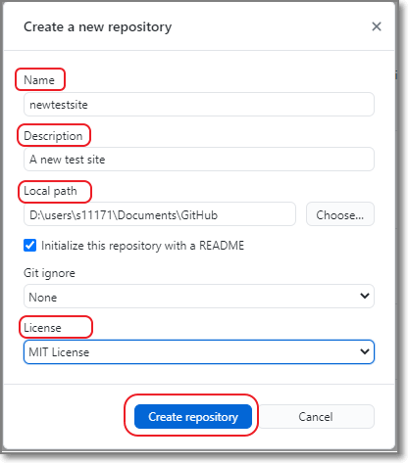
Create Your Repository
git init / git clone

Slide 22
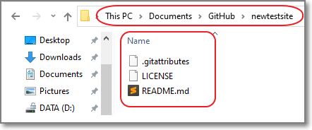
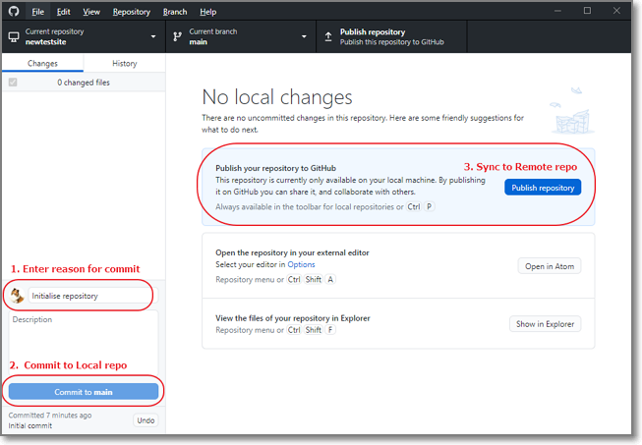
First Commit & Push
git add * git commit git push

Slide 23
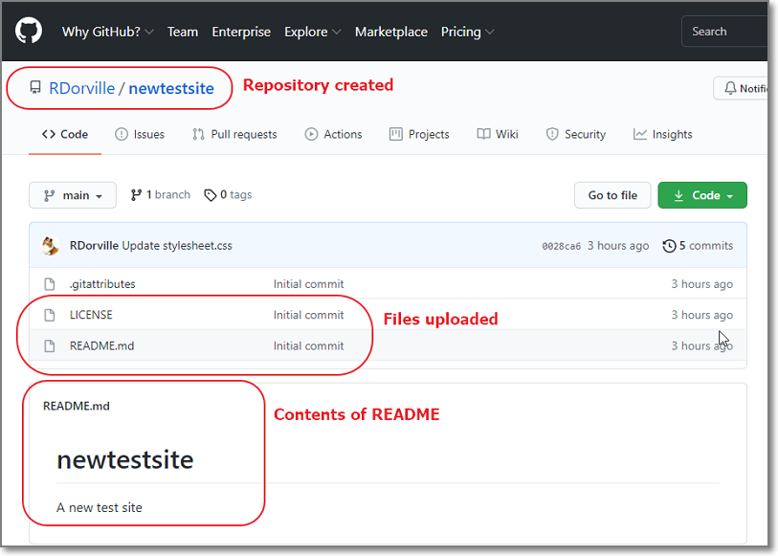
Contents of repository

Slide 24
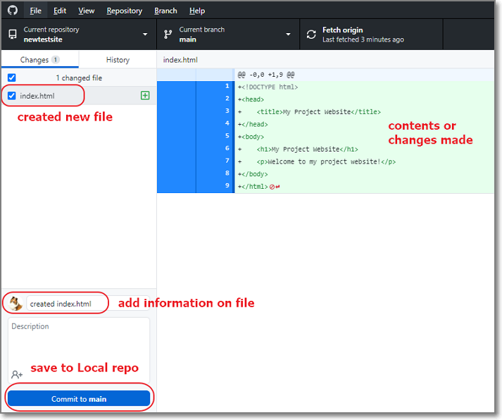
Add File(s)
git add * git commit git push
Add/Create new files
Save to your Local Repository
(or) Sync to your Remote repository

Slide 25
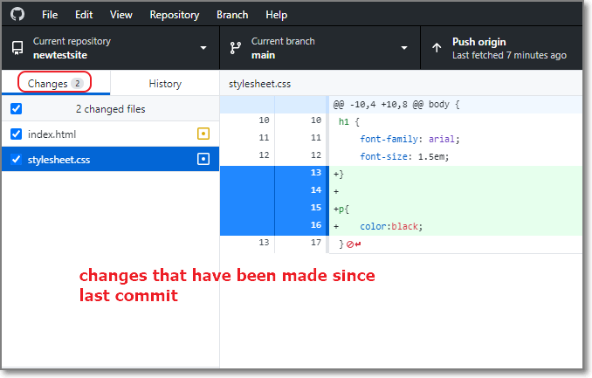
What has changed?
git status
Git shows the files that have changed since the last commit.

Slide 26
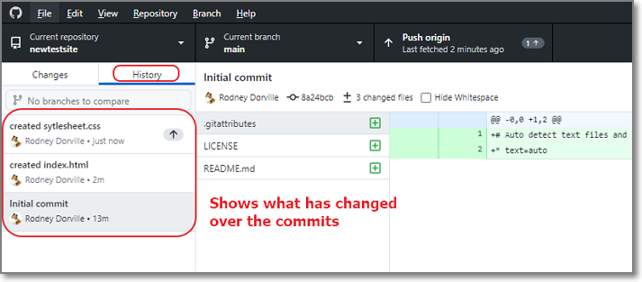
Shows the progress of your work
git log
Git shows the history of the repo (since conception)

Slide 27
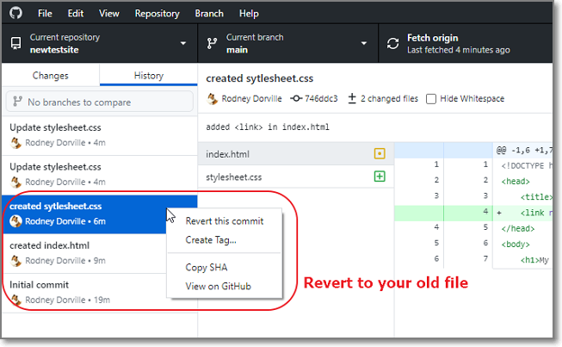
Recover old files
git checkout
Git can restore the files that you were previously working on Rolls back history.

Slide 28
Marked Assignment (part 3)
Final Part
Create a GitHub Repository EP1000
Move your project website into this repository.
Convert the repository into GitHub pages
Submission
Your lecturer will provide a submission sheet for your work
Next to your name, enter the URL
Of your Project Documentation Site
Of your github site repository
The Project site will be used for marking.
You will need to maintain and update your site
Please ENSURE that the site works.

Slide 29
Marked Assignment (part 3)
Requirements
EP1000 Project site with
An introduction page, about page (with photo) and project pages
A link to the JW assignment (If not using his template)
At least 2 project write-ups
How-to develop documentation for a project
How-to use git to maintain the site
You can use the JW template or any template you wish (even Markdown) as long as you are consistent.
Hosted as a Github pages site
Deadline
Last FRIDAY, 5:00pm of this semester
Problems
Telegram-message the Class Group

Slide 30
EP1000
Git
End

