Slide 1
EP1000
Computer Aided Design

Slide 2
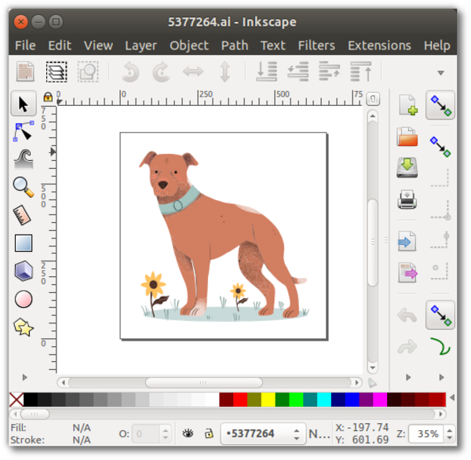
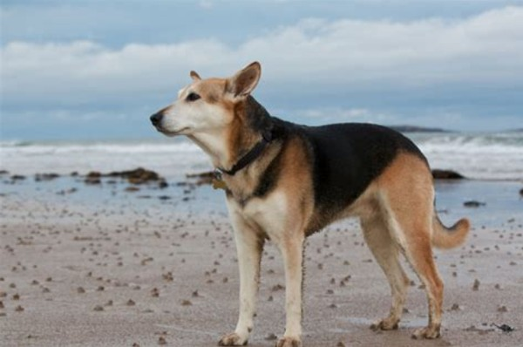
Computer Graphics
Raster
Deals with pixels on the screen
Uses for photographs, images
Formats: .bmp,.jpg,.png
Raster: Zoomed In
Vector
Uses mathematical functions
Characterized by clean lines
Formats: .dxf, .svg, .STEP
Vector: Zoomed In
Dog Vector Image (AI)

Slide 3
Raster Graphics
Software: GIMP, Adobe PhotoShop, Paint
Allows creation, editing of images (photographs)
Common formats .jpg, .png
Task
Choose one of your selfies
Remove the background of the image
Substitute with a seaside scene
Resize to a width of 1024 pixels
Document your work in your project blog
Ref: GIMP: Remove The Background And Make It Transparent

Slide 4
Vector Graphics
Software: InkScape, Adobe Illustrator, Corel Draw
Allows creation of vector art
Common formats .svg, .ai
Task
Choose an image of an animal
Trace the outline of the image to form a vector art
Create a B/W logo with your vector art
Document your work in your project blog
Ref: Inkscape Tutorial: Vector Image Trace

Slide 5
Computer Aided Design
Vector tools that allow you to
create your design
draw and model
simulate and test
analyse the results
We will mainly use the tool to Draw and Model the design
Extract digital information for fabrication
CADD Tools
Autodesk Fusion 360, Autodesk Inventor
Draftsight , FreeCAD
Rhinoceros3D
Solidworks

Slide 6

Autodesk Fusion 360
An integrated CAD, CAM and CAE software.
Can consolidate your product development process.
Provided free for educational use (requires registration)
Easy to learn and master, with lots of online tutorials

Slide 7
Getting Started
Register and Install Fusion 360 on your system.
Here are some good tutorials to get you started:
Autodesk: Getting Started With Fusion 360
Kevin Kennedy - Product Design Online
Fusion 360 Interface
Fusion 360 for Beginners
Warwick University Fusion 360 Tutorials
Exercises
Complete exercise 1 and 2
Export your completed files (.f3d) and include them in your report

Slide 8
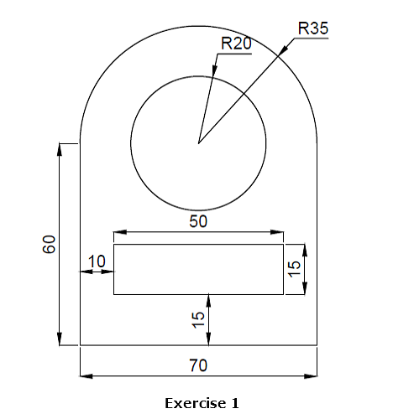
Drawing Exercise 1

Slide 9
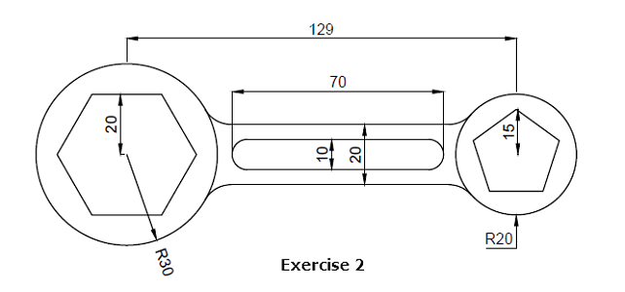
Drawing Exercise 2
Worked Example

Slide 10
EP1000
Computer Aided Design
End

