Slide 1
EP1000
Laser Cutting

Slide 2
Computer Controlled Cutting
Also known as CNC (Computer Numerical Control)
CAD provides the necessary data from design files
Controls cutting of material
Controls marking of material
Very precise and repeatable
Methods:
Laser Cutting and Engraving
Large format routing systems (using a mill)
Cardboard and paper cutting and folding
Plasma cutting, Waterjet
Vinyl cutting

Slide 3
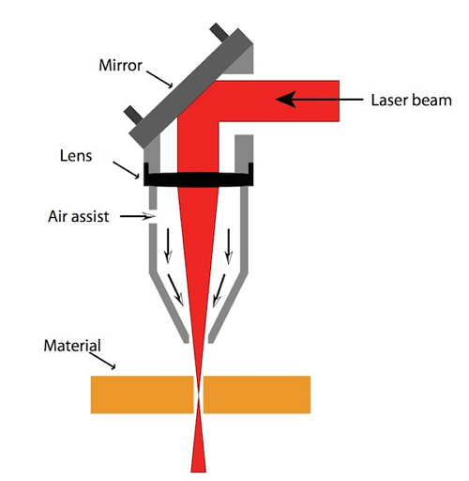
Laser cutting
Laser is focused on the material
To cut through
To engrave / mark
Laser ionises the material
Air-assist removes the ionised material
Suction removes the material and wastes to a HEPA filter
Movement of the head by motors, controls the cutting operations
Light Amplification by Simulated Emission of Radiation

Slide 4
Types of Laser cutters
CO₂ (Carbon Dioxide) Lasers
CO₂ gas mixture stimulated electrically
Suitable for non-metallic materials – wood, acrylic, glass, paper, textile, plastics, foils & films, stone
Fiber Lasers
Solid state lasers which are amplified in gas fibers.
Suitable for cutting/marking thin metals, coated metals, plastics
Nd:YAG, Nd:YVO (Crystal Lasers)
Solid state lasers
Suitable of cutting/marking metals, plastics, ceramics
FablabSP lasers are CO₂ lasers

Slide 5
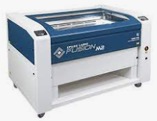

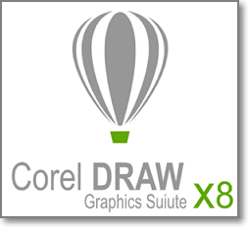


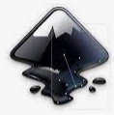
Laser cutting workflow
DXF, SVG, PDF, AI
Prepare your design using a CADD package
Export your 2D layouts to a vector format (DXF, SVG, PDF, AI)
Import your 2D layout into CorelDraw (or graphic editor provided with your laser cutter)
Confirm the necessary cut lines (hairlines)
Insert raster information (graphics, text) for engraving
Send the file to the laser cutter for fabrication

Slide 6
CADD Process
CAD is used to model the object
Provides a visual check/representation of final object
Able to provide tools for construction
Extract to obtain the 2D outline shape of construction
Typical CAD tools
Fusion 360, Inventor, AutoCAD
Rhino
Blender
123Make
Illustrator, CorelDraw, Inkscape

Slide 7
Vector File Formats
Vector files are composed of a set of commands and numbers which can be used to create the CAD drawing.
Vectors are based on formulas and scale to high resolution. E.g. a small logo can be enlarged to poster size without loss in definition or resolution.
Vectors can be translated to machine commands which can move the cutting head of the laser to precise positions.
Vectors are defined as “hairlines” or lines with minimal width (e.g. < 0.1mm). These will be translated to cut lines.

Slide 8
CorelDraw
Most Laser cutters use a Vector/Raster graphic application as the interface for laser cutter.
Able to translate vector hairlines into “cut” lines
Able to translate raster graphics into “engravings”
Most common platform: CorelDraw
Imports most vector formats DXF, AI, SVG, EPS, PDF
Able to perform vector and raster graphics manipulations
Able to send cut/engrave file to the laser cutter for fabrication using a printer driver
Control of the laser is done with the vendor’s driver application.
Alternatives: Inkscape, Adobe Illustrator

Slide 9
Preparing your cut/engrave file
Import your vector file into CorelDraw Tip: you can arrange your cuts into a single DXF file to save time on the laser cutter pc.
Select all cut lines and change the width to hairline.
Add raster graphics for engraving:
Text
Graphics (e.g. photos, patterns)
Tip: Use colors to change the engraving power of the raster
Send the completed file to the laser cutter, configuration of the laser cutting/engraving is done by the laser cutter driver.

Slide 10
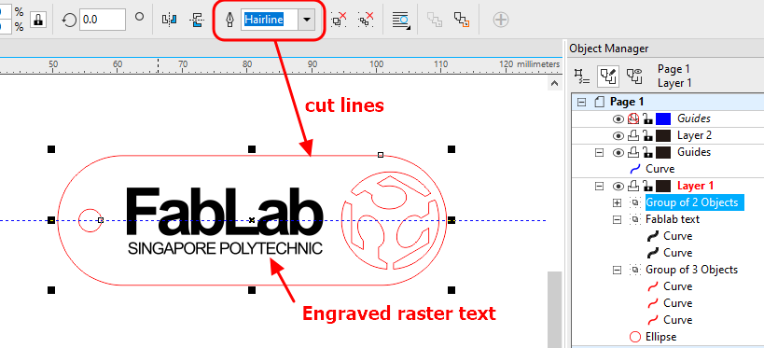
A Keytag with Engraving
Keytag outline was created in Fusion 360, exported as DXF and imported as 1:1 exact size.
Fablab logo was imported as an SVG (vector) file, changed to hairline
Fablab text was added as text and manipulated to size (raster)

Slide 11
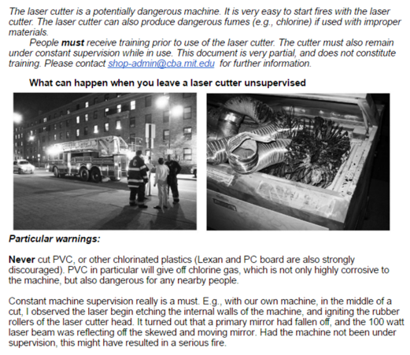
Laser Safety
Supervision at ALL times
Class 1 with safety interlock
Venting of fumes, adequate air flow, HEPA filtration
Regular cleaning of optics
Cutting of ONLY recommended materials
Hazard
Fires during operation
E-stop & fire extinguisher

Slide 12
Materials
Laserable
Prohibited
Cardboard
Wood
Acrylic
Delrin
Fabric
Ceramic
Glass
Flame Test: if it flames it should not be cut
PVC
Pleather
Moleskin
Polycarbonate
Polystyrene foam
Fibreglass
Carbon Fiber
Full Spectrum: Materials banned from laser cutting
Epilog: Laserable Materials

Slide 13
Laser Cutter Settings
Power
Higher power cuts deeper (may melt material)
Try not to use 100% power levels
Speed
Higher speed, moves the laser head faster over material resulting in shallow cuts
Too low speeds may melt material
Frequency (PPI)
Use higher Pulses Per Inch for dense material
Wood (100~300 PPI), Acrylic (700~900 PPI)

Slide 14
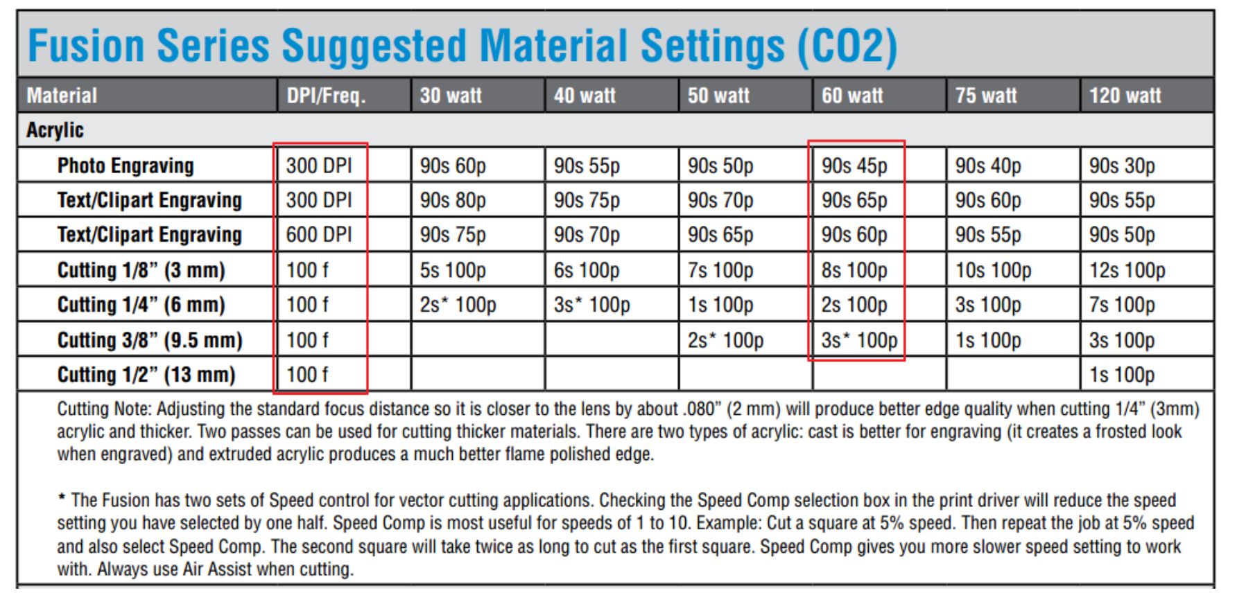

Epilog: Acrylic Recommend settings
Ref: Epilog M2 Fusion Reference Manual

Slide 15
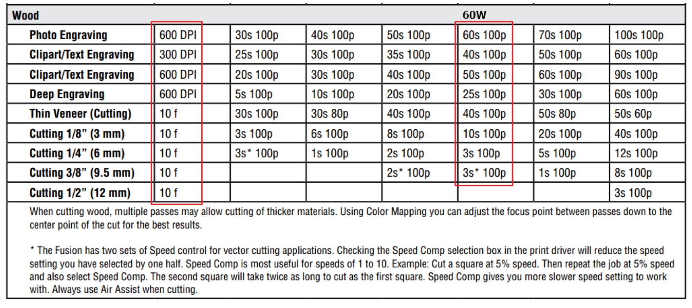
Epilog: Wood Recommend settings
Ref: Epilog M2 Fusion Reference Manual

Slide 16
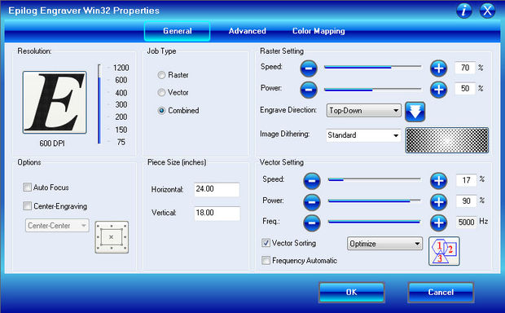
Epilog Settings Menu
Ref: Epilog Job Manager
When in doubt, try a test cut!

Slide 17
EP1000
Laser Cutting
End

