Slide 1
EP1000
A Short Introduction to Electricity & Electronics

Slide 2
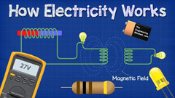
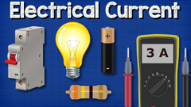
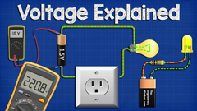

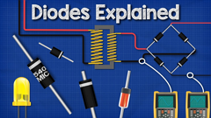
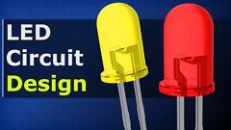
What is electricity?
Youtube: The Engineering Mindset Electrical Engineering Basics Playlist

Slide 3
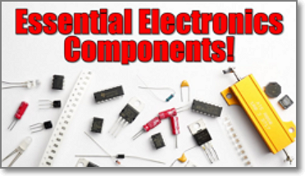
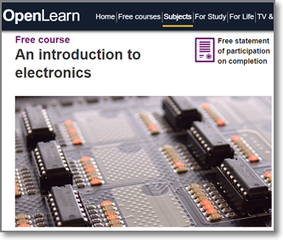
Electronic Components
YouTube: Great Scott! Essential Electronics Components that you will
need for creating projects!
Open University: An Introduction to Electronics

Slide 4
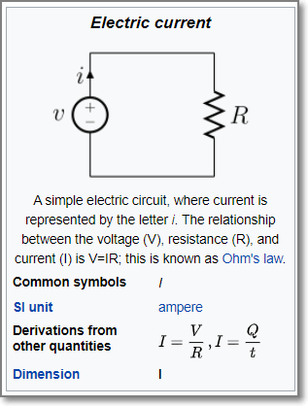
Electricity
The flow of electrons in a closed circuit.
Voltage is the difference in electrical potential between 2 points (volts)
Current is the rate of flow of electrical charge past a point (amps)
Resistance is a measure of the opposition to the flow of electronics (ohms)

Slide 5
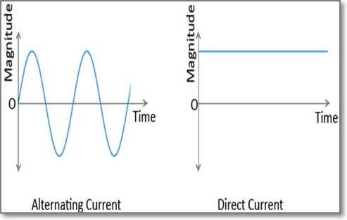
Types of electrical currents
Alternating current (AC) where voltage moves from positive to negative values
E.g. Home electricity
Direct current (DC) where the potential is at a fixed value
E.g. Battery

Slide 6
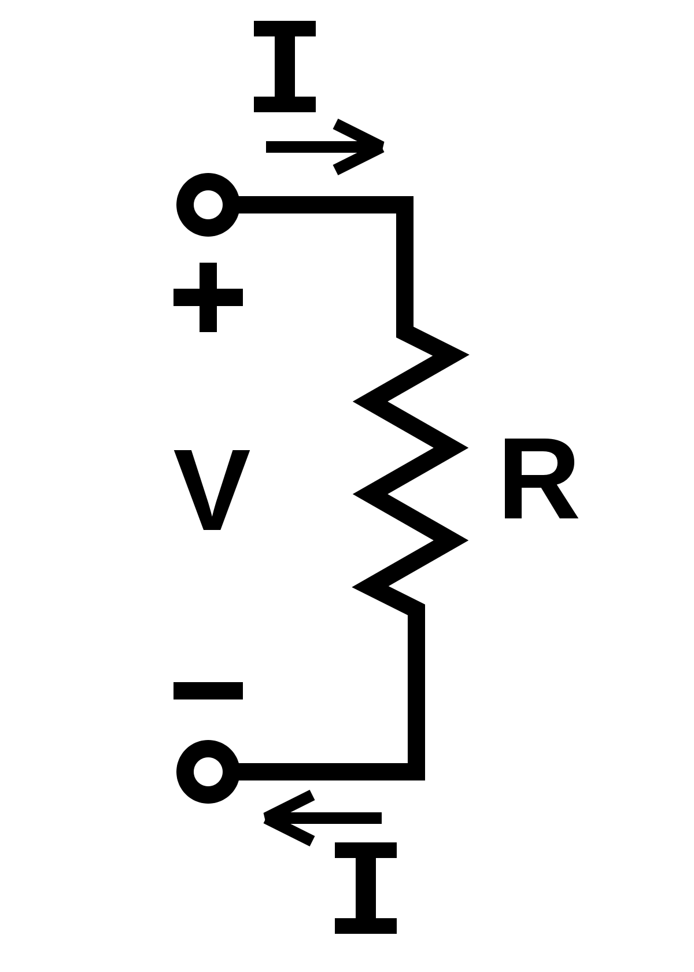

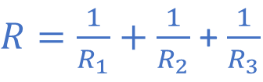



Ohm’s Law
Voltage = Current * Resistance
Resistance calculation
Series
Parallel
$$I=\frac{V}{R}$$
$$R=\frac{V}{I}$$
$$V=I R$$
$$R=R_{1}+R_{2}+R_{3}$$
$R=\frac{1}{R_{1}}+\frac{1}{R_{2}}$ + $\frac{1}{R_{3}}$

Slide 7
Kirchoff’s Laws
Current Law At any junction, or node, in an electrical circuit, the sum of the currents flowing into the node is the sum of the currents flowing out of a node.
Voltage Law When the direction is taken into account, the sum of the potential differences in any closed circuit is zero.

Slide 8
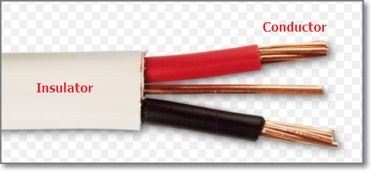
Electrical components
Insulators Do NOT allow current to flow
Conductors Do allow current to flow
Semiconductors Allows current to flow if some electrical conditions are met e.g. diodes.

Slide 9
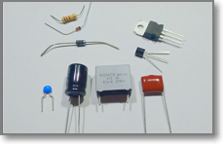
Common components
Wires - Dupont connector wires
Switches
Resistors - Variable resistors, potentiometers
Capacitors
Inductors (seldom used)
Diodes - LED (Light Emitting Diodes)
Semiconductors - 555 Timer, Voltage Regulators
Microcontrollers – Arduino family
YouTube: bigclivedotcom – A Simple Guide to Electronic components

Slide 10
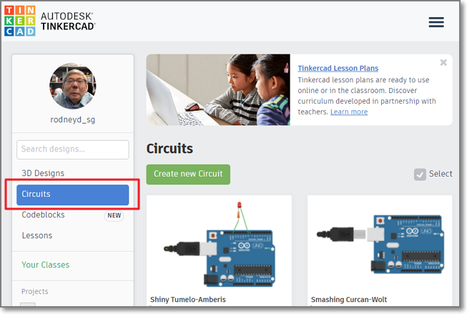
TinkerCAD
Allows creation of simple 3D designs
Circuits – allows simulation of
Electronic circuits
Arduino interfacing with Processing/C++
Micro-bit interfacing with CodeBlocks

Slide 11
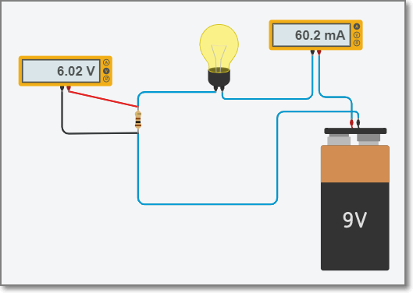
Ohms Law
Amp-meter
Volt-meter
Change the value of R, check V=IR
Voltage is measured with voltmeter in parallel Current is measured with amp-meter in series

Slide 12
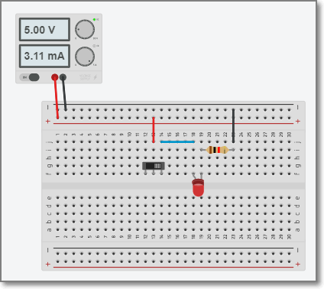
Working with a Breadboard
Breadboard used in many prototyping projects.
Quick testing of circuits
Circuit checks effect of R with LED

Slide 13
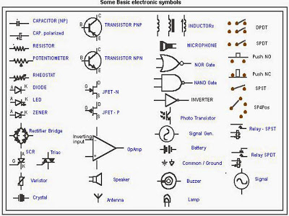
Electronic Symbols
Provides a short-cut method of drawing/expressing electronics circuits

Slide 14
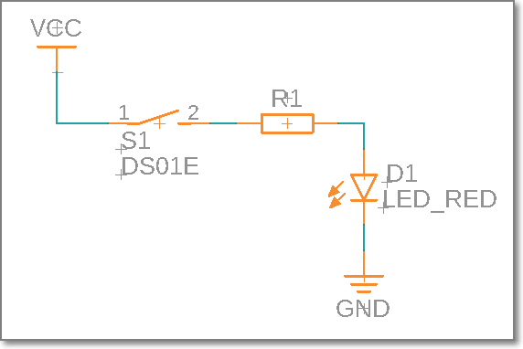
LED Circuit
We use schematics to represent the electrical circuits we create.
We need to be able to transform from a schematic to a layout and vice versa.

Slide 15
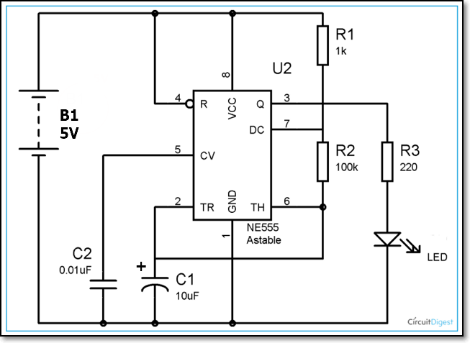
Assignment
Convert the schematic into TinkerCAD circuits and simulate it.
This assignment is not graded.

Slide 16
Expected Result
The 555 timer is configured as an astable using R and C values.
The result is an alternating ON/OFF signal which flashes the LED

Slide 17
Hints & Tips
Assignment sheet: Electronics
Good references:
Introduction to TinkerCAD Circuits
Introduction to TinkerCAD Digital
Introduction to Function Generator & Oscilloscope
You will be asked to implement the circuit on an actual breadboard in the lab.
Document your experiences

Slide 18
EP1000
A Short Introduction to Electricity & Electronics
End

