Slide 1
EP1000
Digital I/O

Slide 2
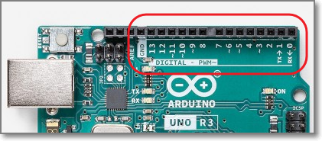
Digital I/O
The Uno uses the ATMega328 processor, which has 14 digital I/O pins (Some of these pins are multifunctional)
A digital I/O pin can input or output digital (0, 5V) signals.

Slide 3
Digital I/O functions
The Arduino system provides 3 functions for the manipulation of digital I/O.
You need to
Configure the pin (pinMode()), before
Using the pin
digitalWrite() output
digitalRead() input
Digital I/O functions
digitalRead()
digitalWrite()
pinMode()

Slide 4
pinMode(pin, MODE)
Configures specified pin to behave either as in input or an output.
Modes available:
INPUT digital input mode (high-impedance state)
INPUT_PULLUP digital input mode with internal 20K~50K ohm pull-up resistor
OUTPUT digital output mode able to source up to 40mA per pin, total of 200mA per chip

Slide 5
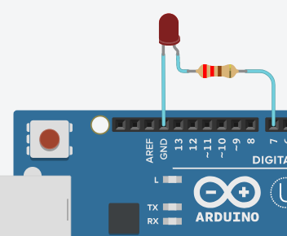
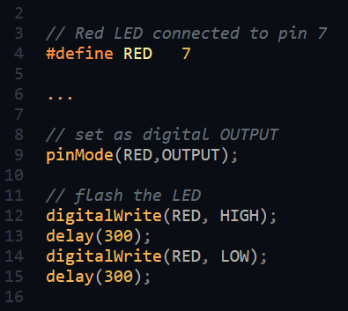
digitalWrite(pin, {LOW|HIGH})
Outputs a LOW (0V) or HIGH (5V) to a digital pin.
The digital pin must be configured as OUTPUT.
You can also output a LOW to create a GND for sinking current!

Slide 6
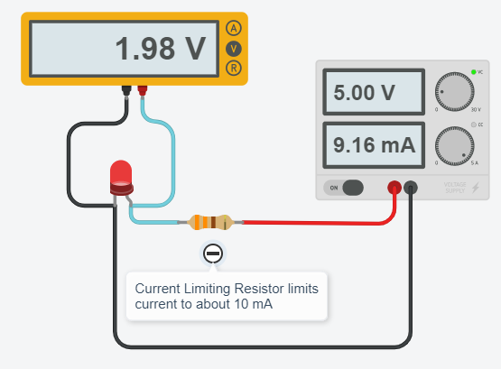
Driving an LED
An LED lights up (conducts) if a correct voltage is applied to the pins.
When the LED conducts, current is allowed to pass through. The LED drops about 2V.
We need to limit this current (10~20mA) otherwise, we will get a short-circuit.
Current limiting resistor value: R = V / I = (5 – 2V) / 10 mA = 300 ohms
LED current depends on type, check data sheet for forward voltage and current limits. Watch: GreatScott! Everything about LEDs

Slide 7
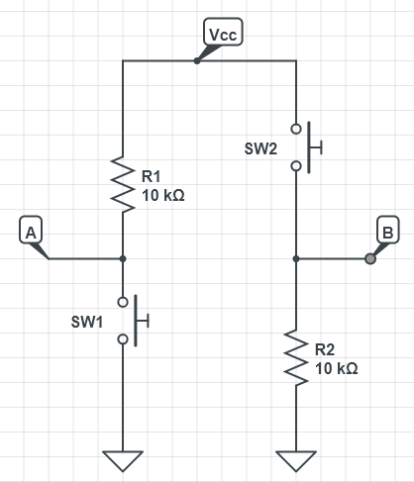
Digital Input
We can use digital inputs to read the status of the switches in a circuit.
Need to add a current-limiting resistor to prevent short circuits.
Usual value is 10 kOhm
States:
A - normal HIGH, when closed LOW
B – normal LOW, when closed HIGH
Circuits by CircuitLab

Slide 8
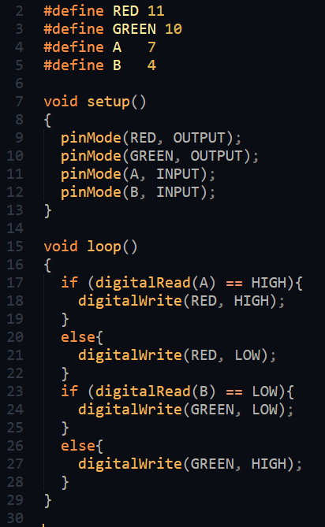
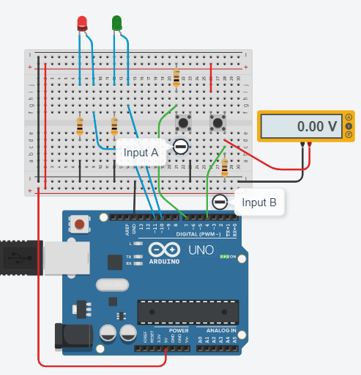
Digital Input
How to use PB switches with digitalRead()

Slide 9
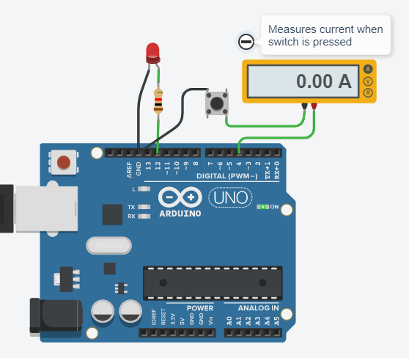
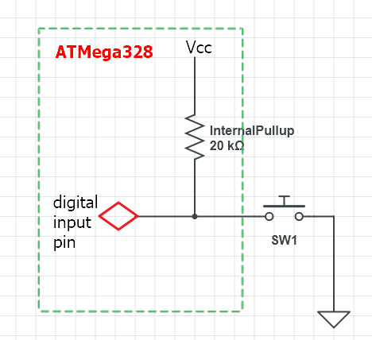
Internal Input Pullup Resistor
We can use the internal pullup resistor by changing the mode
pinMode(pin, INPUT_PULLUP)
Internal pullup resistor is 20K~50K which limits the current.
Uno input pullup resistor demo

Slide 10
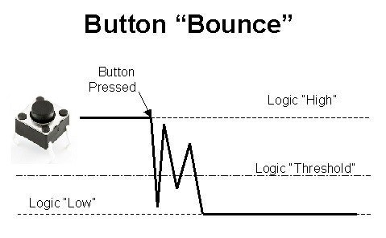
Problems with Mechanical Switches
When a mechanical switch is pressed, it creates transients (bouncing) which causes incorrect states to be read.
Solution:
Software debounce
Add a delay
Use states
Software Debounce of buttons

Slide 11
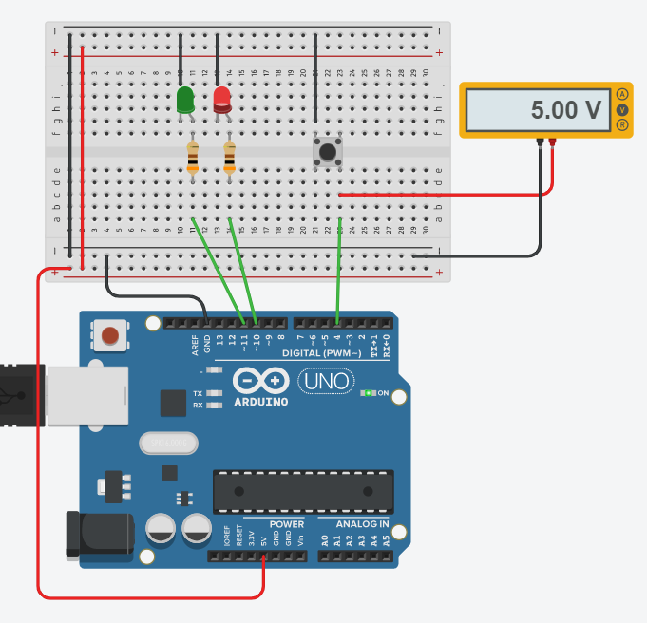
Counting with a Switch
PBSW uses internal pullup resistor.
Each time the switch is pressed, the count is incremented. The LEDs should show the binary equivalent of the count
Sequence: --, -R, G-, GR repeats
Simulate and examine result, does it work as stipulated?
Counting With a Switch

Slide 12
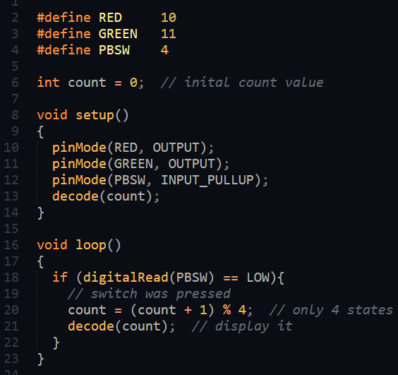
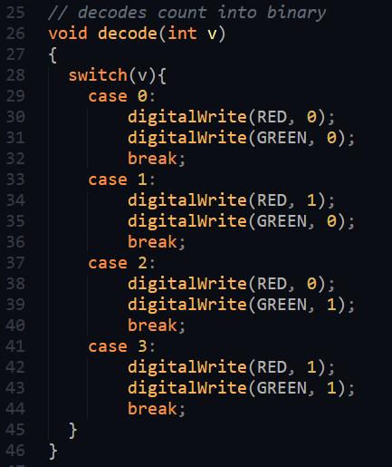
Code: Counting with a switch
How do we debug this code?

Slide 13
Arduino Serial Mode
The Arduino System provides a Serial Mode for displaying text messages.
Uses the Uno’s serial port to transmit data to and from the board to the IDE
Allows data to be displayed in text as well as in graphical format.
Uses the Arduino Built-in library: Serial
When using Serial, you must not use the Tx,Rx pins for any I/O.

Slide 14
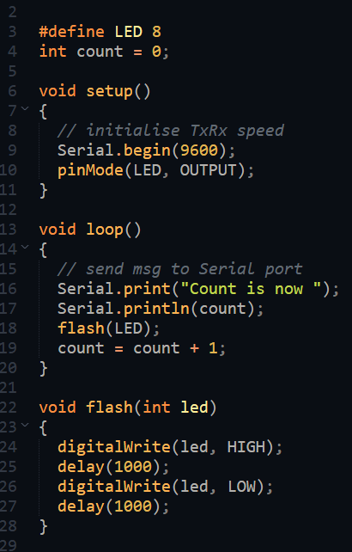
Serial Library
Use Serial to display the count value from a sketch. The sketch updates the count value and flashes an LED with a delay of 1 second between flashes.
Serial.begin(9600) Sets the data rate in bits/sec for serial data transmission
Serial.print(data) Serial.println(data) Sends data to the serial port for conversion and output. If a string of text is sent, it must be delimited with double quotes (“)
There are other functions, but usually not used in embedded circuits.

Slide 15
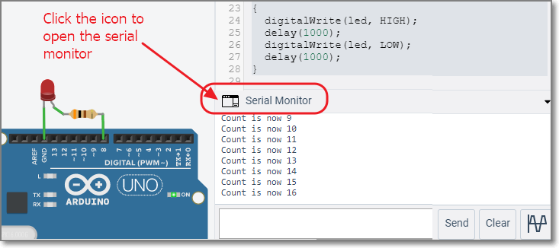
Where does the serial output go?
There is an icon/text “Serial Monitor” on both the TinkerCAD and Arduino IDE interface to show the contents of the serial monitor.
You can clear, input and output data as well as graphically chart the data you receive from the embedded system.
Using the Serial Monitor

Slide 16
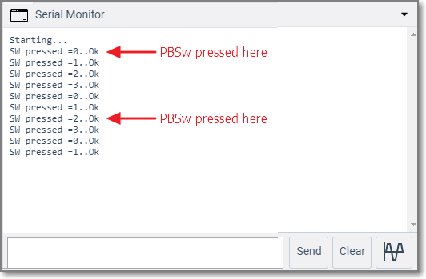
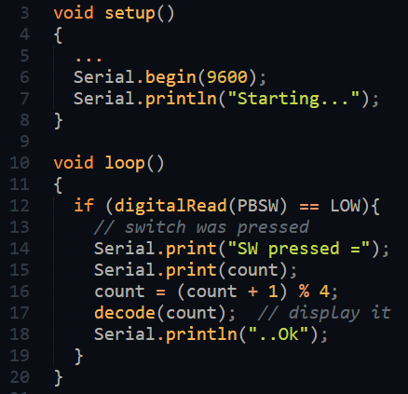
Debug our Counting SW program
Debugging the SW counting program
Looks like we have bouncing problem and/or the switch is being read too fast (SW not recovered yet)

Slide 17
Pushbutton SW
1 push count
HIGH
threshold
LOW
HIGH
LOW
HIGH
Record SW event
STATE
Read SW
Read SW
Read SW
Read SW
Reading of SW in loop()
We keep reading the PBSW taking note of the PBswitch value
We maintain the state so that we know which part of the sequence we are currently in and when the PBSW returns to normal
Register the entire sequence as a single push.

Slide 18
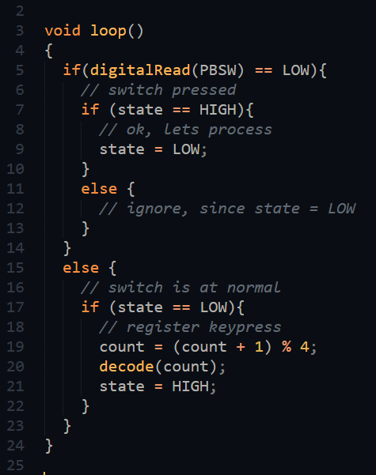
Using states
Use states to track the keypress.
HIGH = normal LOW = in a keypress HIGH = returns to normal
Add short delay when key is pressed to remove bouncing
Record the keypress only when the sequence is complete.
Reading a Pushbutton using states

Slide 19
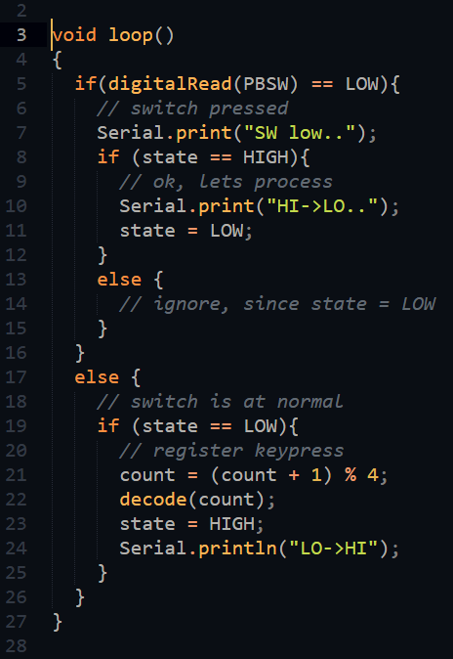
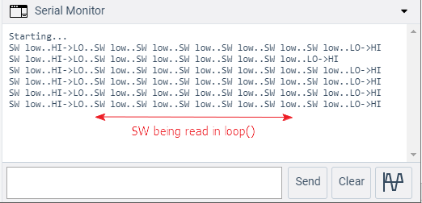
Using Serial to check what’s happening
Serial Monitor output
TinkerCAD Simulation

Slide 20
Assignment: Programming
Work out Assignment 12 Introduction to Arduino Programming using TinkerCAD.
Simulate your solution using TinkerCAD. Use Serial to display messages showing the states and to show that you know how to use the library and the serial monitor.
Document your work on your site.
This method is often used in projects. It uses a single Pushbutton Switch to control different functions.

Slide 21
EP1000
Digital I/O
End

