Slide 1
EP1000
Embedded Systems 1

Slide 2
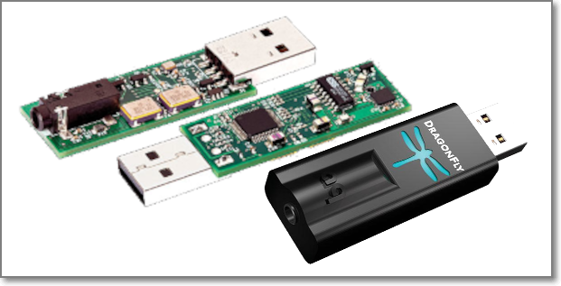
Embedded Systems
A dedicated computer system with a dedicated function within a larger system to perform a specific task. E.g. smart TVs, ovens
After development with a microcontroller, the circuit could be reduced to a single IC with support devices.
AudioQuest Dragonfly audio Digital-Analog Converter

Slide 3
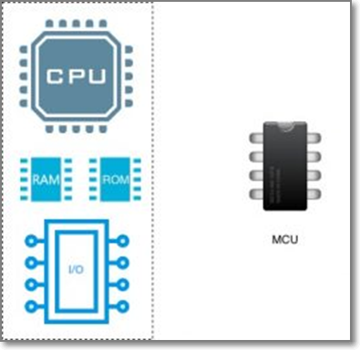
Microcontroller Systems
Combines
Microprocessor
Memory (RAM, ROM)
Input Output
Digital
Analog
Interface protocols
Timing
Other peripherals
Into a Single chip

Slide 4
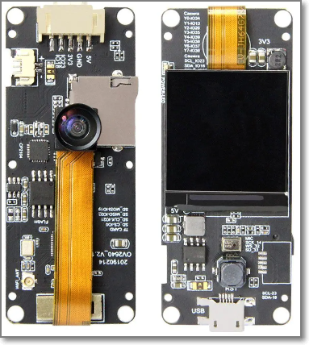
Common Microcontrollers
Atmel
ATTiny 45, 44, 412, 1614
ATMega 328, 3u24
ARM
D11C, D21E
Xtensa
ESP8266, ESP32
Integrated RF, Bluetooth, networking

Slide 5
The Arduino Embedded System
An Arduino Embedded System comprises of
Software & Software Tools
Integrated Development system (IDE)
Arduino programming language (based on Processing)
Development & Debugging Tools
Software libraries
Hardware
ATmel processor boards (and others)
Shields (add-on modules)
Sensors, actuators, peripherals
Open Source Platform

Slide 6
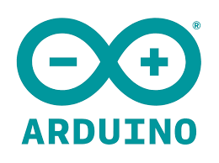
Arduino Systems
A hardware and software company based in Italy
Initial development – software (based on Processing) and later hardware boards (Atmel based)
Produces and markets “official” boards: Uno, Due, Leonardo, Diecimila, Mega, Nano
Software and hardware is open source.

Slide 7
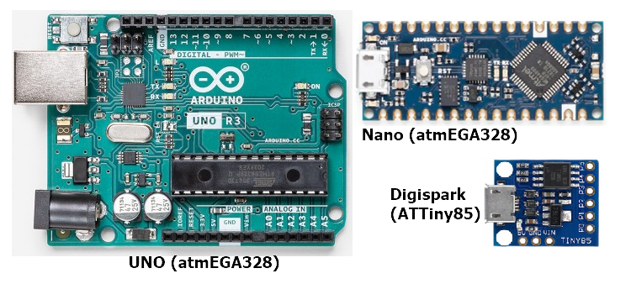
Why use Arduino Systems
Open source libraries & support
Inexpensive, lots of clones, 3rd party manufacturers
Simple, clear programming environment using GUI
Cross-platform (Windows, MacOSx, Linux)

Slide 8
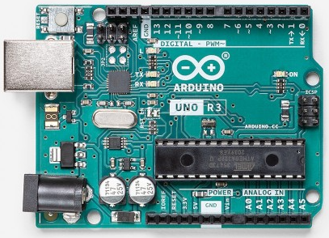
Arduino Uno
Most common microcontroller board to begin Arduino projects.
Uses a ATmel Atmega328P processor with a separate programmable interface using another Atmel processor and USB.
Has sockets for interfacing and power.
So popular that it is called Arduino. (Please don’t make this mistake!)
“Arduino” or “Uno”

Slide 9
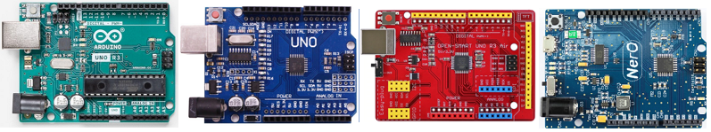
Variations of the Uno
Being open-source, there are many variations.
Programming and usage are basically the same with some minor variations.
All boards use the ATMega328P processor (may be in different formats)
All boards have the same I/O pins
Difference is in $$cost$$

Slide 10
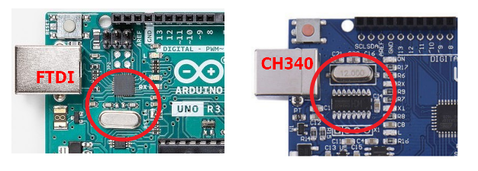
Main Uno board difference
Expensive boards use the FTDI chip for USB China clones use the CH340 chip
Need to install the CH340 drivers.
Lots of tutorials from Google

Slide 11
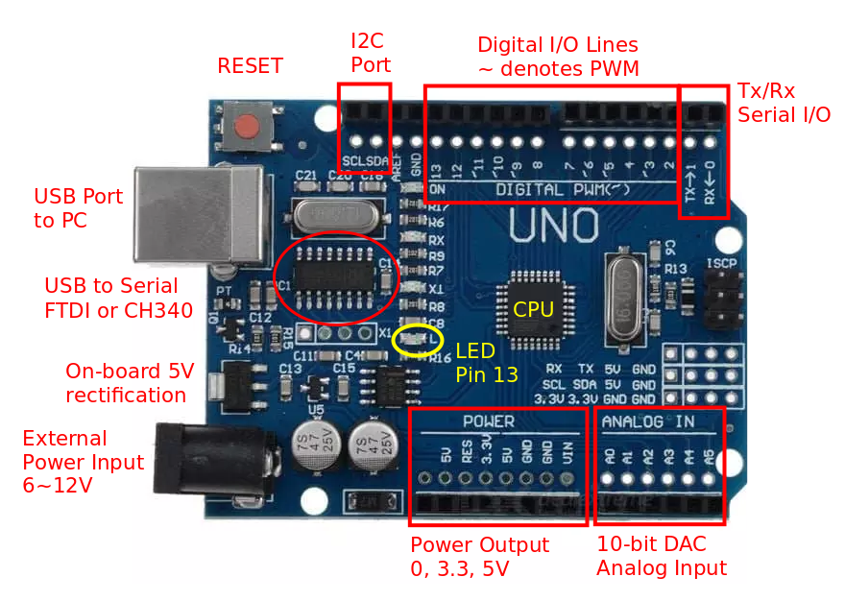
Uno Board Features

Slide 12
Uno Board Features
Power
Can be powered from USB port (<0.5A)
External power from DC jack 6V ~ 12V
Power outputs: 0 (GND), 3.3V, 5.0V (up to 0.3A), Vref (5V)
Digital Input/Output pins
Can be configured as Input, Output or Pull-Up Inputs
Has Pulse-Width-Modulation on ~ indicated Pins
Built-in LED on Pin13
Analog Inputs
10-bit Analog inputs
Others
Serial I/O interface
I2C interface
SPI interface

Slide 13
Programming the Uno
Requires an Integrated Development Environment
Download from Arduino.CC
Suggest using v2.0 BETA because of features
Syntax highlighting
Auto Assist in typing keywords (CTRL-SPACEBAR)
Arduino programs are called sketches.
In text
Have extension .ino

Slide 14
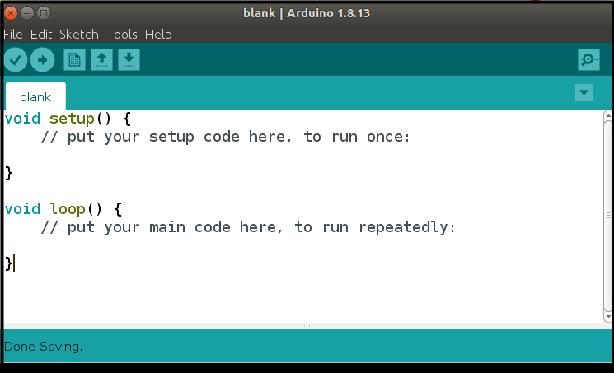
Programming: Getting Started
Saved as sketches (extension .ino)
Follows most characteristics of a C++ syntax/structure
Always has 2 functions:
setup() – code is only executed once
loop() – code is continuously looped

Slide 15
setup()
Executed only ONCE after each powerup or reset of the UNO.
UNO is automatically reset after each successful sketch upload
Contains
initialization code
initialization of variables
setup and configuration of I/O ports
setup of other interfaces
Tip: Use identifiers to name your I/O pins, it makes programming and code recognitions much easier

Slide 16
loop()
The loop() function is executed after the setup() code completes.
Loops infinitely executing code within the loop() function.
Place your code/program within this function, there is NO stopping this code

Slide 17
Coding Tips
Arduino code is loosely based on C++ (actually Processing)
Follow good C++ programming habits:
use comments
indent your code
use UPPERCASE to denote constants or defines
name your variables intelligently

Slide 18
Digital Input/Output
ATMega328 has 14 digital I/O Pins
labelled pin0 to pin13
Pin0(Tx), Pin1(Rx) are assigned as Serial I/O
Pin3, Pin5, Pin6, Pin9, Pin10 and Pin11 have PWM functionality
Digital values
0 (0 V, GND, ON, LOW)
1 (5 V, Vcc, OFF, HIGH - typically > 3.3 V)
Some pins are multifunctional, i.e. have different functions depending on how they are initialized.
inputs (default)
inputs with pull-up resistors
outputs
Pulse Width Modulation outputs

Slide 19
Digital Input/Output
Arduino provides useful functions and libraries simplifying these operations
pinMode() - initialises the pin
digitalRead() - reads/inputs a digital value
digitalWrite() - outputs a digital value
analogWrite() - outputs a PWM

Slide 20
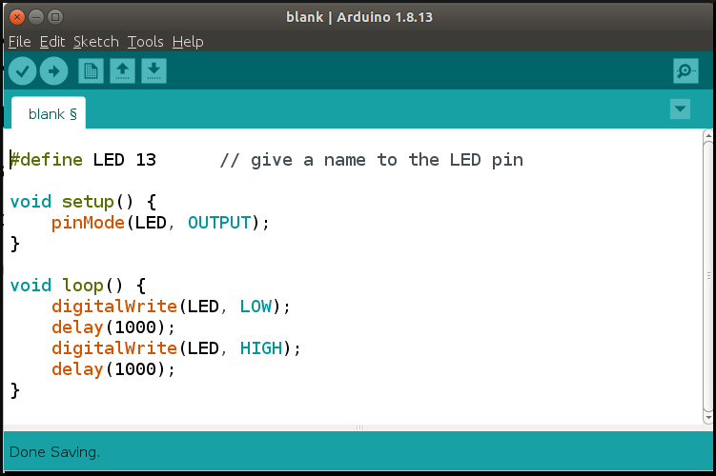
Digital Output
Let's blink (turn ON/OFF) the on-board LED
pinMode() initialises pin13 to be an OUTPUT pin
digitalWrite() outputs a 0 or a 1 alternately
delay of 1 second to allow us to view the result

Slide 21
pinMode( pin, MODE )
Configures specified pin to behave either as input or output.
Modes available
INPUT digital input mode (high-impedance states)
INPUT_PULLUP digital input mode with internal 20K-50K ohm pull-up resistor
OUTPUT digital output mode able to source up to 40mA per pin, total of 200mA per chip

Slide 22
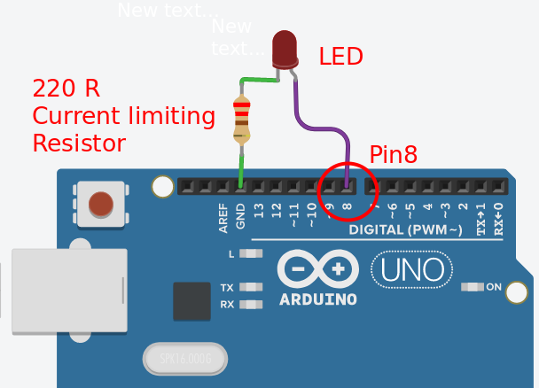
Using an External LED
Let’s blink an external LED
need to WIRE-up the circuit
requires a current-limiting resistor
change the pin to 8
Compile, Upload, Execute!
What is the purpose of the resistor? Which pins can be used as output pins?
Can you add additional leds?

Slide 23
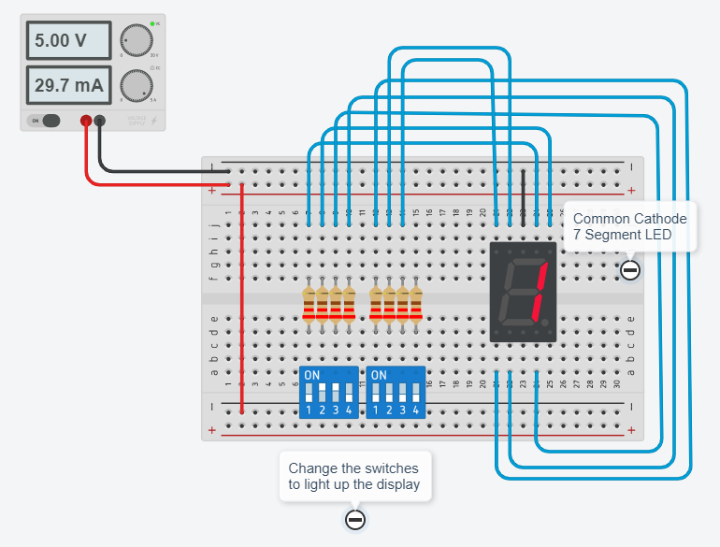
Assignment: A countdown timer
Seven segment LED
Made up of 7 separate LEDs
Combined in segments, forms digits
Change the switches to see the effect
TinkerCAD: CC 7 Seg LED

Slide 24
Assignment: A countdown timer
Experiment with the 7-segment circuit
Convert the circuit which uses an Uno to control the 7-segment CC display
Write a program that counts from 0 to 9 continuously
Why I should use Arduino IDE 2.0?
Why can’t I use a single resistor at the CC pin?

Slide 25
Review: This lesson
Review the notes (Introduction to Arduino Systems)
Install Arduino IDE (ver 2)
Use TinkerCAD, play with Uno + single LED
Use TinkerCAD, open Uno CC 7 Seg display
Check out codes of digits 0..9
Replace switches with UNO
Program UNO to display 0..9 continuously, 1 second between digits

Slide 26
EP1000
Embedded Systems 1
End

