Slide 1
EP1000
Embedded Systems 2 Programming

Slide 2
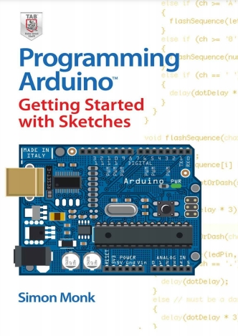
Arduino System
Programs written for the Arduino system are text files called sketches (extension .ino)
The programming language used is based on Processing, which is loosely based on the C++ syntax.
A simple and easy introduction to Programming Arduino. Available in the SP Library

Slide 3
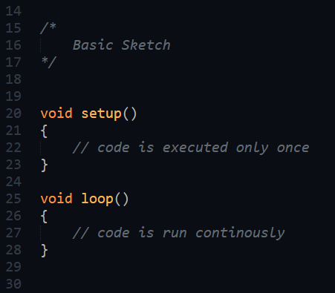
Sketches
All Arduino sketches have 2 functions:
setup() code is executed only once used for initialisation and setup of I/O
loop() code is executed continuously application code is placed here

Slide 4
Variables
Variables are memory set aside to hold changing data.
Variables use different amounts of memory depending on the data type used.
Common data types are
char 8-bit
int 16-bit
float 32-bit
String stores a sequence of characters
We use identifiers (names) to name the variable and locate it.
Use conversion functions to convert between them
Data Types
array
bool
boolean
byte
char
double
float
int
long
short
size_t
string
String()
unsigned char
unsigned int
unsigned long
void
word

Slide 5
Operators
Arithmetic Operators
Boolean Operators
Compound Operators
% (remainder)
* (multiplication)
+ (addition)
- (subtraction)
/ (division)
= (assignment operator)
! (logical not)
&& (logical and)
|| (logical or)
%= (compound remainder)
&= (compound bitwise and)
*= (compound multiplication)
++ (increment)
+= (compound addition)
-- (decrement)
-= (compound subtraction)
/= (compound division)
^= (compound bitwise xor)
|= (compound bitwise or)
Bitwise Operators
& (bitwise and)
<< (bitshift left)
>> (bitshift right)
^ (bitwise xor)
| (bitwise or)
~ (bitwise not)
Use the KISS principle!
Operators work only with similar data types
Use conversion functions to help.

Slide 6
Boolean
Boolean variables have only 2 values: True/False
Boolean expressions have only 2 results: True/False
Comparison operators give a Boolean result
Boolean operators work only with Booleans
Comparison Operators
Boolean Operators
!= (not equal to)
< (less than)
<= (less than or equal to)
== (equal to)
> (greater than)
>= (greater than or equal to)
! (logical not)
&& (logical and)
|| (logical or)
Used in Conditionals, Loops

Slide 7
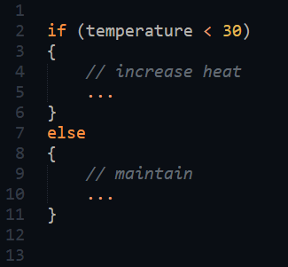
Conditional: if … else
Control Structure which checks the condition expression and if true executes the following code block.
Condition Expression is a Boolean expression.
When used with the else, control transfers to the else block.
Can have nested or have multiples else-if conditionals for more granular control.

Slide 8
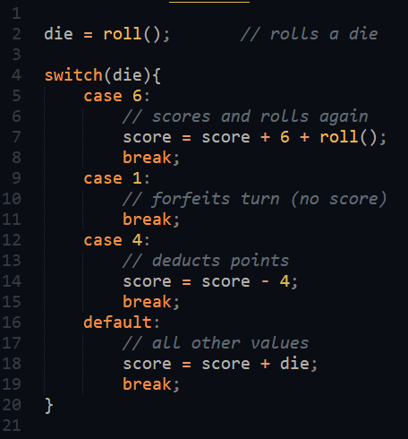
Conditional: switch … case
Control Structure which checks the value in switch (preferably ordinal) and transfers control to the matching case code block.
Each case code block must be terminated with a break.
Each case must match exactly.
Control is transferred to the default code block (if any) if there is no match.

Slide 9
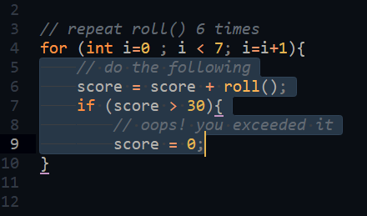
Loop: for
Structure of for
Initialization
Conditional expression
Increment
Used when we know exactly the number of times we wish to loop.
Loops a fixed number of times

Slide 10
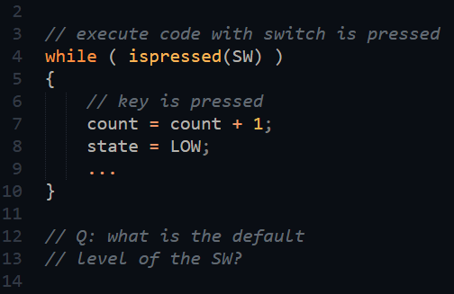
Loop: while
Tests conditional expression, if true the code block is executed.
Indefinte loop, code block is executed zero, once or many times.
If the condition results always in True, we have an endless loop.
Loops a 0, 1 … n number of times

Slide 11
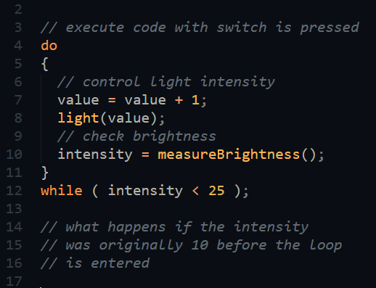
Loop: do … while
Executes the code block before testing the conditional expression.
If conditional expression is true the code block is repeated.
Indefinte loop, code block is executed once or many times.
If the condition results always in True, we have an endless loop.
Loops a 1 … n number of times

Slide 12
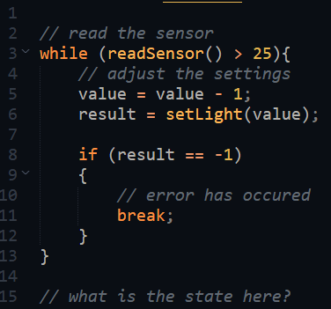
Control: break
When used in a loop, break exits the loop, control transfers to next statement after loop.
break is also used to transfer control out of a matching case in a switch statement.
Control: continue ignores the remaining statements and transfers control to the loop condition. (not commonly used)

Slide 13
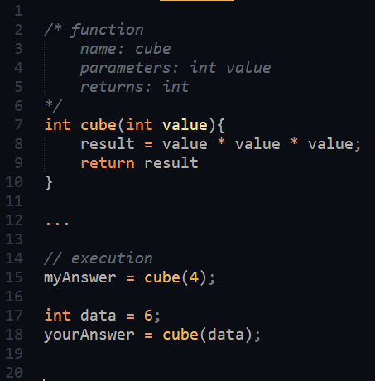
Functions
A function is identified using ()
A function is a block of code that can accept parameters.
Executes the code when called, returns a single value as it’s name.
return is used to return the value in the indicated data type.

Slide 14
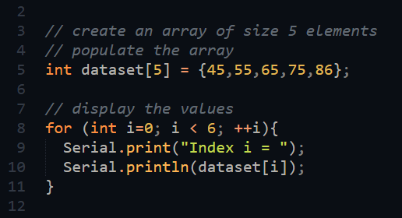
Arrays
Arrays is a data type which can hold multiple values in a single variable.
The values must be of the same data type, as defined by the array.
Each element can be accessed using an index, which starts from 0.
You can identify an array by the “[ ]”

Slide 15
Class
A user-defined data type that is used to create objects.
An object has
attributes (constants, variables)
methods (functions)
An object’s attributes and methods are accessed using the dot (.) operator
Classes are predominantly used in code libraries
Classes should be identified using a starting uppercase character e.g. Serial

Slide 16
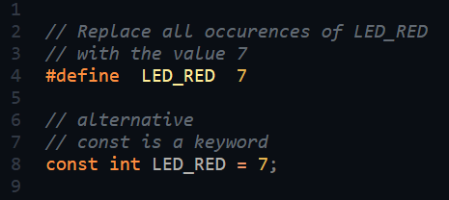
Directive: #define
#define is a compiler directive and not a code statement.
Does not end with a semi-colon
Used to name a constant and assign the value
const is the preferred method of defining constants
Constants should be identified using uppercase

Slide 17
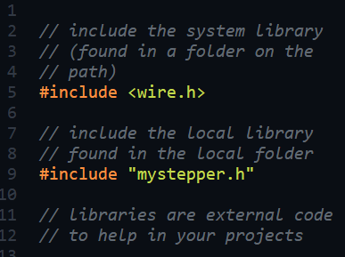
Directive: #include
#include is a compiler directive and not a code statement.
Does not end with a semi-colon
Instructs the compiler to read and insert code from the target file
< file > indicates system library, found along the library path
“ file “ indicates local file in same folder

Slide 18
EP1000
Embedded Systems 2 Programming
End

