Slide 1
EP1000
Libraries

Slide 2
Arduino System
Very popular because of abundance of Code Libraries for every known sensor, device, application.
No need to write your own code, use a library
Lots of examples available
Library consists of
C++ file (.cpp) which holds the code (usually a Class) which talks to the device/application
Header file (.h) which holds the definitions of the Class and functions available. This must be included in your source code.
Once library is loaded, we just need to use the functions/methods to implement our application.

Slide 3
Loading the Library
3 ways of loading the library
Use the Arduino Library Management system
Download the compressed library (.zip) and use the IDE to load the library
Download the compressed library (.zip), extract the .h and .cpp files, manually copy them into the correct folders, restart the IDE.
Library folder location
Library | Folder location
Arduino IDE System Libraries | C:\Program Files (x86)\Arduino\libraries
User libraries | C:\Users\<username>\Documents\Arduino\libraries
User Library folder: IDE > File > Preferences

Slide 4
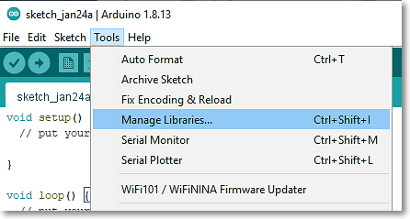
Arduino IDE Managed Libraries
Simplest method of loading a library
Recommended by Arduino, for most used libraries
IDE > Tools > Manage Libraries
Search for the library you require
Select the library
To use the library IDE > Sketch > Include library
Sometimes examples are included with the library for you to test the functions.
Problems: Sometimes library you want is not available. (too new, rarely used)

Slide 5
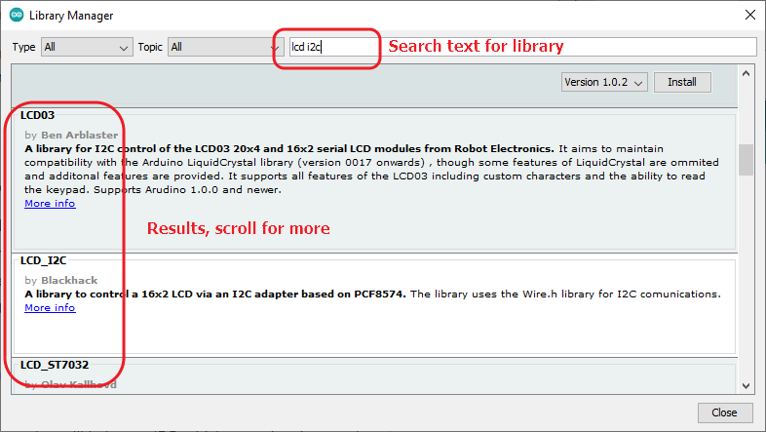
IDE Managed Library

Slide 6
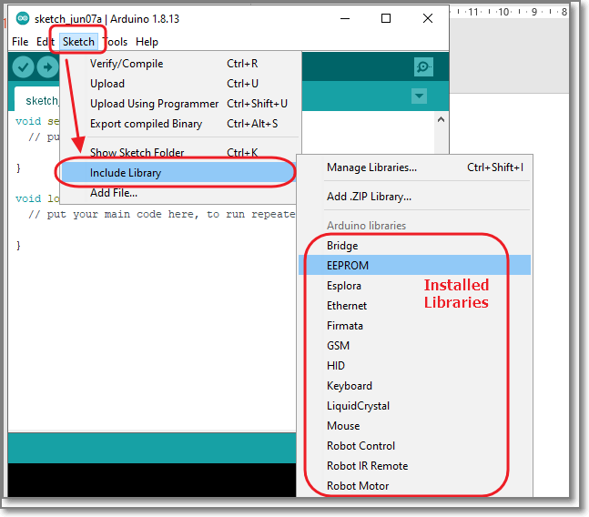
Include the header file
#include <device.h> System library, header file is found in the system folders
#include “device.h” User library, header file is found in the local folder library
(see IDE > File > Preferences>
Similar interfaces for IDE v2

Slide 7
Manually Installed Library
Manual method of installing a library
Manually download the compressed library (.zip)
Extract the files (usually a folder is created)
Check that the .h and .cpp files are present
Copy the folder to either
Arduino System Library Folder
User library folder
Restart the IDE
Include the header file (system/local) in the appropriate manner.

Slide 8
References:
Adafruit: All About Arduino Libraries
Sparkfun: Installing an Arduino Library
Youtube: Arduino Libraries! How to Install them properly! Tutorial showing you 3 different ways

Slide 9
EP1000
Libraries
End

