Slide 1
EP1000
Sensors

Slide 2
Input Devices - Sensors
Sensors are input devices
Measure some physical quantity (touch, light, heat etc)
Changes are slow (compared to computational power)
Most readings are analog by nature
Requires conversion to digital for processing
Methods of reading sensors
Data is always available (e.g. temperature)
Polling to check whether data is available from sensor
Triggering – sensor will send a signal indicating data

Slide 3
Typical Sensors
Physical Quatity | Sensor | Typical devices
Heat | Thermal probe | LM35, DHT11, DS18B20
Light | Light-sensitive transistor | LDR-5516, Light detectors
Sound | Microphones | Sound Sensor KY-038
Distance | Ultrasonic distance measurer | HC-SR04
Touch | Capacitive touch plate | Touch switches
Movement | Infra-red movement detector | HC-SR501 PIR, RCWL-0516
Water (Humidity) | Humidity sensor | DHT-11, Water level sensor
Time | Real-time Clocks | DS3231. DS1302
Weight | Load Cell | LWC with HX711 ADC
Video | Video Camera | OV7670, Pixy2
Ref:
Arduino - 245 Sensor Projects
Instructables – 37 in 1 Sensor Kit Explained
Bas On Tech – Arduino Tutorials

Slide 4
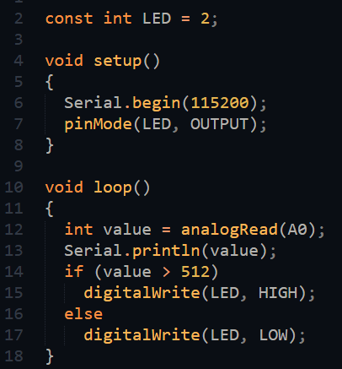
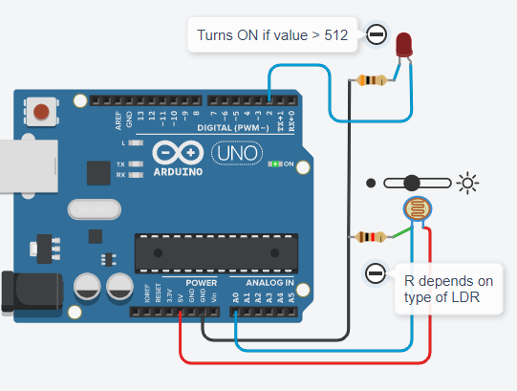
Measure Light Intensity
Light-depended Resistor (LDR 5516)
Read the equivalent analog voltage

Slide 5
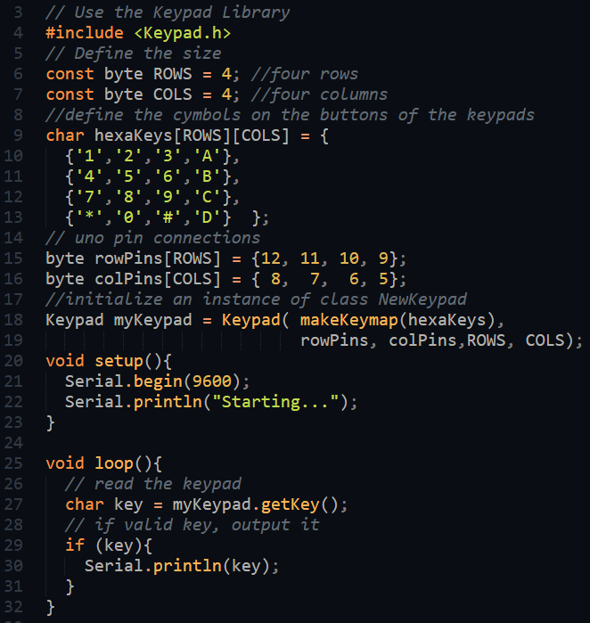
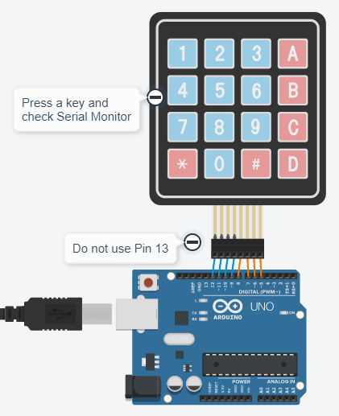
Matrix Keypad with Library
KeyPad Library
Simulation only works with some libraries Ref: Libraries with TinkerCAD

Slide 6
Infra Red Remote Control
Alternative method of providing input to a project.
The Remote control sends Infra Red (IR) pulses which carry a code. An IR receiver reads the pulses and sends it to the controller input pin Microcontroller decodes the pulses
Library: Arduino IRRemote Simple and can be used with a variety of commercial remotes
Simplest is to use it with the IRReceiver and Control for Arduino Kits
A very good YouTube tutorial: DroneBot Workshop: Using IR Remote Controls with Arduino
Can be simulated with TinkerCAD

Slide 7
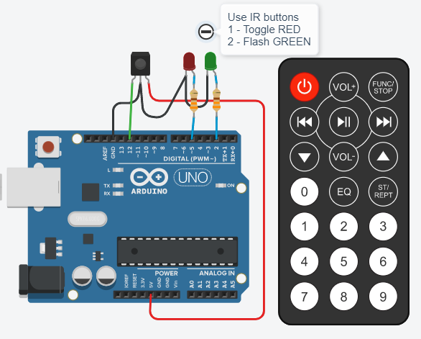
IRRemote Example
Uno IRRemote Control
Use Serial Monitor to determine the hex codes before writing the application for the IR Remote
Example:
Key 1 = 0xFD08F7
Key 2 = 0xFD8877
Use a switch-case to effect the applications to be done

Slide 8
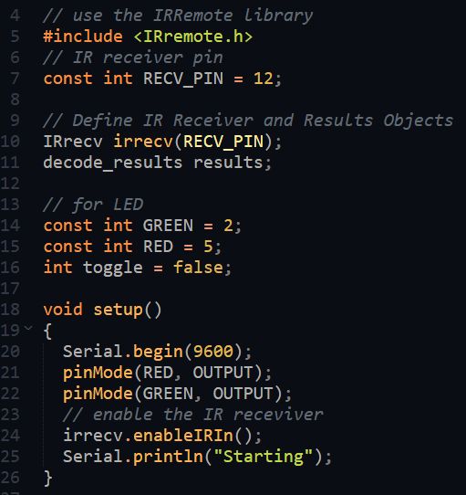
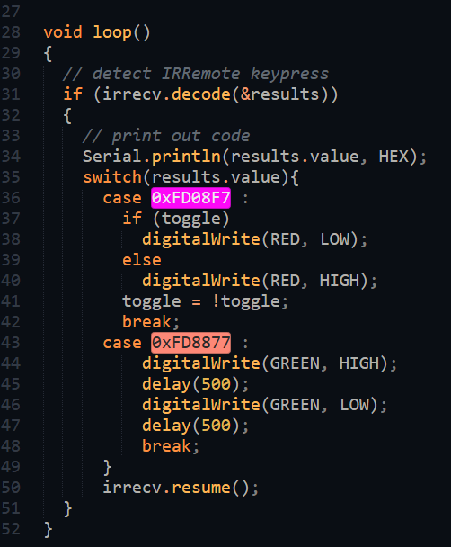
IR Remote code

Slide 9
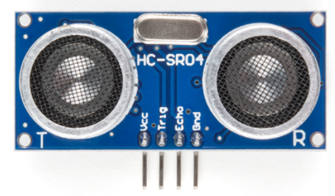
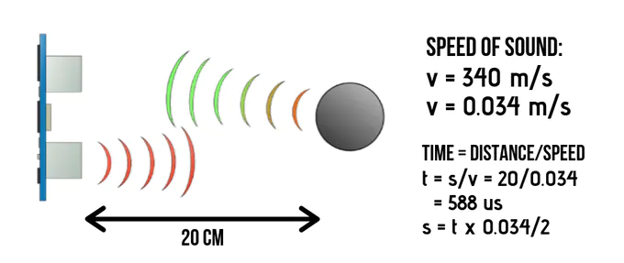
Measuring Distance
Ultrasonic Sensor HC-SR04
Measures distances between 2cm to 400cm without contact using sound (ultrasonic)
Requires a trigger and an input (2 digital pins)
Lots of tutorials:
Arduino.cc
Instructables

Slide 10
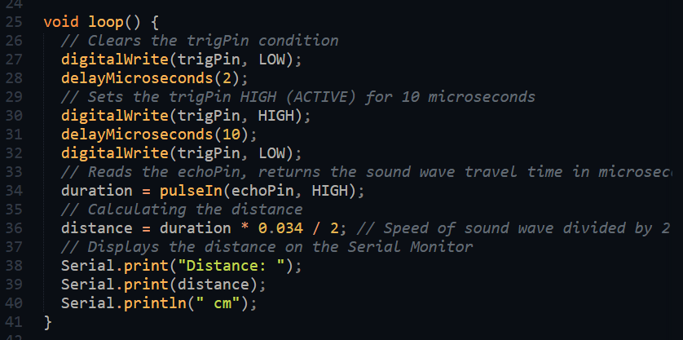
Measuring Distance – SR04
LOW pulse (10 mS) is used to trigger the sensor
Return pulse is measured using pulseIn(), distance is proportional to pulse length

Slide 11
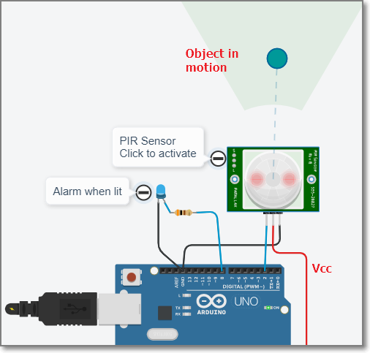
PIR Motion Sensor HC-SR501
Passive Infra Red
Detects motion
Adjust Sensitivity
Wait at least 15 s
No Library required, 1 digital I/O input pin for status.
Check pin
LOW no motion
HIGH motion detected
Cannot measure distance
Motion detection using PIR HC-SR501
Better alternative: RCWL-0516 Microwave Proximity Sensor

Slide 12
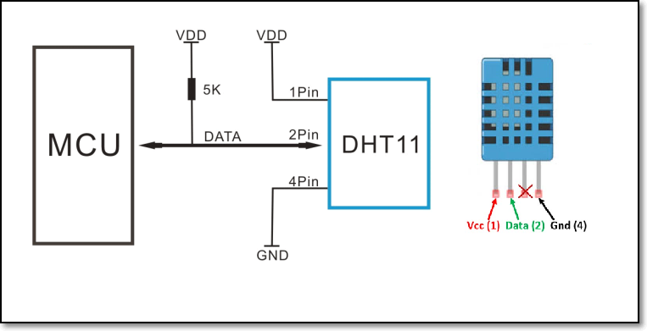
Room Temperature & Humidity
DHT-11 Temperature and Humidity sensor
20~80% humidity, 0~50ºC 1 Hz sampling rate.
Library from Adafruit (install both):
TinyDHT
TinyWire
Requires 1 digital I/O pin
Better results, accuracy with the DHT-22, however, 2~3x more expensive

Slide 13
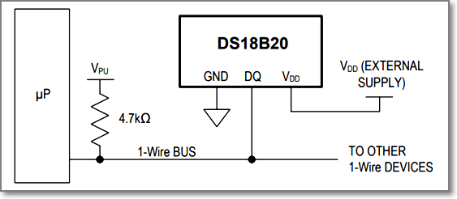
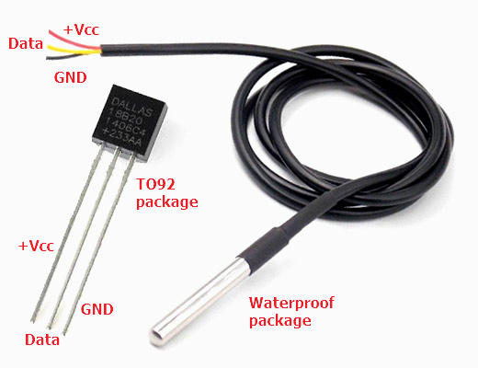
Higher Temperatures: DS18B20
Specifications:
Temperature range: -55ºC ~ 125ºC, Accuracy: +/- 0.5ºC
Communication: 1Wire
Sampling: 750mS at 12bit
Library: DS18B20_RT Arduino Temperature Control Library
Minimal functions, simple
1 sensor per MCUpin
Uses: temperature sensing in hard environments, liquids away from processing unit

Slide 14
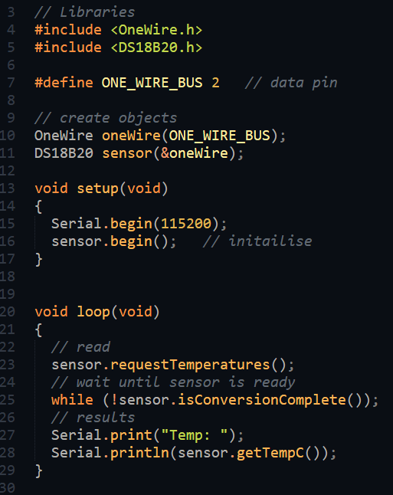
Reading the DS18B20
Libraries:
DS18B20_RT sensor library
OneWireNG communications library
Library only provides minimal functions
Instantiate object
Trigger sensor read
check data ready
Read temperature ºC

Slide 15





Temperature Sensor Comparison
Sensor | DHT11 | DHT22 (AM2302) | LM35 | DS18B20 | BME280 | BMP180
Measures | Temperature Humidity | Temperature Humidity | Temperature | Temperature | Temperature Humidity Pressure | Temperature Pressure
Communication protocol | One-wire | One-wire | Analog | One-wire | I2C SPI | I2C
Supply voltage | 3 to 5.5V DC | 3 to 6V DC | 4 to 30 V DC | 3 to 5.5V DC | 1.7 to 3.6V (for the chip) 3.3 to 5V for the board | 1.8 to 3.6V (for the chip) 3.3 to 5V for the board
Temperature range | 0 to 50ºC | -40 to 80ºC | -55 to 150ºC | -55 to 125ºC | -40 to 85ºC | 0 to 65ºC
Accuracy | +/- 2ºC (at 0 to 50ºC) | +/- 0.5ºC (at -40 to 80ºC) | +/-0.5ºC (at 25ºC) | +/-0.5ºC (at -10 to 85ºC) | +/-0.5ºC (at 25ºC) | +/-0.5ºC (at 25ºC)
Support (Arduino IDE) | Adafruit DHT Library Adafruit Unified Sensor Library | Adafruit DHT Library Adafruit Unified Sensor Library | analogRead() | DallasTemperature OneWire | Adafruit BME280 library Adafruit Unified Sensor Library | Adafruit BME085 Adafruit Unified Sensor Library

Slide 16
Real Time Clock Modules
Uno has no RTC to keep track of time.
Use RTCLib
Use independent RTC Modules
DS1307
Has a 32KHz crystal oscillator (slightly off)
Has provision for DS18B20 connection
Has battery backup
DS3231
Uses I2C communications
Uses temperature controlled oscillator
Has battery backup

Slide 17
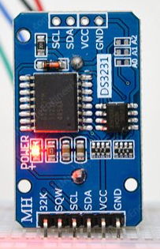
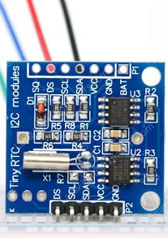
Real Time Clock Modules
Uno does not have a RTC module to keep accurate time (powerd off)
Use a RTC Clock Module and Adafruit RTCLib
DS1307
Uses OneWire communications
Has a 32KHz crystal oscillator
Has provision for DS18B20 connection
Has battery backup
DS3231
Uses I2C communications
Uses temperature controlled oscillator
Has battery backup

Slide 18
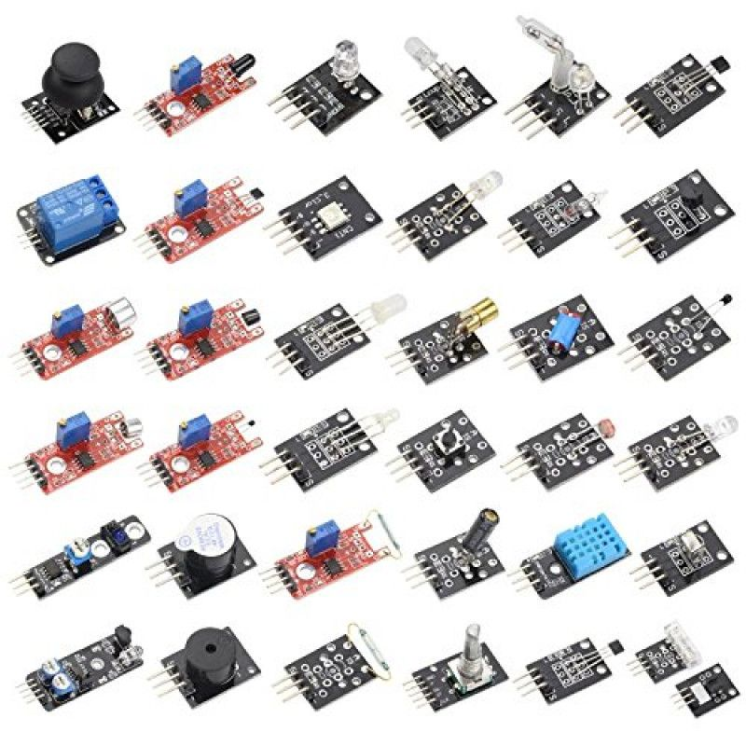
Sensor Kit 37-in-1
Almost all physical properties can be measured.
Affordable way of learning how to work with sensors.
Code & Tutorials available
Libraries and simplicity make the Arduino system popular.
NB. Not all are sensors, some are actuators

Slide 19
References:
Dronebot workshop
Last Minute Engineers
Arduino Project Hub
Instructables

Slide 20
EP1000
Sensors
End

