Slide 1
EP1000
Actuators

Slide 2
Actuators
A component of a machine that moves/controls a mechanism in a system.
An “output” device.
Examples:
Displays – LED, LCD, Neopixels
Motors – DC Motors, Stepper Motors, Servo Motors
Valves – Water, gas
Solenoids – controls heavier voltages, currents
Sounds – buzzers, alarms

Slide 3
Display devices
The most common output display devices used in projcects are:
LEDs (indicators)
LCD (display panels, information) 16x2, 20x2
7-segment tube displays
Dot-matrix displays (running messages)
Oled displays
NeoPixels (strip lights, multi RGB leds)

Slide 4
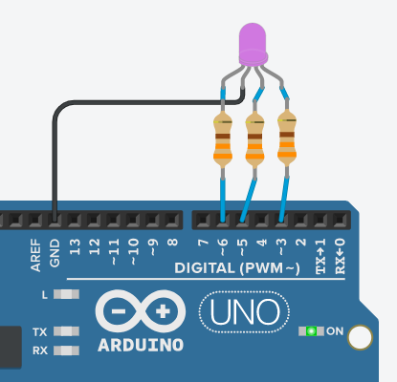
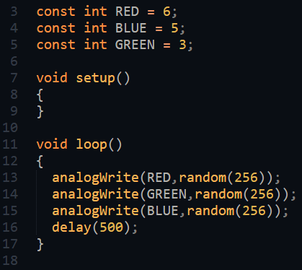
LEDs
Types: single, RGB, 7-segment
Identify the Anode (or Cathode)
Ensure there is proper current limiting resistors
You need a delay to maintain the display (persistence of vision)
You can use PWM to obtain different intensity levels.
Uno Random RGB Led using PWM

Slide 5
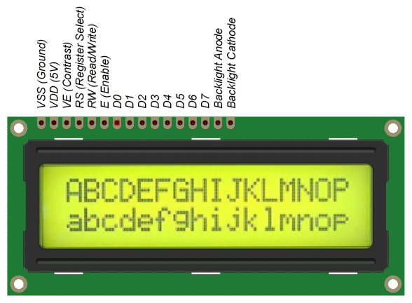
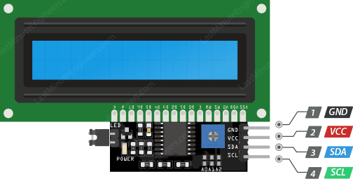
LCD Displays
Common method of displaying information
Usually Hitachi HD44780 control requires 11 lines (8 data, RS, RW, En)
Made simpler using an I2C 1602 controller for the LCD panel
Library: LiquidCrystal I2C by Frank de Brabander.
Reference: LastMinuteEngineers

Slide 6
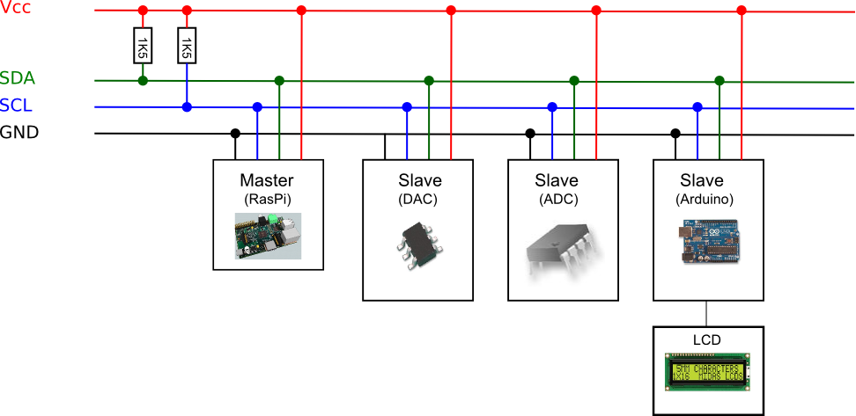
I2C Interface
A method of Serial communication.
Uses 2 wires (SDA, SCL) to communicate between devices.
Each device has a unique address which identifies it.
Can have up to 1024 devices
Ref: How To Mechantronics How I2C Communication Works and How to use it with Arduino

Slide 7
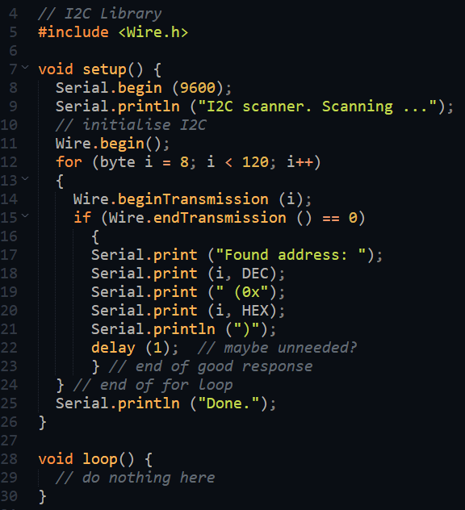
Identifying I2c devices
Use the controller (master) to scan the bus for devices (slaves).
The addresses will be printed out on the Serial Monitor.
You can then use the address to write/read from the device.
Library: Arduino Wire Library
Example code is usually provided by the device library.

Slide 8
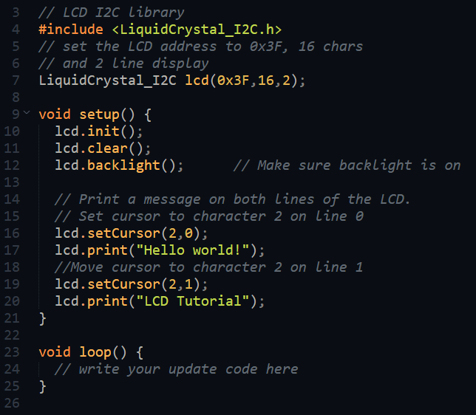
Writing to I2C LCD display
Using the LiquidCrystal_I2C library.
Create the object lcd
Initial housekeeping
Initialise
Clear the screen
Turn on backlight
To print messages
Position the cursor
Print the message

Slide 9
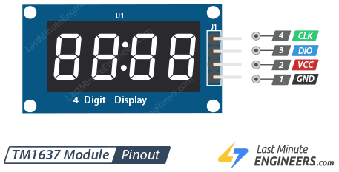
Tube 7-Segment Display TM1637
7-segment displays common in projects
Having multiple 7-segments require conversion and multiplexing
TM1637 provides 4-digit 7-segment display with only 2 digital I/O lines.
Library: TM1637-master by Avishay Orpaz.
Tutorial:
Last Minute Engineers
Makerguides
Other versions have 6~8 digits
Simplifies circuitry

Slide 10
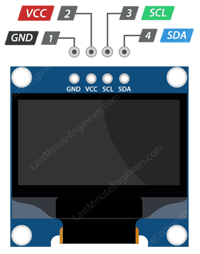
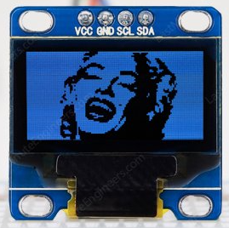
Oled Displays SSD1306
Very small, graphic displays (30x20mm)
Getting popular, for IOT projects for information display.
Resolution: 128x128, 128x64, 128x32 pixels
Uses I2C interface
Library: SSD1306 by Adafruit
Tutorials:
Last Minute Engineers
Adafruit

Slide 11
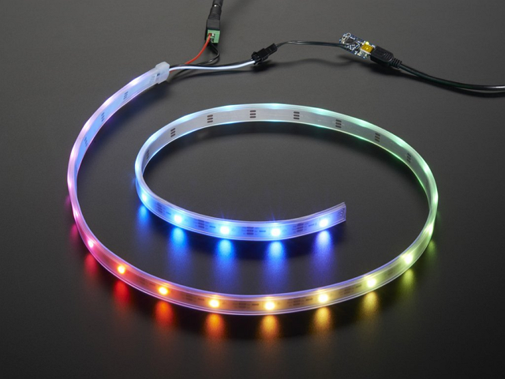
NeoPixels
Individually addressable LEDs housed on a strip and controlled by a single digital I/O pin from the microcontroller.
Can control
Which LED to turn ON/OFF
Intensity of light
Color (If RGB)
Good for lighting, ambient light control, effects
Library: Adafruit Neopixel
Tutorial:
Adafruit
Neopixels require quite a lot of current. Always supply the neopixels from a separate power source, not from the microcontroller.

Slide 12
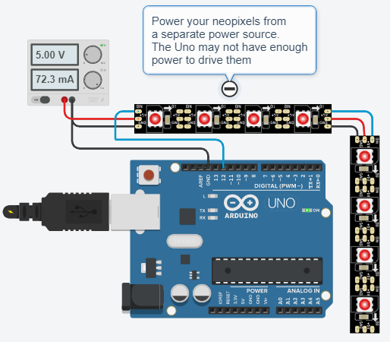
Neopixels - demo
Always power up neopixels using a separate power source for the extra current required.
You can join strips of neopixels together.
Adafruit Library comes with a number of very useful methods:
Color(r, g, b) returns a 32bit color
fill() fills neopixels with same color
setColor() sets individual neopixels
setBrightness() controls intensity
clear() blanks out
show() must be called before the neoplxels can display
Uno Neopixel Strip

Slide 13
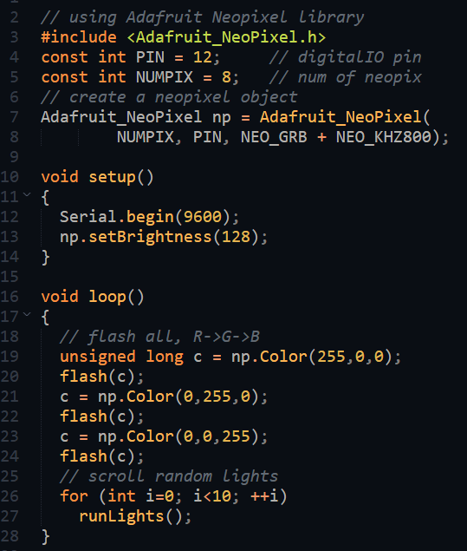
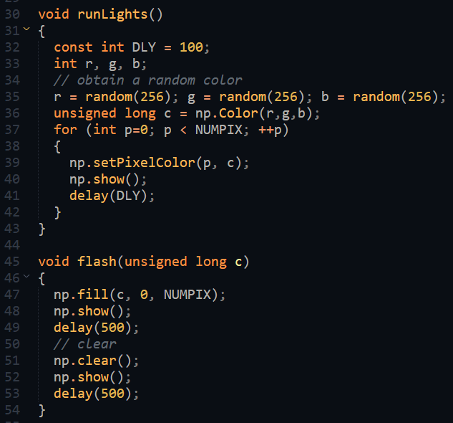
Neopixels – demo code
uint32_t = unsigned long = 32bit
uint16_t = unsigned int = 16 bit

Slide 14
Motors
Motors
AC
DC
DC Motors require a DC current to work.
DC motors are usually continuously rotating. Can control speed and direction
Stepper motors can move in ‘steps’. Usually done using a controller module, or by changing phase activation.
Servo motors can be controlled to move, stop/hold, change direction using pulses.
Motors consume a lot of current, hence requires an interface circuit. Should not be driven from a digital IO pin.
continuous
stepper
servo
rotational
positional

Slide 15
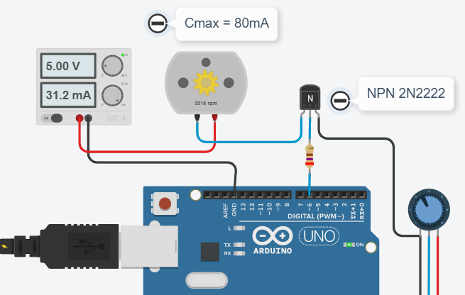
DC Motor control
Use a digital IO pin to control a transistor (Q). Transistor acts like a “tap”
Qon allows current to flow, which makes motor move.
Qoff turns off the current.
Using PWM to control the On/OFF sequence allows control in motor speed.
PWM at low speeds do not provide much torque.
This method only allows one direction of motor.
PWM Motor Control Simulation

Slide 16
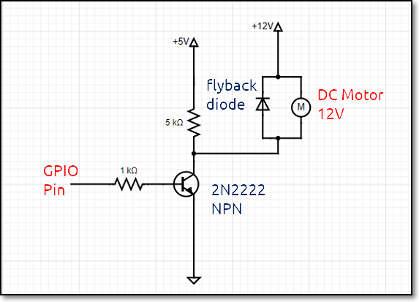
Motor Control with PWM
Many circuits available
Transistor
MOSFET
Transistor acts as a “control tap/valve” for current. Used in the saturation mode.
Problems:
Single direction only
Need to worry about resistor values
Small duty cycles result in lower torque.

Slide 17
H-bridge
Allows PWM motor control in both directions.
H-bridge is an IC made up of transistors or MOSFETs
Most common method of controlling DC motors
References:
Dronebot Workshop
LastMinuteEngineers

Slide 18
H-bridge connections
Transistor driven, combined voltage drop is 1.4V.
If motor is 9V, you will need minimum 9+1.4 = 10.4V.
Can drive 2 DC motors
Enable line controls speed of motors if PWM is applied.
L298 can be supplied separately from the motor voltages
Control | Purpose
IN1 | Input 1 for Motor A
IN2 | Input 2 for Motor A
EN1 | Enable line for Motor A
IN1 | IN2 | Direction
0 | 0 | Motor OFF
5V | 0 | Forward
0 | 5V | Reverse
5V | 5V | Not used

Slide 19
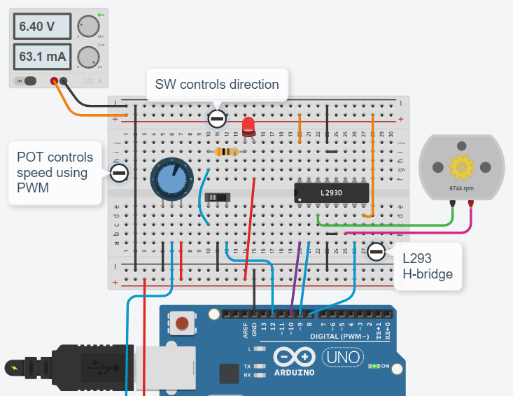
H-bridge Simulation
H-bridge L293
H-bridge (L293) control of a dc motor.
Use SW to control direction of motor (IN1, IN2) Use POT to control speed of the motor (EN1)

Slide 20
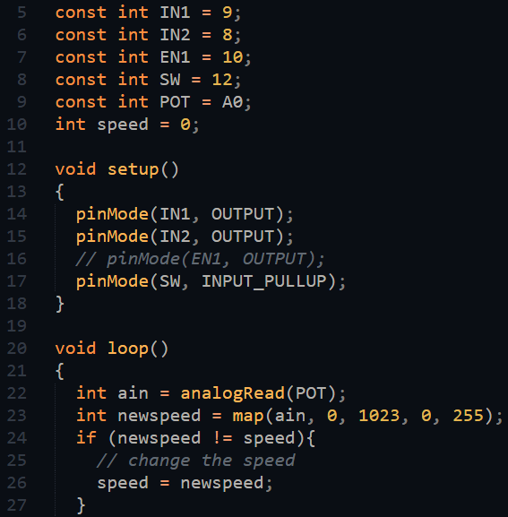
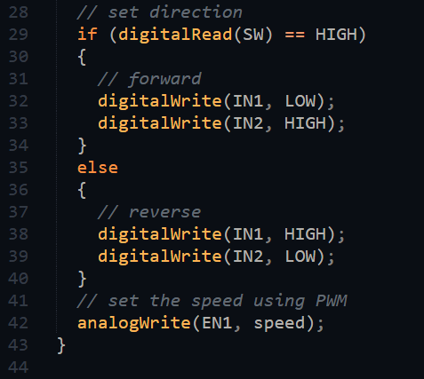
H-bridge code

Slide 21
Stepper Motors
A motor that can move in steps.
Each step is a division (in degrees) of a full rotation.
Done by activation motor coils.
Stepper Motors are good
For exact positional control
Movement at specific speeds
High torque (even at rest)
Have Stepper control modules
References:
Wikipedia: Stepper Motor
Dronebot Workshop
LastMinuteEngineers

Slide 22
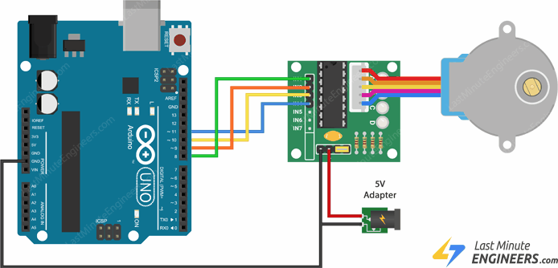
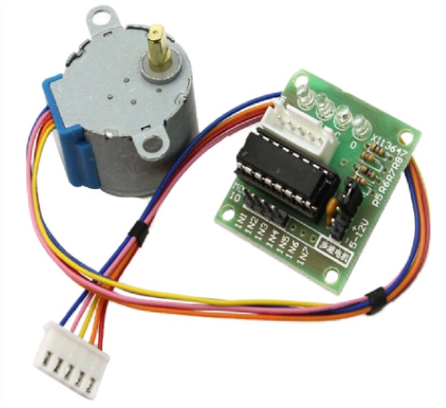
Simple Stepper Motor: 28BYJ-48
Common hobby motor with controller board for many projects.
Able to work with 5V supply (external)
Can be controlled manually or with a library
Library: Arduino Stepper
References:
LastMinuteEngineers
Dronebot workshop (has manual code and library examples)

Slide 23
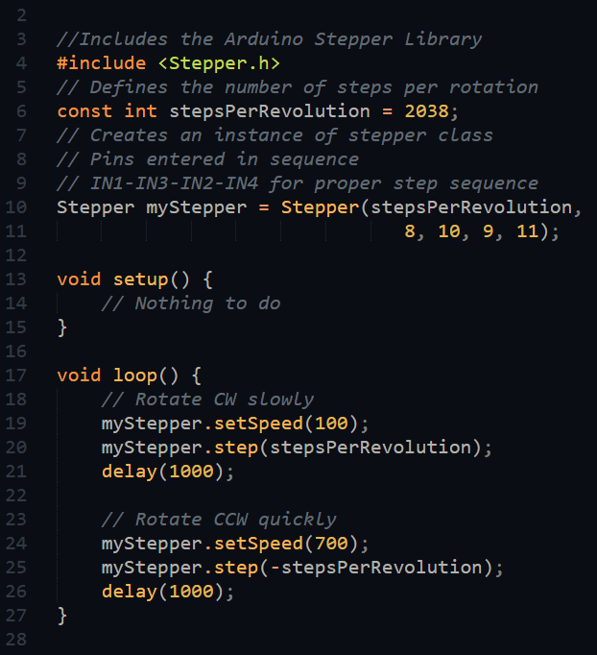
Stepper Motor Code
Uses stepper motor library
There is a min and max speed the motor can achieve.

Slide 24
Servo Motors
Has an internal control circuit with geared motors
Controlled using PWM
Pulse width determine
Position of servo
Direction of rotation
Library: Arduino Servo
Reference:
LastMinuteEngineers
Dronebot Workshop
Positional Servo (FS90)
3.0~5.0V, 120º angle
Servo pulse 900~1200uS determines position
Maintains control position
Continuous Rotation (FS90R)
3.0~5.0V, 360º rotation
Servo pulse 900~1200uS controls direction of rotation or speed
For small robots or moving objects

Slide 25
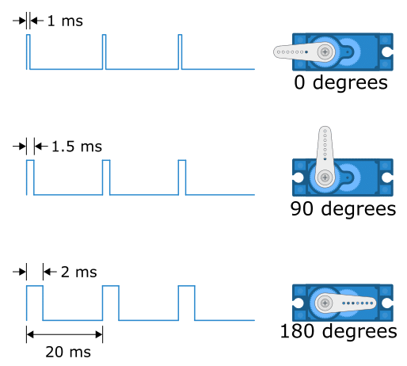
How Servos work
Controlled by pulse width
0 = 1ms (min)
90 = 1.5ms (neutral)
180 = 2ms (max)
Varys slightly with motor
Continuous motor
0 = full speed direction 1
90 = stop
180 = full speed reverse direction 1
Must always use external power.

Slide 26
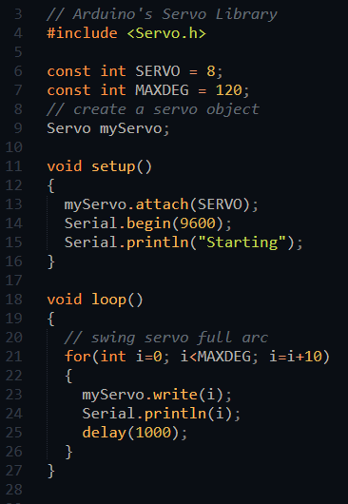
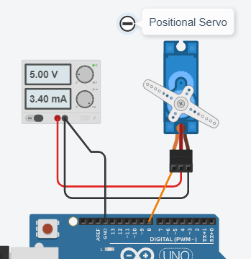
Positional Servo
Positional Servo Use any digital I/O pin
Assume max angle = 120º

Slide 27
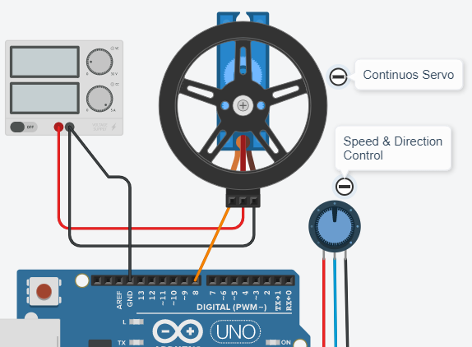
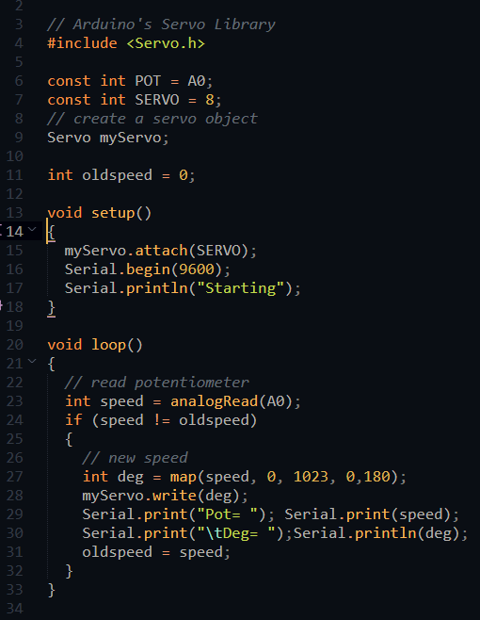
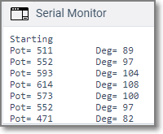
Continuous Servo - code
Uno Continuous Rotational Servo

Slide 28
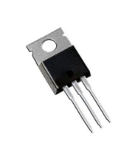
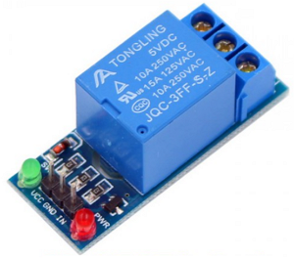
Controlling high powered applications
Use transistors or Mosfets (Ref: Dronebot workshop – Transistors & MOSFETS)
Use relays/relay modules (Ref: Dronebot workshop – Relays)
Control = Turn ON/OFF high power devices.
Be very careful when working with higher voltages!

Slide 29
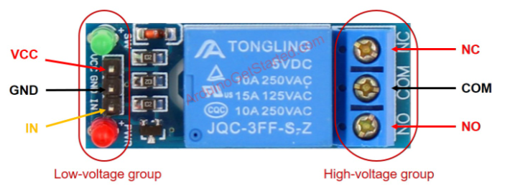
Typical Relay Module
Inputs 5V DC
Outputs 10A 250VAC
Relay module must be powered up on the input side.
One digital I/O pin (IN) for control in switching
Split the “Live” end on high voltage side for switch
Ref:
LastminuteEngineers
Dronebotworkshop
IN | Outputs NO-COM
0 V | No connection
5 V | Conducts
NC (Normally Closed) works opposite to NO (Normally Open)

Slide 30
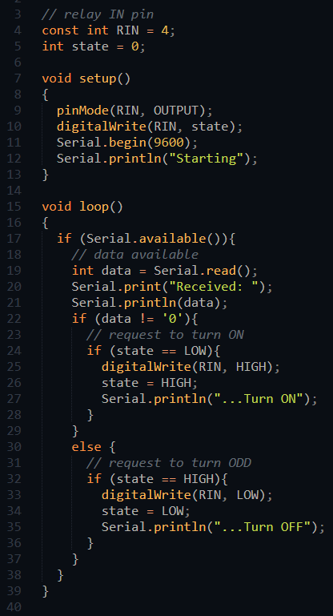
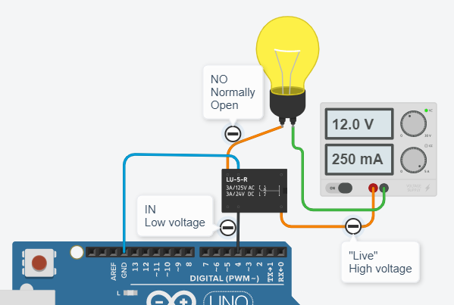
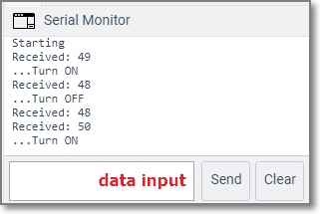
Relay connection
Control High Power devices using a relay

Slide 31
EP1000
Actuators
End

