Slide 1
EP1000
Today’s Class CSS, Version Control (Git), Markdown

Slide 2
Review
Have you created JR’s site?
Have you played with CSS?
Local hosting

Slide 3
Jake Wright’s site
Key points
How to layout a typical site – JW modified
Navigation links
Sections – section, div
Simple examples to CSS
Class
Ids
External CSS files

Slide 4
Website construction
Jake Wright’s Learn CSS in 12 minutes
How to plan a site
How to sub-divide your site into sections
Use CSS to format your content
Need to implement JW Site in Github
Modify to 1024 width
Choose a nice color scheme
Start populating the site
How would you add pages?
Is this a viable solution

Slide 5
Hosting HTML pages
How to view HTML pages?
Drag and drop onto a browser
Use a local webserver (HTTP server)
Apache Web Server (too complex)
Portable Web Servers
RTLabs - Tiny HTTP Server
Use python (python –m http.server)
Need to fix Chrome – only allows HTTPS
Spiceworks: How to: Chrome: allow localhost site even without https certificate
chrome://flags/#allow-insecure-localhost - enable

Slide 6
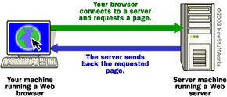
What is a webserver?
Protocol: https
Address: www.google.com
Cmd: GET
Parameter: index.html
How do Webservers work?
https://www.google.com

Slide 7
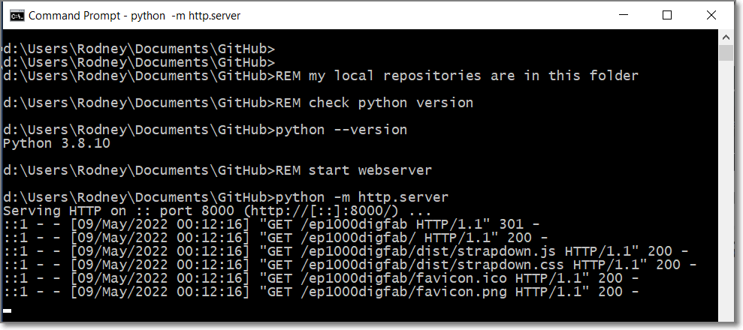
python –m http.server
Only works with python version 3
^C (Ctrl-C to exit and close)

Slide 8
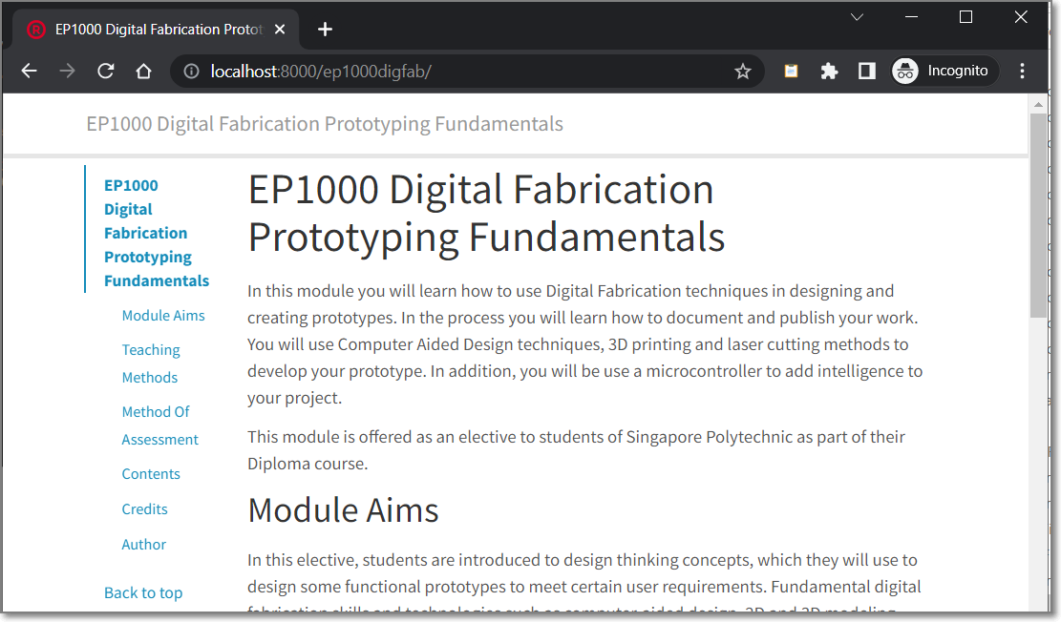
Localhost:8000
Great for advanced testing

Slide 9
Version Control - git
Keeps a backup of your work
Allows you to access and view previous changes
Alternatives:
Dropbox
Google Drive (have to do manual backup)
Microsoft Onedrive
Problems:
Instantaneous
Not suited for collaborative (group) work

Slide 10

A little technical…
Latest addition to “git” videos
Suited for programmers
Uses git desktop
Youtube:
Andreas Spiess - GitHub Tutorial without using the Command Line

Slide 11
Markdown
Easy to learn, write and use – Markdown Guide
Used in github (README)
Can be used to develop an entire site: EP1000
Viewing in Chrome (need extensions)
Markdown Viewer
Markdown Preview Plus
Editing in VSCode, Atom, Sublime

Slide 12
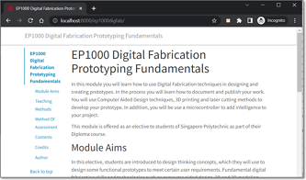
How it works…(on Github)
Servers pre-processor
Server sends
to requestor
.md
.html
page.md
(markdown)
page.html
(converted)
Owner uploads .md files, server automatically converts them
Client requests for site files
Server sends HTML code

Slide 13
Alternatively…
Strapdown.js - use Javascript to convert the contents on the client side.
Files saved as HTML
Client receives the HTML file
Executes the JS code
JS converts contents to HTML
Displayed on browser
Example: ep1000digfab site

Slide 14
Markdown
Advantages
Easy to learn, use and write
Easy to read (looks like notes)
Disadvantages
Looks like notes
Cannot “prettify” site, looks very plain
What you cannot do in Markdown, do in HTML/CSS (Markdown processors ignore HTML/CSS)

Slide 15
EP1000
Notes
End

