Slide 1
EP1000
Computer Controlled Cutting

Slide 2
Computer Controlled Cutting
Perform Cutting operations based on digital data.
Also known as CNC (Computer Numerical Control)
Data is provided from:
CADD operations
Digital 2D drawings
Provides accurate and precise cutting operations
Used in:
Laser cutting & engraving
Flatbed cutters & 2D routers
Milling machines

Slide 3
2D profile
All cutting systems work on a 2D profile which provides an outline of the cut.
Advantages:
The cut is precise with little wastage of material.
Allows positioning to prevent wastage.
Repeatability
Vector File formats:
DXF (Data eXchange Format)
PDF (Portable Document Format)
SVG (Scalable Vector Graphics)

Slide 4
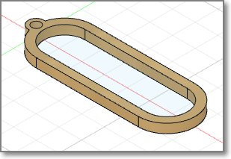
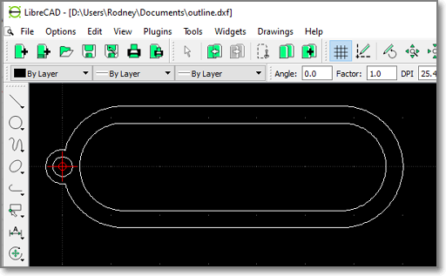
Vector Software
2D Vector drawing programs: Inkscape, AutoCAD
CADD Software – Fusion 360
Don’t forget InkScape !

Slide 5
Software Tools
Fusion 360
Full CAD/CAM software to obtain profiles
Lots of modelling tools to help
Vector Drawing software
Inkscape
LibreCAD (for DXF files)
CorelDraw (licensed software)
Output Vector formats
DXF (outdated, but still used, text editable)
PDF, EPS
SVG (may have different variants)
AI (Adobe Illustrator format)

Slide 6
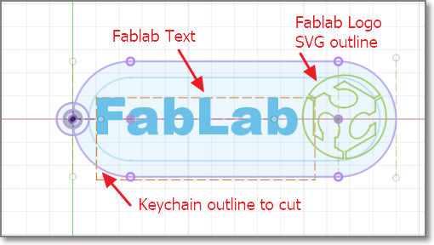
Exercise 1: Keychain for cutting
Let's make a keychain for the fablab with logo
Size: 30mm x 70mm x Thickness (dependent on material)

Slide 7
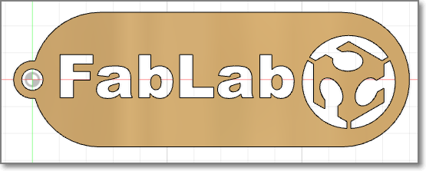
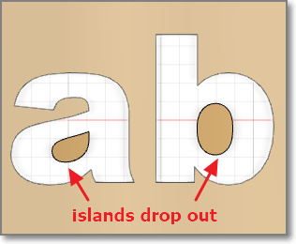
What happens when cut
Islands may form, these drop out after cutting
Need to edit the Vector file before cutting
Placement of causeways to prevent drop-outs
Post production (i.e. edit DXF exported file)

Slide 8
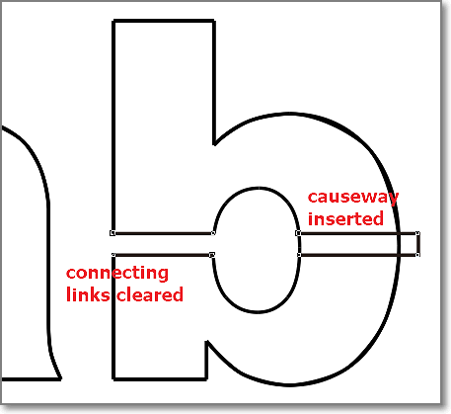
Post Production Editing
Use a Vector Drawing program to create the causeways
May need knowledge of vector drawing program
Suggest CorelDraw

Slide 9
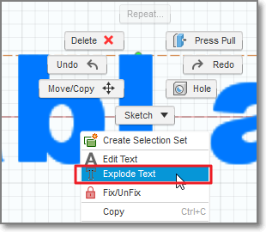
Fusion 360 Explode Text
Use the Explode Text function to separate each letter in the word.
Add causeways in Fusion 360 before extrusion for cut surface

Slide 10
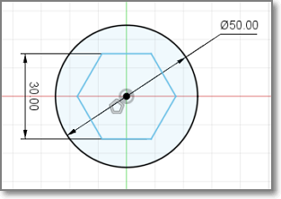
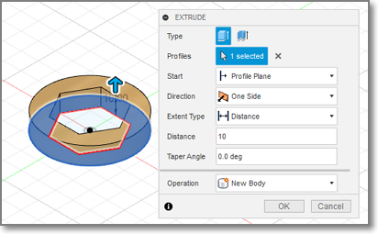
Fusion 360: Export Cut Profile -1
Create your design
Extrude surfaces to create object

Slide 11
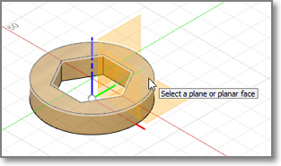
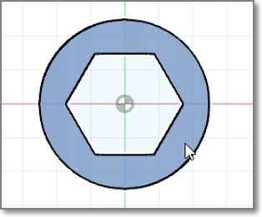
Fusion 360: Export Cut Profile -2
New sketch on object profile to cut
Click again on profile to verify/select

Slide 12
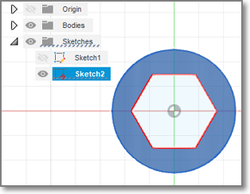
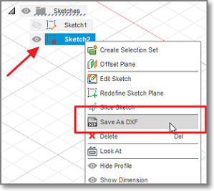
Fusion 360: Export Cut Profile -3
New sketch created
Should rename to avoid confusion (design_dxf)
R-Click on sketch name
Save As DXF

Slide 13
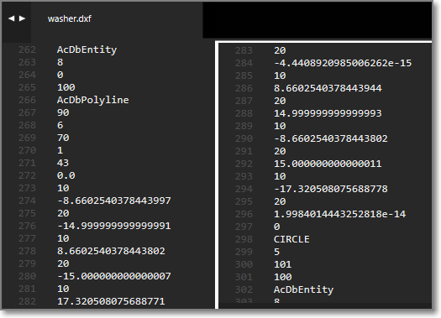
DXF format
A simple text format that defines the coordinates of the profile.
Can come in different versions
Backward compatible only

Slide 14
Fusion 360: Modelling
Modelling allows us to simulate the actual object using CADD
We can use CADD tools to help us in the design
Most common tools are:
Combine
Joints
Cross-sectional views
Clearances

Slide 15
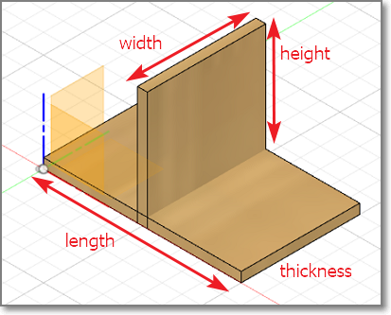
Let’s make a joint
We will use the CADD features to assist us
We would like to join 2 pieces of wood

Slide 16
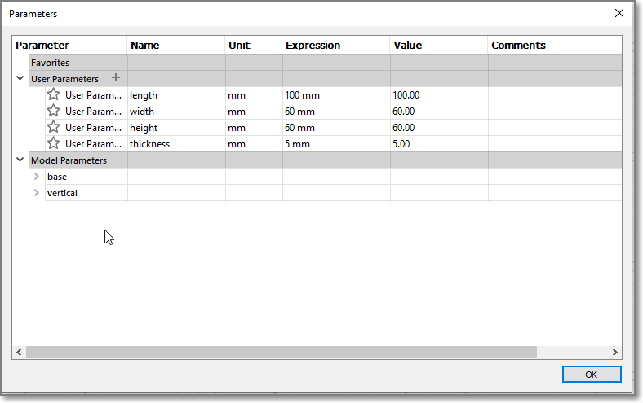
Drawing Parameters

Slide 17
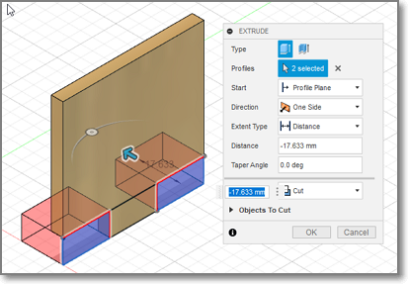
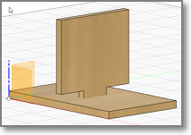
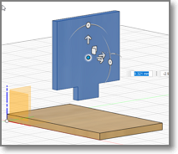
Draw the 2 components
We would like a “tight” fit, since we are going to CCC the wood.
The cuts will be very precise.
(The joint is exaggerated to show the effect)

Slide 18
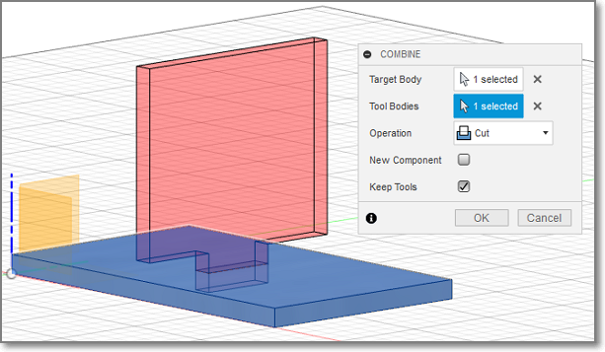
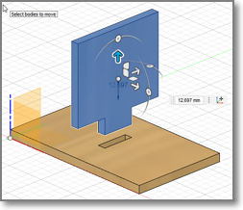
Use CADD to effect the joint
Blue = Target Body
Red = Tool Body
Operation = Cut
Keep tools
Modify > Combine
Creates the joint and necessary cuts without further drawing

Slide 19
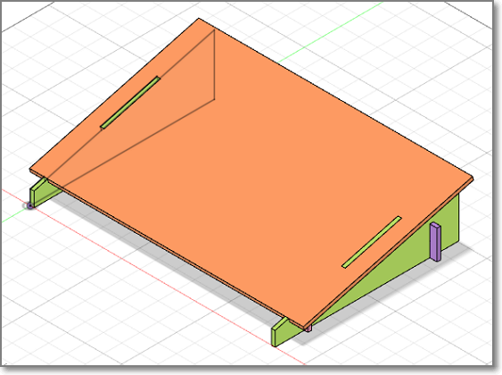
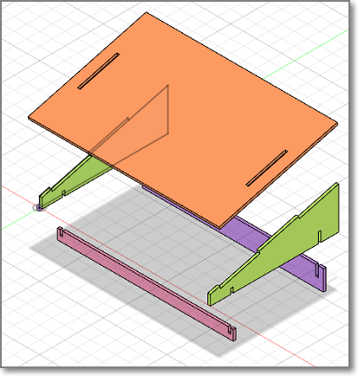
Laptop Stand
Let’s quickly design a laptop stand that can be lasercut.
4 components
legs (x2)
top
front support
rear support

Slide 20
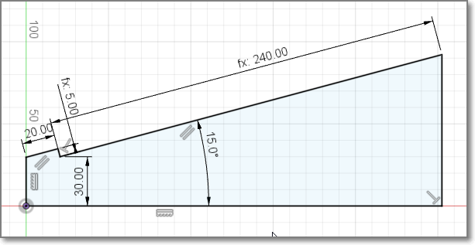
Legs
Set your own parameters

Slide 21
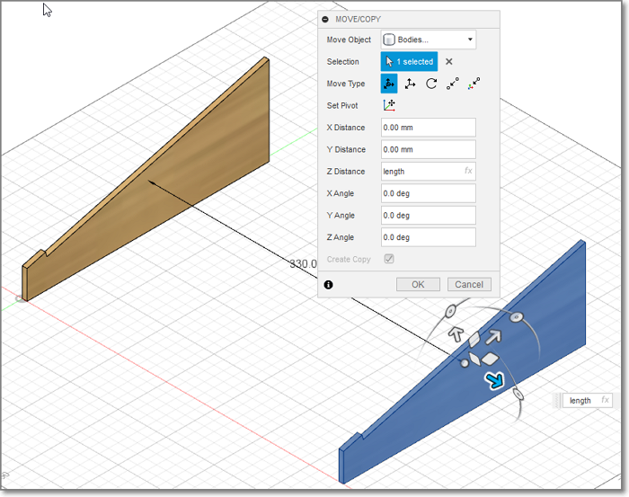
Create the body and a copy of the leg
Extrude the profile using thickness
Move/Copy the body
Length of laptop

Slide 22
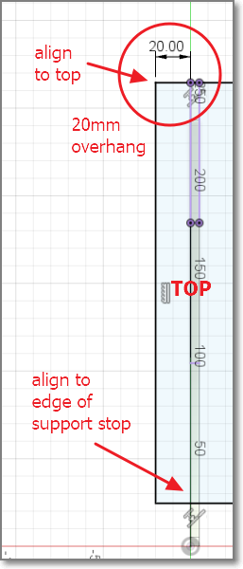
Add Component - Top
Create component Top
Enable the component!
Create new sketch, select slope surface
Top should line up with the top edge of the legs
Bottom should line up with the slip support stop
Sides extend 20mm on each side
Extrude the top

Slide 23
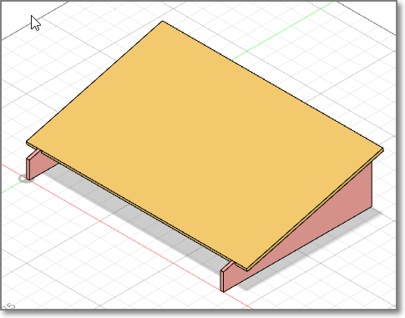
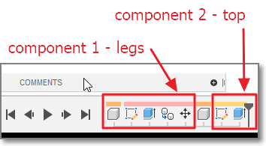
..so far .. so good!
You should have 2 components.
Use Inspect > Component Color Cycling

Slide 24
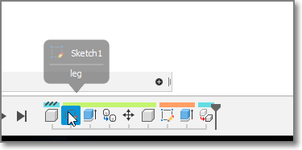
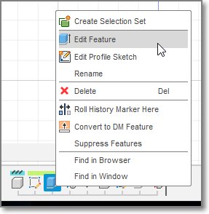
Fusion 360 History/Playback bar
We can use the History/Playback bar to walk through and edit (sometimes) changes
Let’s add supports for our top so that it does not move while we use it

Slide 25
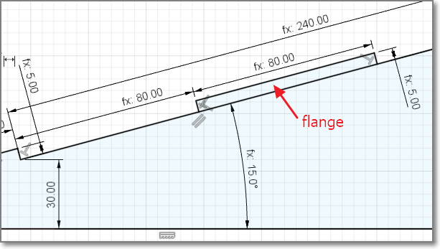
Edit/Add flanges to the legs
Use the history bar to add the flange
The rest of the design will auto-correct itself to accommodate the change

Slide 26
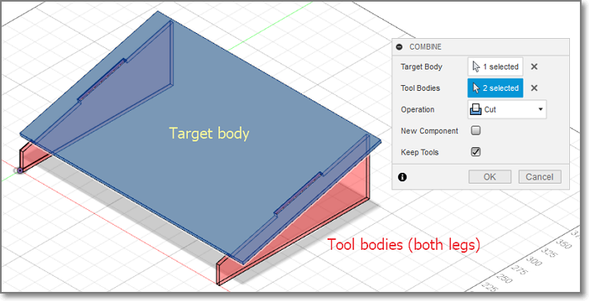
Modify > Combine
Use the combine function to cut the slots into the top
Remember to “keep tools” after cutting

Slide 27
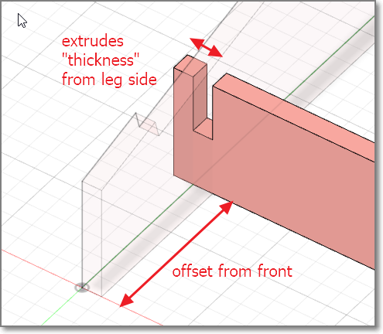
Add front support
The front support adds strength to the frame
Offset the spar from the front e.g. 40mm
Protrude the side for support
Use Combine to cut the slots on the legs

Slide 28
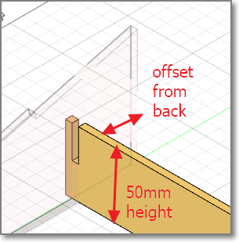
Add back support
Create new component
Create offset plane from back leg
Create new sketch
Draw structure, ensure constraints
Modify > Combine to cut out the slots

Slide 29
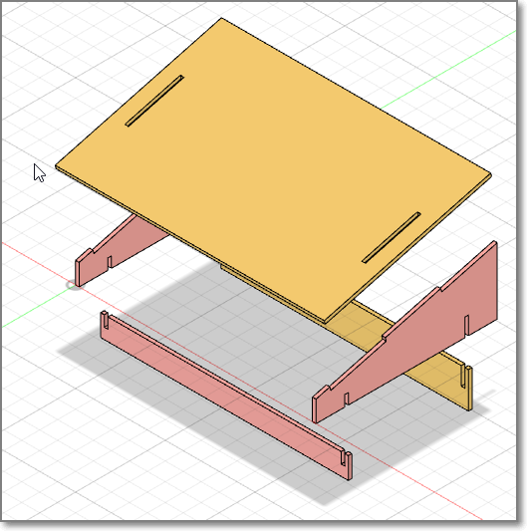
Completed Model
Move the bodies and examine the result
Check for clearances and cuts

Slide 30
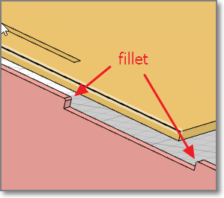
Finishing touches
Fillet (smooth) the edges
Fillet/Chamfer the joints for easy insertion

Slide 31
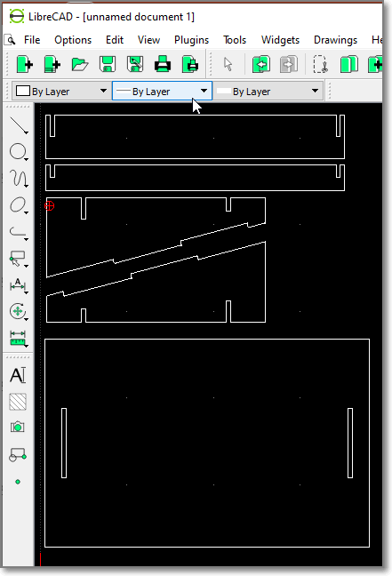
Export & check the DXF for cutting
For each body
Turn off other components/bodies
Create new sketch for cut profile
Rename the sketch for reference
Export to DXF
Use LibreCAD to check or layout the cuts

Slide 32
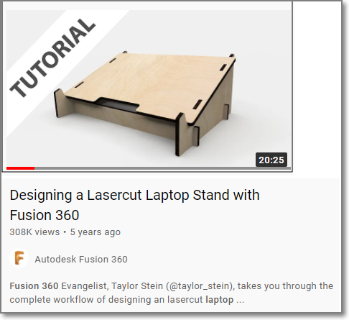
Task: Draw your laptop stand
Draw your own laptop stand (measure your laptop)
Add features (?)
Ref: https://youtu.be/7riGolu7BpA

Slide 33
EP1000
Computer Controlled Cutting
End

