Slide 1
EP1000
Analog I/O

Slide 2
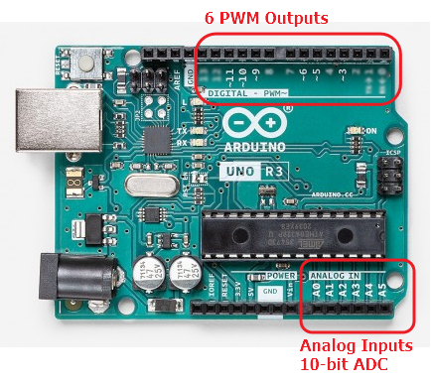
Analog I/O
The Uno uses the ATMega328 processor, which has 6 analog input pins.
Each analog input has a 10-bit analog-to-digital converter that can produce an equivalent binary value for an analog voltage between 0 and Vref.
Analog output is done using Pulse Width Modulation which can be used to control LEDs and Motors.
Pins that can perform PWM are denoted with a ~ (Pins 3, 5, 6, 9 , 10, 11)

Slide 3
Analog vs Digital
Analog signals are continuous.
Analog signals require conversion (ADC) before processing
Analog signals are real world.
Digital values are discrete e.g. 0, Vcc
Digital values are easy to process.
Digital signals need to be converted to appear to be real world signals.

Slide 4
Reading Analog Signals
Analog signals need to be converted to digital values before they can be processed.
Analog-to-Digital Conversion required
Sampling (at least 2X input signal frequency)
Vref
Timing
References:
YouTube:
All About Electronics: Introduction to ADC and DAC
Great Scott: Electronic Basics #27: ADC (Analog to Digital)
Embedds: ATMega328 ADC – Raw Mode

Slide 5
Simplified ADC with Arduino System
Assumes that input signals are stable and does not change quickly.
Uses a default Vref = 5V
Resolution = 5/2¹⁰ = 4.9mV
Max Read speed = 100 mS = 0.001s
Result is between 0 ~ 1023
Analog I/O
analogRead( pin )
where pin = A0..A5

Slide 6
EP1000
Analog I/O
End

