Slide 1
FLMS
Trainer Role Assignment

Slide 2
FLMS
Fablab Management System manages
Users
Courses
Equipment
Material
Knowledgebase
AWS GCC Cloud-based system by SP

Slide 3
Users
Users
Users have NO supervisory roles and can only “use” the system for booking of courses and equipment.
Internal Users (Free)
Students
Staff
External Users (Charged)
Registration
Internal Users:
Self (ichat account)
Bulk assigned
External Users:
PACE list
We require:
Email address
Contact number
Identification Photo
Upon registration for contact and tracing purposes

Slide 4
Supervisory Roles
Designates who can change/administer sections of FLMS
Roles are assigned by System Admin upon approval
Supervisory staff can be assigned multiple roles
System Admin
Supervisor
Administrative – Skills, Levels, Categories
Add, Void, Credits
Approval from System Admin
Trainer
FablabTech
Courses Only
New Courses
Schedules
Equipment Only
New Equipment
Bookings
Material
Knowledge Base
Trainer-assistants
Lab-assistants

Slide 5
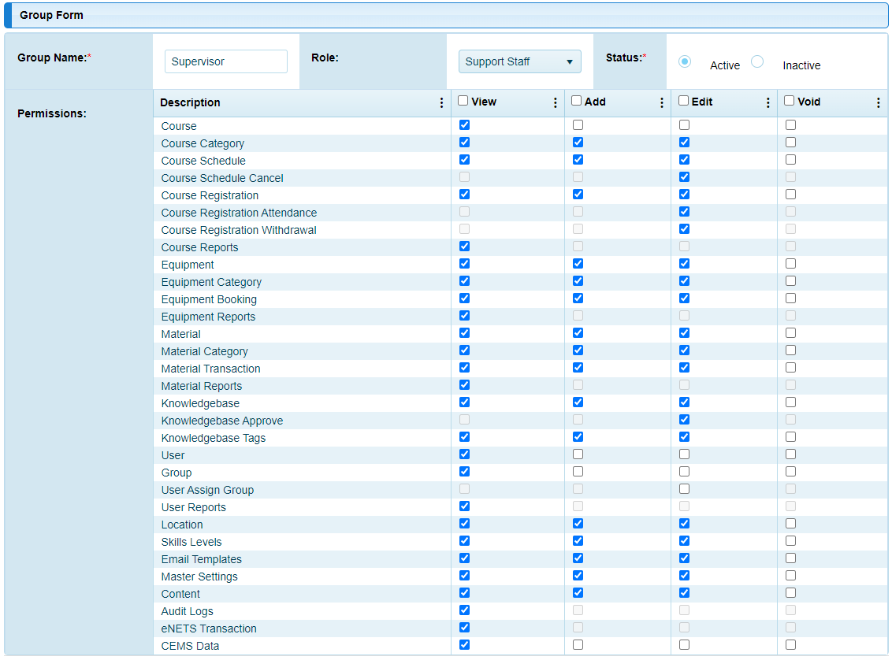
Super- visor Rights

Slide 6
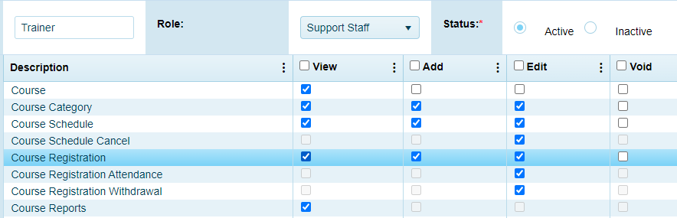
Trainer Rights

Slide 7
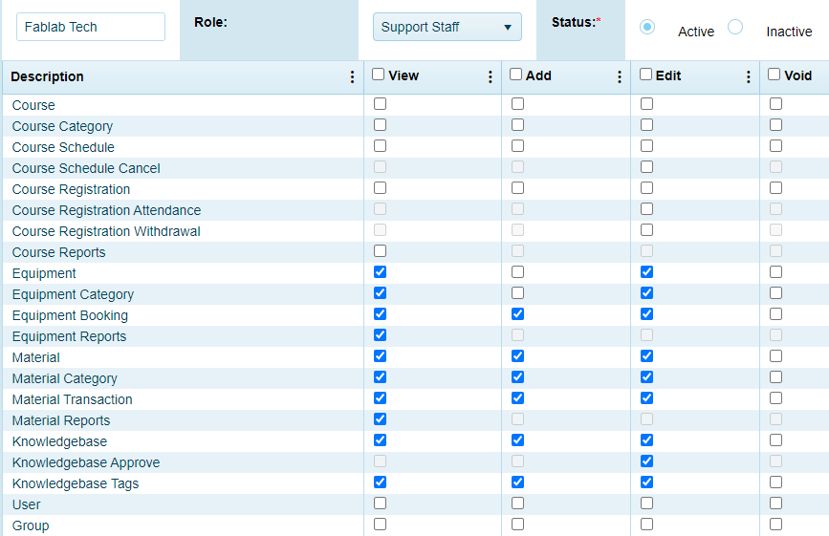
FablabTech Rights

Slide 8
Locations, Skills & Levels
Locations
T11C, T1442, MakerSpace etc
Skills
Not Available (default)
Safety
3D Printing, Laser Cutting, Routing, etc
Levels
Basic
Intermediate, Advanced
SysAdmin defined

Slide 9
Course Categories
SysAdm defined (with approval track)
So far…
Safety
3D printing
Laser cutting

Slide 10
Courses
Defines the courses that FabLab Offers
Examples
Safety Internal
3D Printing Basic
Laser Cutting Basic
Have a different set for External Users
Charging & Credits
Registration

Slide 11
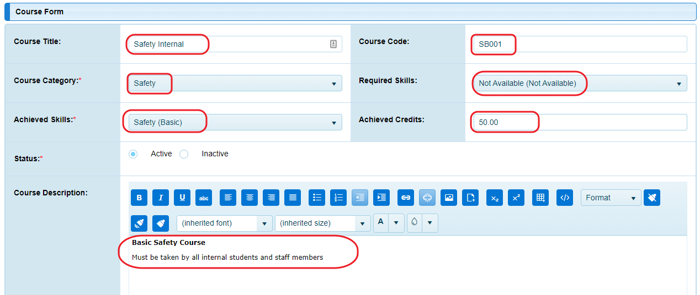
Courses creation info
Formal course catalog & approval track required

Slide 12
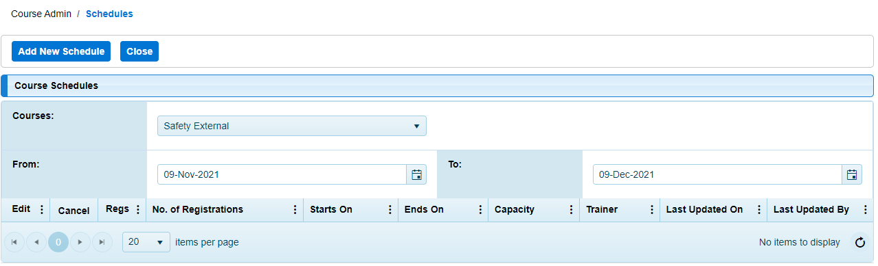
Course Schedule
Trainers can create schedules for courses they run
Mark attendance and pass students (register/de-register as well)
Once passed, students attain the skill level required for equipment booking

Slide 13
FLMS
Trainer Role
End

Slide 14
Let’s run a class…
Class targets
SP internal students
Safety course & Quiz
Course is hosted on ESP
Quiz to be taken and passed at 90%
Introduction to 3D printing (plus certification)
Course run by staff (physically)
Online learning through esp, with quiz
Demo and exercise done by students

Slide 15
Background setup
Check that the course categories exist
Safety Internal (Basic)
3D Printing Internal
Create schedules for your course
Assume class is run from 10:00am – 12:00pm
Safety basic e.g. 10:30am ~ 10:45am
3D Printing basic 11:00am ~ 12:00pm

Slide 16
Class registration
Class starts at 10:00am
Self registration at flms.sp.edu.sg
Use digital device (phone, ipad, laptop)
Student enters phone number, email, photo (profile)
Self registration for Safety Course
Check that it is the correct course
Register
Conduct the safety course
Check the attendance
Mark attendance and award “Pass” grade

Slide 17
3D Printing course
After passing the Safety class, ask students to register for the 3D printing class
Conduct the class
E-learning lesson
Physical demonstration & application
Mark attendance and pass the students
Students should now be able to book the 3D printers

Slide 18
Equipment Category
Naming convention:
3DP equipment type
Ultimaker2P name
14 location - MS,11C,14
01 number - ##
3DP-Ultimaker-14-01
3DP-Ultimaker-11C-01
LC-EpilogM2-11C-01
LC-Universal660-MS-01

Slide 19
Courses
Course name e.g. 3D Printing
Course type:
Internal
External
Private, Staff, Project
Important:
Skill requirement e.g. Safety (Basic)
Skill achieved e.g. 3D Printing (Basic)
Credits achieved
Safety 50
3D Printing 100 (cost/hr: 6 credits)
Laser cutting 200 (cost/hr: 48 credits)

