Slide 1
FLMS
Trainer Role Assignment

Slide 2
FLMS
Fablab Management System manages
Users
Courses
Equipment
Material
Knowledgebase
1st Cloud-based system by SP

Slide 3
Users
Users
Users have NO supervisory roles and can only “use” the system for booking of courses and equipment.
Internal Users (Free)
Students
Staff
External Users (Charged)
Registration
Internal Users:
Self (ichat account)
Bulk assigned
External Users:
PACE list
We require:
Email address
Contact number
Identification Photo
Upon registration for contact and tracing purposes

Slide 4
Supervisory Roles
Designates who can change/administer sections of FLMS
Roles are assigned by System Admin upon approval
Supervisory staff can be assigned multiple roles
System Admin
Supervisor
Administrative – Skills, Levels, Categories
Add, Void, Credits
Approval from System Admin
Trainer
FablabTech
Courses Only
New Courses
Schedules
Equipment Only
New Equipment
Bookings
Material
Knowledge Base
Trainer-assistants
Lab-assistants

Slide 5
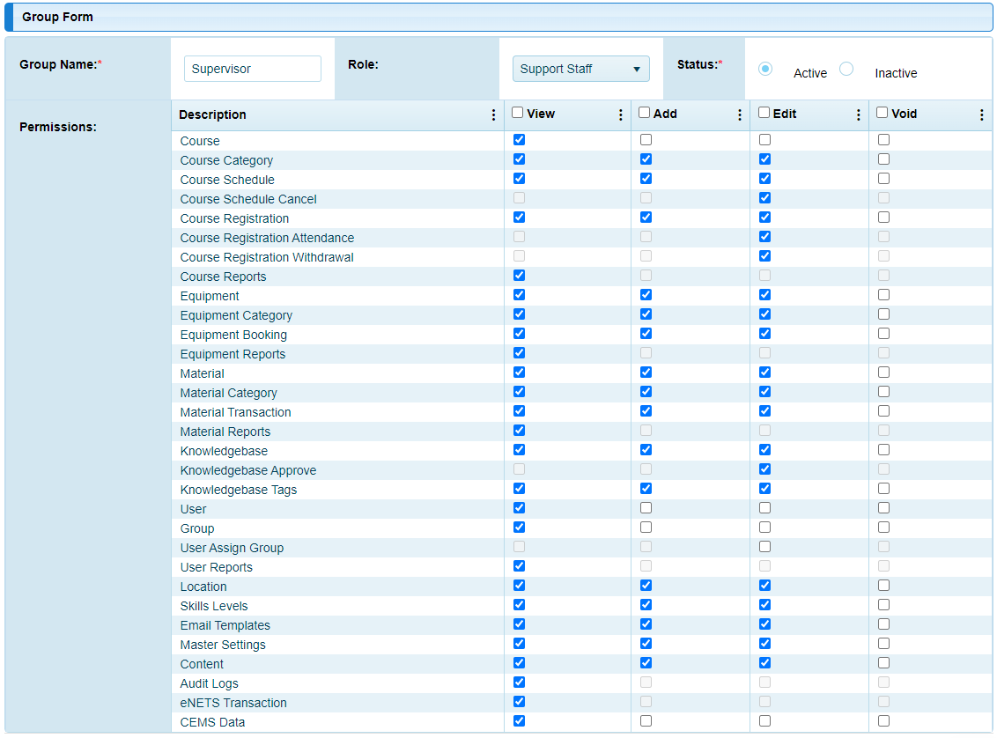
Super- visor Rights

Slide 6
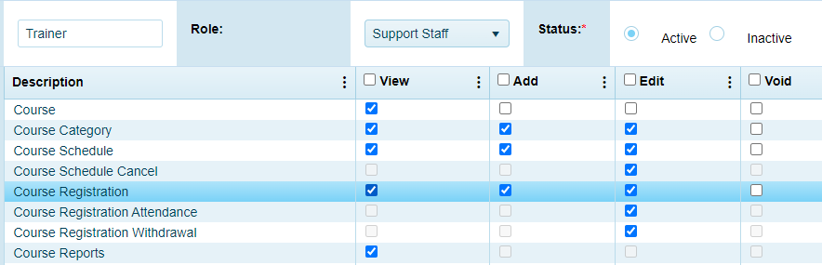
Trainer Rights

Slide 7
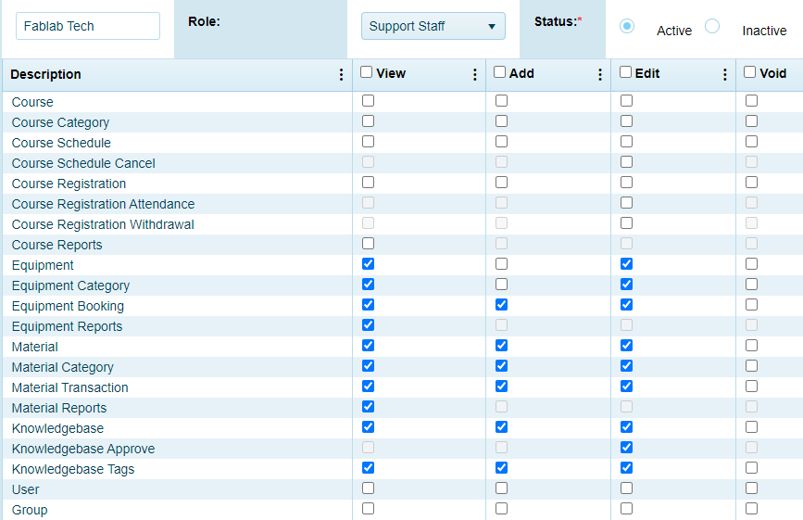
FablabTech Rights

Slide 8
Locations, Skills & Levels
Locations
T11C, T1442, MakerSpace etc
Skills
Not Available (default)
Safety
3D Printing, Laser Cutting, Routing, etc
Levels
Basic
Intermediate, Advanced
SysAdmin defined

Slide 9
Course Categories
SysAdm defined (with approval track)
So far…
Safety
3D printing
Laser cutting

Slide 10
Courses
Defines the courses that FabLab Offers
Examples
Safety Internal
3D Printing Basic
Laser Cutting Basic
Have a different set for External Users
Charging & Credits
Registration

Slide 11
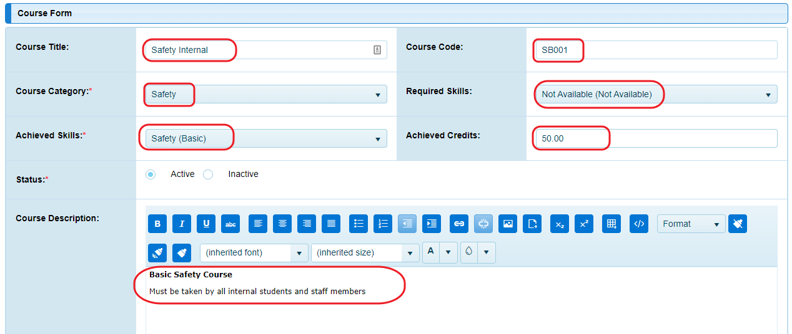
Courses creation info
Formal course catalog & approval track required

Slide 12
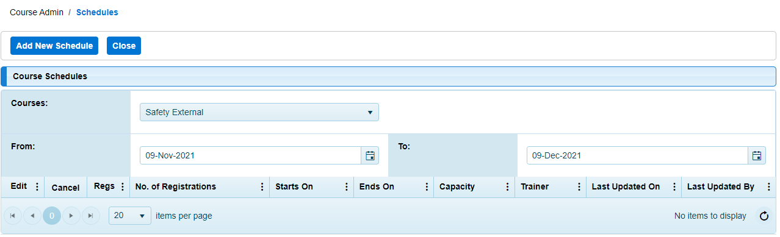
Course Schedule
Trainers can create schedules for courses they run
Mark attendance and pass students (register/de-register as well)
Once passed, students attain the skill level required for equipment booking

Slide 13
FLMS
Trainer Role
End

