Slide 1
Check-in /Check-out
FLMS Equipment Booking

Slide 2
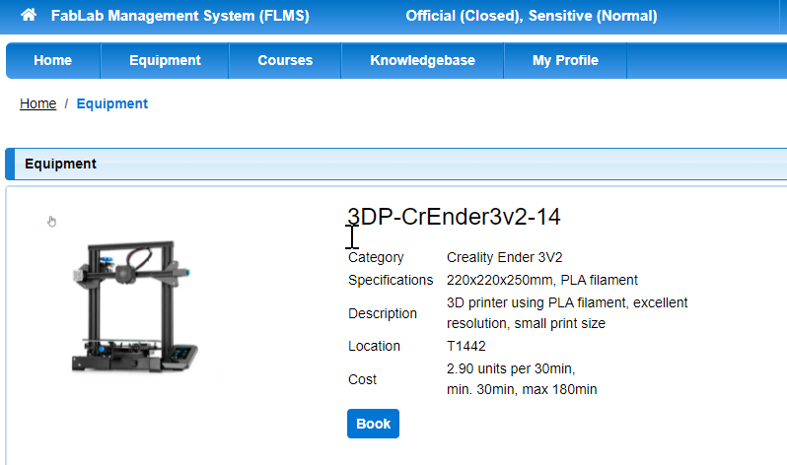
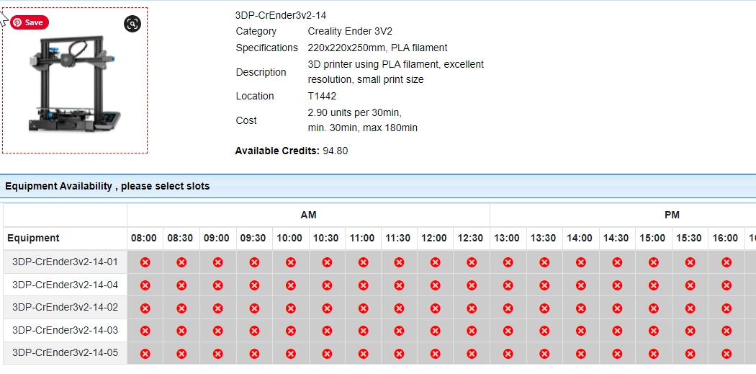
Dinah books an equipment
Notes:
Dinah books equipment at one of the Fablabs e.g. T1442
>> Show booking page with equipment, click on 3D printer to book
>> show actual bookings not the red ones

Slide 3
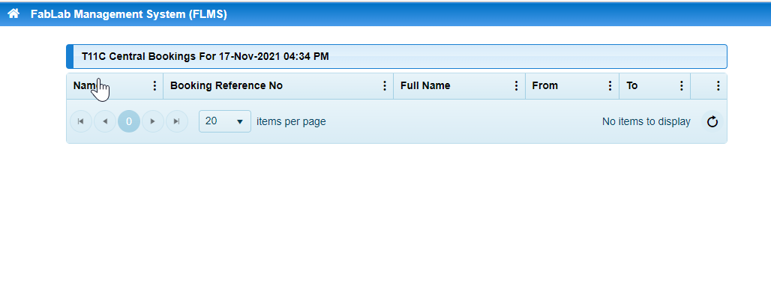
Booking shows up on Fablab Attendance Laptop
Need to show with
Check-in on the side
Notes:
>> Show Fablab Attendance laptop screen with bookings
>> Show checkin tab (blue) this comes on 10 minutes before the booking

Slide 4
Dinah clicks check-in to get the QRcode
Notes:
>> click on check in to get the QR code, this page should show screen capture of QR code
>> show QR code here

Slide 5
Dinah scans QR code with handphone
Notes:
>> show Dinah with phone scanning the screen (Qrcode)
>> show the successful checkin, should have the tick sign (missing in above picture)

Slide 6
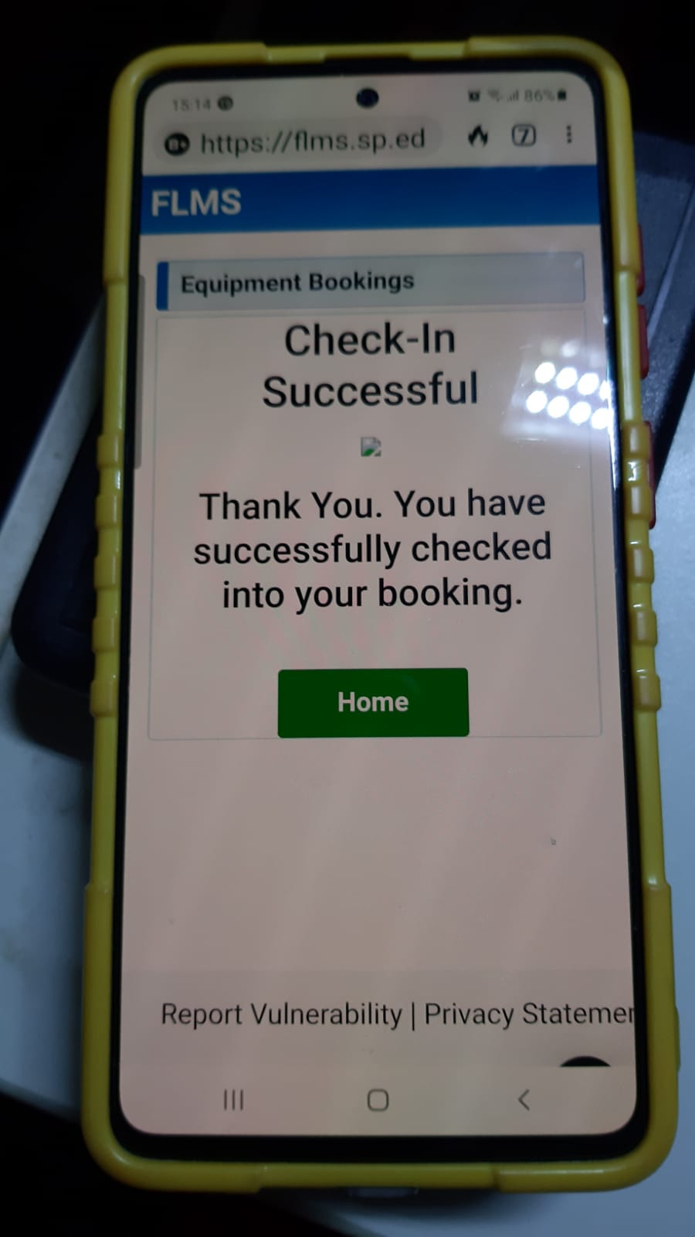
Qrcode takes Dinah to FLMS login
Notes:
>> Show Dinah using phone to login
>> Show checkin successful, should have the tick

Slide 7
Dinah has successfully login
Need to change this
Notes:
>> This should show the line with the “check-out” which indicates successful checkin
>> Dinah can now use equipment

Slide 8
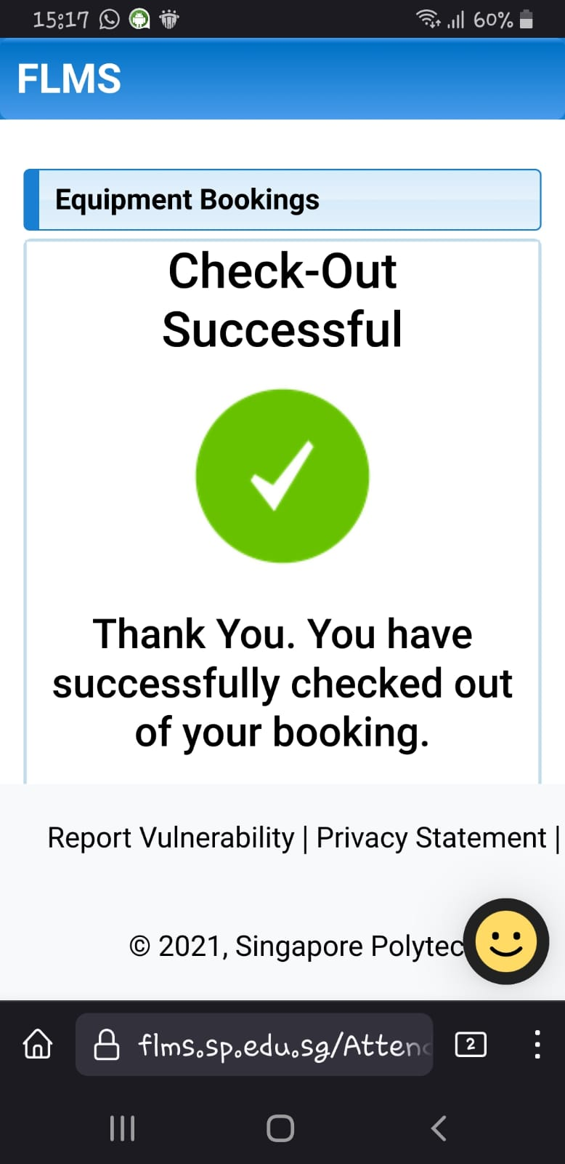
When Dinah has finished, checkout procedure
Notes:
>> Show checkout procedure,should end with the phone with checkout successful

Slide 9
End

