Slide 1
Healthy Life

Slide 2
Topic
A healthy life and its sustainability
My task: the mens section
Mobile application
Web page (responsive)
https://github.com/nyvirag/webbackend
https://github.com/nyvirag/webfrontend
https://github.com/nyvirag/mobilbackend
https://github.com/nyvirag/zarodolgozat

Slide 3
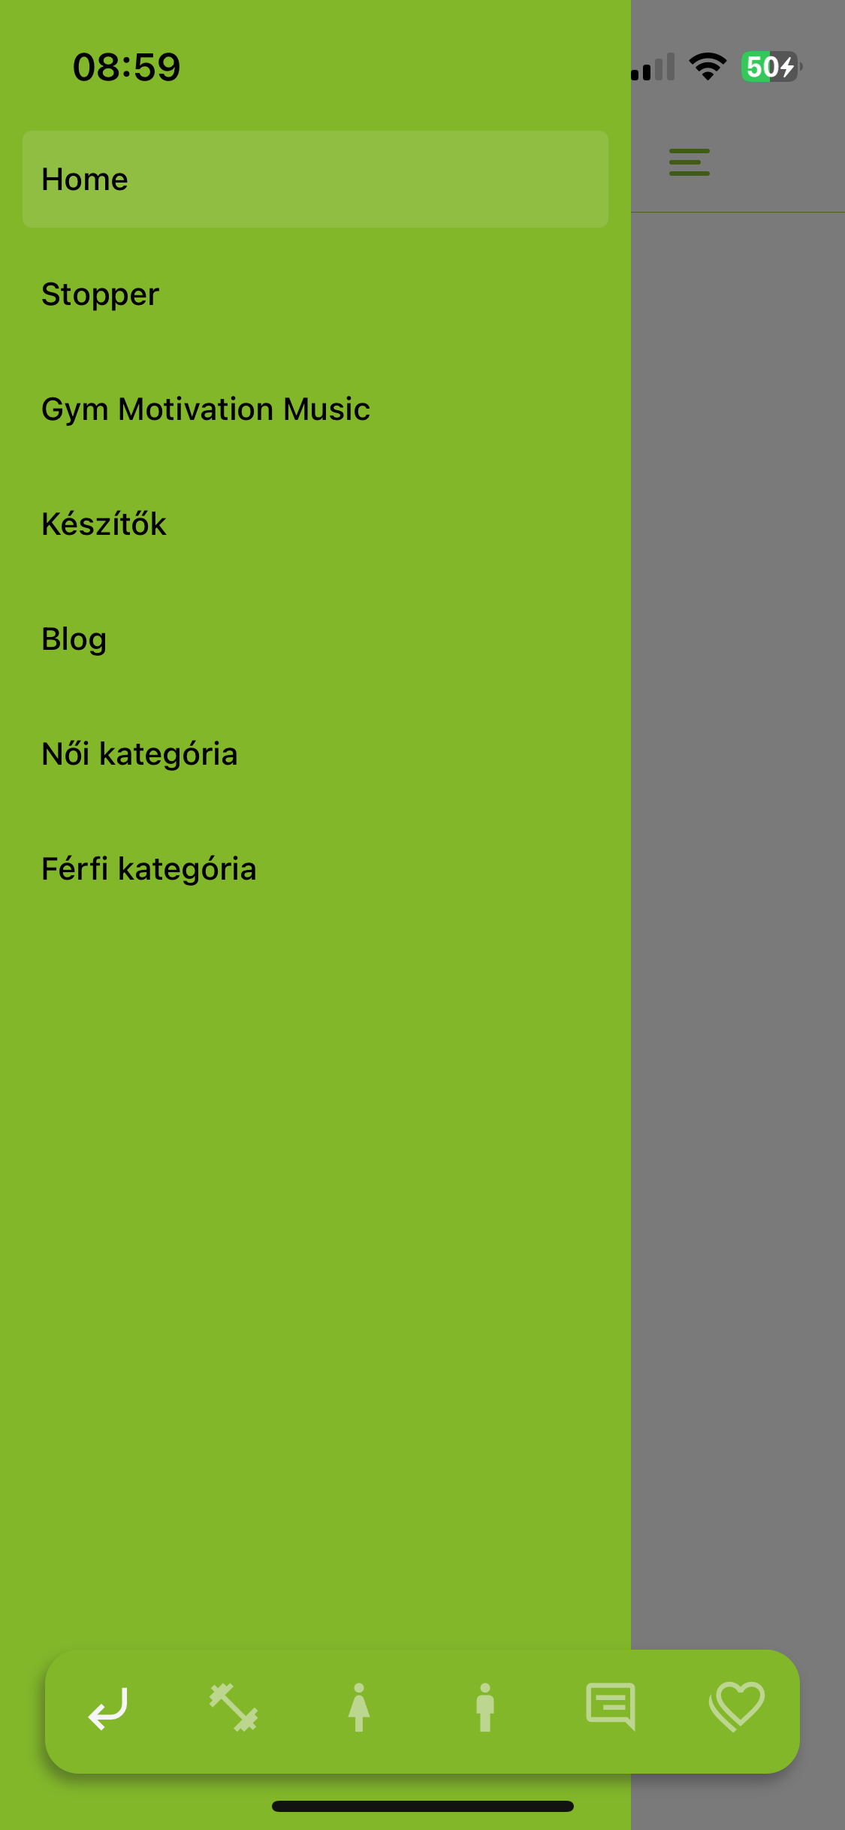
Functions in Mobile App
Mens category
Blog
Comments
Stop watch

Slide 4
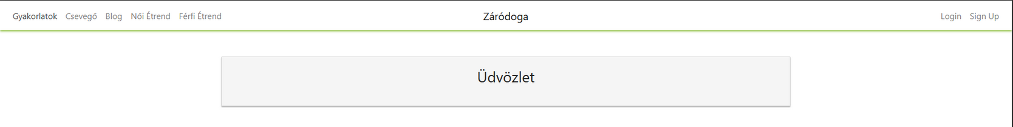
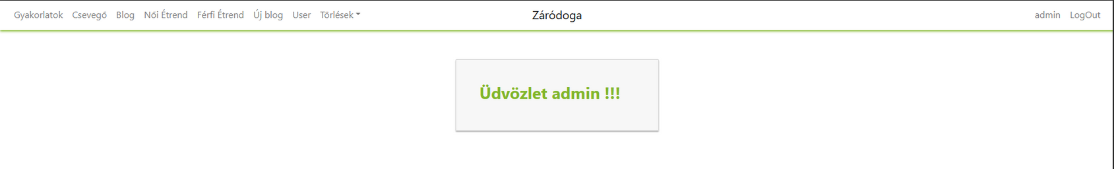
Functions in Web page
mens diets
comments
Admin functions: new blog, blog deleting

Slide 5
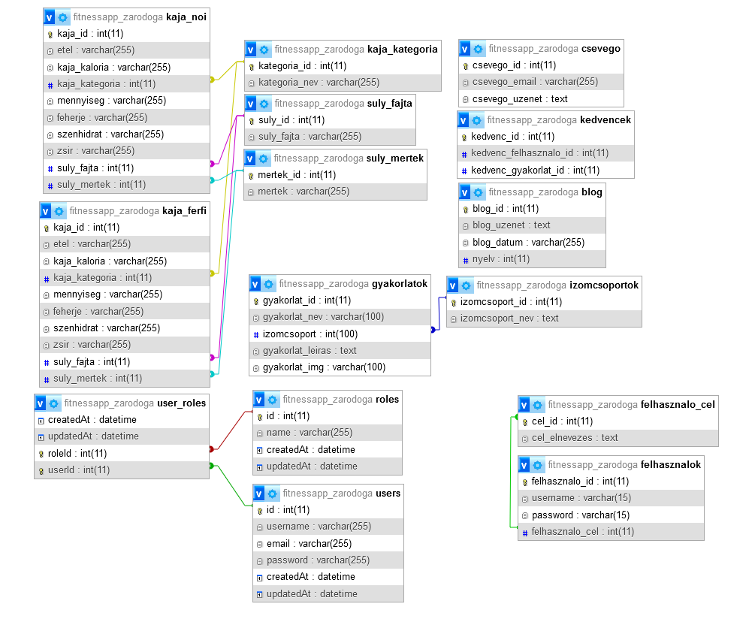
Database

Slide 6
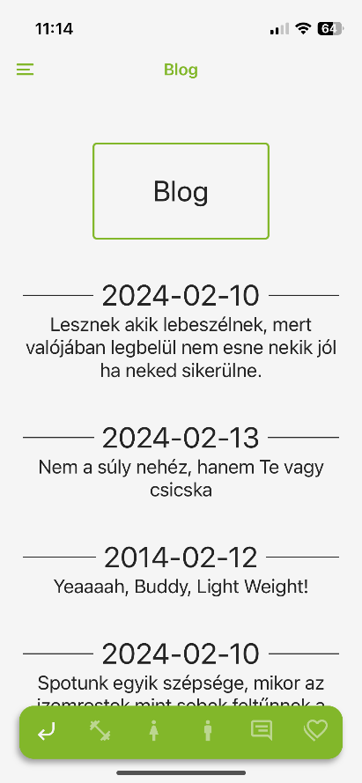
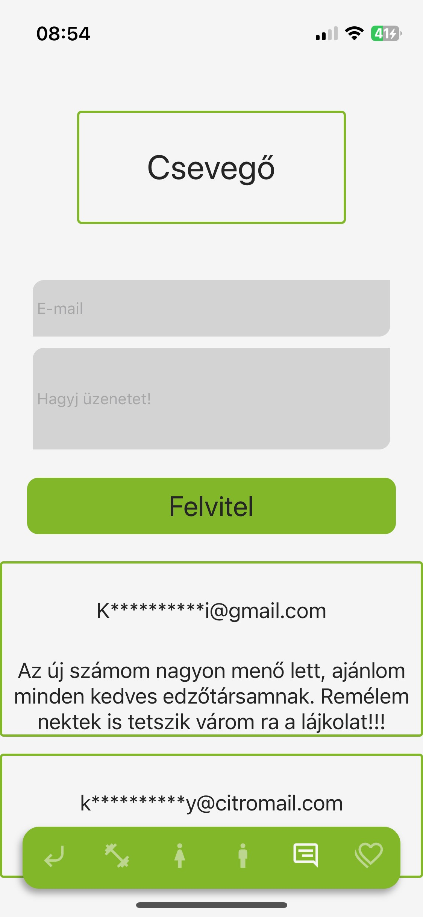
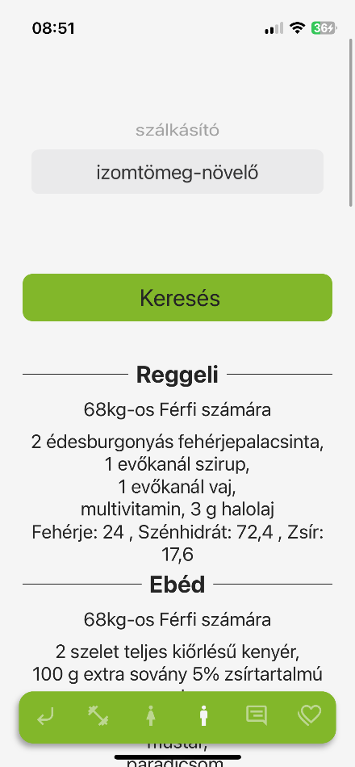
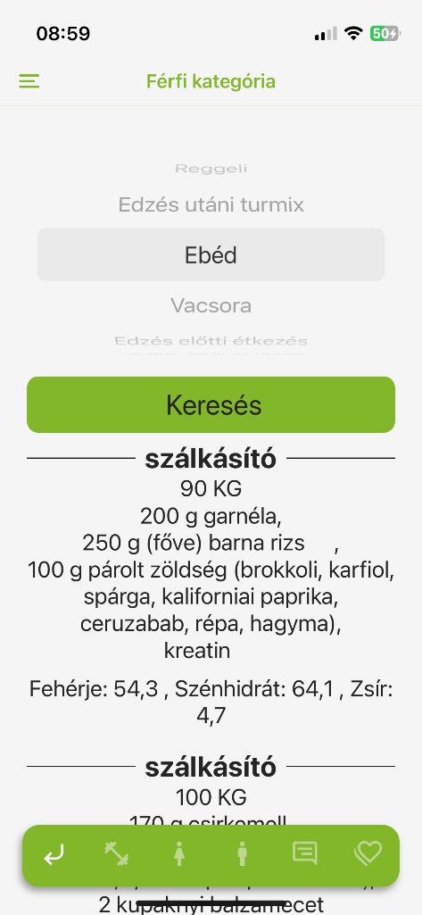
Moblie
Search by goals
Comment/chatting
Blog

Slide 7
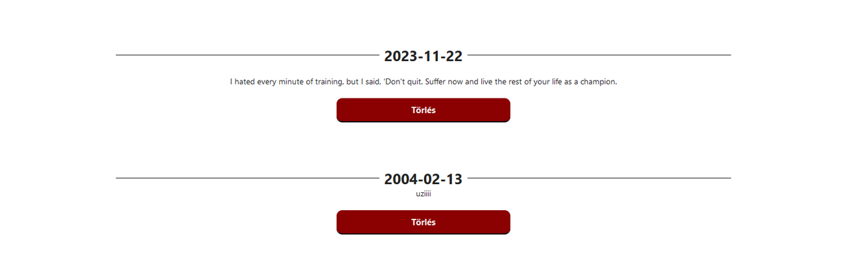
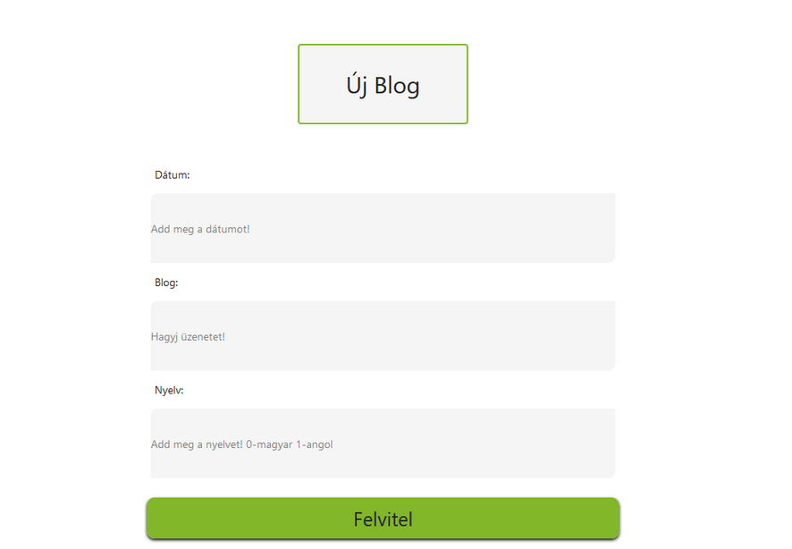
Web Page – Admin function – delete blog-new blog

Slide 8
Development tools
Softwares:

