Slide 1

PROJECT PRESENTATION
Movie Review Sentiment Classification
NLP | TF-IDF | Logistic Regression, Naive Bayes, Linear SVM
BCA (AI), Section B | Mentor: Mr. Sahil Kasaudhan
Invertis University, Bareilly | Session 2026-27

Slide 2
Our Team
Shreya Sharma
BCAI2025172
Utkarsh Kumar
BCAI2025167
Drasti Singhal
BCAI2025189
Deepti Gangwar
BCAI2025191
Abhisar Kumar
BCAI2025171
Manish Kumar Gautam
BCAI2025166
Pawan Kushwaha
BCAI2025169
Vanshika
BCAI2025176
Aashish Pandey
BCAI2025177
Devvrat Kushwaha
BCAI2025182
Jagat Singh
BCAI2025186
Anubhav Kumar
BCAI2025179
Mentor: Mr. Sahil Kasaudhan | Dept. of Bachelors of Computer Application
Movie Review Sentiment Classification | BCA_AI_ML_08
2

Slide 3
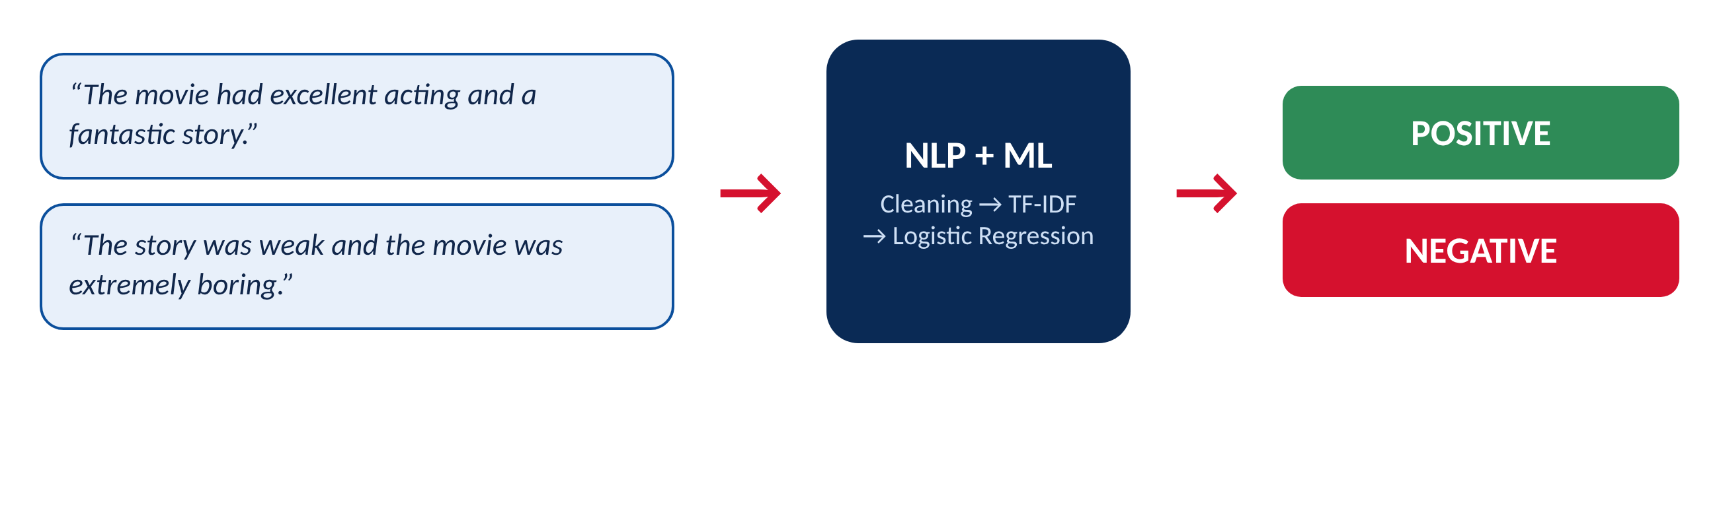
Problem Statement & Objectives
The problem
Objectives
Thousands of movie reviews arrive daily
Manual reading is slow and inconsistent
Need: predict Positive or Negative automatically
Clean and preprocess review text
Extract TF-IDF features
Train and compare 3 models
Evaluate with accuracy, precision, recall, F1
Test custom reviews, analyse errors
Build a live Gradio demo
Movie Review Sentiment Classification | BCA_AI_ML_08
3

Slide 4
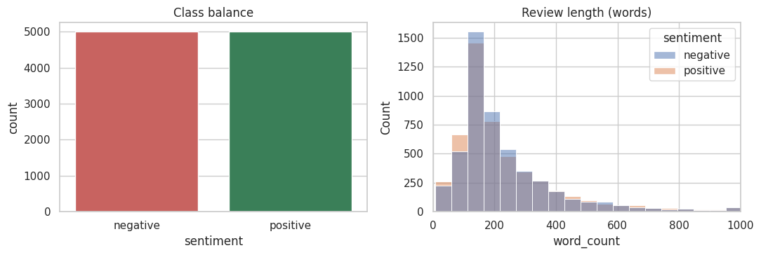
Dataset: IMDB Movie Reviews
Source: IMDB, 50,000 labelled reviews
Used: 10,000 reviews (5,000 positive + 5,000 negative)
Split: 8,000 train / 2,000 test (80:20, stratified)
Average review: about 230 words (median 173)
Sample
"Excellent acting and a fantastic story." → Positive
"Boring, and the story was disappointing." → Negative
Movie Review Sentiment Classification | BCA_AI_ML_08
4

Slide 5
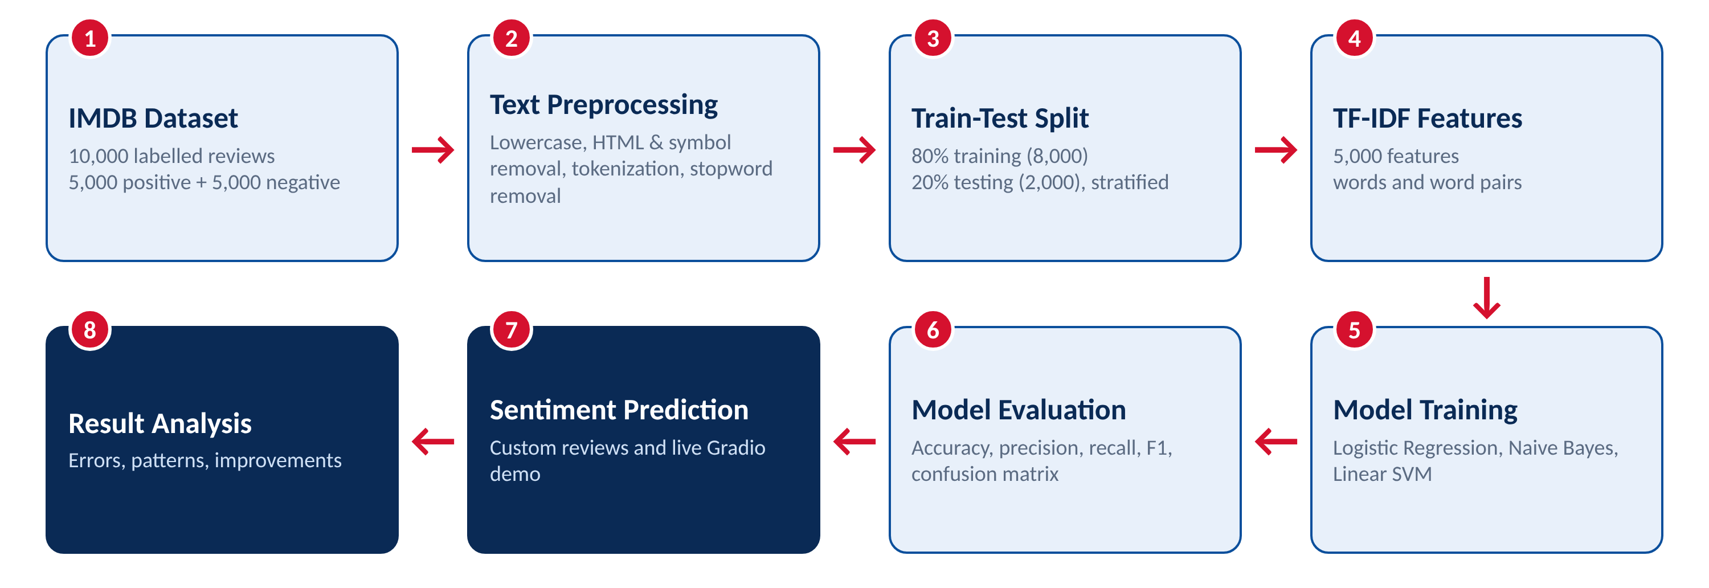
Methodology & Workflow
IMDB data → Preprocess → Split → TF-IDF → Train → Evaluate → Predict → Analyse
Eight stages from raw reviews to analysis of results
Movie Review Sentiment Classification | BCA_AI_ML_08
5

Slide 6
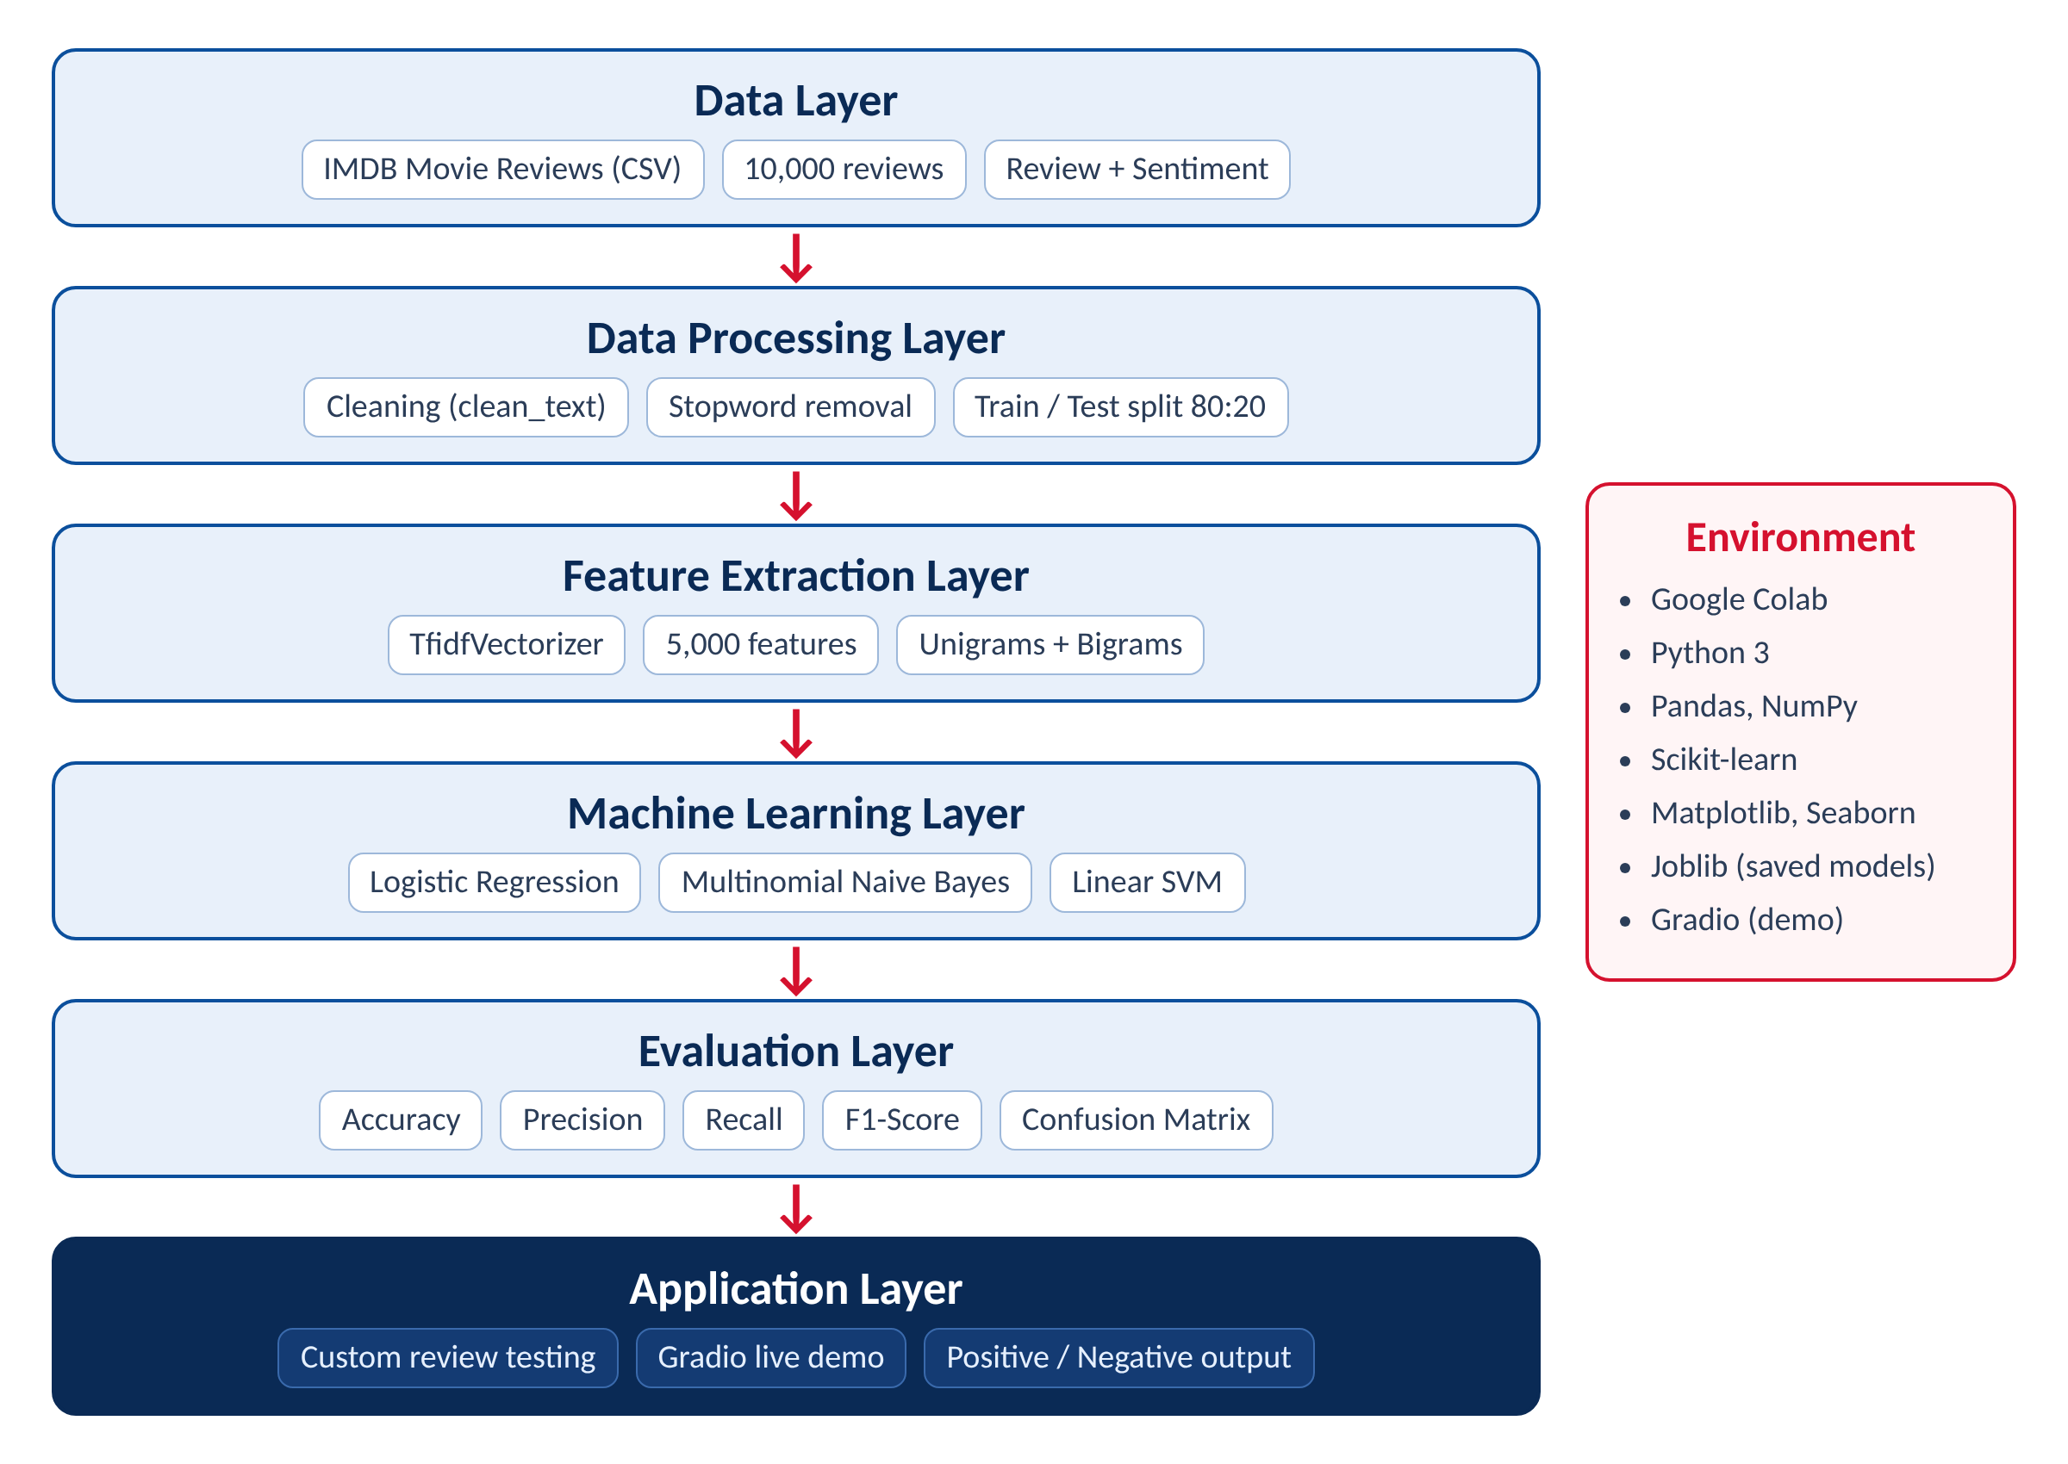
System Architecture
Layered design: each layer feeds the next
Data → Preprocessing → Features → Models → Evaluation → Application
Every stage can be tested and improved on its own
Movie Review Sentiment Classification | BCA_AI_ML_08
6

Slide 7
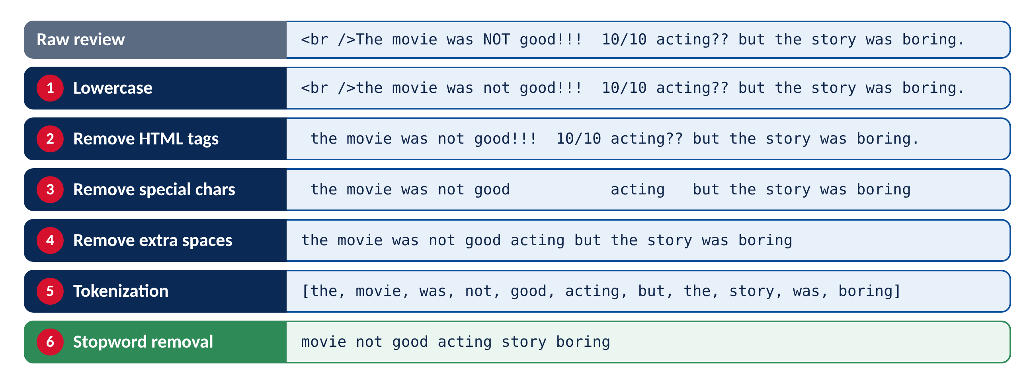
Text Preprocessing
Lowercase, remove HTML tags, symbols, digits, extra spaces
Tokenize and remove stopwords
Negations (not, no, nor, never) are kept on purpose
Movie Review Sentiment Classification | BCA_AI_ML_08
7

Slide 8
Feature Extraction: TF-IDF
Rare, opinionated words get higher weight
5,000 features, unigrams + bigrams, min_df=2
Fit on training data only (no leakage)
Shapes: (8000, 5000) and (2000, 5000)
Term | IDF | TF-IDF
fantastic | 4.669 | 0.670
excellent | 3.659 | 0.525
acting | 2.517 | 0.361
story | 2.205 | 0.316
movie | 1.496 | 0.215
"movie excellent acting fantastic story"
Movie Review Sentiment Classification | BCA_AI_ML_08
8

Slide 9
Machine Learning Models
Logistic Regression
Naive Bayes
Linear SVM
Weighted sum of word scores gives a probability. Accurate and interpretable.
Combines word-class probabilities. Very fast baseline.
Widest-margin boundary. Strong on sparse text.
Movie Review Sentiment Classification | BCA_AI_ML_08
9

Slide 10
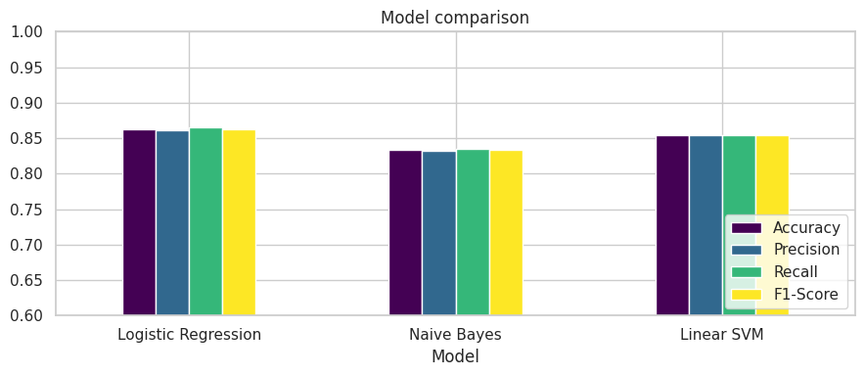
Results: Model Comparison
Model | Acc | F1
Logistic Reg. | 0.8625 | 0.8628
Linear SVM | 0.8545 | 0.8541
Naive Bayes | 0.8325 | 0.8324
Logistic Regression is best on every metric and was selected as the final model.
Movie Review Sentiment Classification | BCA_AI_ML_08
10

Slide 11
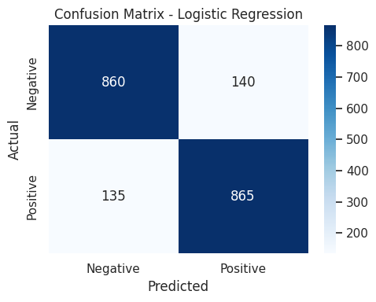
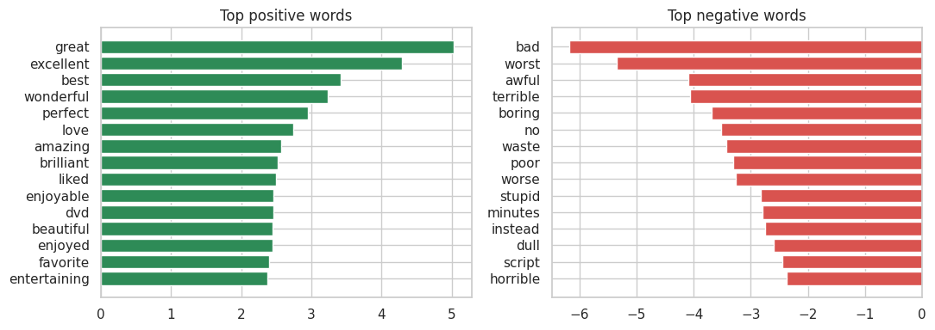
Confusion Matrix & Key Words
1,725 of 2,000 correct; FP 140 and FN 135, so errors are balanced
Top positive: great, excellent, best, wonderful
Top negative: bad, worst, awful, terrible, boring, no
Movie Review Sentiment Classification | BCA_AI_ML_08
11

Slide 12
Custom Testing & Error Analysis
6 of 7 custom reviews correct
Miss: "Not bad at all, I actually enjoyed it." (double negative)
275 of 2,000 test reviews wrong (13.75%)
Why the model fails
Mixed or delayed opinions
Description instead of opinion
Quoted criticism
Double negatives and sarcasm
Bag-of-words ignores context
Movie Review Sentiment Classification | BCA_AI_ML_08
12

Slide 13
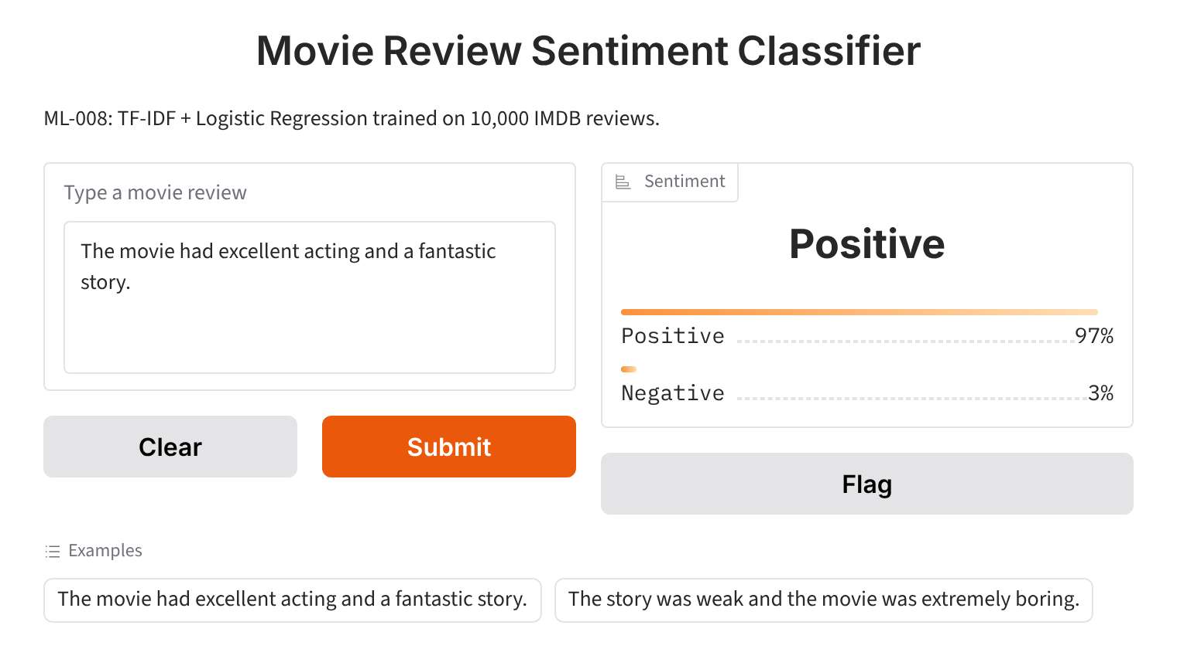

Live Demo: Gradio Interface
Positive review → Positive
Negative review → Negative
Movie Review Sentiment Classification | BCA_AI_ML_08
13

Slide 14
Applications & Future Scope
Business applications
Future scope
OTT and movie-review platforms
Studios: audience feedback
Social-media monitoring
Product and customer reviews
BERT / LSTM models
Full 50,000-review dataset
Lemmatization, tuning
Multi-class and Hindi support
Movie Review Sentiment Classification | BCA_AI_ML_08
14

Slide 15
Conclusion
Built a full NLP pipeline: clean, TF-IDF, 3 models, evaluation, demo
Logistic Regression: 86.25% accuracy, F1 0.8628
Errors come from context the bag-of-words model cannot see
Fast, reliable base for review analytics
Thank you | Questions?
Movie Review Sentiment Classification | BCA_AI_ML_08
15

