Slide 1
How AI will Change the President Election
Zeyu Zhang
07/26/2024

Slide 2
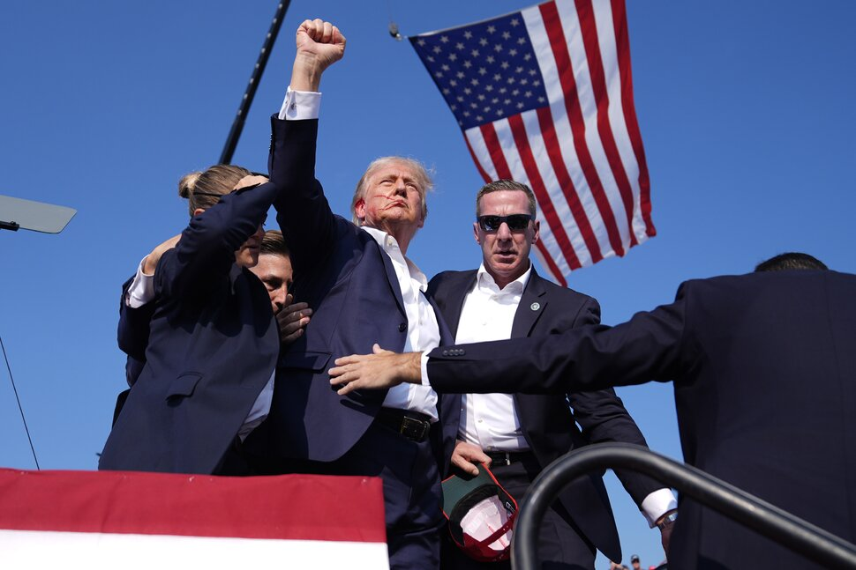


Slide 3
Campaign Strategies
Targeted Advertising: AI can analyze vast amounts of data to identify and target specific voter demographics with personalized messages.
Voter Sentiment Analysis: AI-driven tools can monitor social media and other platforms to gauge voter sentiment and adjust campaign strategies in real-time.
Example: In the 2020 U.S. Presidential Election, the Biden campaign used an AI tool called "Hawkfish" for strategic decision-making.
Hawkfish analyzed vast amounts of data, including voter registration files, social media activity, and public opinion polls, to identify persuadable voters and optimize campaign efforts.
The AI-driven insights helped the campaign tailor messages, allocate resources efficiently, and target specific demographics more effectively.

Slide 4
Debate and Speech Analysis
AI can analyze candidates’ speeches and debates to provide insights into their rhetoric, promises, and consistency over time. This can help voters make more informed decisions.
Example: During the 2016 U.S. Presidential Election, IBM's Watson was used by several media outlets for real-time debate and speech analysis.
Watson's AI capabilities allowed it to analyze candidates' speeches and debates by identifying key themes, sentiments, and trends.
It provided insights into the candidates' rhetorical strategies, fact-checked statements in real-time, and measured audience reactions.
This AI-driven analysis helped journalists and viewers understand the nuances of the debates, making it easier to interpret the candidates' positions and the overall impact of their performances.

Slide 5
Deepfake and Misinformation Detection
AI tools can be used to identify and combat deepfakes and misinformation, ensuring that voters receive accurate information.
Example: During the 2020 U.S. Presidential Election, Facebook deployed AI algorithms to detect and combat deepfake videos and misinformation.
Using advanced machine learning techniques, the AI system analyzed video content to identify manipulated media, flagging suspicious content for further review.
This initiative helped to reduce the spread of false information and protect the integrity of the election by ensuring that voters received accurate information.

Slide 6
Polling and Predictions
AI-driven models can provide more accurate predictions and insights into voter behavior and election outcomes by analyzing historical data and current trends.
Example: In the 2020 U.S. Presidential Election, Kinetica, in collaboration with researchers from Stanford University and the University of Virginia, utilized an AI-driven platform to enhance polling and prediction accuracy.
Diverse data sources: social media sentiment, historical voting patterns, demographic information, real-time polling data…
Dynamic and real-time updates.
Higher prediction accuracy.
Better understanding of voter sentiment and trends.

Slide 7
Security and Integrity
AI can enhance election security by monitoring and detecting cyber threats, ensuring the integrity of voting systems and protecting against potential interference.
Example: In the 2020 U.S. Presidential Election, Microsoft deployed its AI-powered "ElectionGuard" software to enhance security and integrity.
ElectionGuard provided end-to-end verifiable elections, allowing voters to confirm their votes were correctly counted while keeping the vote itself secret.
It used homomorphic encryption to ensure that votes could be accurately tallied without being decrypted, preventing tampering and fraud.

Slide 8
Resource Allocation
Campaigns can use AI to optimize resource allocation, ensuring that time and money are spent in the most effective ways to maximize voter outreach and influence.
Example: In the 2012 U.S. Presidential Election, the Obama campaign utilized an AI-powered analytics tool called "Narwhal" to optimize resource allocation.
By integrating vast amounts of data from various sources, including voter files, social media, and online interactions, Narwhal enabled the campaign to identify key swing states and demographic groups needing more attention.
This AI-driven approach allowed the campaign to strategically deploy field staff, allocate advertising budgets, and tailor outreach efforts more effectively, significantly contributing to the efficient use of resources and ultimately to the campaign's success.

Slide 9
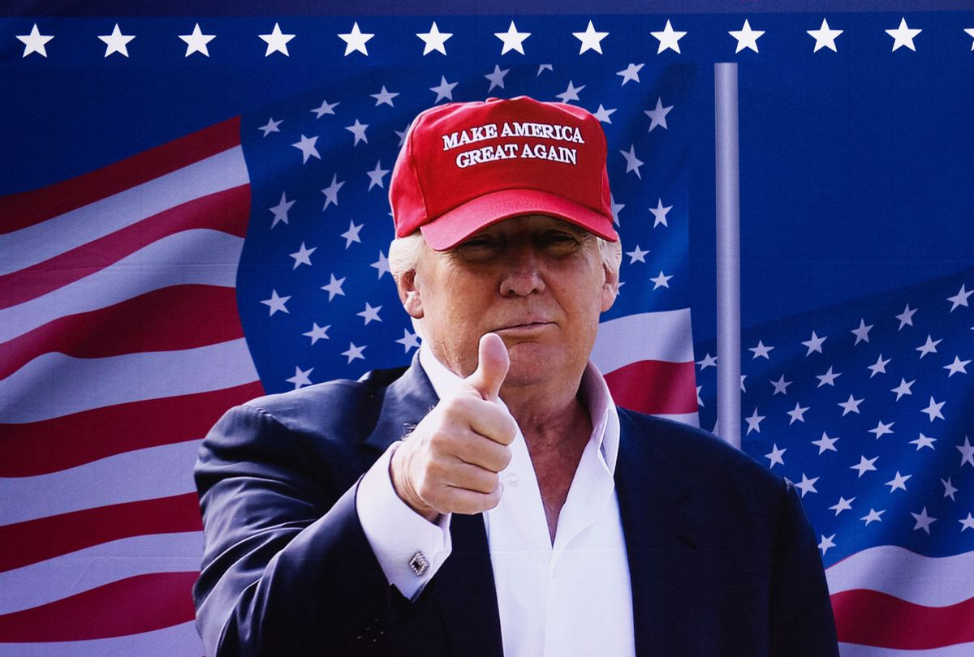
THANK YOU～

