Slide 1
Build your first personal website
Jifan Zhang

Slide 2
Why create a personal website?
Showcase your research and publications
Increase visibility in your field
Share resources and ideas
Network with other researchers

Slide 3
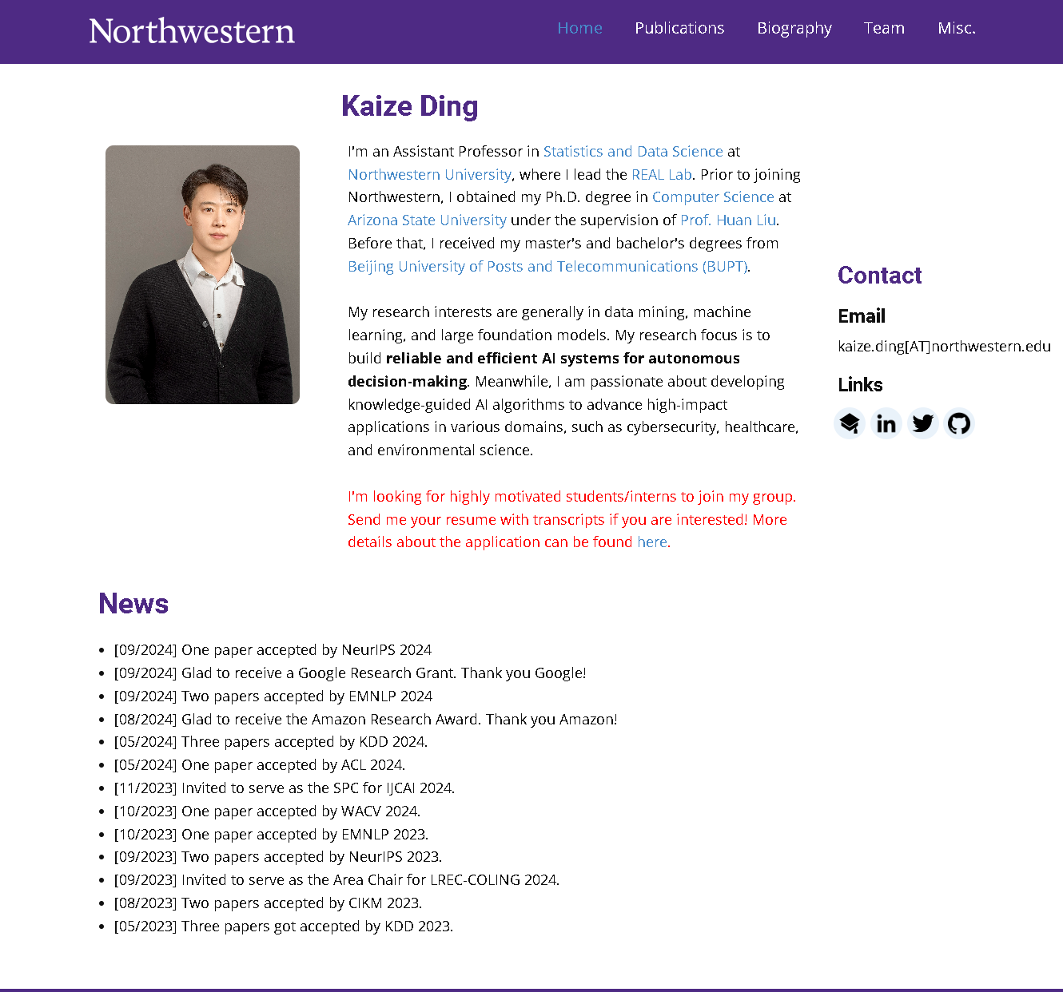
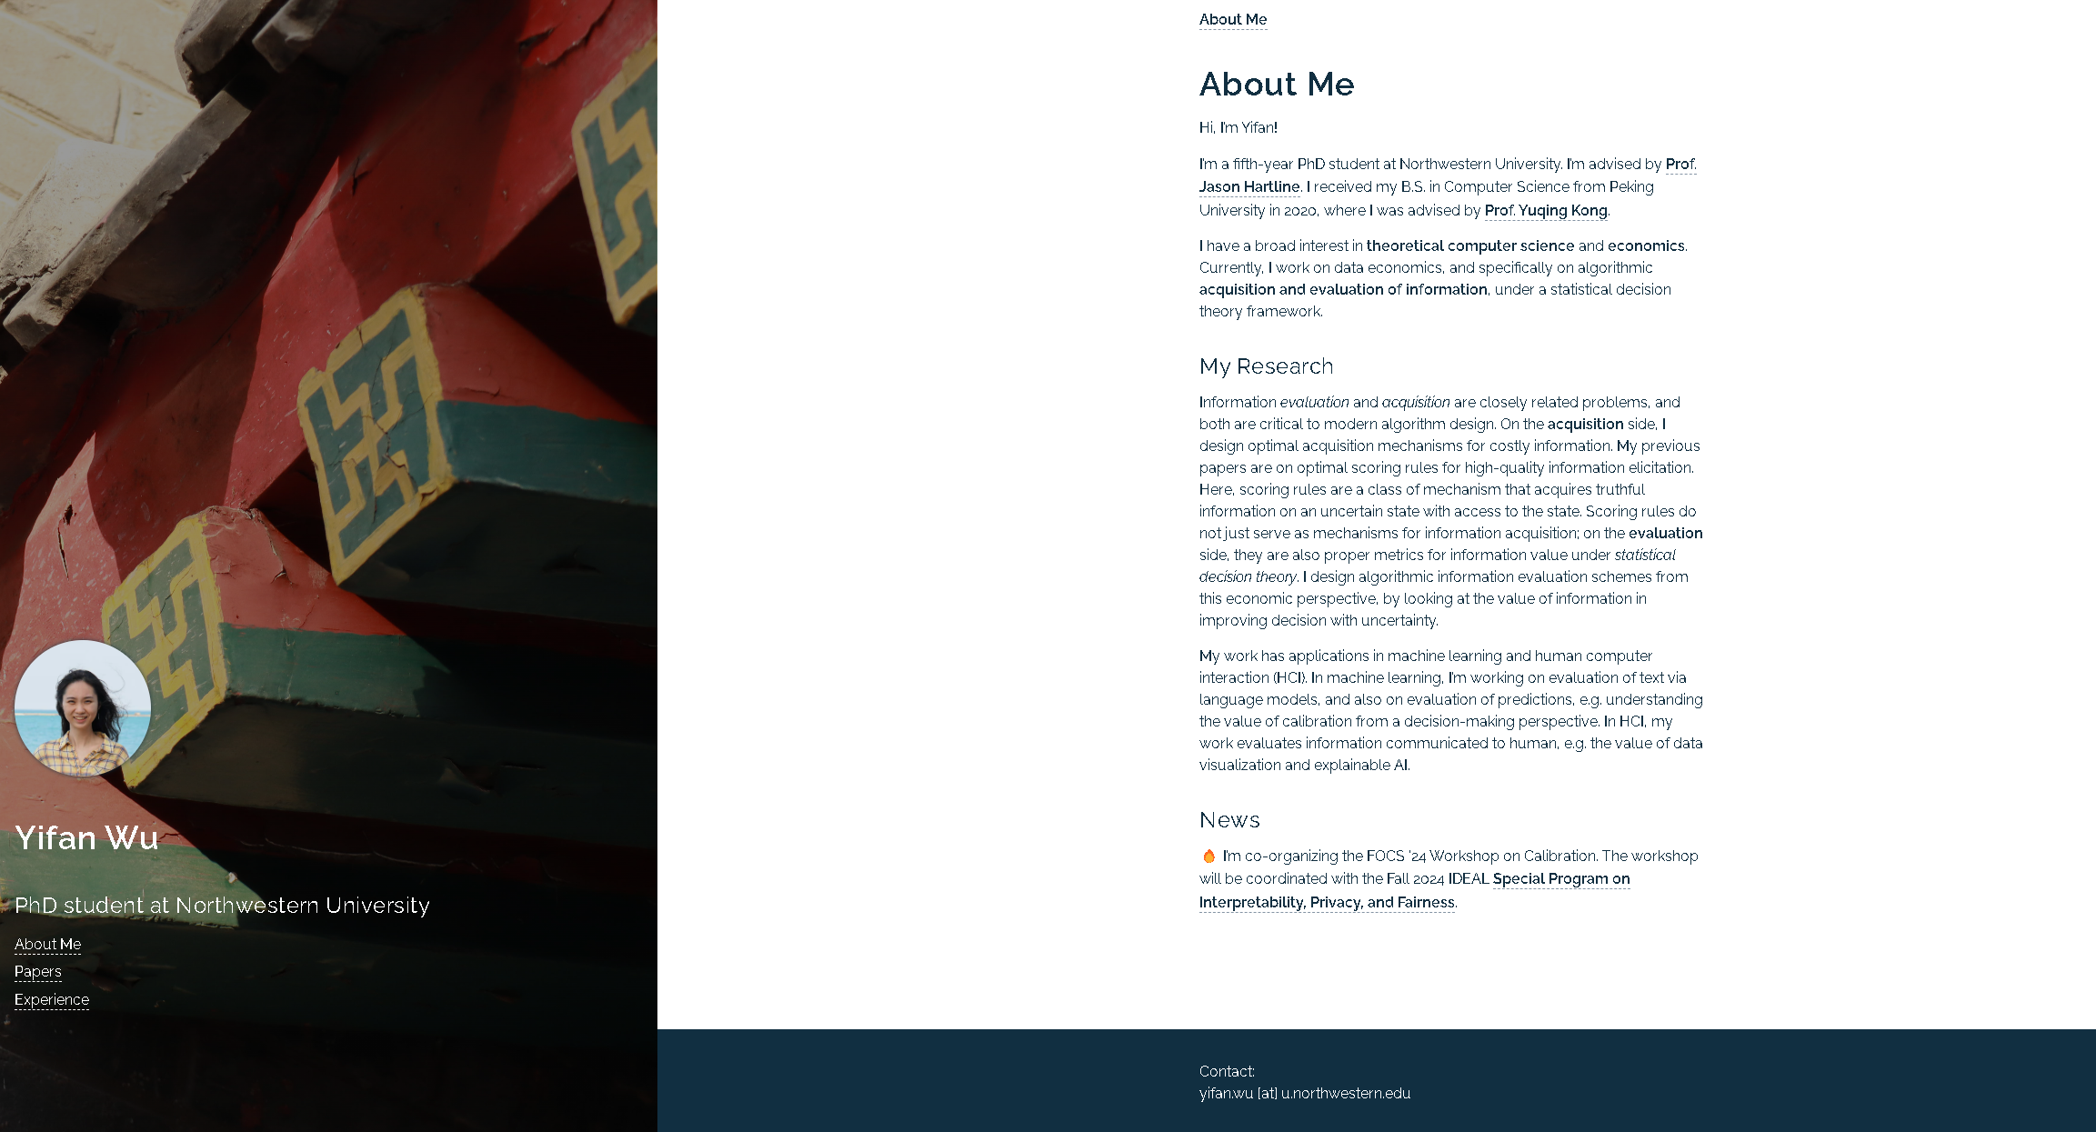
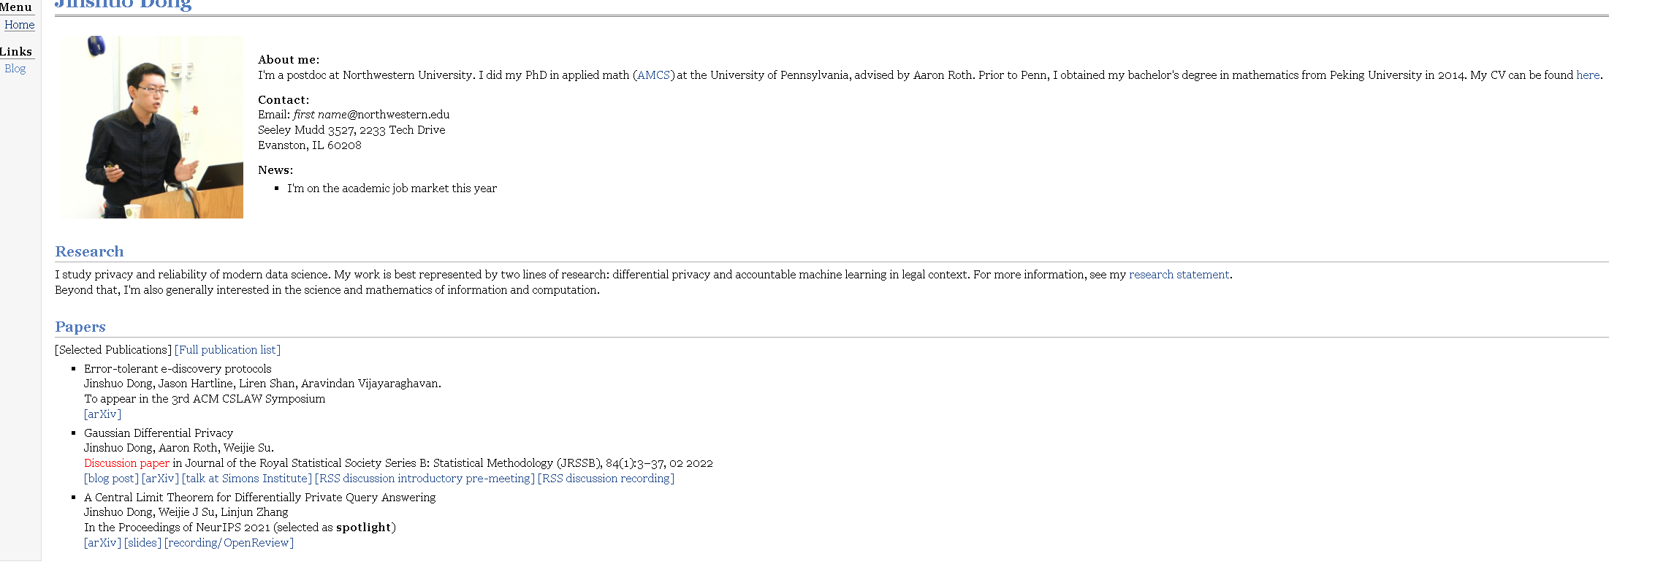

Slide 4
The key components
About Me / Biography
Research Interests
Publications
CV / Resume
Contact Information
Links to Social/Academic Profiles (e.g., Linkedin, Google Scholar)
Teaching Experience
News

Slide 5
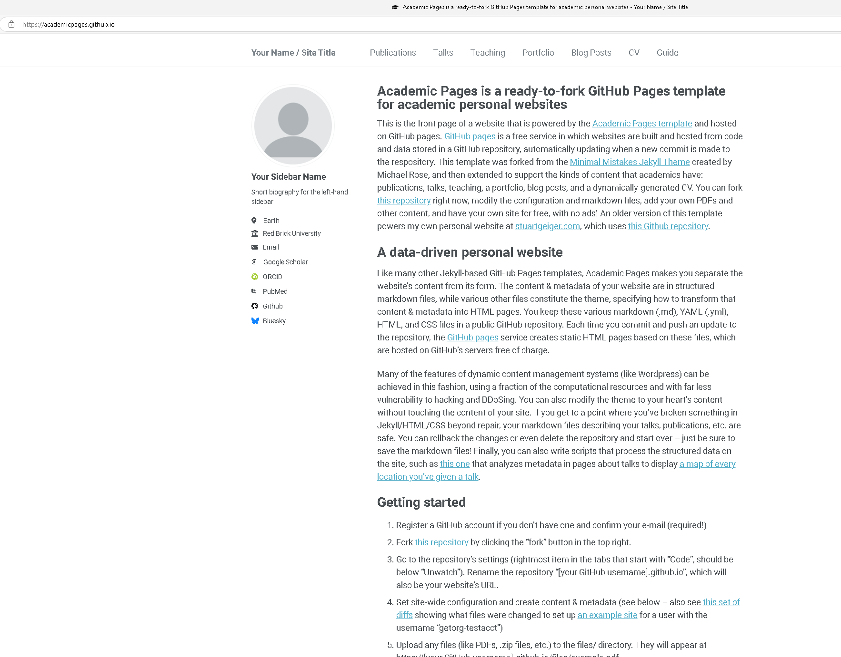
A easy way to start: Academic Pages
a ready-to-fork GitHub Pages template for academic personal websites. https://academicpages.github.io/
Free and simple
Delete& add pages as you like

Slide 6
Getting started
Register a GitHub account
Fork the repo https://github.com/academicpages/academicpages.github.io
3. Go to the repository’s settings. Rename the repository “[your GitHub username].github.io”, which will also be your website’s URL.
4. Set site-wide configuration and create content & metadata (see below –http://archive.is/3TPas showing what files were changed to set up your own personal website).
5. Upload any files (like PDFs, .zip files, etc.) to the files/ directory. They will appear at https://[your GitHub username].github.io/files/example.pdf.

Slide 7
