Slide 1
Large Language Models can Deliver Accurate and Interpretable Time Series Anomaly Detection
Jun Liu, Chaoyun Zhang, Jiaxu Qian, Minghua Ma, Si Qin, Chetan Bansal, Qingwei Lin, Saravan Rajmohan, Dongmei Zhang

Slide 2
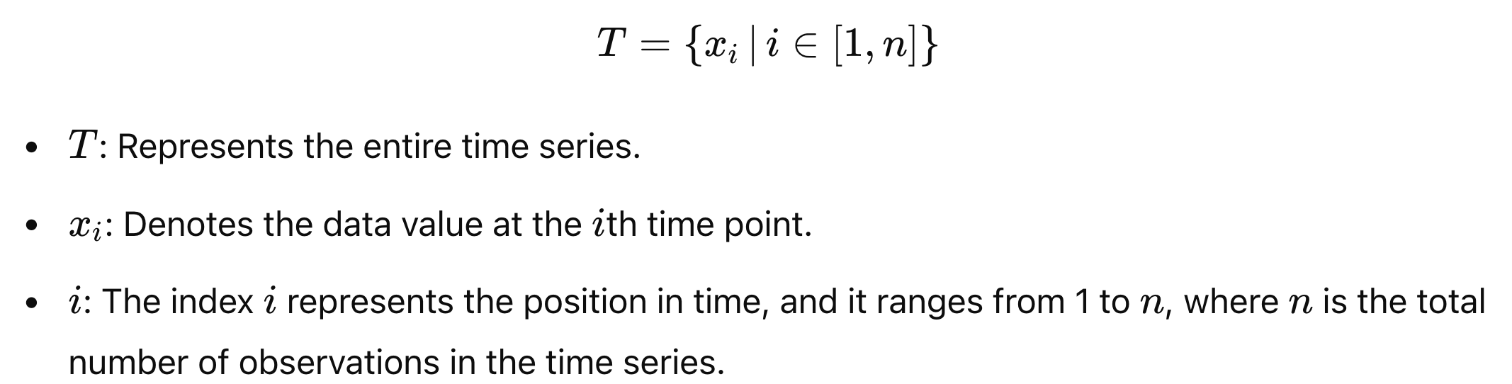
Introduction
Univariate Time Series
A univariate time series is a sequence of data points, typically measured at successive times spaced at uniform intervals.

Slide 3
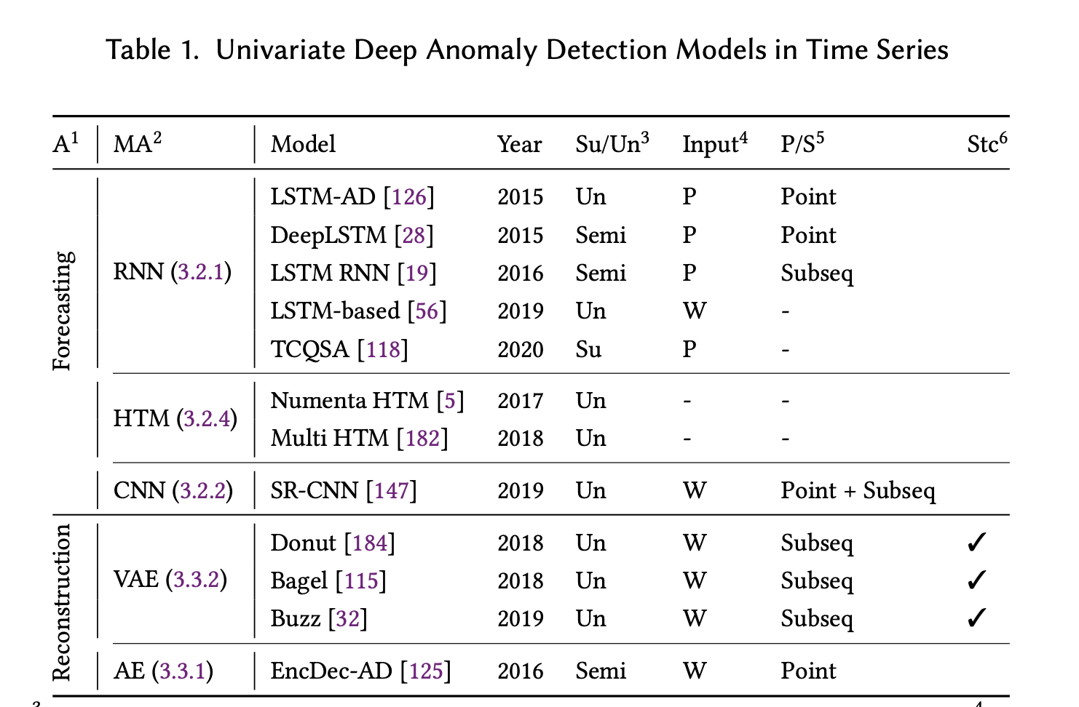
Introduction
Time Series Anomaly Detection
The objective of TSAD is to identify instances of abnormal behavior at each time step.
Forecasting-based methods will take the prediction loss as the anomaly scores
Reconstruction-based methods take the reconstruction error as the anomaly score
Notes:
The forecasting-based approach uses a learned model to predict a point or subsequence based on a point or a recent window. In order to determine how anomalous the incoming values are, the predicted values are compared to their actual values and their deviations are considered as anomalous values. For reconstruction-based, , anomalies are detected by reconstructing a point/sliding window from test data and comparing them to the actual values, which is called reconstruction error. I

Slide 4
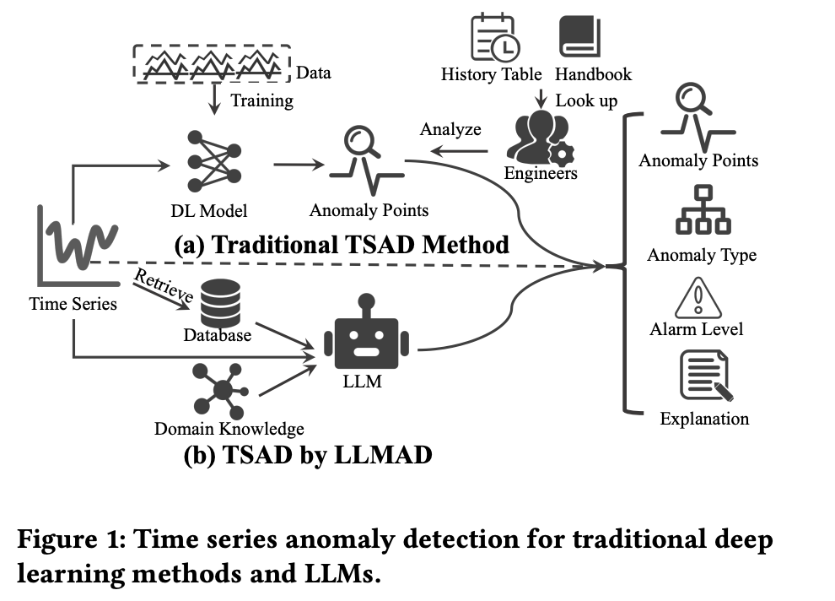
Introduction
Need massive training data for learning, requiring significant data collection efforts.
Only provide detected anomalous points, failing to offer additional interpretation.

Slide 5
Introduction
Maintain high accuracy without additional training and fine-tuning.
Provide meaningful interpretation of the results, such as anomaly type and emergency level.

Slide 6
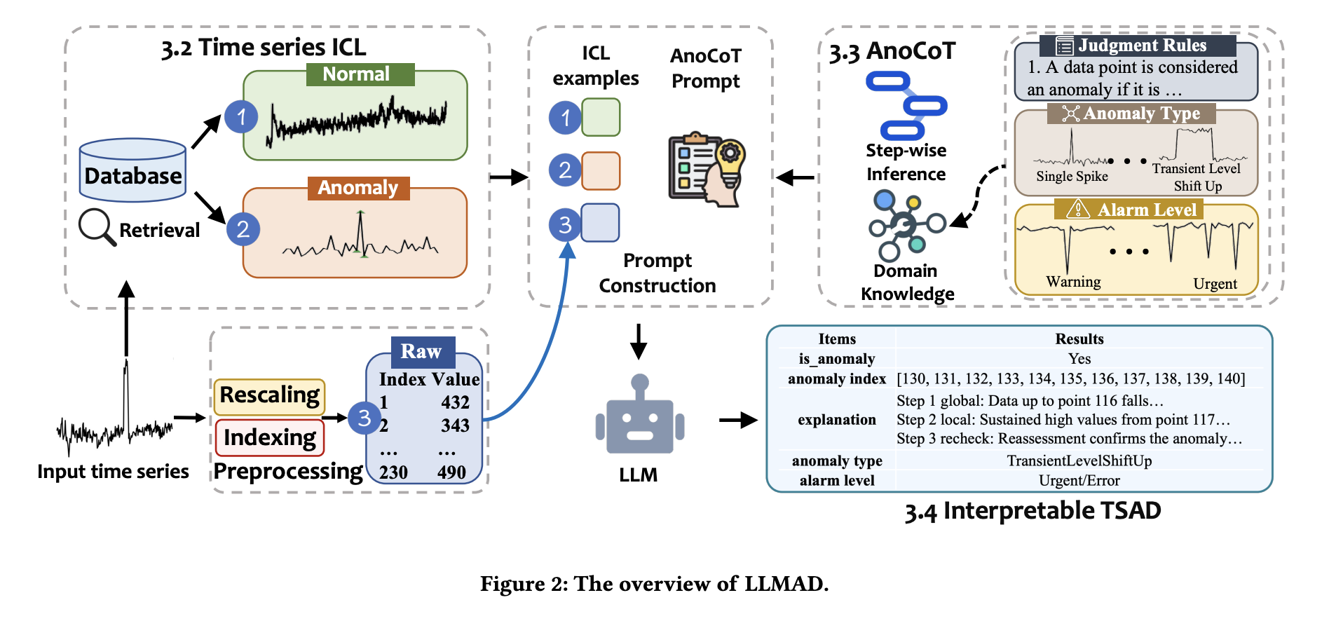
Overview

Slide 7
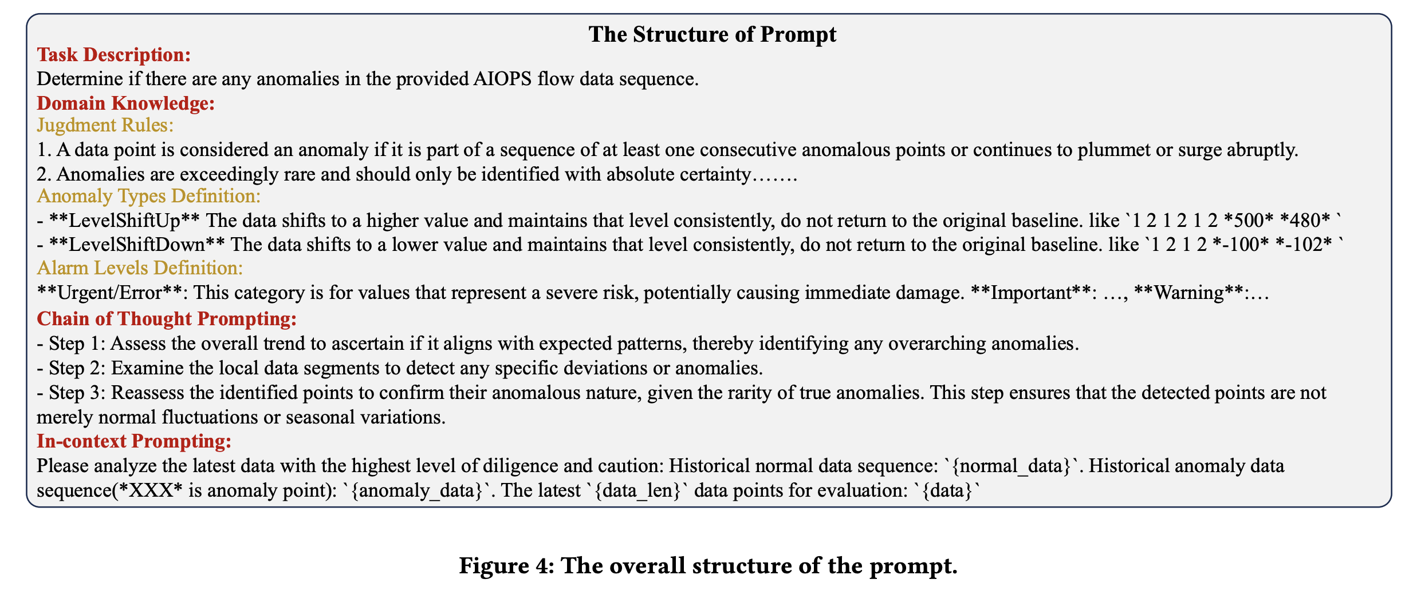
Example Prompt Template

Slide 8
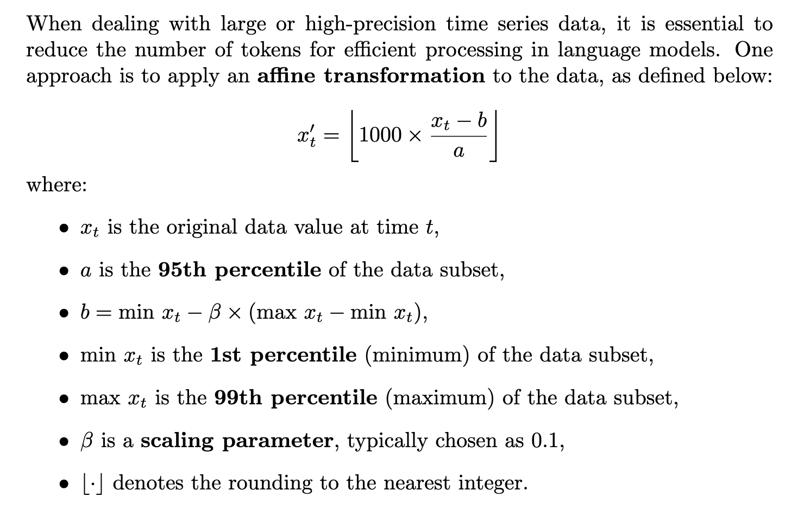
1. Time Series Data Preprocessing
Rescaling

Slide 9
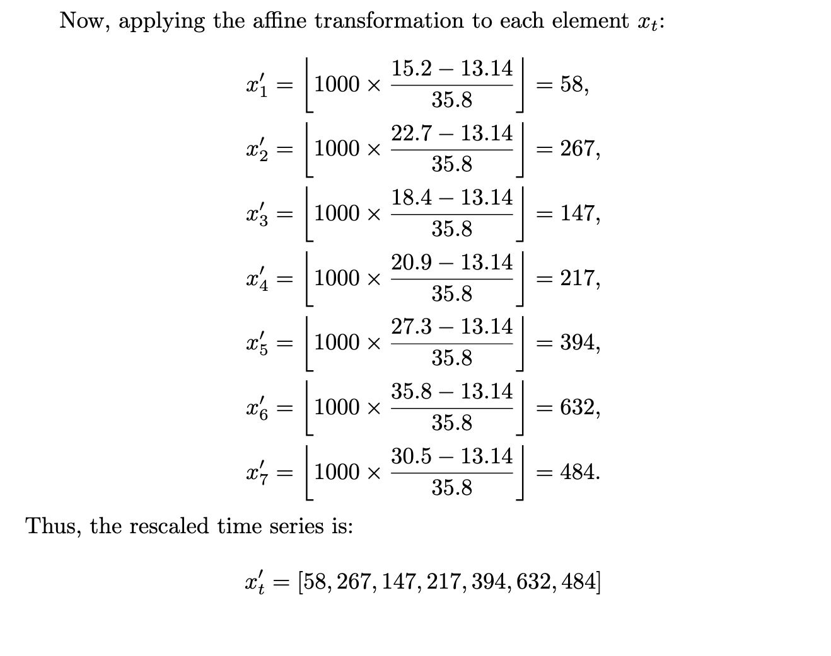
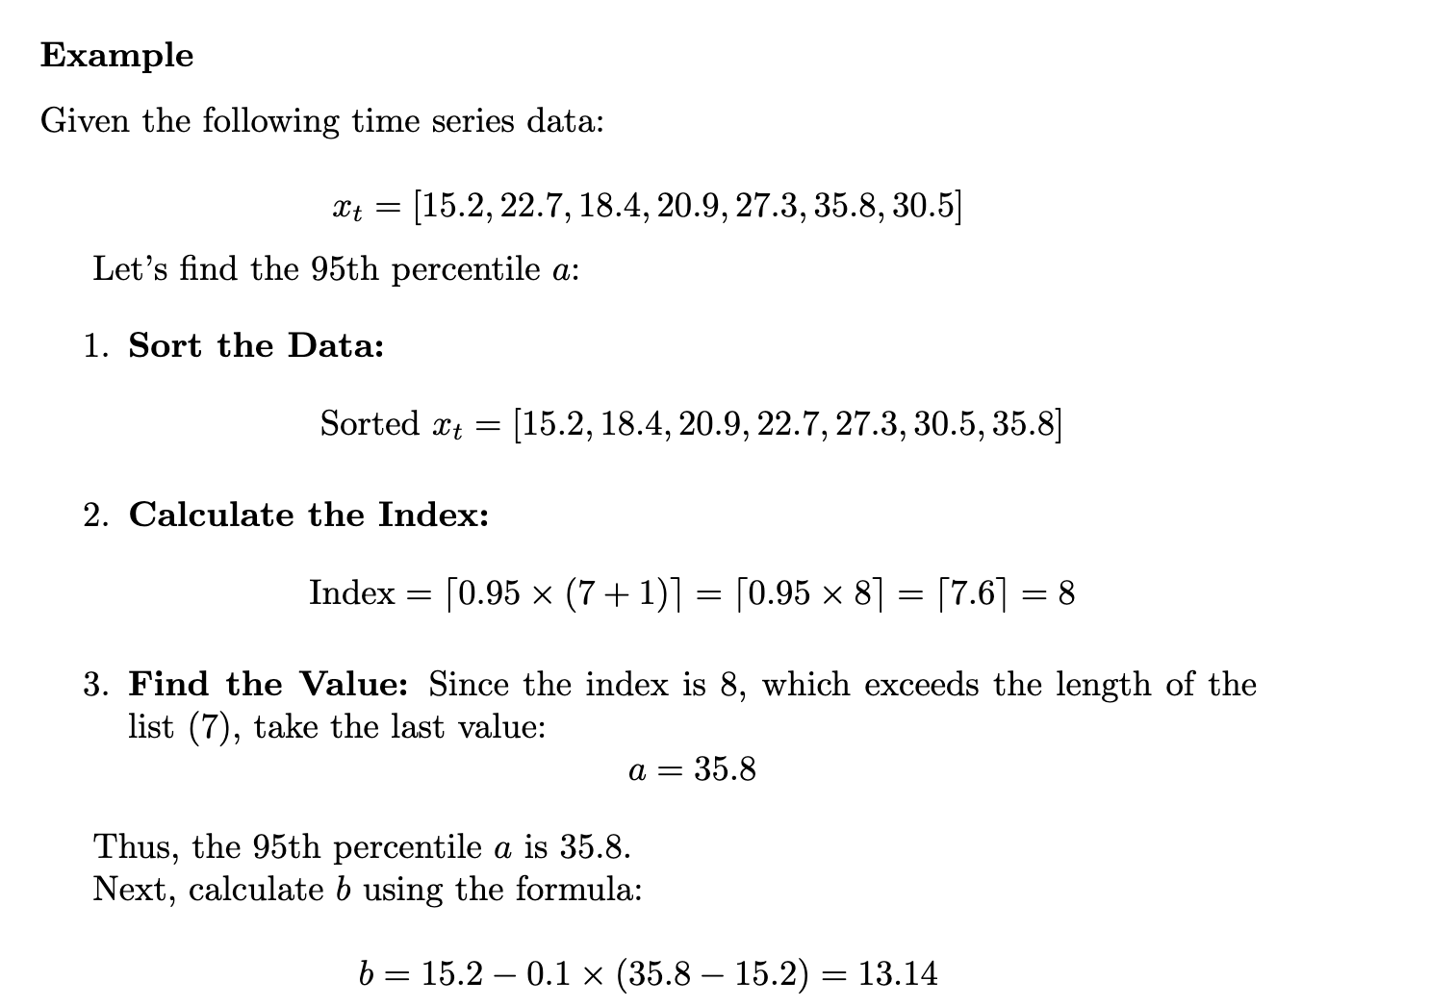
Example

Slide 10
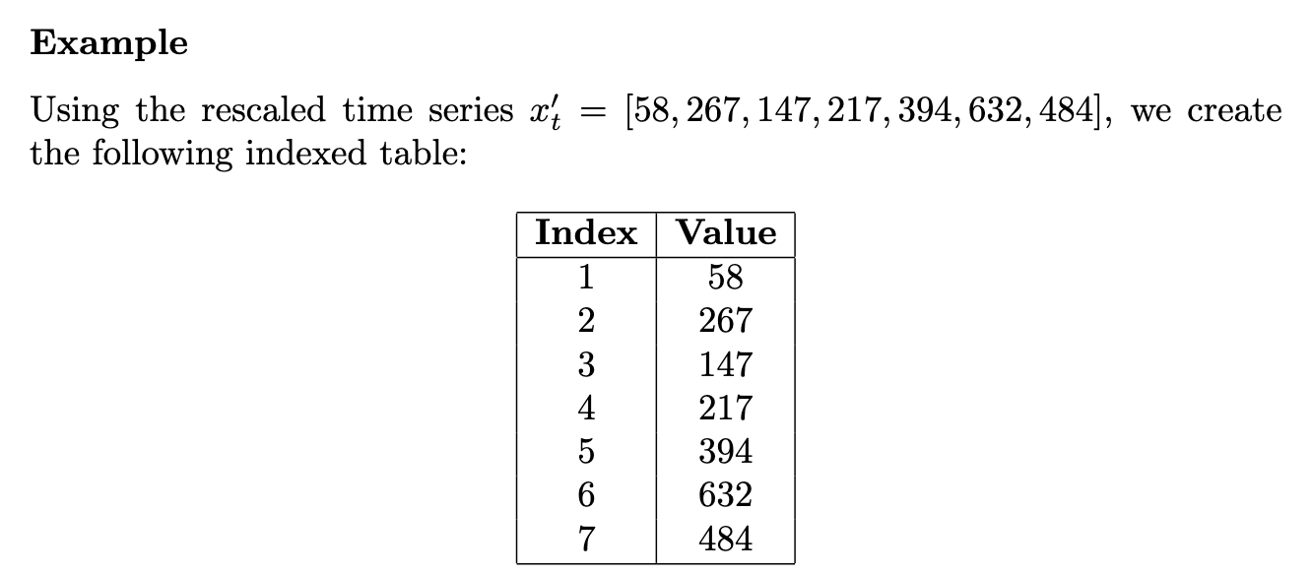
Value Indexing
In Time Series Anomaly Detection (TSAD), the objective is to accurately identify the exact data index of anomalous points. To facilitate this, we can reformat the time series data by assigning unique numerical indices to each value:

Slide 11
2. Time Series In-Context Learning
Step 1: Construction of Databases
Normal Time Series Database: This database comprises normal time series data extracted from the same dataset.
Anomaly Time Series Database: To address the rarity of anomalies, it is assembled from various abnormal sources across different subsets within the dataset, expanding the variety and quantity of anomaly types.
Step 2: Time Series Retrieval
Uses DTW (Dynamic Warping Distance) algorithm to retrieve the most similar K normal and abnormal time series data from the constructed databases.

Slide 12
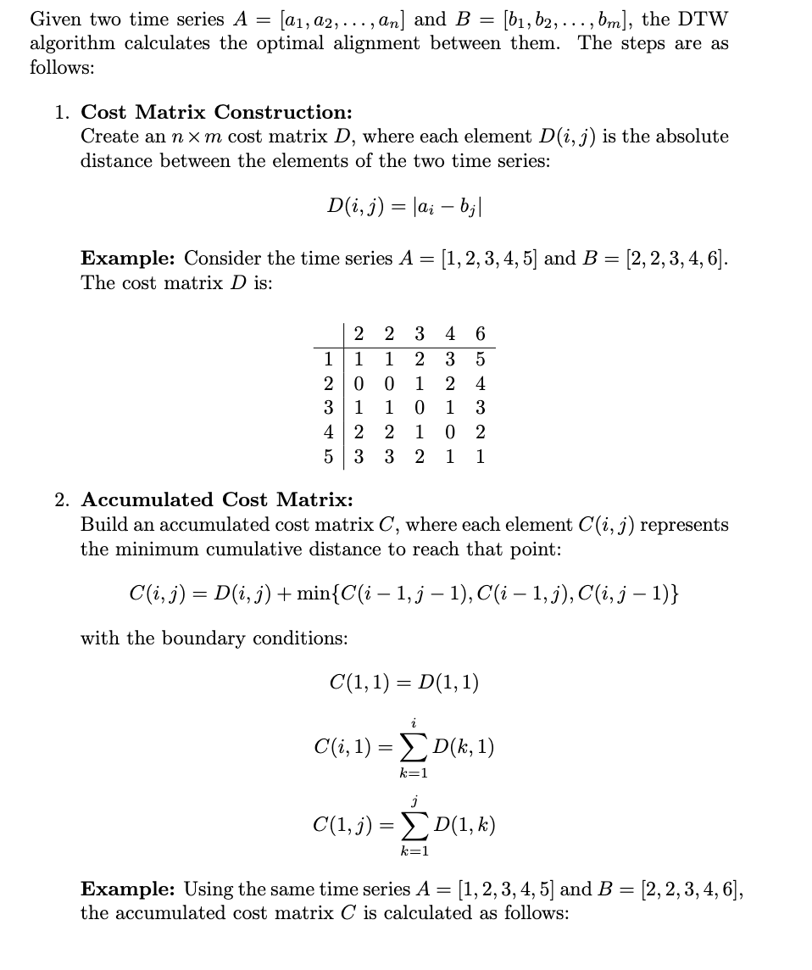
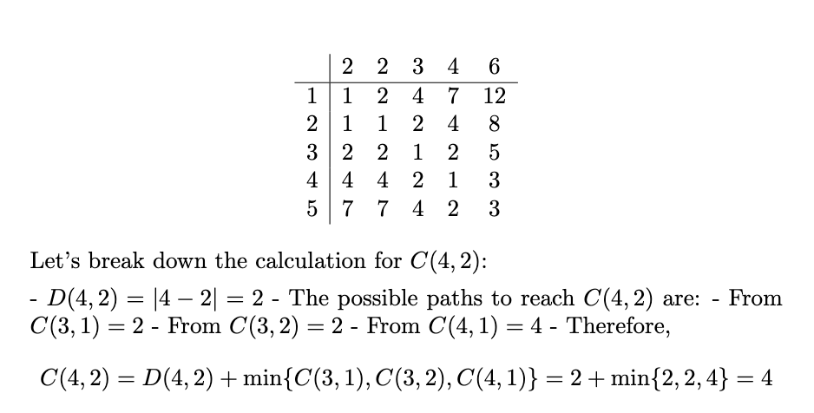
DTW Algorithm

Slide 13
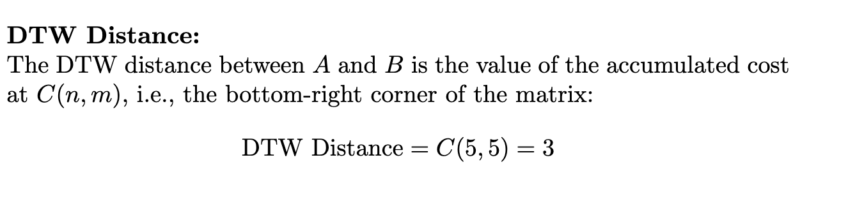
DTW Algorithm

Slide 14
Step 3: In-Context Learning (ICL) Examples
The retrieved similar normal and anomalous time series are incorporated into the prompt for the LLM.

Slide 15
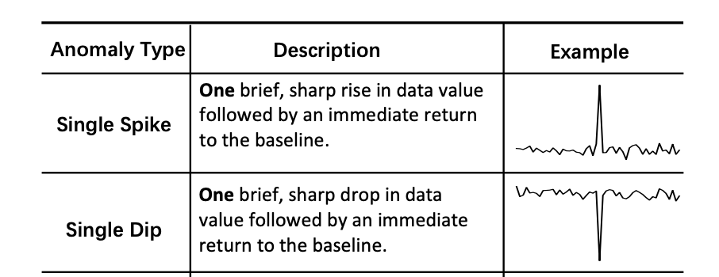
3. Anomaly Detection Chain of Thoughts
A data point is considered an anomaly if it is part of a sequence of at least one consecutive anomalous points or continues to plummet or surge abruptly.
Domain Knowledge Injection
judgment rules
anomaly type definitions
criteria for alarm levels
Urgent/Error: This category is for values that represent a severe risk, potentially causing immediate damage or harm across all event types whether increases, decreases, spikes, dips, or multiple occurrences.

Slide 16
Expert Step-Wise Inference
global trend assessment
local anomaly assessment
reassessment

Slide 17
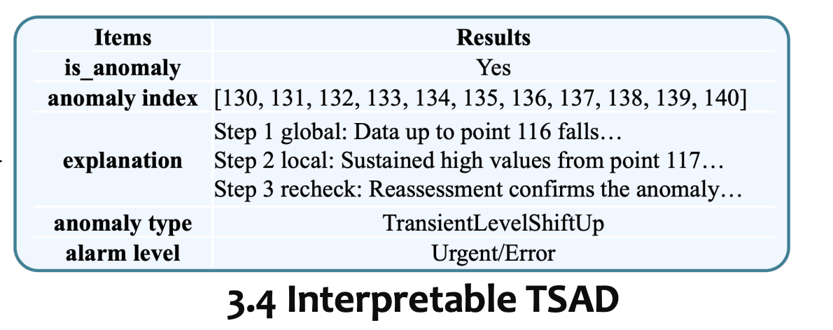
4. TSAD Interpretation
##Response Format
{ "briefExplanation": {"step1_global": analysis reason, "step2_local": analysis reason, "step3_reassess": analysis reason},
"is_anomaly": false/true,
"anomalies": []/[index1, index2, index3, ...],
"reason_for_anomaly_type": "no"/"reason for anomaly type",
"anomaly_type": "no"/"classification of main anomaly",(only one) "reason_for_alarm_level": "no"/"reason for alarm level",
"alarm_level": "no"/"Urgent/Error"/"Important"/"Warning",(only one) }
The report encompasses three key aspects:
(i) anomaly explanation
(ii) anomaly type classification
(iii) alarm level classification

Slide 18
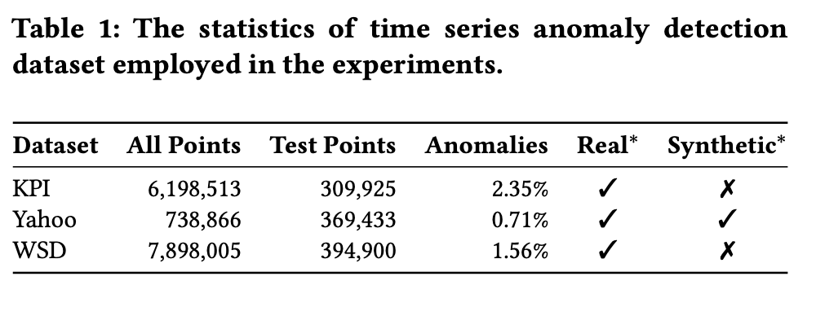
Experiments - Detection
Datasets
Training and Testing set
Select final 50% of data from the Yahoo dataset and 5% of data from both the KPI and WSD datasets as the test set
For baseline models, they use the first 50% of the data in each datasets for training and model selection.
“Real” indicates datasets derived from real-world data sources.
“Synthetic” denotes datasets that have been artificially created to include specific anomalies.

Slide 19
Evaluation Metrics
Best F1
Measure the peak F1 score that a model can achieve across different thresholds.
Delayed F1
If an anomaly is detected within K time intervals after it occurs, it is considered detected.
If the detection happens after K intervals, the anomaly is considered undetected.
The concept allows for practical scenarios where immediate detection may not always be feasible.

Slide 20
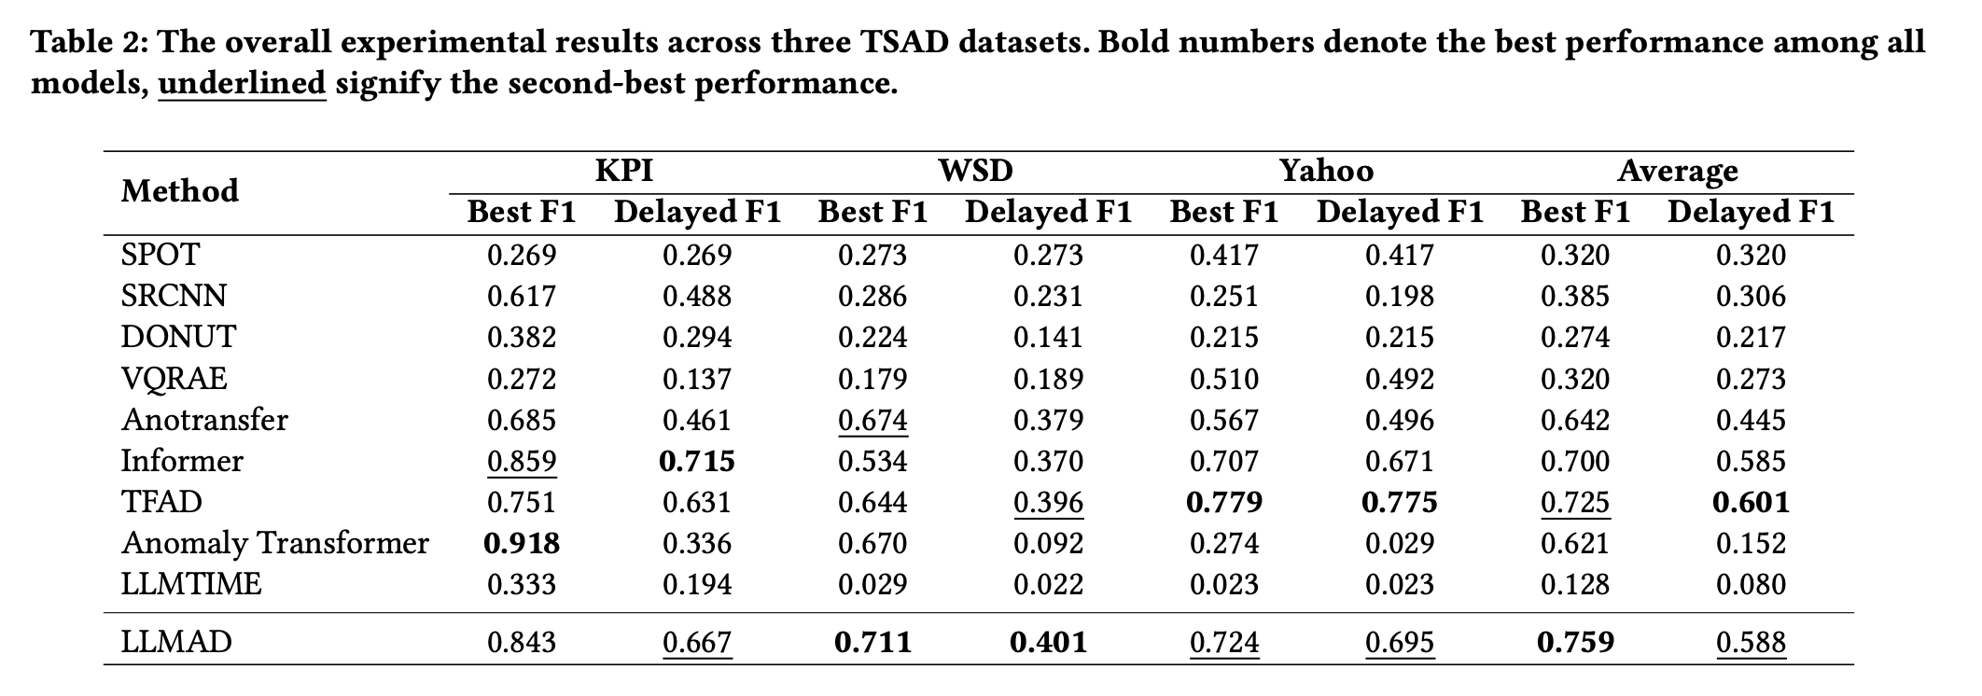
Results

Slide 21
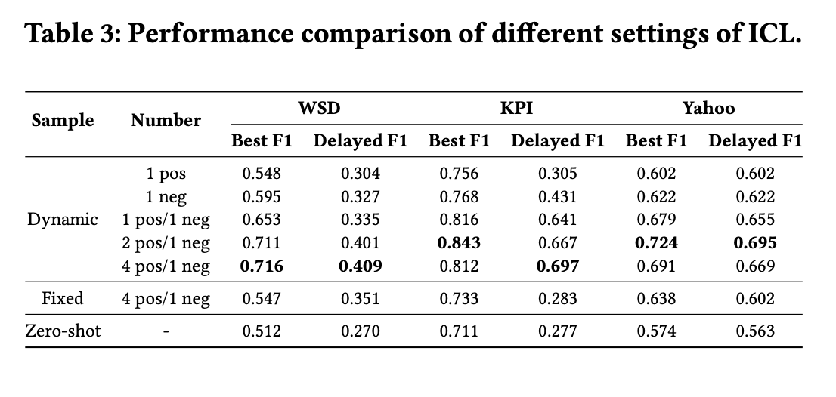
Ablation Study
whether to retrieve samples dynamically, use fixed ones, or not use ICL at all (zero-shot)
the number of positive (anomaly) and negative (normal) samples used for ICL.

Slide 22
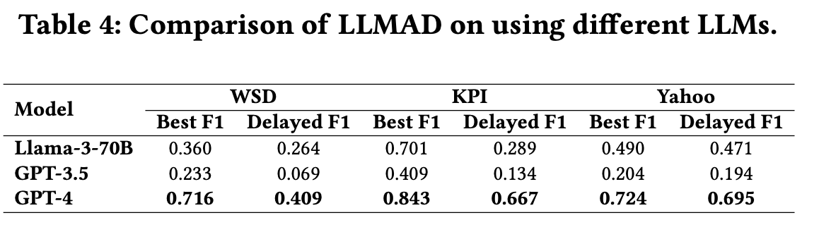
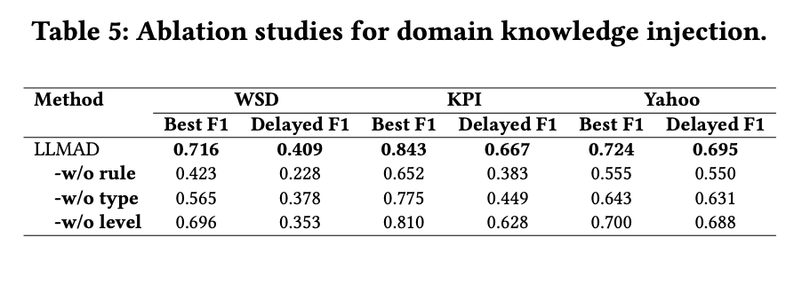

Slide 23
Experiments - Interpretation
Data Selection
Randomly selected 100 anomaly cases from three datasets for human evaluation.
Evaluation Criteria
Usefulness
Assesses the effectiveness and practical relevance of the explanation in real-world applications.
Rated on a scale from 1 to 5, with 5 representing the highest utility.
Readability
Evaluates the clarity and ease of understanding of the explanation.
Rated on a scale from 1 to 3, with 3 representing the clearest explanations.
Metrics Reported
Mean and Standard Deviation (Std) Scores
Calculated from the ratings provided by human evaluators for each criterion.
High Incidence Proportion (HIP)
Measures the percentage of evaluations exceeding a predefined performance threshold.

Slide 24
