Slide 1

InstructGraph: Boosting Large Language Models via Graph-centric Instruction Tuning and Preference Alignment
Jianing Wang, Junda Wu , Yupeng Hou, Yao Liu, Ming Gao, Julian McAuley
Findings of ACL 2024

Slide 2
Motivation
Graphs are essential for capturing relationships and connections within data (knowledge graph, social networks, etc)
LLM relies on unstructured text and struggle with effectively understanding graph structures
may impede LLM in graph reasoning and generation tasks
Goal: bridge the gap in empowering LLMs to understand and reason on graph data

Slide 3
Challenge 1
Semantic gap between graph and text
Existing solutions: Graph description, and Graph embeddings
Current Limitations:
large number of manual templates to describe the graph
Representing large or complex graph via embeddings may cause information loss
Difficult to use the result produced by these methods in LLM to generate actual graphs
Observation: LLM great at code understanding/generation
Proposal: Unify graph data into a code like universal format to enhance graph understanding/generation

Slide 4

Graph Input Engineering
Let $𝒟$ denote possible graph tasks, the corresponding dataset of each task can be denoted as
$𝒟_{j}=\{\left(I_{i},𝒢_{i},𝒫_{i}, A_{i}\right)\}_{i=1}^{N_{j}}$

Slide 5

Graph Input Engineering
Let $𝒟$ denote possible graph tasks, the corresponding dataset of each task can be denoted as
$𝒟_{j}=\{\left(I_{i},𝒢_{i},𝒫_{i}, A_{i}\right)\}_{i=1}^{N_{j}}$
Answer
$N_{j}$ samples for task j
Instruction
Optional Passage: additional textual descriptions

Slide 6
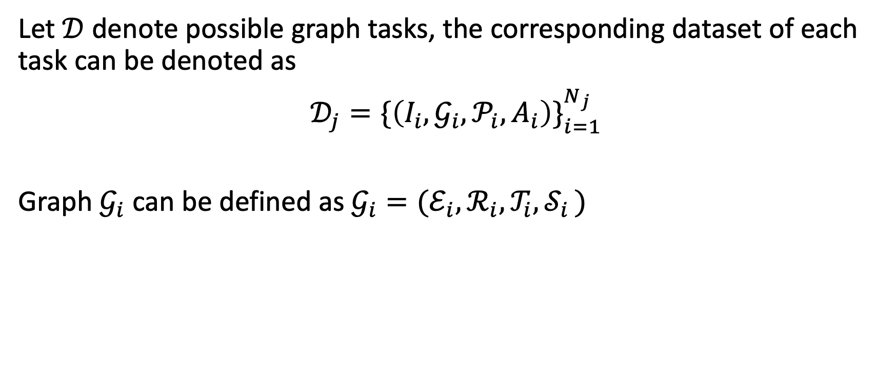
Graph Input Engineering
Let $𝒟$ denote possible graph tasks, the corresponding dataset of each task can be denoted as
$𝒟_{j}=\{\left(I_{i},𝒢_{i},𝒫_{i}, A_{i}\right)\}_{i=1}^{N_{j}}$
Graph $𝒢_{i}$ can be defined as $𝒢_{i}=(ℰ_{i},ℛ_{i},𝒯_{i}, 𝒮_{i })$
$N_{j}$ samples for task j
nodes
Edge(triple) set

Slide 7
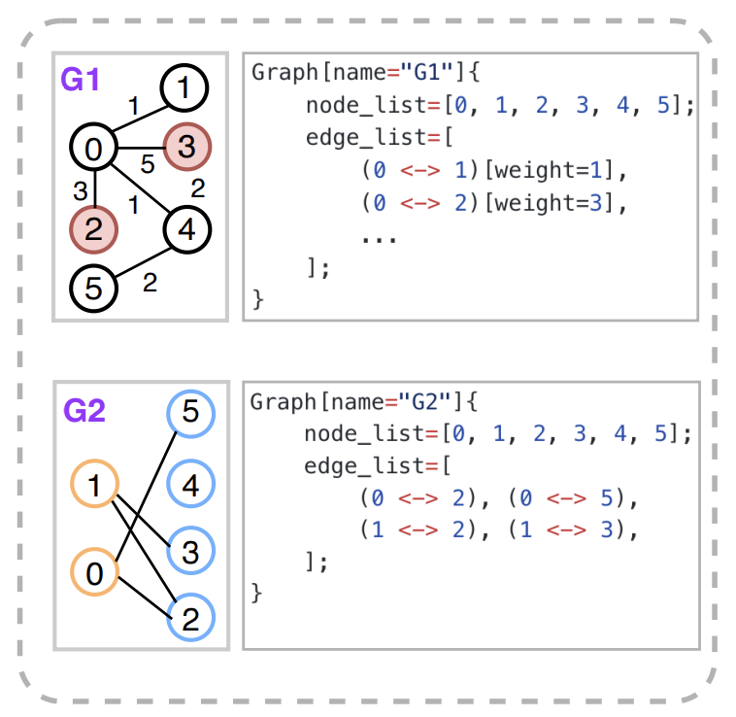
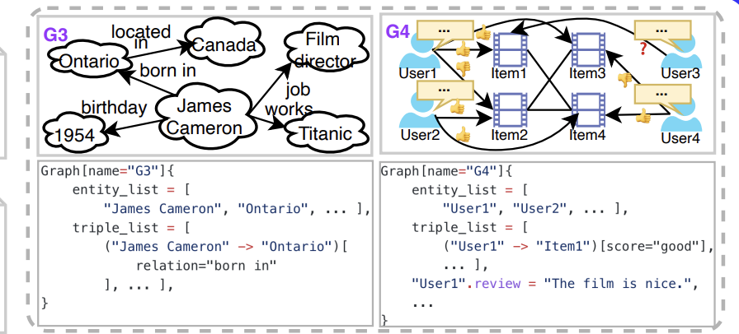

Graph Input Engineering
Given one task graph $𝒢_{i}∈ 𝒟_{i}$, we define $M(∙)$ as the structured format verbalizer and the original graph can be mapped into a sequence
$C_{i}=$ $M(𝒢_{i})$
Side info

Slide 8
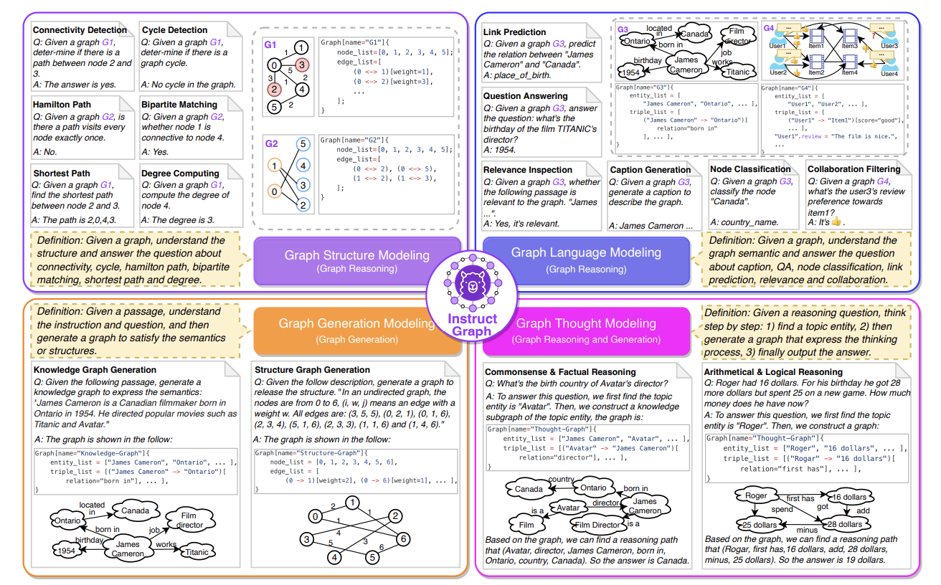
Graph Instruction Tuning
Graph Structure modeling
Given a graph, understand the structure and answer questions about structure
Graph language modeling
Interpreting and generating meaningful textual representations
Graph Generation Modeling
Converts text descriptions into corresponding graph structures.
Graph Thought Modeling
Use graph-based representations to simulate the thought process for solving general reasoning tasks.

Slide 9
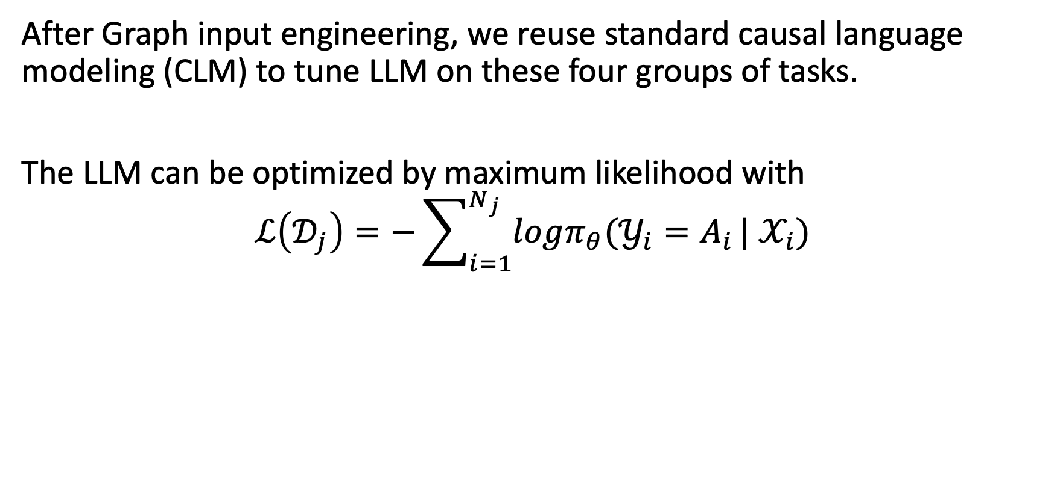
Graph Instruction Tuning
to predict the next token in a sequence based on all preceding tokens.
After Graph input engineering, we reuse standard causal language modeling (CLM) to tune LLM on these four groups of tasks.
The LLM can be optimized by maximum likelihood with
$$ℒ\left(𝒟_{j}\right)=−\sum_{i=1}^{N_{j}}{logπ_{θ}(𝒴_{i}=A_{i}}|{ 𝒳}_{i})$$
Input sequence

Slide 10
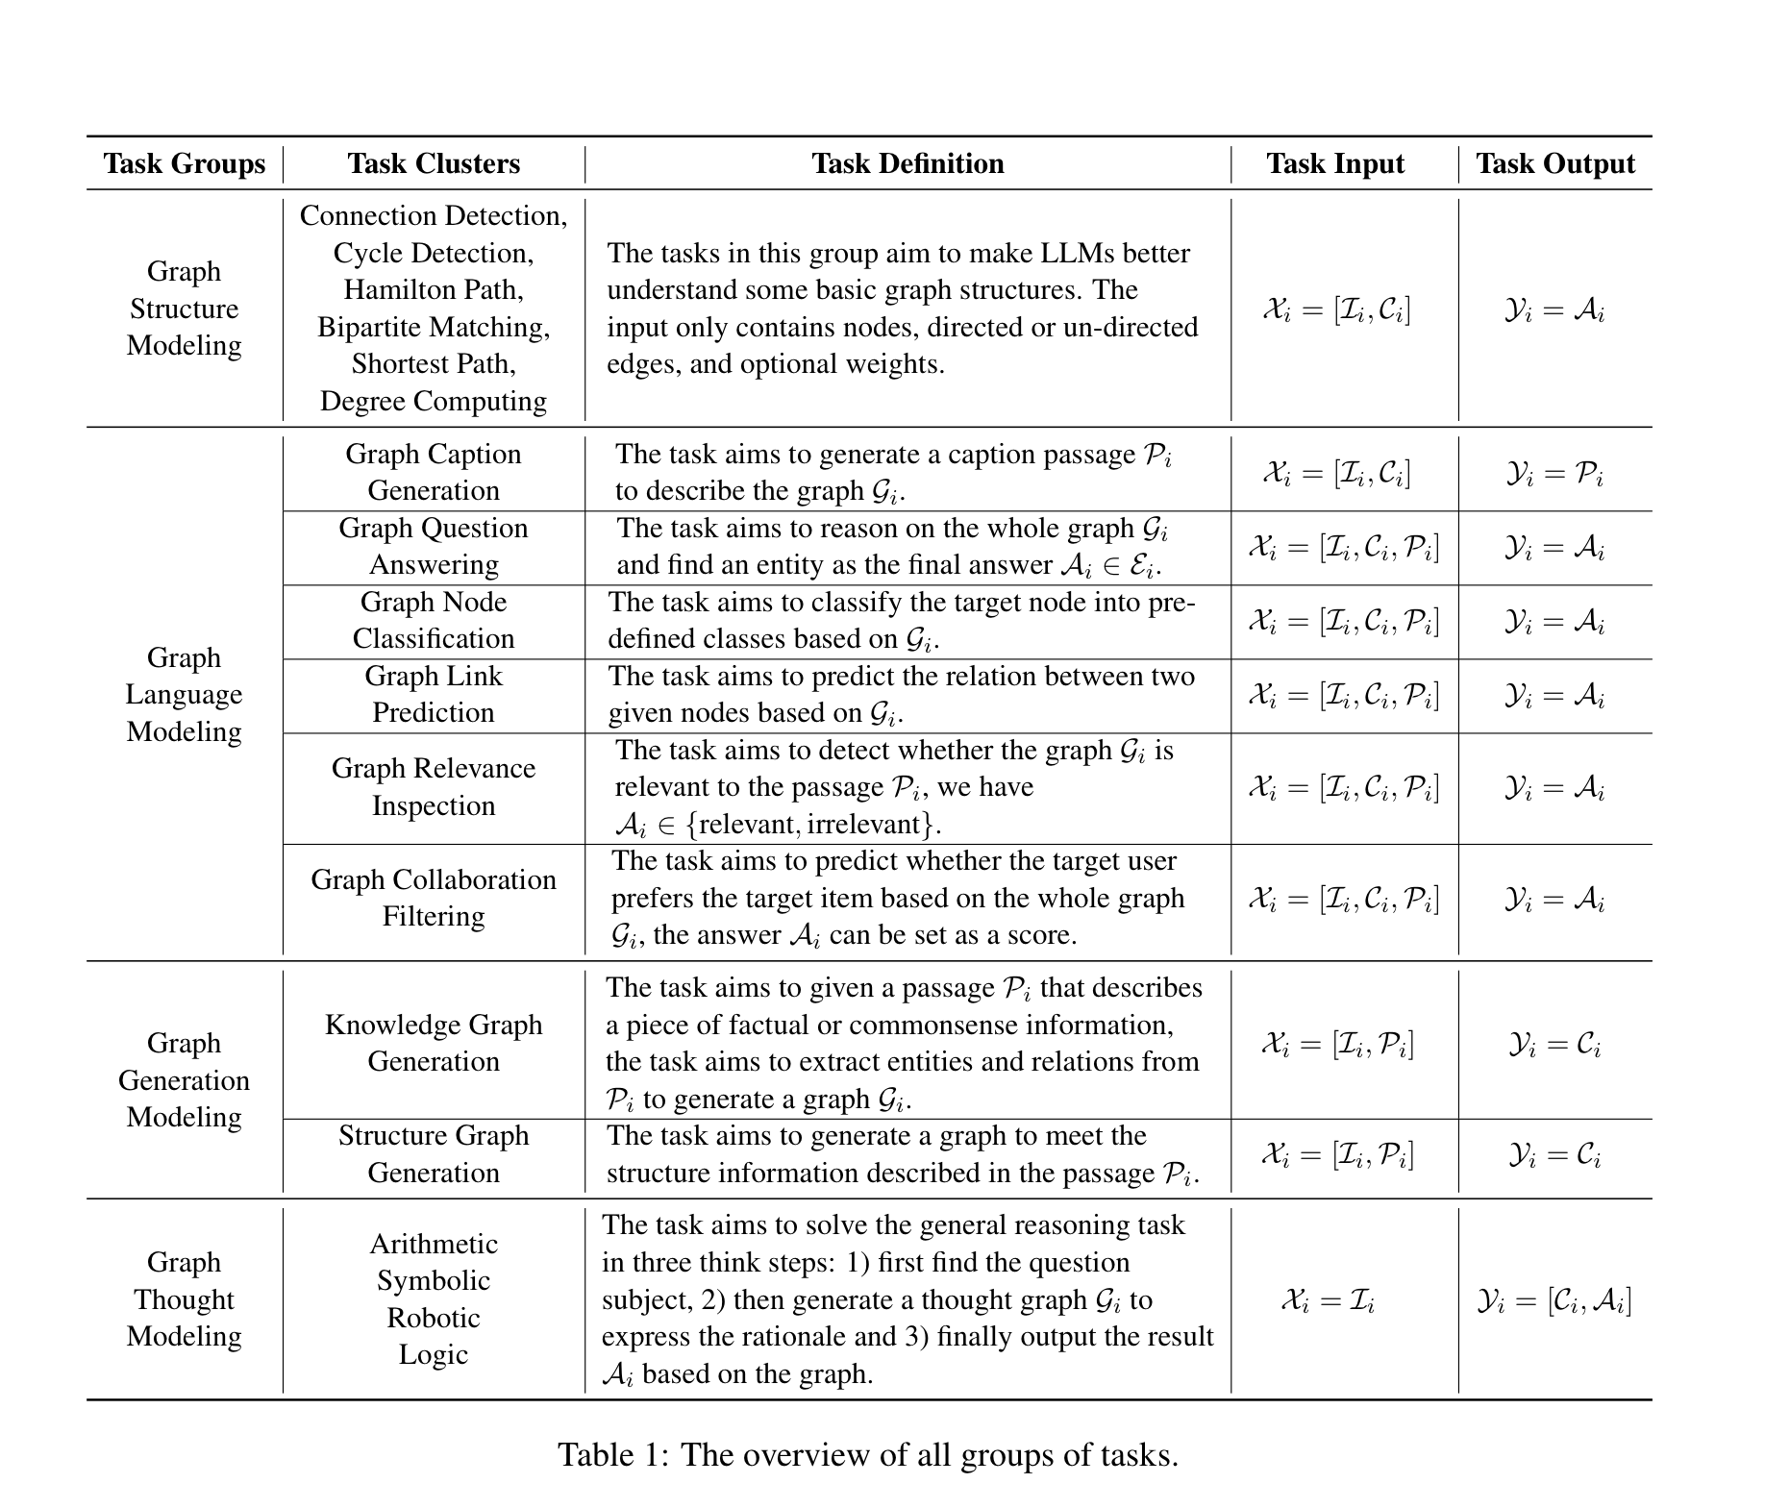

Slide 11
Challenge 2
LLM hallucinates when following erroneous inputs or lack intrinsic knowledge (eg. When being questioned on a graph that lacks key information)
Proposal: direct preference optimization (DPO) to alleviate hallucination in LLM reasoning and generation

Slide 12

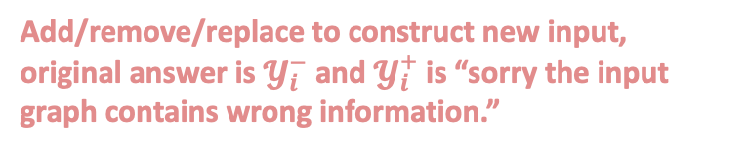
Hallucination for Graph Reasoning
To simulate the following hallucination scenarios, we could
Correct input graph
Unfactual input graph
Conflict input graph
Missing input graph
Choose a result from other examples to form a negative output $𝓨_{i}^{−}$
Add/remove/replace to construct new input, original answer is $𝓨_{i}^{−}$ and $𝓨_{i}^{+}$ is “sorry the input graph contains wrong information.”

Slide 13
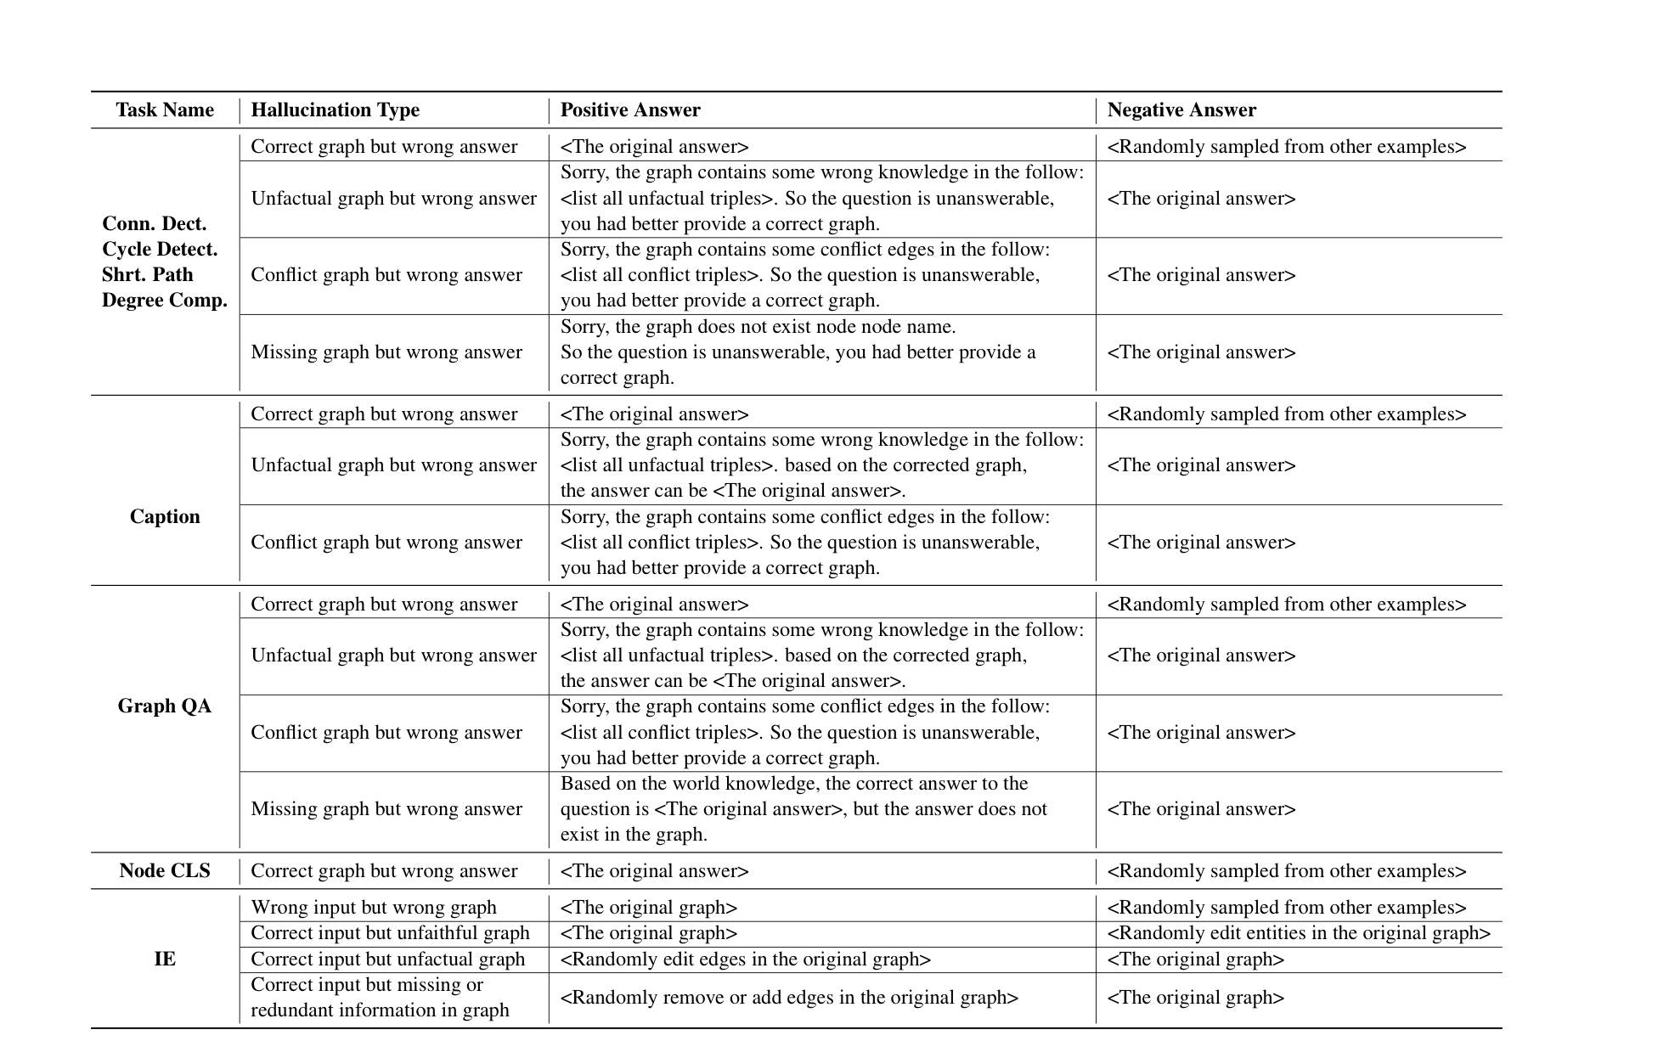

Slide 14
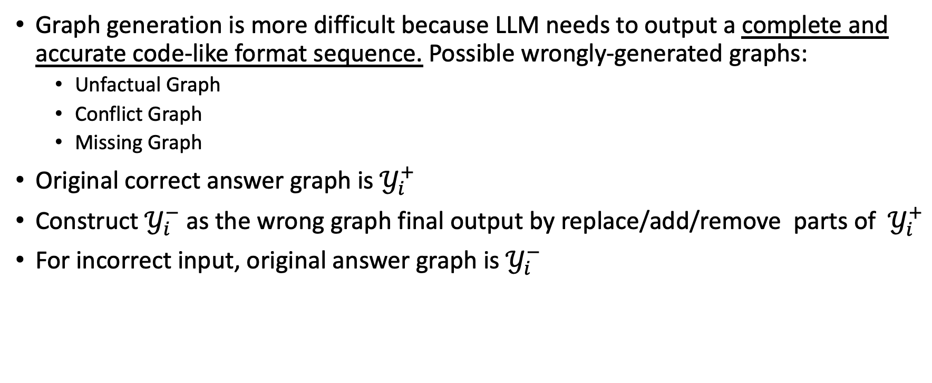
Hallucination for Graph Generation
Graph generation is more difficult because LLM needs to output a complete and accurate code-like format sequence. Possible wrongly-generated graphs:
Unfactual Graph
Conflict Graph
Missing Graph
Original correct answer graph is $𝒴_{i}^{+}$
Construct $𝒴_{i}^{−}$ as the wrong graph final output by replace/add/remove parts of $𝒴_{i}^{+}$
For incorrect input, original answer graph is $𝒴_{i}^{−}$

Slide 15
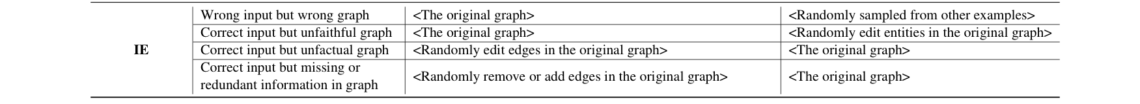

Slide 16

DPO Algorithm
Given one instruction example ${(𝒳_{i},𝒴}_{i}^{+})$ and a corresponding negative ${(𝒳_{i},𝒴}_{i}^{−})$
We can define the preference model as
$$p_{θ}\left(𝒴_{i}^{+}≥𝒴_{i}^{−} | 𝒳_{i}\right)=\frac{1}{1+exp⁡\{r\left(𝒴_{i}^{+},𝒴_{i}^{−},𝒳_{i}\right)\}}$$
Preference Model

Slide 17
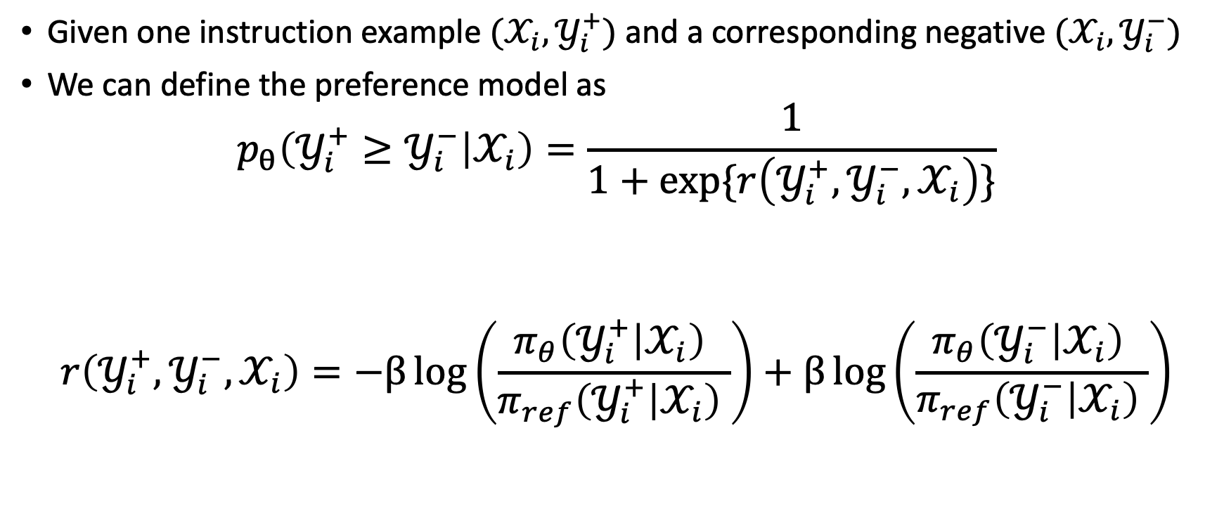
DPO Algorithm
Given one instruction example ${(𝒳_{i},𝒴}_{i}^{+})$ and a corresponding negative ${(𝒳_{i},𝒴}_{i}^{−})$
We can define the preference model as
$$p_{θ}\left(𝒴_{i}^{+}≥𝒴_{i}^{−} | 𝒳_{i}\right)=\frac{1}{1+exp⁡\{r\left(𝒴_{i}^{+},𝒴_{i}^{−},𝒳_{i}\right)\}}$$
$$r\left(𝒴_{i}^{+},𝒴_{i}^{−},𝒳_{i}\right)=−β\log\left(\frac{π_{θ}\left(𝒴_{i}^{+} | 𝒳_{i}\right) }{π_{ref}\left(𝒴_{i}^{+} | 𝒳_{i}\right) }\right)+β\log\left(\frac{π_{θ}\left(𝒴_{i}^{−} | 𝒳_{i}\right) }{π_{ref}\left(𝒴_{i}^{−} | 𝒳_{i}\right) }\right)$$
Preference Model
Policy Model
Reference model
Relative score: determine whether the model prefers the positive output over the negative output

Slide 18
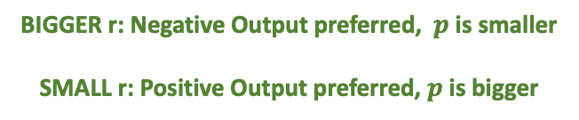
DPO Algorithm
Given one instruction example ${(𝒳_{i},𝒴}_{i}^{+})$ and a corresponding negative ${(𝒳_{i},𝒴}_{i}^{−})$
We can define the preference model as
$$p_{θ}\left(𝒴_{i}^{+}≥𝒴_{i}^{−} | 𝒳_{i}\right)=\frac{1}{1+exp⁡\{r\left(𝒴_{i}^{+},𝒴_{i}^{−},𝒳_{i}\right)\}}$$
$$r\left(𝒴_{i}^{+},𝒴_{i}^{−},𝒳_{i}\right)=−β\log\left(\frac{π_{θ}\left(𝒴_{i}^{+} | 𝒳_{i}\right) }{π_{ref}\left(𝒴_{i}^{+} | 𝒳_{i}\right) }\right)+β\log\left(\frac{π_{θ}\left(𝒴_{i}^{−} | 𝒳_{i}\right) }{π_{ref}\left(𝒴_{i}^{−} | 𝒳_{i}\right) }\right)$$
BIGGER r: Negative Output preferred, $p$ is smaller
SMALL r: Positive Output preferred, $p$ is bigger

Slide 19

DPO Algorithm
The relative probability of the negative output assigned by the current model compared to the reference model
We can optimize LLM by maximum likelihood with:
$$ℒ\left(π_{θ},π_{ref}\right)=−𝔼_{{(𝒳}_{i},𝒴_{i}^{+},𝒴_{i}^{−})\sim 𝒟}\left[logσ\left(β\log\left(\frac{π_{θ}\left(𝒴_{i}^{+} | 𝒳_{i}\right) }{π_{ref}\left(𝒴_{i}^{+} | 𝒳_{i}\right) }\right)−β\log\left(\frac{π_{θ}\left(𝒴_{i}^{−} | 𝒳_{i}\right) }{π_{ref}\left(𝒴_{i}^{−} | 𝒳_{i}\right) }\right)\right)\right]$$
how well the current model scores the correct answer relative to the reference.

Slide 20
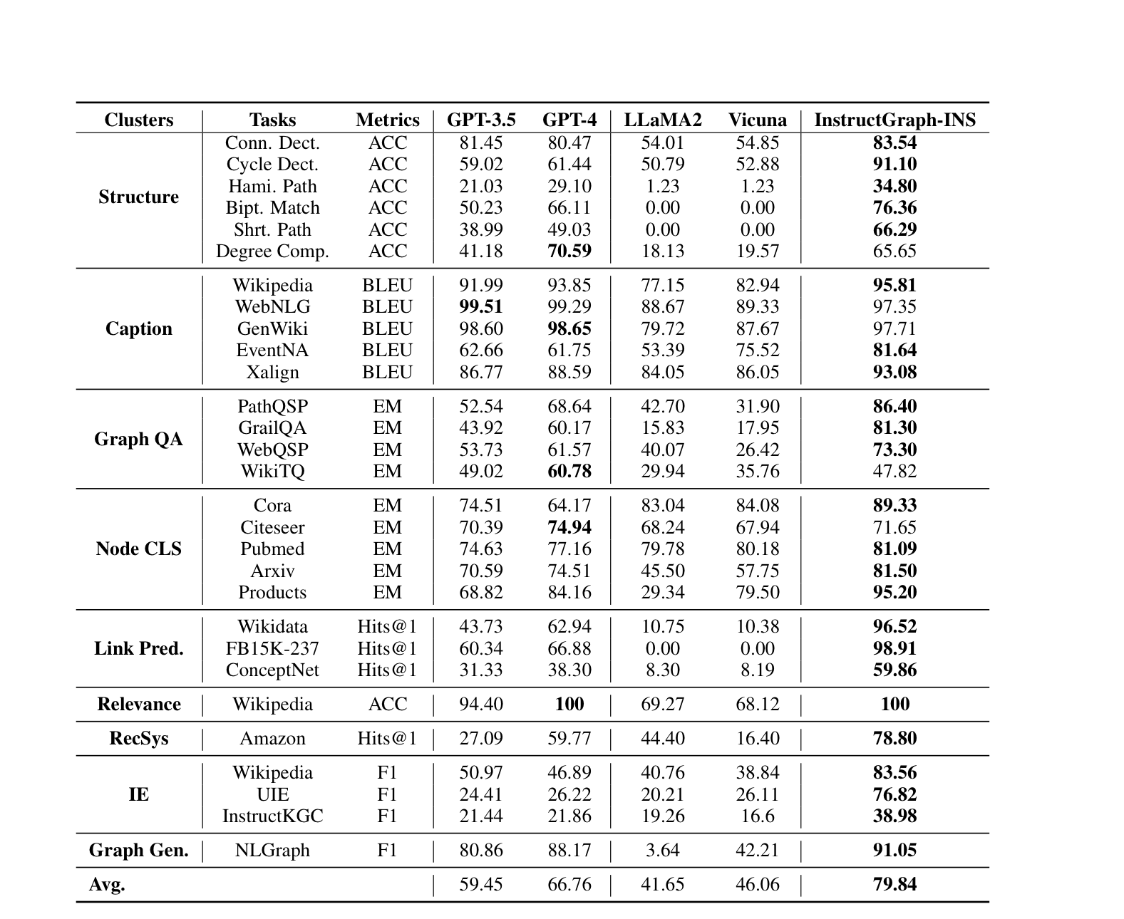
Experiments: Graph Reasoning
Instruction based graph LLM
Structure Modeling
Caption Generation
Reasoning on Whole Graph
Node Classification
Link Prediction
Relevance between graph and text
Recommender System
Information Extraction

Slide 21
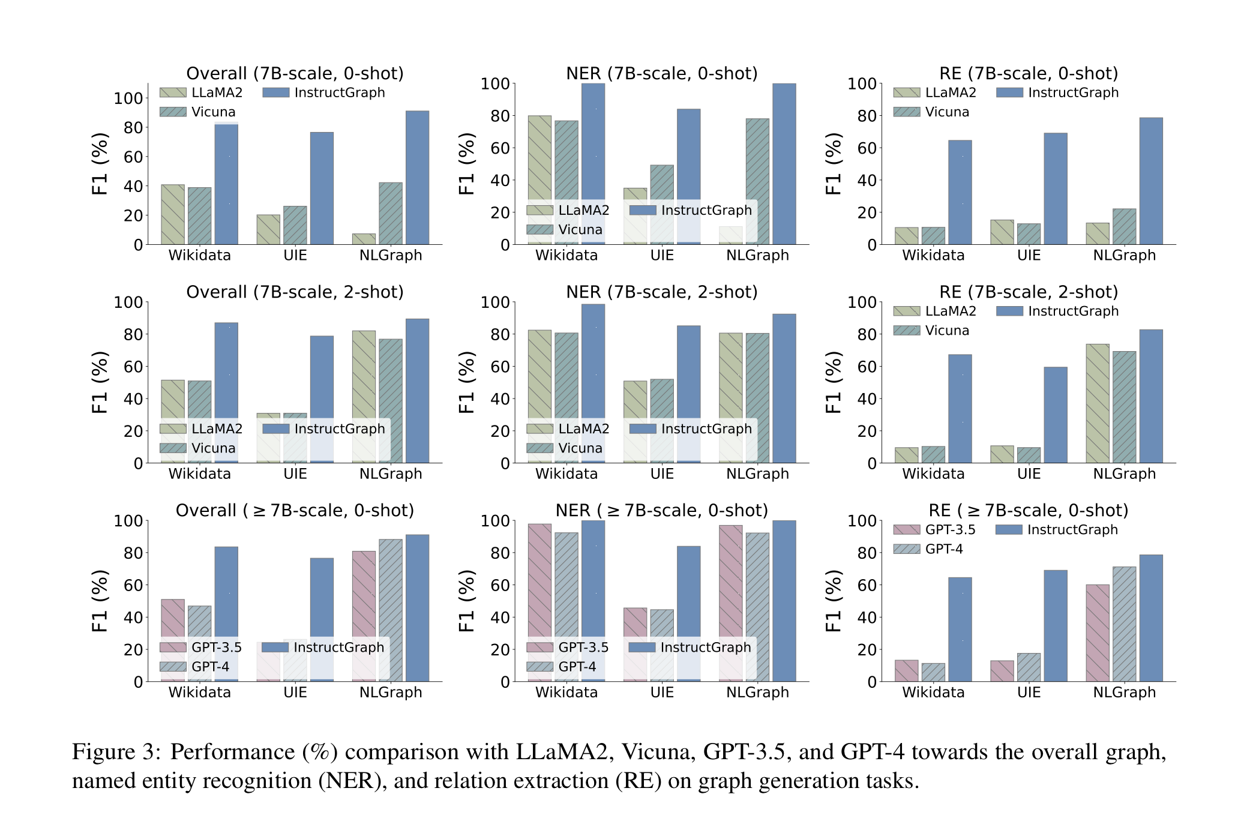
Experiments: Graph Generation
Name-Entity Recognition
Relation Extraction

Slide 22
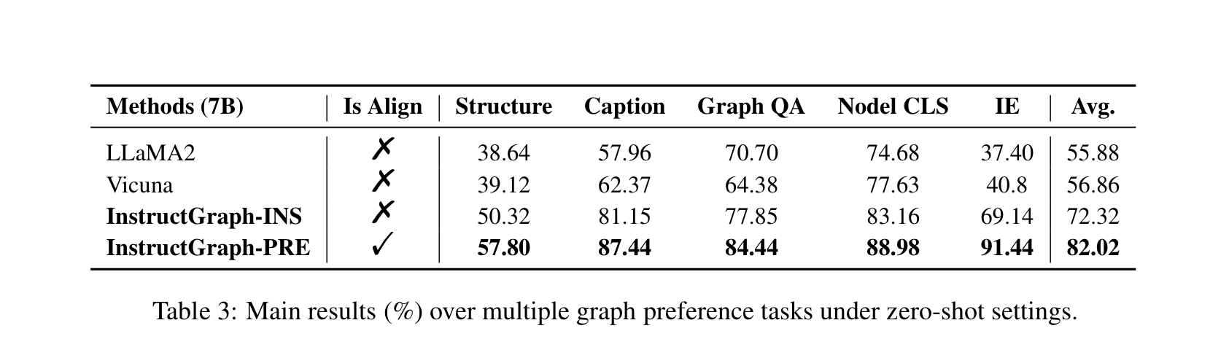
Experiments-Graph Preference
Sample tasks to build a hallucinating testing set, including structure, caption, graph question answering, and node classifications
Each example consists of a positive and negative output, we calculate LLM perplexity on these answers and choose the one with the lowest PPL
Insights: injecting task related knowledge into LLM’s intrinsic parameter can be one of significant factors for hallucination reduction

