Slide 1
Get ready:
> Calculate the remainder of 13/10 in Python.
> ** Write a program to ask a user how much a slice of pizza costs. Ask the user how many slices of pizza the user eats per week. Finally, print the amount of money the user spends on pizza per week.
Sample output: “You spend $60 per week on pizza!”
** Challenge!! **
Review

Slide 2
Today’s lesson:
<str> - <int> - <float>
We can multiply a string by an integer:
>“snailface”*7
snailfacesnailfacesnailfacesnailfacesnailfacesnailfacesnailface
Today’s Lesson
Notes:
Did anyone notice anything weird about calculations? Eg 11/2 is not 5.(Floor division.) Also, did anyone try to use commas?

Slide 3
Today’s lesson:
<str> - <int> - <float>
We get the same result by adding strings:
>“snailface” + “snailface” + “snailface” + “snailface” + “snailface” + “snailface” + “snailface”
snailfacesnailfacesnailfacesnailfacesnailfacesnailfacesnailface
Today’s Lesson
Notes:
Did anyone notice anything weird about calculations? Eg 11/2 is not 5.(Floor division.) Also, did anyone try to use commas?

Slide 4
Today’s lesson:
<str> - <int> - <float>
We can’t multiply a string by an float:
>“snailface”*17.5
TypeError: can't multiply sequence by non-int of type 'float'
Today’s Lesson
Notes:
Did anyone notice anything weird about calculations? Eg 11/2 is not 5.(Floor division.) Also, did anyone try to use commas?

Slide 5
Today’s lesson:
<str> - <int> - <float>
We can multiply an integer by an integer:
>5*3
15
Today’s Lesson
Notes:
Did anyone notice anything weird about calculations? Eg 11/2 is not 5.(Floor division.) Also, did anyone try to use commas?

Slide 6
Today’s lesson:
<str> - <int> - <float>
We can multiply an integer by a float:
>82*33.5
15
Today’s Lesson
Notes:
Did anyone notice anything weird about calculations? Eg 11/2 is not 5.(Floor division.) Also, did anyone try to use commas?

Slide 7
Today’s lesson:
<str> - <int> - <float>
When we use raw_input( ), the value of the variable is a string.
age = raw_input (‘How old are you?’) > How old are you? 17 age = 17
string!!
Today’s Lesson
Notes:
Did anyone notice anything weird about calculations? Eg 11/2 is not 5.(Floor division.) Also, did anyone try to use commas?

Slide 8
Today’s lesson:
<str> - <int> - <float>
We can concatenate strings with strings, so this works:
age = raw_input(‘How old are you?’) print “You are " + age + “ years old."
All strings!
Today’s Lesson
Notes:
Did anyone notice anything weird about calculations? Eg 11/2 is not 5.(Floor division.) Also, did anyone try to use commas?

Slide 9
Today’s lesson:
But what if we need to do math with our raw_input( ) variable?
# I am four times older than Manik. How old am I?
Manik = raw_input(‘Manik, how old are you?’) > Manik, how old are you? Manik = 14
Jenkins = Manik*4
Jenkins = 1414141414141414141414141414
Today’s Lesson
Notes:
Did anyone notice anything weird about calculations? Eg 11/2 is not 5.(Floor division.) Also, did anyone try to use commas?

Slide 10
Today’s lesson:
XXX
But what if we need to do math with our raw_input( ) variable?
# I am four times older than Manik. How old am I?
Manik = raw_input (‘Manik, how old are you?’) > Manik, how old are you? Manik = 14
Jenkins = Manik*4
Jenkins = 1414141414141414141414141414
Today’s Lesson
Notes:
Did anyone notice anything weird about calculations? Eg 11/2 is not 5.(Floor division.) Also, did anyone try to use commas?

Slide 11
Today’s lesson:
But what if we need to do math with our raw_input( ) variable?
# I am four times older than Manik. How old am I?
Manik = int(raw_input(‘Manik, how old are you?’)) > Manik, how old are you? Manik = 14
Jenkins = Manik*4
Jenkins = 56
Today’s Lesson
Notes:
Did anyone notice anything weird about calculations? Eg 11/2 is not 5.(Floor division.) Also, did anyone try to use commas?

Slide 12
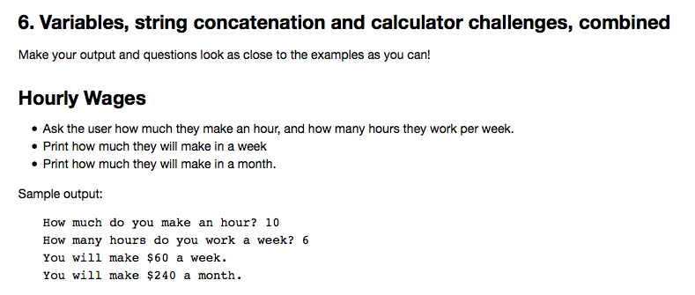
Your turn:
Focus on exercise 6!
Your turn!
Notes:
Tomorrow, we’ll talk about the difference between

