Slide 1
eResearch
@UoA
Paul Bonnington
Associate Dean (IT) – Science
p.bonnington@auckland.ac.nz

Slide 2
Outline
Scene setting video (4mins)
Advanced Research and Education Networks
eResearch
BeSTGRID (TEC funded iDF project)

Slide 3
Video Presentation
European Advanced Network “GEANT”
Example of eResearch: Climate Modeling
PRISM: global co-laboratory

Slide 4


National Research and Education Networks
High-speed “next generation internet” for Research and Education purposes only
New Zealand: KAREN
Linking Universities, CRIs and national library, 10GBits/s
International links to Australia and North America (then onto Europe)

Slide 5
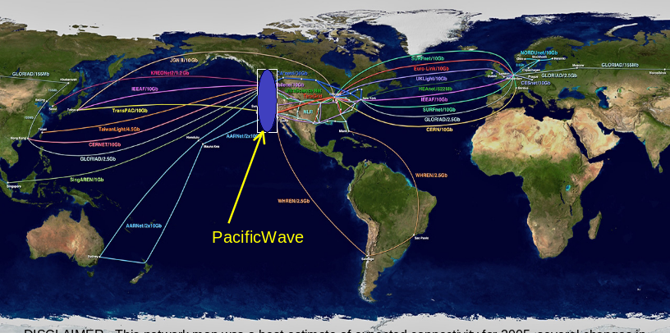
Global Research and Education Network Routes

Slide 6
The Advanced Network is only an infrastructural element for eResearch….
….it is like a “highway without cars”…
…it is up to us to put the cars on the road

Slide 7
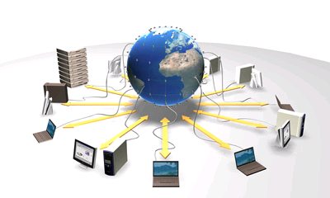
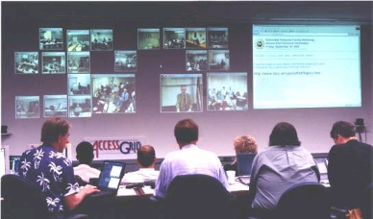
eResearch
eResearch typically employs one or more of:
  Capture, storage and sharing of research data
  Computational processing, analysis and presentation of that data
  Multi-discipline, multi-modal online collaboration

Slide 8
Strategy
TREND: Science and Engineering moving to
  large-scale collaborative projects
  based on global eResearch co-laboratories
  supported by:
    US National Science Foundation (NSF)
    US National Institutes of Health (NIH)
    European Framework 6 and 7 programmes
We must develop eResearch ability if our science and technology is to remain competitive in an international context

Slide 9
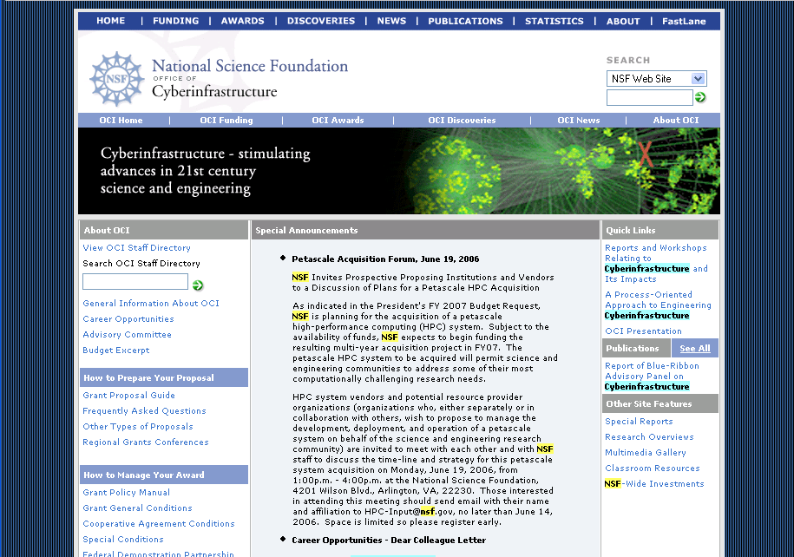

Slide 10
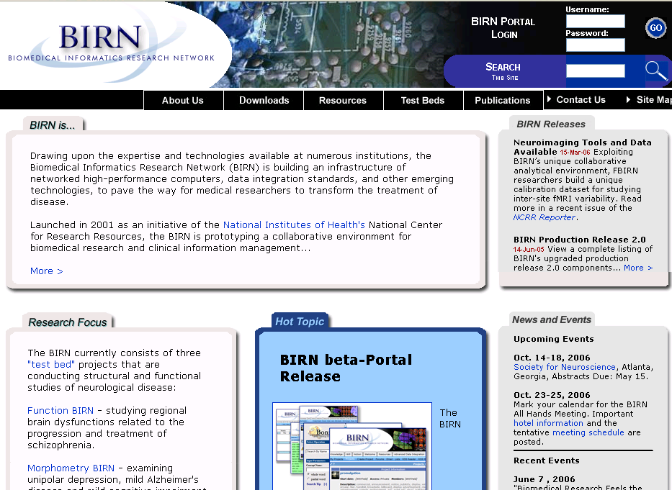
Example co-laboratory

Slide 11
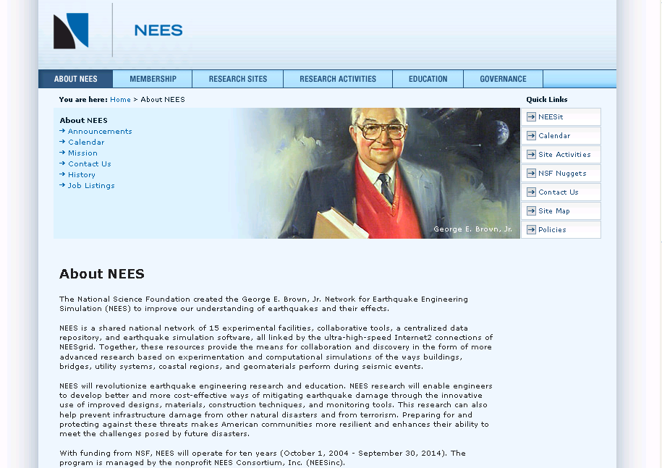
Example co-laboratory

Slide 12
Messages
It will not be possible for us to participate in these international projects if we do not have appropriate eResearch infrastructure to support our involvement.
Due to the complexities we must take a coordinated approach to developing the core eResearch infrastructure

Slide 13
Enhancing Research
What is in it for me?
  New collaborative opportunities
  Opens new funding opportunities
eResearch is not a threat to “Business-as-usual”
eResearch can enhance existing research activities
  Technological enhancement (like the increasing role email and internet play in research activities)
  can lead to new research endeavours

Slide 14
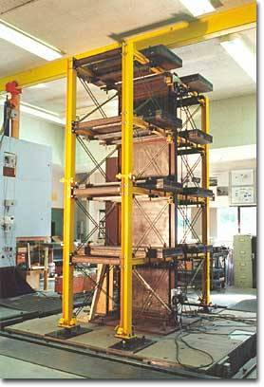
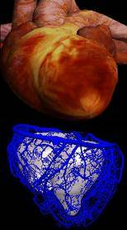
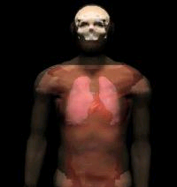


Early Adopters/Champions
@UoA
Physiome Project – Bioengineering
Earthquake Engineering (NEES) – Civil Eng
Bio and Biomedical informatics - Biomirror
Synchrotron Analysis (Australian Synchrotron) – Materials Chemistry, Bio/Medical Imaging

Slide 15
Other Early Adopters/Champions
@UoA
Geographic Information Systems (GIS) – Geography
Social Science Data Archive (ASSDA) - Sociology
Institutional Repositories - Library
Climatology – Physics, Geography
Computational Mathematics - Mathematics/NZIMA CoRE
Electron microscopy – Chemical and Materials Engineering
Planet Hunting (MOA Project) – Physics and Astronomy

Slide 16

Good model for UoA: UC San Diego
Federated Top Layer: Disciplines run their own research business on top of the core infrastructure
Middleware ‘glue’: GRIDS
A centre providing core eResearch infrastructure (communication, storage, computational)

Slide 17
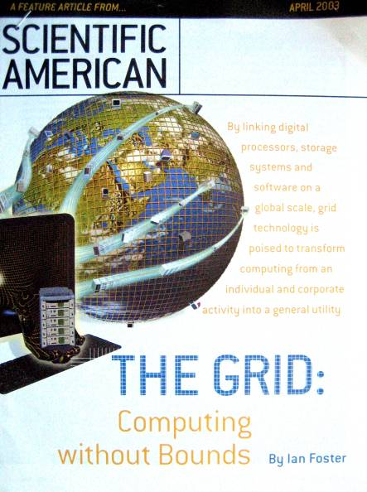
MIT Technology Review has named Grid computing one of "Ten Technologies That Will Change the World“
GRID Services are the modern extensions of email and the world-wide web
GRID: Make data storage or computational processing as ubiquitous as a national power grid
“Don’t care where the resource is located or generated”

Slide 18
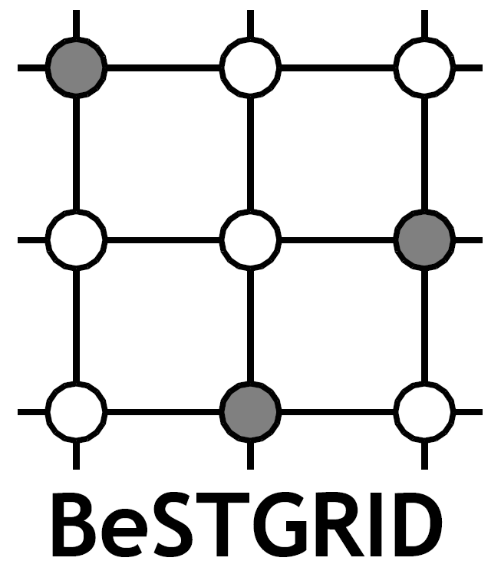



Broadband enabled Science and Technology GRID
www.bestgrid.org
TEC iDF

Slide 19
BeSTGRID: Technology themes
Federated Top Layer: Disciplines run their own research business on top of the core infrastructure
BESTGRID Middleware ‘glue’: GRIDS
Access GRID, Data GRID, Computational GRID
A centre providing core eResearch infrastructure (communication, storage, computational)

Slide 20
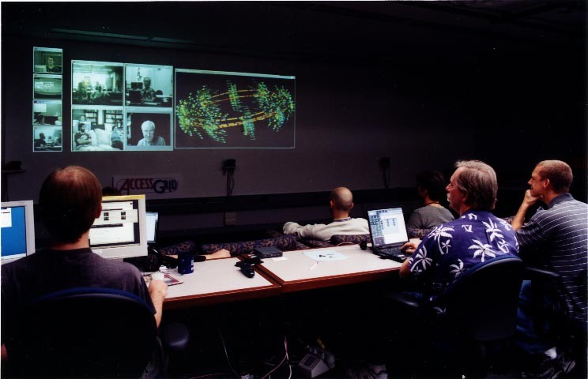

Slide 21
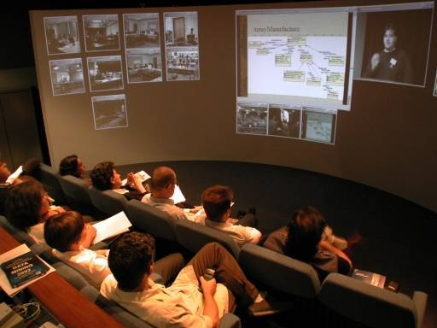

Slide 22
What BeSTGRID will deliver
Competency centres
Demonstrate GRID ‘middleware’ not yet seen in NZ
Assist with common ‘tools and methods’ for champions/early adopters
www.bestgrid.org

