Slide 1
Summary: Capability Building: BeSTGRID
BeSTGRID: Collaboration between Universities of Auckland and Canterbury, and Massey University.
Capability Development programme funded by NZ Tertiary Education Commission starting July 2006.
Assists with common ‘tools and methods’ for high profile early adopters (expertise in partner institutions): e.g.
  Bioinformatics (Genome, Genetics)
  NEES (Earthquake Engineering)
  Bioengineering (‘Heart Physiome’)
  Astrophysics (‘Planet Hunting’) etc.
Centered around technology themes: Grid Computing, Access Grid, Data Repositories
Project Lead: Paul Bonnington

Slide 2
Capability Building: BeSTGRID
BeSTGRID: Broadband enabled Science and Technology GRID
Capability development project supported by the NZ Tertiary Education Commission Innovation and Development Fund
Begins July 2006, ~$2million
Joint Project involving: University of Auckland (Lead Institution), University of Canterbury and Massey University.

Slide 3
Drivers/Early Adopters/Champions
Earthquake Engineering (NEES) – Civil Engineering UoA, UoC
Physiome Project – Bioengineering UoA
Planet Hunting, SALT project – Physics and Astronomy UoA, UoC
Molecular Ecology and Evolution – Allan Wilson Centre (CoRE) UoA, UoC, MU
Bioinformatics UoA, UoC
Geographic Information Systems (GIS) – Geography, UoA, UoC (joint Masters programme)
Synchrotron Analysis (Australian Synchrotron) – Materials Chemistry UoA
Computational Algebra - Mathematics/NZIMA CoRE UoA
Electron microscopy – Chemical and Materials Engineering UoA
Theoretical and Computational Chemistry Research Centre MU
Structural Biophysics Group MU
Computational Intelligence – Advanced Intelligent Systems Lab MU
Molecular Genetics UoC
Ecological Genomics – Molecular Ecology Research Lab UoC
Icecube Neutrino Observatory UoC
Climatology and Meterology – Geography UoC

Slide 4
BeSTGRID: Technology themes
There are three main activities that occur within the digital science ecosystem
Capture, storage and sharing of data (Science GRID = “Data GRID and Service GRID”)
Computational processing, analysis and presentation of that data (Computational GRID)
Multi-discipline, multi-modal collaboration (Access GRID) – enhance BRCSS network.
BeSTGRID builds true digital science capability within NZ on the Advanced Network

Slide 5
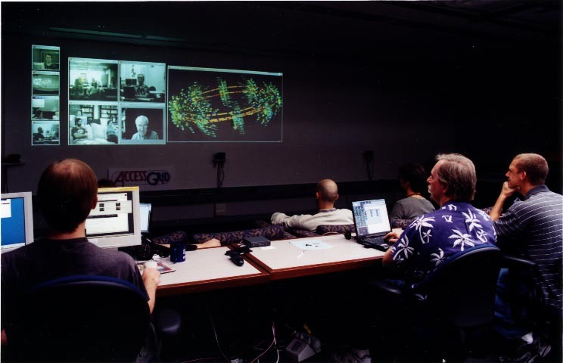

Slide 6
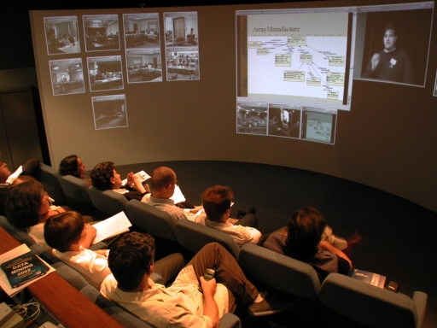

Slide 7
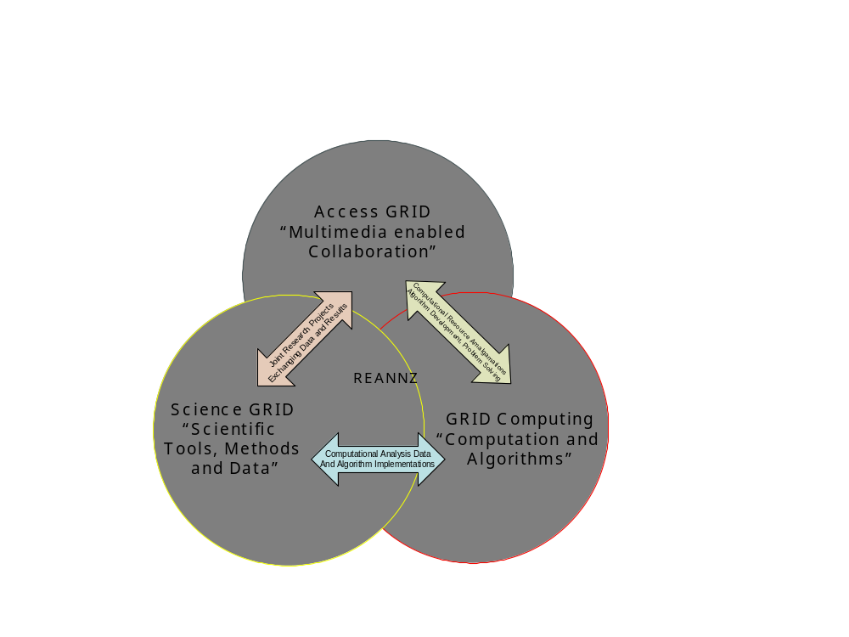

Slide 8
What will we deliver
Competency centres in the institutions: stop the creation of ‘silos’ developing.
Demonstrate middleware not yet seen in NZ.
Phase 2 (2007-): extend BeSTGRID themes/Grids to other universities/Cri’s
BeSTGRID will deliver mechanisms, methods and tools that facilitate collaboration on shared information, sharing of computational resources and online visualization of instruments and experiments.

Slide 9
Strategies
“Just make it work” - Avoid early “over-engineering”
Use the early exemplar research projects (e.g. NEES, Bio) to lead the way.
“Spread the bird-seed”: we can anticipate some species of birds flocking, but some unanticipated species will also flock.
Bring in federated governance structure (i.e. trust models etc)

Slide 10
Pre-project work
BeSTGRID funding begins July
Pre-project: “bottom-up evangelism” - target likely early adopters
Refine technology themes after early survey work -Identity/evaluate middleware
Identify resources and people will can call on to assist (local IT support etc)
Establish stakeholders group, Steering committee
AAA activity: Towards Shibboleth based. Follow international leads

Slide 11
Challenges
- quickly
Cooperation/collaboration. NZ Universities compete among themselves for researchitive – new international collaborations will be easier to establish (co-laboratories)
NZ universities can cooperate at level of BeSTGRID technology themes.
Document as we go (Wiki)
Technology challenges: Reliability, security, standards

Slide 12
Opportunities
WETA studios Supercomputer (GRID Computing)
Strengths in interpreting Scientific data
Advancing Bio-tech research/industry
Crown Research Institutes – research-industry link
Links-to-schools (Secondary level): Link research and education through Access GRIDs, Science GRID
Flexible Learning technologies: transfer from Universities to Schools

