Slide 1


Traffic Tracks
REGRESSION PROJECT
Predicting pedestrian timestamps from traffic track data
Presented by Rebecca
Notes:
Good morning everyone. I am Rebecca. My project is called Traffic Tracks. It is a regression project on a pedestrian traffic dataset. I cleaned the data, selected features, trained five regression models to predict the timestamp, and I also found and fixed a mistake in my own first result.

Slide 2
Regression on pedestrian tracks
PROJECT INFORMATION
Problem type
Instances (rows)
Features (columns)
Regression
4,759
14
Target is a number
from 45 pedestrians
13 inputs and 1 target
Group | Columns | Role
Time | timestamp | Target (y)
Identity | oid (pedestrian ID) | Input
Position | x, y | Input
Body and head | body and head roll, pitch, yaw | Input (57% missing)
Nearby objects | other_oid, other_class, other_x, other_y | Input (text)
Rebecca · Traffic Tracks
2 / 10
Notes:
This slide is the project information. It is a regression project, because my target, timestamp, is a continuous number. There are 4,759 instances, which are rows, from 45 pedestrians. There are 14 features: 13 inputs and one target. The inputs are the pedestrian ID, position x and y, six body and head angles, and four columns about nearby objects. The six angle columns are missing about 57 percent of their values.

Slide 3
What I did, step by step
PROJECT OVERVIEW
01
02
03
04
05
Statistics
Missing values
Duplicates
Correlation
Encoding
info, describe, shape: 4,759 × 14
2,698 per angle column, filled with median
0 found, nothing to remove
Heatmap: oid is the strongest link, 0.37
Label Encoding for the text columns
06
07
08
09
10
Outliers
SMOTE
Feature selection
Skewness
Scaling
Box plots, then IQR capping
Skipped: it is for classification only
SelectKBest, f_regression, k = 4
Yeo-Johnson tested, no gain
StandardScaler, then 5 models
Rebecca · Traffic Tracks
3 / 10
Notes:
This is the overview of everything I did. I started with statistics, then handled 2,698 missing values per angle column with the median, and found no duplicates. I drew a correlation heatmap, encoded the text columns, and checked outliers with box plots. SMOTE was skipped because my target is a number. I selected 4 features, tested a skewness fix, scaled the data, and trained five models. The next slides show the heatmap and box plot in detail.

Slide 4
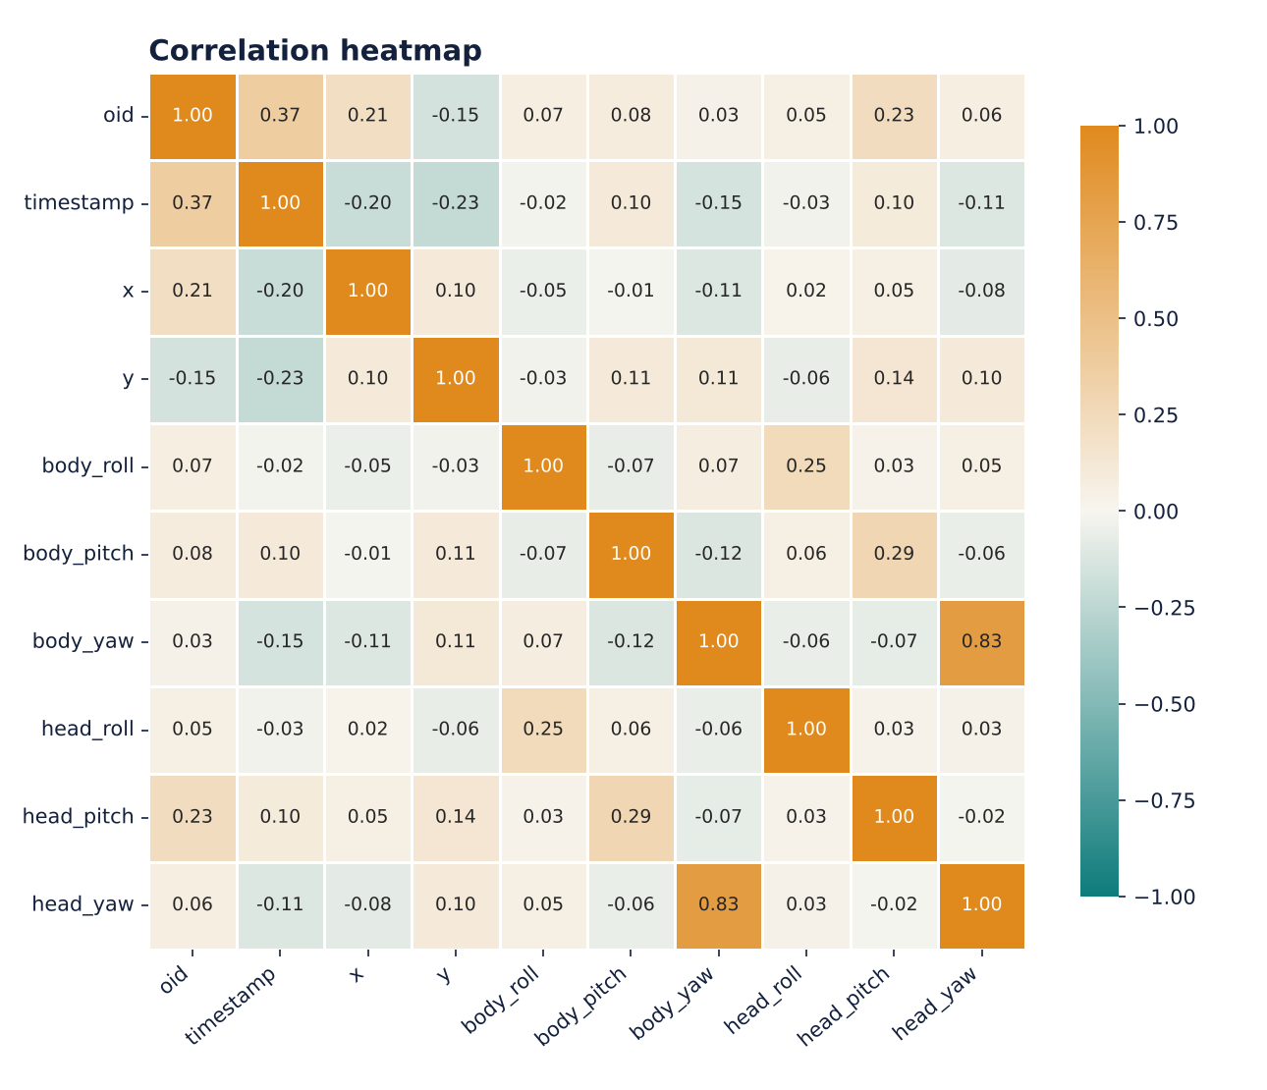
How the features relate
CORRELATION · HEAT MAP
Strongest link to timestamp
oid: 0.37, a positive link.
Position
x is −0.20 and y is −0.23: weak and negative.
Angles
All between −0.15 and 0.10: almost no link.
Takeaway: no single feature explains timestamp.
Rebecca · Traffic Tracks
4 / 10
Notes:
This is my correlation heat map. I used df.corr and seaborn. Orange means a positive link and teal means a negative link. Against timestamp, the strongest link is oid at 0.37. Position x and y are weak and negative, and the angle columns are almost zero. So no single feature explains the timestamp, and I expected a simple model to struggle.

Slide 5
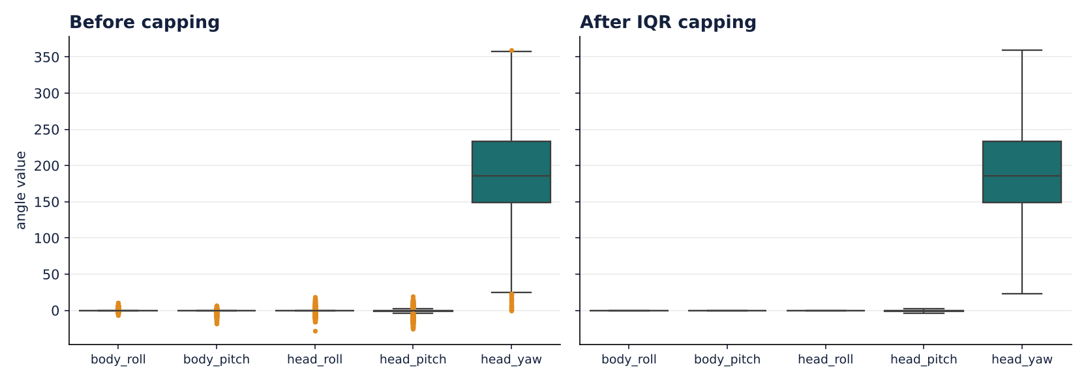
Finding and capping outliers
OUTLIERS · BOX PLOT
Outlier rows (IQR rule): head_roll 831 · head_pitch 726 · body_pitch 481 · body_roll 411 · head_yaw 37
Lesson: these angles are mostly 0, so IQR = 0 and capping flattened three of them to a constant 0.
Rebecca · Traffic Tracks
5 / 10
Notes:
This is my box plot. On the left are the five angle columns before capping, and the orange dots are outliers. On the right is after I capped values with the IQR rule. The counts are: head roll 831, head pitch 726, body pitch 481, body roll 411 and head yaw 37. One thing I learned: most angle values are zero, so the IQR is zero, and capping made three columns completely flat. That is why they get a score of zero in feature selection.

Slide 6
Choosing the features
STEPS 5, 7 AND 8 · ENCODING, SMOTE, FEATURE SELECTION
Encoding and SMOTE
Feature scores
Label Encoding turned the four text columns into numbers.
Feature | Score
oid | 773.5
y | 254.3
x | 201.0
body_yaw | 40.3
head_yaw | 24.9
head_pitch | 11.1
3 flattened columns | 0
SMOTE skipped. It balances classes, and my target is a number, not a class.
SelectKBest with f_regression, because the target is continuous. k=25 was too big for 13 features, so I used k = 4.
Shaded rows are the 4 selected features.
Rebecca · Traffic Tracks
6 / 10
Notes:
Encoding: I used Label Encoding for the text columns. SMOTE is only for classification, so I deliberately skipped it. For feature selection I used SelectKBest with f_regression because my target is continuous. I first wrote k as 25, but there are only 13 features, so I used 4. The selected features are oid, y, x and body yaw. The three flattened columns scored zero.

Slide 7
Getting the data model-ready
STEPS 9 AND 10 · SKEWNESS, SCALING, MODELS
Skewness
Scaling
Split
Tested Yeo-Johnson. Score changed by under 0.002, so I did not need it.
StandardScaler put x, y, oid and body_yaw on one scale.
80% training, 20% testing, random_state 40.
Five regression models compared
Linear Regression
Decision Tree
Random Forest
AdaBoost
Gradient Boosting
Measured with MAE, MSE and R². Not accuracy, because accuracy is for classification.
Rebecca · Traffic Tracks
7 / 10
Notes:
For skewness I tested a Yeo-Johnson power transform and the score barely moved, so I did not need it. I scaled the four selected features with StandardScaler, split the data 80 and 20, and compared five regression models. I measured them with MAE, MSE and R squared, because accuracy is only for classification.

Slide 8
A perfect score was a warning
A MISTAKE I CAUGHT
Before
After the fix
R² = 1.00
R² = 0.24
The target, timestamp, was still inside my features. SelectKBest gave it a score of 1.8e308.
Linear Regression with timestamp removed from the features. An honest score.
x = x.drop(columns=['timestamp'])
Rebecca · Traffic Tracks
8 / 10
Notes:
This is the most important slide. My first model gave R squared of 1.0 and an error close to zero. That is too perfect. I checked and found that timestamp, my target, was still in the features, so the model was predicting timestamp using timestamp. I removed it with one line, and Linear Regression dropped to 0.24. That is the honest result.

Slide 9
Random Forest performed best
RESULTS AFTER THE FIX
Model | MAE | R² (test split) | R² (new pedestrians)
Linear Regression | 571.4 | 0.24 | 0.25
Decision Tree | 0.2 | 1.00 | 0.83
Random Forest | 0.1 | 1.00 | 0.93
AdaBoost | 150.0 | 0.95 | 0.70
Gradient Boosting | 8.6 | 1.00 | 0.92
The last column tests on pedestrians the model never saw, a harder and fairer check. Values are approximate and can vary slightly between runs.
Rebecca · Traffic Tracks
9 / 10
Notes:
After the fix, Linear Regression is weak, with R squared 0.24. The tree models score near 1.0 on my normal split, because nearby points from the same pedestrian are in both train and test. So I also tested on pedestrians the model never saw. There, Random Forest is best at about 0.93, and Gradient Boosting is close at 0.92. Linear Regression stays weak.

Slide 10
What I learned
CONCLUSION
1
2
3
Simple is not enough
Ensembles win
Question perfect scores
Linear Regression reached only R² 0.24. The link between position and time is not a straight line.
Random Forest scored about 0.93 even on new pedestrians, the best of the five models.
R² = 1.0 meant my target had leaked into the features. Always check.
Thank you
Next steps: tune the Random Forest and add more informative features.
Rebecca · Traffic Tracks
10 / 10
Notes:
To finish: three lessons. One, a simple linear model was not enough. Two, Random Forest was the best model, even on pedestrians it had never seen. Three, a perfect score should make you suspicious. Check for leakage before you celebrate. Thank you, I am happy to take questions.

